Slide 1
Western Short Narrative Fiction
Historical Survey, Formulae of the Genre, Textual Analysis and Contextual Interpretations
By Feng Duan
Associate Professor
English Department,
Fudan University
duanfeng@fudan.edu.cn
13391128261

Slide 2
What is the Short Narrative Fiction
Non-fictional narrative:
Of special interest:
Historical narrative
Legal narrative
Popular genres:
Science fiction
Comics
Detective story/thrillers/horror
Situation comedy
Manfred Jahn’s modification of Roland Barthes’s famous list
Can you add something to this list, is there any other narrative

Slide 3
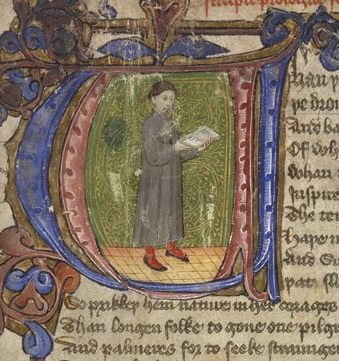
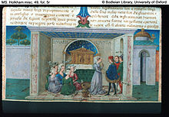
A Brief Historical Survey
The Greek and Roman Tales: Aesop’s Fables; The Golden Ass
The Popularity of the In-set Tales: the Canterbury Tales (1387-1400); Decameron (1349-1353)
The decline of the Boccaccio tradition in 17th and 18th Century (with the rise of novels, drama and poetry)
The emergence of the 19th century Modern Short Story

Slide 4
The Emergence of the 19th century Modern Short Stories in Two Strains
Important chronological facts
Twice-told Tales, by Nathaniel Hawthorne
1840 Tales of the Grotesque and Arabesque, by Edgar Allan Poe
1842 The Overcoat, by Nikolai Gogol
Review of Twice-Told Tales, by Edgar Allan Poe
1852 A Sportsman’s Sketches, by Ivan Turgenev
1867 The Celebrated Jumping Frog and Other Sketches, by Mark Twain
Tales
Sketches

Slide 5
Poe’s Guidelines for the Short Story
It must produce a certain unique effect.
It must have brevity (a reader should be able to read it in "one sitting").
It must have unity.
It must have intensity.
It must begin with the first sentence (i.e., not spend too long on background, setting, introduction of characters, etc.).

Slide 6
Critical Contemplations:
“Fiction at its most intensive and compact”
“small in a way that a bullet is small”
“a laboratory where just about all the structures, forms and tricks available to the writers can meet.”
Questions to be considered
Implications of the form’s shortness
Formal characteristics of the genre
The affective side of the short narrative fiction

Slide 7
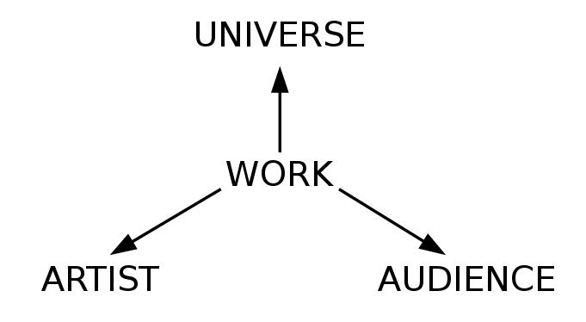
Internal and External Approaches to Literature and Four basic types of literary criticism
Mimetic Theories
Objective theories
Expressive Theories
Pragmatic Theories
Wellek and Warren. Theory of Literature (1942).
M.H.Abrams. The Mirror and the Lamp (1953).
Notes:
First of all, I would like to cite two important books of literary criticism. The Theory of literature by Wellek and Warren, and the Mirror and the Lamp by M.H. Abrams. In the theory of literature, Wellek and Warren has formulated two basic approaches of literary studies, the internal and external ones; and in The Mirror and the Lamp, Abrams also classified four basic types of literary criticism. As displayed by this diagram, there are four basic things to be considered in our study of literary texts: the universe, the artist, the readers, and the work itself. In Abram’s formulation, any theories focused on the relationship between the work and the universe is mimetic in nature, theories interested in the relationship between the work and artistist, expressive, the work and audience, pragmatic, and any theories that focuses on the internal structure and close reading of the text itself are labeled as objective theories. (although we know that literary criticism can never be truly objective)
Seen in this light, classical narratology, at its very origin, is internal study of literature, aiming to abstract the underlying grammar of narrative works. Actually, narratology is a discipline that rises in the 1960s, under the influence of Russian formalism and French structuralism.

Slide 8
Narrative as Rhetoric
“The phrase ‘narrative as rhetoric’…means instead that narrative is not just story but also action, the telling of a story by someone to someone on some occasion for some purpose.”
James Phelan, Narrative as Rhetoric: Techniques, Audiences, Ethics, Ideology, Columbus: Ohio UP, 1996.

Slide 9
Questions to ask in approaching a narrative fiction
Who tells the stories, what does he/she tell, and how!
How overtly or covertly the narrator makes his presence felt
Where the narrator is located (inside or outside the story world)
The relationship between the narrator and character

Slide 10
The basic dichotomy of Story and discourse
Story
Content matter
Discourse
Fictional mediation
character
Narrator
Action
plot
Space
Setting
Narratee
Perspective
Speech
Consciousness
perception
Evaluation
/comments
Story time
Discourse time

Slide 11
Course Objectives
A basic grasp of the genre formula and historical development of western short fiction.
A tool kit of analytical instruments in interpretation and appreciation of narrative fiction [Narratological terms and their applications]
Close reading and textual analysis of selected sample texts.

Slide 12
Form of instruction:
=>Lecture + Seminar (about 14 weeks): brief reading report after each lecture
=>Presentation, discussion and draft writing (about 2 weeks)
Work to do: Reading, writing, presenting
Selected readings
Reading reports (every lecture/seminar weeks) and questions
Textual analysis of chosen short stories: Presentation, group discussion and final paper
Final grading:
Class participation (10%)
Reading reports and feedbacks (40%)
Paper drafting, class presentation and final paper (50%)
=> Integrate the narrative tools we have learned in your reading of the selected short stories.

Slide 13
Nine Lectures and Chosen texts (tentative):
Religious, Allegorical, Romantic, Gothic, and Realistic: Hybrid Origin or Short Narrative (from the Book of Job; Cain and Abel; to Decameron; the story of the Wife of Bath, a True Relation of the Apparition of One Mrs. Veal by Daniel Defoe)
The Gothic Romance: Edgar Allen Poe and The Single Effect of the Short story: (A Tell-Tale Heart; Review of Twice-Told Tales; the Black Cat)
Reading for the Plot: Unity of the Story: (the Nightingale and the Rose; Bartelby the Scrivener)
Reading for the Characters: Short Stories as Sketches ( Mark Twain, Turgenev A Sportsman’s Sketches)
Kafka and The Allegorical Power of the Short Story (In the Penal Colony, A Report to an Academy, Judgement)
Modernist Turn I: The Ambiguous Speech (Hills like White Elephants; Rope)
Modernist Turn II: Emotions, Cognitions and Fleeting Perceptions (“the Art of Fiction” by Henry James; Psychology; A Pair of Silk Stockings; Eveline)
The Mythic Brevity: Killers; The Yellow Woman; the Snake (Steinbeck); Atlas (Margaret Atwood)
Feminine experience and the short fictional form: from Katherine Mansfield, Kate Chopin, to Leslie Marmon Silko and Alice Munro)

Slide 14
Assignment for the next class
“Cupid and Psyche” from The Golden Ass by Apulieus
a True Relation of the Apparition of One Mrs. Veal by Daniel Defoe
A historical survey of short story at
https://global.britannica.com/art/short-story

