Slide 1
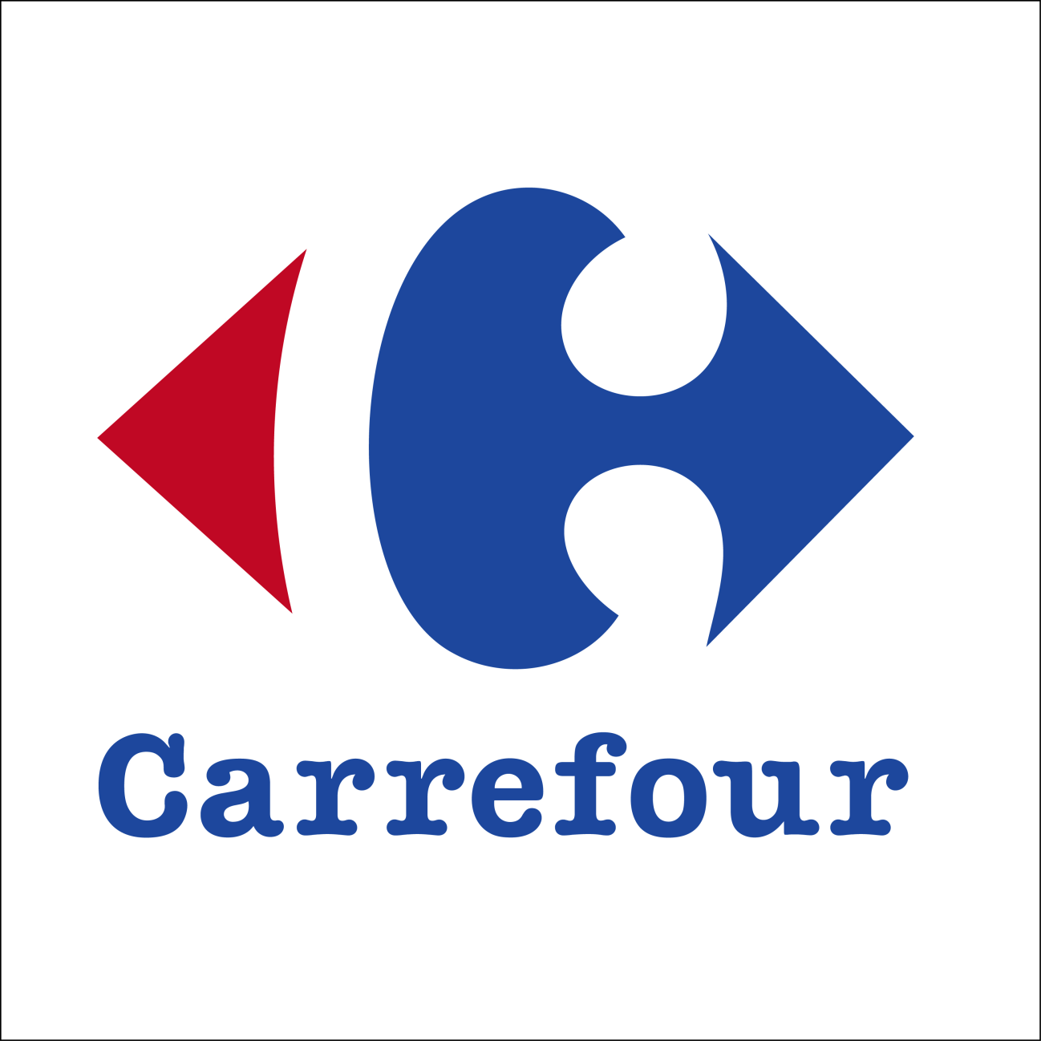
CARREFOUR: CROSSROAD

Slide 2
Content to be covered:
Company overview and main business in the world
Business Model Analysis
Carrefour in China
Understanding the Chinese market and consumers
Situation and competitors’ analysis (local & int’l)
Major Problems
Next Step Out

Slide 3
Company Overview
Established in 1959
France/Europe/Latin America/Asia
Current operating profit: 766 million euros

Slide 4
Company Overview
Cash & carry stores
Convenience stores
Hypermarkets
French Multi-channel Retailer
Supermarkets
Hard Discount stores
E-Commerce

Slide 5
Main business in the world
Hypermarkets
Offer wide range of food and non-food items
Low prices
Targeted promotions
1,300 globally

Slide 6
Main business in the world
Cash & Carry stores
Carry a range of food and non-food items at wholesale prices
Support the work of caterers and convenience food stores
Promocash (France), Dock Markets (Italy), Carrefour Wholesale Cash & Carry (India)
160 stores

Slide 7
Main Business in the world
Hard Discount Stores
Operate under the names of stores that Carrefour acquired
Low prices all year round
“Dia” in Spain, Greece and Argentina, “Minipreço” in Portugal
365 stores

Slide 8
Business Model Analysis
Product (Service)
Place
Price
Promotion

Slide 9
Business Model Analysis
Product (Service)
One-stop shopping area for consumers
Wide range of food and non-food items
Focuses on high volume
Place
Carrefour has the business strategy of opening their outlets at crossroads as it believe that it will attract consumers

Slide 10
Business Model Analysis
Price
Low prices to consumers
Charge suppliers high prices and requested for more rebates
Low profit margins from the sales of goods, higher profit margins received from the suppliers
Promotion
Emphasizes on price competitiveness and quality of goods

Slide 11
Carrefour in China
Entered the Chinese market in 1995 with the hypermarket concept
Consumers’ first choice when Carrefour first entered
Aimed to provide a one-stop pleasant shopping experience for the consumers
Focuses on high volume and low prices
218 outlets as of the end of 2012

Slide 12
How Carrefour understand the Chinese market and Chinese consumers?
Amended their business practices:
Provided more management positions for the locals
Letting the local managers take charge of orders, purchasing, pricing, employee recruitment, promotional campaigns and arrangement of store displays

Slide 13
How Carrefour understand the Chinese market and Chinese consumers?
2) Analyzing consumer habits
Outlets have more parking spaces for scooters than cars as compared to other countries
Sell live fish to consumers from bigger coastal cities who prefer their fish alive
Frozen fish to Chinese from West and Middle China who prefer their fish to be fresh
Brought in bigger shelves to place all different brands of a similar product in the same area

Slide 14
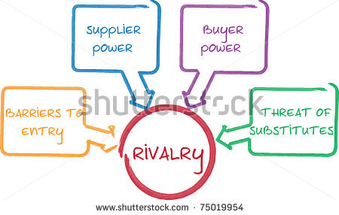
Situation and Competitors Analysis

Slide 15
Situation and Competitors Analysis
Supplier Power
Reputable brand
Charging fees to suppliers to maintain healthy cash flow → Eating into suppliers’ profits
Only big enterprises (e.g. Master Kong, MonMilk) can afford to stop supplying to Carrefour. Small and medium enterprises have no choice.
Operation model of charging high slotting fees is successful in China → other supermarkets are following it → Leaves suppliers with little bargaining power

Slide 16
Situation and Competitors Analysis
Buyer Power
Many options in the market- Walmart, RT Mart, Tesco, Yihaodian
Convenience
☺ Carrefour prides itself on being the “next door” supermarket based on its crossroad concept.
But it still cannot beat the convenience that online retailers like Yihaodian brings: Having items sent right to one’s doorstep
Price has a strong effect on consumers’ decisions → Supermarkets compete by offering low prices
Bargaining power of buyer is HIGH!

Slide 17
Situation and Competitors Analysis
Threat of New Entrants
High barriers to entry
Large supermarket chains require abundant funds as quantity of stores ensure the success in the market
Existing large supermarkets all hold significant amount of market share

Slide 18
Situation and Competitors Analysis
Threat of Substitutes
Substitute products can be found in other supermarkets or convenience stores
Being a hypermarket, Carrefour stands out from its convenience stores competitors by having cheaper prices, higher product variety and many locations
Substitute products (maybe even at a cheaper price) from online retailers such as Yihaodian, Womai etc.

Slide 19
Situation and Competitors Analysis
Intensity of Rivalry
Many competitors, from big supermarkets to small convenience stores
Market share lessened due to great number of branded businesses flooding the country, including Walmart and French-based Auchan
Carrefour has the highest rate of setting new stores and the total number of stores have surpassed its competitors

Slide 20
Challenges Faced
Corruption
Quality and safety of goods
Very diverse cultures in different parts of China→ Have to cater to different consumer groups
Inefficient supply chain management

Slide 21
What’s the next big step for Carrefour?
Long-Term
Medium-Term
Short-Term

Slide 22
Short-Term Strategy
QR Code shopping:
Customers get to shop in Carrefour’s retail store by scanning the QR Code of each item
QR scanning will provide:
Information on products such as manufacturing date, expiry date, place of manufacture and production process→ increase food safety and product knowledge (leads to higher credibility)
Consumers can purchase directly and goods will be delivered to the counter where they can proceed to pay→ Shopping made convenient
No more having to carry heavy baskets of stuff with huge trolleys getting in the way!

Slide 23
Medium-Term Strategy
E-commerce shop:
Online shopping baskets are more than offline shopping baskets (Average transaction size for F&B- $80 online, $30 offline. Health and beauty purchase- $30 online, $10 offline)
Have to keep up with China’s ecommerce trend (e.g. Walmart investing in Yihaodian)

Slide 24
Long-Term Strategy
Catalogue Shopping:
Customers receive catalogues whereby they can scan QR codes of the products they want to buy and have it delivered to their doorstep
Feasible in the long term after an efficient shipping service is set up after the appearance of an online platform

Slide 25
References
Why Carrefour is struggling to keep up with Chinese shoppers. (2013, June 24). Retrieved September 24, 2013, from Quartz: http://qz.com/97251/why-carrefour-is-struggling- to-keep-up-with-chinese-shoppers/
Bentonville, A. (2012, October 26). Walmart Global eCommerce Completes Increased Investment In Yihaodian. Retrieved September 24, 2013, from Walmart: http://news.walmart.com/news-archive/2012/10/26/walmart-global-ecommerce- completes-increased-investment-in-yihaodian
Hui, L., & Cheng. (2011, October 19). Slotting Fees Hit Suppliers. Retrieved September 24, 2013, from 商报网: http://cib.shangbao.net.cn/c/59664.html
Lin, M.-Q., & Liang, W.-K. (n.d.). A Comparative Study of Asia Strategy: Wal-Mart versus Carrefour. Retrieved September 24, 2013, from http://citeseerx.ist.psu.edu/viewdoc/download?doi=10.1.1.202.50&rep=rep1&type=pd f
liu, w. (n.d.). 家乐福商业模式. Retrieved September 24, 2013, from 360Doc: http://www.360doc.com/content/11/0415/22/1284834_109947141.shtml
Perkowski, J. (2012, October 24). International Retailers Struggle In China. Retrieved September 24, 2013, from Forbes: http://www.forbes.com/sites/jackperkowski/2012/10/24/international-retailers- struggle-in-china/
Staertzel, L. (n.d.). Carrefour in China. Retrieved September 24, 2013, from http://bear.warrington.ufl.edu/oh/IRET/Student%20Experience/Carrefour%20Essay% 20Edited.pdf
The Nielson Company. (2010). Global Trends in Online Shopping.
Vidalon, D. (2013, August 29). Carrefour profit rises as French recovery plan delivers. Retrieved September 24, 2013, from Reuters: http://uk.reuters.com/article/2013/08/29/uk- carrefour-earnings-idUKBRE97S09S20130829

