Slide 1
Legends

Slide 2
Made by
李平章 黄耀宗
Li Ping Zhang Ng Yew Chong

Slide 3
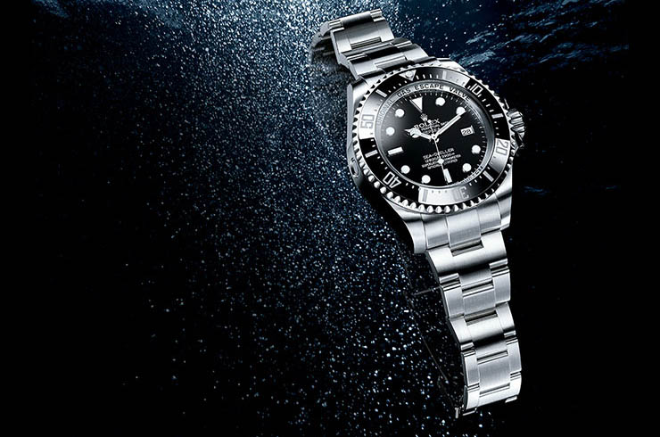
Brief of
Rolex
1906 Founded by Hans Wilsdof
1926 First Waterproof Watch/Oyster
1950s Professional Series
1980s Deepsea Series

Slide 4
Competition Analysis
Self-actualization
Esteem needs
Physiological needs
Love and belonging needs
Safety needs
Basic spirit of luxury products
Needs to be fulfilled
Esteem Needs

Slide 5
Competition Analysis
Narrow Sense View： Horology
Broad Sense View： Luxuries

Slide 6
Competition Analysis
Anything that fulfills customer needs (Awards /etc.)
Luxury（Autos/Clothing/etc.）
Timekeeper
Rolex

Slide 7
Competition Analysis
China Timekeeper Market

Slide 8
Competition Analysis
4 Monopoly Groups
Swatch
Rolex
LVMH
Vendome
Omega
Rolex
Tag-Heuer
Cartier

Slide 9
Market Share in China

Slide 10
Market Share in China

Slide 11
Market Share Worldwide
Europa：27%
North America:18%
Latin America: 14%
Africa: 2%
Asia-Pacific:39%
(China:12%)

Slide 12
Luxury Marketing Condition in China

Slide 13
China Luxury Market
2013e

Slide 14
China Luxury Market

Slide 15
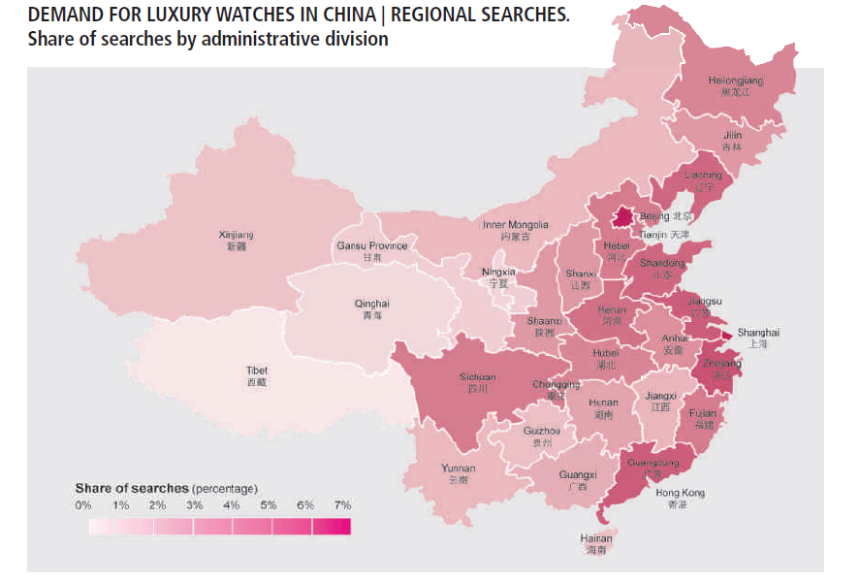

Slide 16
China Luxury Market
Avg. Age of Luxury Consumers

Slide 17
China Luxury Market
In Brief
Marketing Opportunity：
Conversion from other categories
New Rich Generation

Slide 18
Distribution
Producer-Retailer
Producer-Vendor-Retailer
Shops by vendor:61
Franchised store:5
IWC Tag-Heuer Longines Omega Swatch
18 22 14 32 9
46 80 63 112 75

Slide 19
Distribution
Custom-made（USD100000 above）
Greenwich series（USD20000 above）
Oyster series（USD10000 above）
Lower class（USD 5000 above）

Slide 20
Marketing
Rolex’s
Achilles’ Ankle

Slide 21
Marketing
Earliest but the laziest
Awful Public Relations
Lack of Advertising Attacks
Shop numbers
Promotion

Slide 22
Marketing
4P Theory
Price: 15% Higher than its same-level competitors
Place: Shops in metropolis
Product: top level, but crushed by Omega
Promotion: Every year’s sales

Slide 23
土豪
Tu Hao
ネットの浪費家 Hillbilly Millionaire Arriviste

Slide 24
Marketing
“Made in China”
2000-2010
Over 400000 pirate Rolex copies in China

Slide 25
Marketing
Competitor: Omega
Spokesman: 章子怡
CM（TVC）：4CMs
2012-2013 Ad Campaign
26TVs，including CCTV
DM on 11 Newspapers

Slide 26
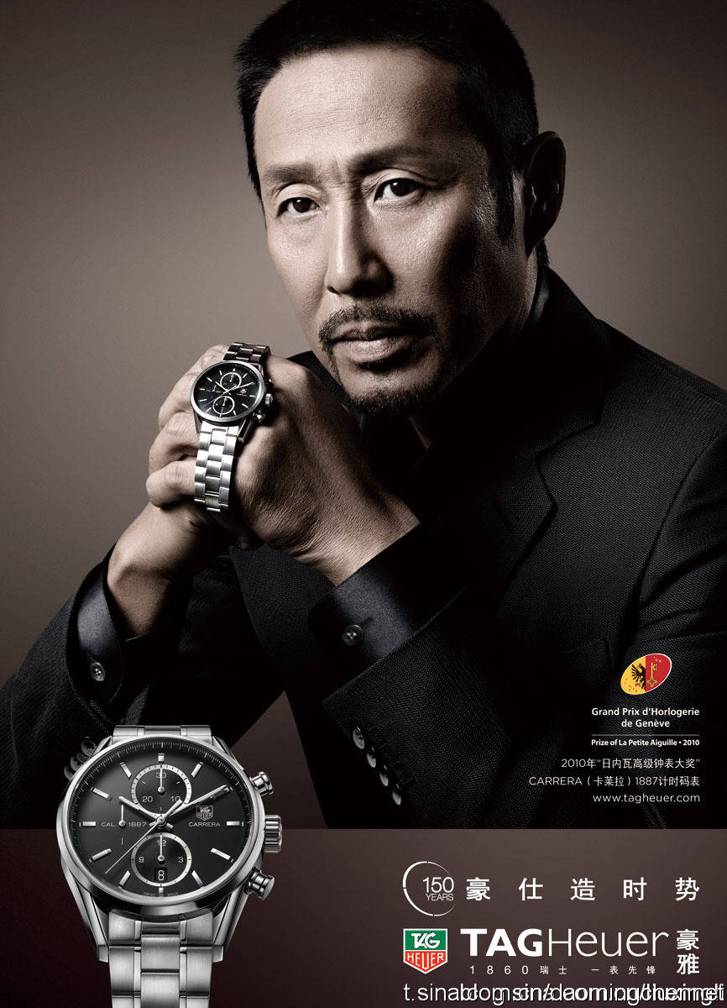
Marketing
Competitor: Tag Heuer
2007-2012
Newly-open Shops(including vendors) 41
CM(TVC) in 2012
3 CMs
IMC——Online Ads/Promotion/DM/etc.
陈道明
豪仕造时势
慧者潜锋芒
Brave Man Fights
Wise Man Hides

Slide 27
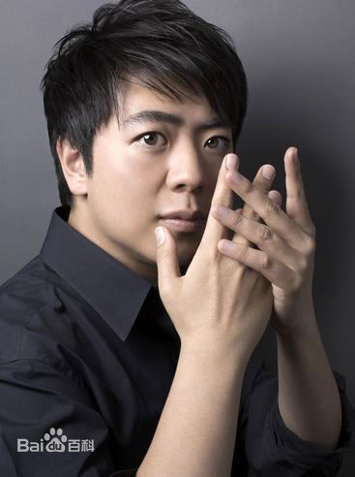
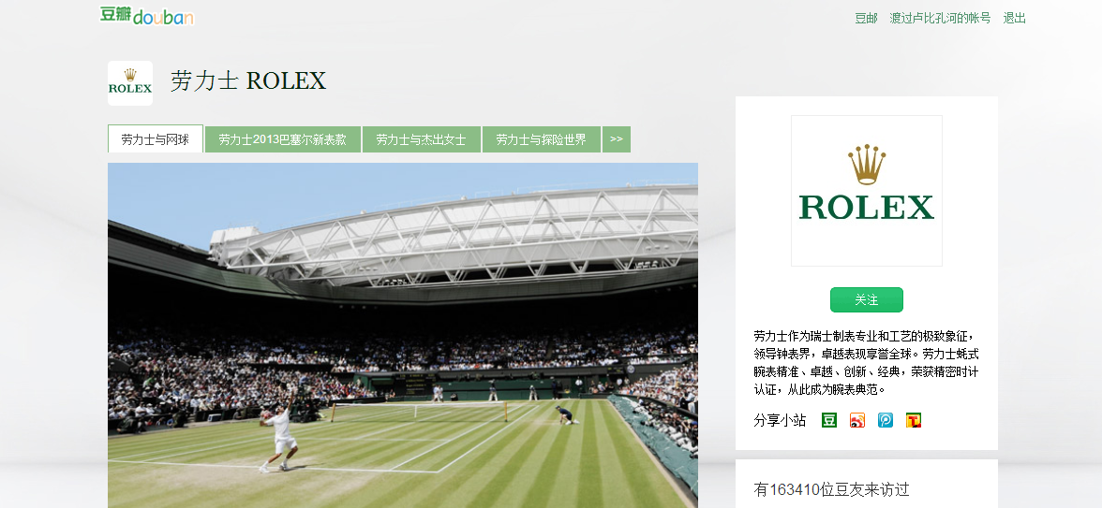
Marketing
Rolex’s Public Relations 2012-2013

Slide 28
Marketing
Daytona
Explorer
Date Just
Bubble back
？
Star
Dog
Cash Cow

Slide 29
Marketing
Strength
Quality
Weakness
Distribution & Delivery
Threaten
Competitor’s plan
Opportunity
Rise of Middle Class
Tradition
Contacting point
Advertising & PB
Brand Awareness
The lower trend of luxury consumer
Brand Image’s threatens by opponents

Slide 30
Marketing
STP Model
25-35
Scholar
Politician
Mid-Class
1st
35-40
40-45
45-50+
Merchant
2nd
3rd
4th
Eastern
Western

Slide 31
Marketing
STP Model
Target
Life Experience
40-45
Mid-Class
Capability on Shopping/Concept
Western
2nd Cities

Slide 32
Marketing
STP Model
Positioning:
For those who-
Want their esteem needs to be fulfilled
Want to be elegant by wearing a timekeeper
Want to chase high quality of their luxuries
Want to retrace their dreams
Rolex : the best choice to keep your dreams.
with best quality , as always

Slide 33
謝謝！
ありがとう！
감사합니다！
Thank You！
Merci Beaucoup！ Gracias！

