Slide 1

Session 3
Consumer Behavior
Chapter 6

Slide 2
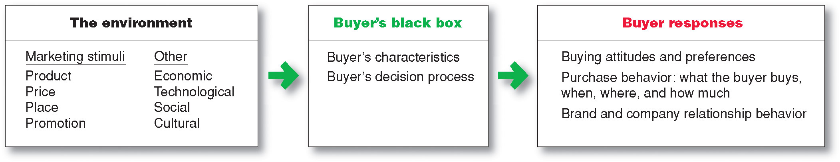
Model of Consumer Behavior
Consumer Behavior is the study of how individuals, groups, and organizations select, buy, use, and dispose of goods, services, ideas, or experiences to satisfy their needs and wants.
Understanding the consumer helps us translate the marketing mix into profits
Variations in preferences are strongly affected by:
  Culture
  Social Class, group membership
  Psychological factors
  Personal characteristics
  Information processing
  Decision making
Notes:
Consumer Behavior is the buying behavior of final consumers (individuals and households) that buy goods and services for personal consumption
However, consumer choice is not a monolith.
Evidence of this is on every store shelf.
There is always a choice of many brands that have slightly different product benefits and features, different target markets and positioning strategies.
The preferences for products and the ultimate decisions that consumers make vary greatly.
Much of this variation comes from environmental features that, while marketers may be unable to alter, they can use to understand consumer decisions.
Today we will focus on how a consumer’s culture, social class and group membership, as well as personal and psychological factors affect their behavior.
Why is this important to marketers? Understanding differences in consumers helps marketers with every piece of the marketing strategy (price, place, promo, product).
A good understanding of consumer behavior can thus help increase the value pie, or help to capture more of it.

Slide 3
The buyer’s black box has many levels of influence
Cultural
Social
Personal
Psychological

Slide 4

Subculture
Subculture: group of people within a culture with shared value systems based on common life experiences and situations
Include nationality, religion, age cohort, geography, race/ethnicity
Examples
African American – increasing affluence
  Price conscious
  Enjoy shopping
Asian – most affluent
  Brand conscious, not brand loyal
  Shop frequently
Rich 2nd Generation (富二代)
  ？
Notes:
A subculture is a group of people within a culture with shared value systems.
These are a result of common life experiences and situations
Subcultures often form around nationalities, religions, age groups, or geographic racial/ethnic differences.
- Geographic subcultures in the US may be “Minnesota nice” or “jersey shore”
Religious subcultures include observant Jewish or Islamic groups, or fundamentalist Christians
Age subcultures include gen Y’s – very distinctive from other age subcultures like baby boomers.
DQ: When thinking about subcultures, consider what other subcultures you belong to and how your membership influences yoru consumer choices.
Some of the most influential subcultures in the United States are Hispanics, African Americans, Asian Americans, and older Americans.
… (one way to target African American and other subcultures is to use a product spokesperson from that culture)
From these examples we can see that it is important for marketers to understand subcultures because they have different
Brand preferences and loyalties
Shopping behaviors
Attitudes toward price
Why else do subcultures matter for marketers?
Subcultures can be an easy way to segment– shared experiences translate into similar needs
Marketers may make products for specific needs of the subculture
(religious goods, ethnic identification, grooming products, etc.,
foods that meet specificiations like Halal, Kosher, safe for Lent)
Operate in a market where you must be sensitive to the wishes of a particular market
(amount of body exposure, language)
Another important way of dividing consumers is according to their social class

Slide 5
Culture
Culture is :
the collective programming of the mind that distinguishes the members of one category of people from those of another;
the learned values, perceptions, wants, and behavior from family and other important institutions
Attitudes, Beliefs and Values
Religion
Aesthetics
Dietary Preferences
Language and Communication
Notes:
Culture can be difficult to define – there are literally hundreds of definitions and ways of measuring culture (Kroeber and Kluckhorn = 164; Taras and Rowney 121 measures)
While culture can be difficult to define, we usually know it when we see it.
What does American culture look like? =
Focused on individual achievement, success, materialism
“american dream” of hard work and progress, freedom
Of course, culture is not static.
Cultural shifts are extremely important to marketers
Understanding what culture looks like now, and how it is changing, helps marketers identify
Un-met consumer needs
growing markets
Two important cultural shifts that we have witnessed recently include
1 – health and wellness (growing markets for a variety of related products and services including…
health clubs alone are a $20 billion market, and have posted gains during the recession
(Mintel Reports “Health and Fittness Clubs – US – June 2011”)
2 – concerns regarding energy consumption and environmental warming have also spawned a huge growth market for environmentally responsible consumption
161 ecolabels used in North America
(Mintel Reports “Green marketing – US – April 2011”)
Despite the existence of an “American” culture, culture is rarely a monolith.
For example, undergraduate culture at UW looks very different from general American culture
= partying, cramming, cheering for bucky

Slide 6
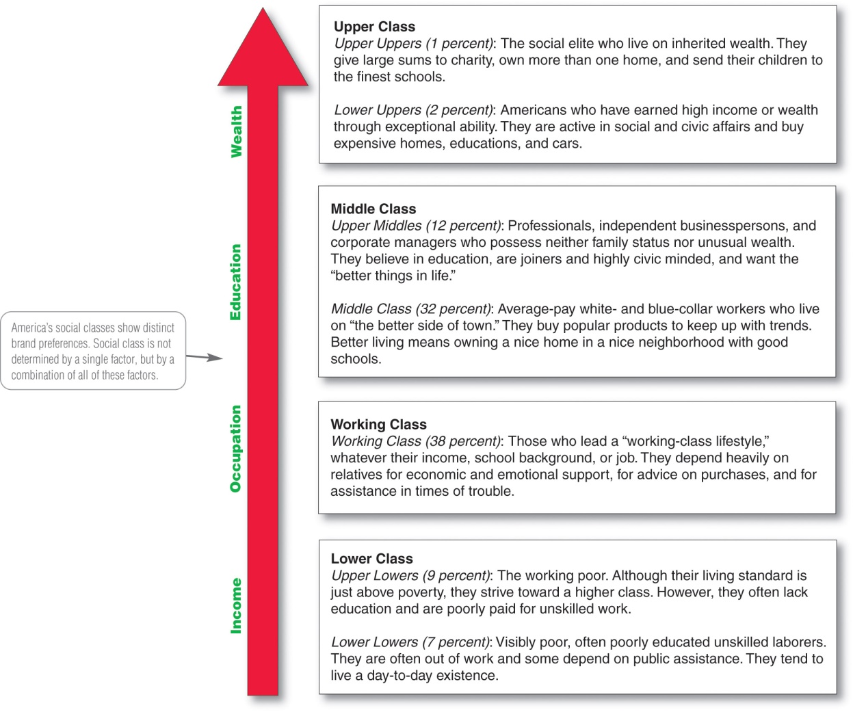
Social Class
Social classes: society’s relatively permanent and ordered divisions whose members share similar values, interests, and behaviors
Social class is a function of:
Education, occupation, income, wealth
Family and social network, geographic location, lifestyle & taste
Social classes often have different brand and product preferences
Home furnishings (Coleman 1983)
Leisure activities (Bourdieu 1984)
Spending, saving, credit (Bernthat 2005)
Notes:
Social classes are defined as society’s relatively permanent and ordered divisions whose members share similar values, interests, and behaviors.
operates similarly to culture and subculture in that it shapes consumer attitudes, interests, and behaviors.
In its most basic form social class is about your rank is society, based on how much money you have
Measured as a function of Education, occupation (occupational prestige), income, and wealth
However, there are a variety of factors that go into determining a person’s social class.
These other factors can include:
your family and friends (social network) – its all about who you know
Geogrpahic location (park avenue address? St. Louis Park 1st alphabet address – proximity to wealth)
Lifestyle and taste often act as a mark of social class
A common way of dividing Americans into social class is the 7-class scheme on the right. 2 largest = working and middle
each of which has unique consumer preferences and behaviors that we will examine in a minute.
Americans tend to be very hesitant to classify themselves into a particular social class (Savage and ___ 2001).
GSS shows that Americans overclaim working and middle class status
It impacts a person’s preferences for brands and products.
The text points out that social classes have different preferences in terms of automobiles and clothing.
But it’s a little light on details.
Scholars have noted differences in a variety of consumption patterns. For example,
People in higher social classes prefer
- Modern furniture and abstract paintings
more likely to visit museums and attend live theater
save more and invest in longer term and higher yield products
Middle-class:
Prefer traditional and French style furniture
more likely to go camping and fishing
Working class:
Crowded homes, religious decorations
have less savings, in very conservative (low yield) investments

Slide 7
Groups
Membership Groups: Groups with direct influence and to which a person belongs
Reference Groups: form a comparison or reference in forming attitudes or behavior
  Aspirational Groups: Groups an individual wishes to belong to
  Avoidance Groups: Groups an individual does not want to belong to (especially on game day)
Important Groups:
  Family
  Social Networks
Notes:
In addition to cultural influences, consumers are also subject to powerful social influences in the form of groups. Three kinds of groups are commonly noted:
The first is a membership group (to which a person belongs/ is a member)
All of us are members of Fudan University.
Members of various other groups – a club or sports team.
Reference groups are groups that we do not belong to, but that we see and use for purposes of social comparison. They help us form attitudes or behaviors. They act like benchmarks for setting our own attitudes, behavior, and consumption.
- Groups we admire and want to belong to are aspirational groups. On game day as we sit in the stands or watch from a bar stool – we may wish we were members of the football team or the marching band.
- Of course, if there are groups we want to belong to, there are also groups we do not want to belong to. On game day, you may consider gopher fans an avoidance group.
Groups that are especially important to marketers are families and social networks. The influence of family is pretty clear. Many consumer preferences are “inherited” from our parents. Think of the first time you had to do your own laundry. What detergent did you use? If you weren’t pilfering from your roommate, you probably bought what your parents did – either because you didn’t have any knowledge about the product category or you were homesick and wanted the same smelling sheets.
Social networks are important for marketers because they help spread marketing messages among group members and between social groups. This spread is known as word of mouth.
P&G’s Old Spice presentation showed how this form of communication can be effective marketing tool. Marketers are also drawn to WOM in social networks because it is considered more credible than a traditional marketing message.
The growth of online social networks has made word of mouth increasingly important to marketers.

Slide 8
Psychological Factors
Attitude- learned tendency to respond in a consistent way to a given object or entity
Belief- an organized pattern of knowledge that an individual holds to be true about the world
Value- enduring belief or feeling that a specific mode of conduct is personally or socially preferable to another mode of conduct
Motive – need that directs consumer to seek satisfaction
Perception- process of selecting, organizing and interpreting information to form a meaningful picture of the world
Learning- changes in a consumer’s behavior from experience
-positive vs. negative experiences

Slide 9
Attitudes and Behavior
Strangely enough, attitudes aren't connected to behavior very well.
Reason 1: A host of variables influence the connection between attitudes and behavior, including:
  Strength of the attitudes.
  Their accessibility in memory.
  Their relevance to the behavior in question.
Reason 2: The behavioral component of an attitude is only a predisposition which is influenced by situational variables.

Slide 10

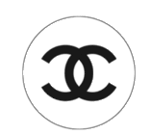

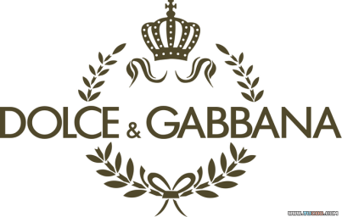

Personal Characteristics
Age and family life-cycle stage
  Millenials, baby boomers
  DINKs, single parents, 2 parents 2 kids
Lifestyle
  Personal pattern of living in psychographics
  Activities – work, hobbies, shopping, sports, social events
  Interests – food, fashion, family, recreation
  Opinions – about themselves, social issues, business, products
Personality
  Psychological characteristics
  self-confident, dominant, sociable, defensive, aggressive
  Brands also have personalities: sincerity, excitement, competence, sophistication, ruggedness
Self concept
  People’s possessions contribute and reflect their identities
  We are what we have
Notes:
Finally, there are a number of personal factors that influence consumer behavior. These include:
Age
Family life-cycle stage
Lifestyle
Personality
Self-concept
The importance of many of these factors is clear.
Millenails (you and me) have very different consumption patterns than our baby boomer parents.
Some of this difference is a factor of our unique experiences, other differences are because we do not yet have children or spouses. Important changes in family structure often mean different consumption choices.
Lifestyles are also a key personal difference. More than just social class or occupation, lifestyles are a broader concept that includes a consumer’s activities, interests, and opinions.
Finally, personality is an important difference. We know that people have very different personalities. However, brands are also known to have personalities. Aaker identified five top level brand personalities: sincerity, excitement, competence, sophistication, and ruggedness.
For example:
Armani, Prada, and Chanel are all sophisticated brands. In contrast,
The Carhart work clothes and the Ford F-150 is a rugged brand.
Other brands such as Hallmark might be considered sincere.
The importance of personalities, for people and brands, is when marketers can get the two to line up. This is called “self-concept” theory and is the idea that people’s posessions, their consumption choices, reflect their identities.

Slide 11
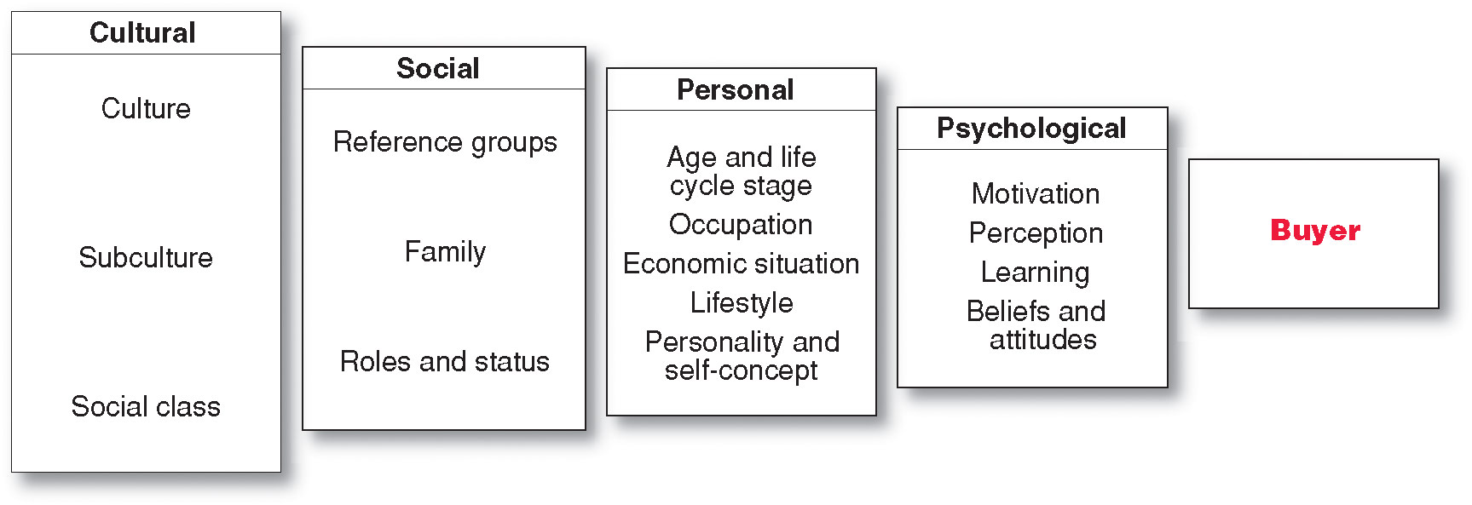
Summing up the buyer’s black box…

Slide 12
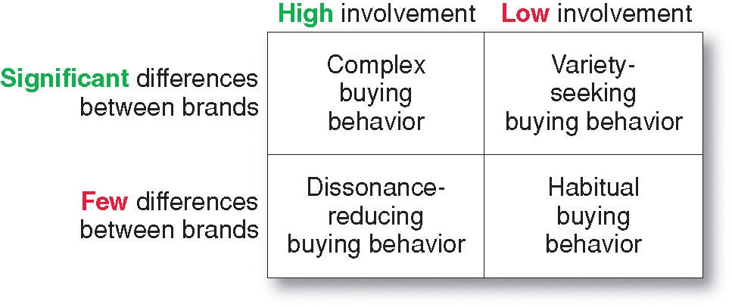
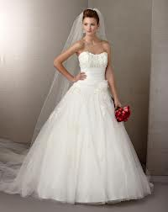

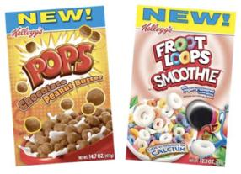
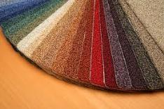
Buying behavior changes with different types of products

Slide 13
#Variety Seeking
Low involvement decisions
No developed brand preferences and low brand loyalty
more differences among brands
Reasons consumers seek variety: satiation and boredom

Slide 14
#Habitual Buying
When both involvement and information processing are low
A consumer’s natural inertial movement toward a product or service based on familiarity and convenience
Especially for low priced, frequently purchased products
Brand Loyalty
Intrinsic commitment to a brand based on the benefits or values it provides
Minimal information processing

Slide 15
Let’s look at the formula again!
Consumer seeks to maximize value.
Value = Benefits - Costs
Benefit/cost is not single construct, better considered by different layers
PERCEIVED benefits & PERCEIVED costs. It’s all about perceptions
Differ from person to person, from situation to situation

Slide 16
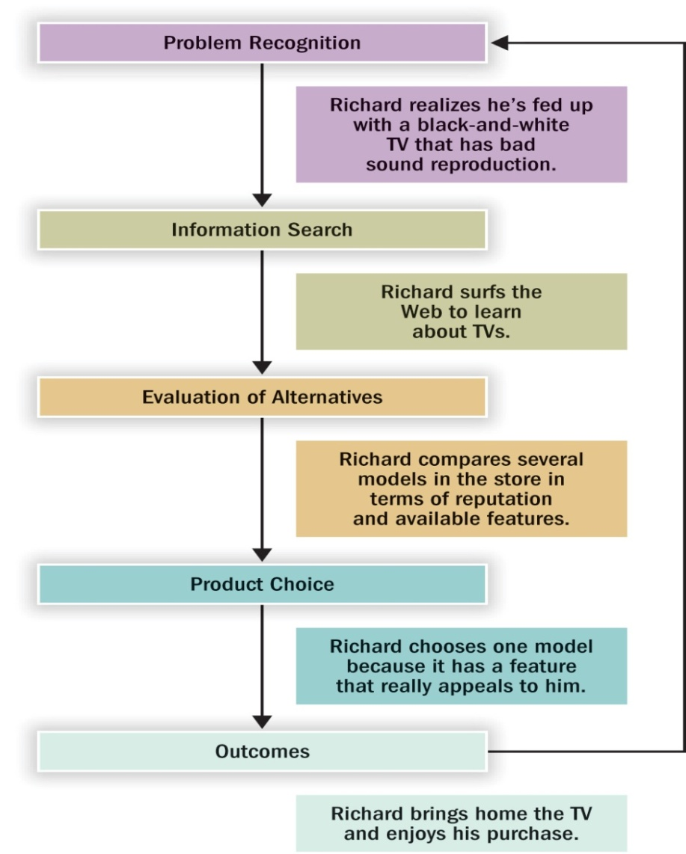
Consumer Decision-making Procedure
Need Recognition
Post-purchase behavior

Slide 17
Consumer Decision-making Procedure
Need Recognition

Slide 18
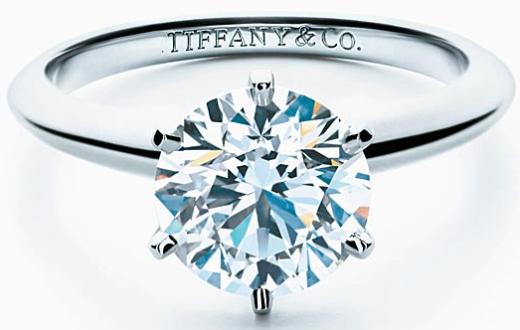
#Need/Problem Recognition
Occurs when consumer sees difference between current state and desired end state
  Need recognition: actual state declines
  Opportunity recognition: ideal state moves upward
GOT
WANT
GAP
Diamond lasts forever

Slide 19
Consumer Decision-making Procedure

Slide 20
#Information Search
Internal Search
Recall (of brands, attributes, evaluations, experiences)
– evoked sets
We recall more when we have experienced involvement.
External Search
How much consumers engage in external search depends on motivation, opportunity, ability

Slide 21
Consumer Decision-making Procedure

Slide 22
Consumer Decision-making Procedure

Slide 23
Consumer Decision-making Procedure
Post-purchase behavior

Slide 24
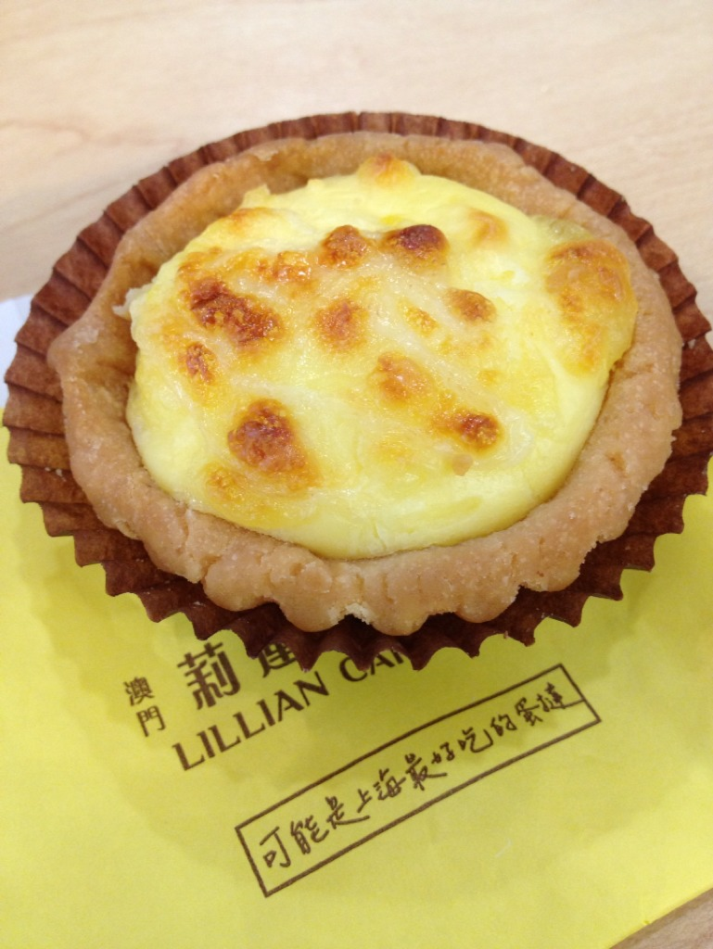

Post Purchase Behavior
Satisfaction = perceived performance −
consumer’s expectation
Possibly the most delicious egg tart in Shanghai

Slide 25


New Purchases
Adoption Process
  Awareness
  Interest
  Evaluation
  Trial
  Adoption

Slide 26
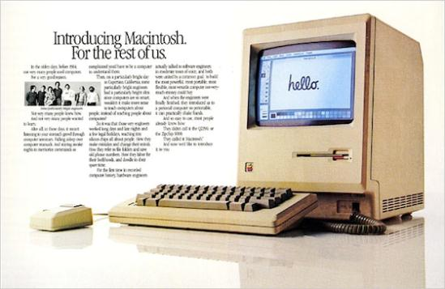
#Consumers and Innovation
Five adopter groups:
Innovators are venturesome
Early adopters are guided by respect
Early majority are deliberate
Late majority are skeptical
Laggards are tradition-bound

Slide 27
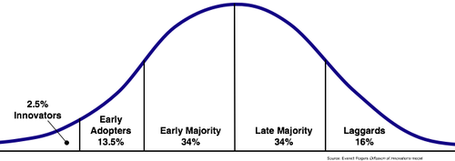
#Consumers and Innovation

Slide 28
Business Behavior
Larger buys
More rational process; collective decision making
More professional purchase/sales team
Takes longer time to close the deal
Closer seller/buyer relationship
Might customize product

Slide 29
Business Behavior
Longer-term oriented
Not end user
For production/reselling
Cautious about cost
Risk averse, e.g. rent vs. buy

