Slide 1
The Indirect Share Transfers of He’nan Shuanghui
December, 2014

Slide 2
Contents
Overview
Questions
Answers

Slide 3
Overview
Between 2006 and 2009, Goldman Sachs (GS) and CDH sold down a large portion of their stake in He’nan Shuanghui through a series of share transfers.
He’nan Shuanghui didn’t disclose the transfers to regulators and the public until December 2012.
However, eventually GS and CDH didn’t pay taxes to Chinese tax authorities for their income from selling the shares.
Major participants in this case include
He'nan Shuanghui Investment & Development Co., Ltd (Ticker symbol: 000895.SZ, went public on Dec 10, 1998)
Shuanghui Group
Goldman Sachs Strategic Investment（Asia）,L.L.C
CDH Shine
Rotary Vortex Limited
Onshore
Offshore

Slide 4
Overview
The share structure of He’nan Shuanghui as of Dec 31, 2009 is shown below.
Dunearn
CDH Shine III
CDH Shine
Goldman Sachs
Focus Chevalier
12%
17%
48%
15%
8%
Shine B
100%
Profit Summit
Cardilli
Heroic Zone
CDH Shine II
Shine D
CDH Shine IV
5.00%
7.79%
31.82%
36.36%
9.69%
6.00%
3.34%
Shuanghui International Holdings Limited
100%
Glorious Link International Corporation
100%
Onshore
100%
Rotary Vortex
Shuanghui group
others
Offshore
30.27%
21.18%
48.55%
He'nan Shuanghui Investment & Development Co.,Ltd

Slide 5
Overview ——Rotary Vortex
In Feb 2006 GS and CDH established Rotary Vortex Limited in Hong Kong, in which the two companies held a 51% and a 49% stake respectively.
Prior to the establishment of Rotary Vortex, GS and CDH had been selected as foreign strategic investors by the State-owned Assets Supervision and Administration Commission (SASAC) of Luohe City.
In May 2006 SASAC of Luohe and Haiyu Investment together sold 60.72% of He’nan Shuanghui’s shares to Rotary Vortex.
GS
CDH Shine
SASAC of Luohe city
Share Transfer
51%（30.97%）
49%（29.75%）
Rotary Vortex
100%
Shuanghui group
Haiyu investment
others
Shuanghui group
others
35.72%
25%
39.28%
25%
39.28%
35.72%
He'nan Shuanghui
He'nan Shuanghui

Slide 6
Overview ——Rotary Vortex (cont’d)
In Jun 2007 He’nan Shuanghui converted capital reserve into share capital, thus lowering Rotary Vortex’s stake to 51.454%.
On 6 Oct, 2007 GS transferred 5% of Rotary Vortex’s shares to CDH Shine.
The above changes were disclosed in the annual reports of He’nan Shuanghui in 2007 and 2008.
GS
CDH Shine
GS
CDH Shine
51%（30.97%）
49%（29.75%）
46%（23.67%）
54%（27.78%）
The first share transfer
Rotary Vortex
Rotary Vortex
100%
100%
Shuanghui Group
others
Shuanghui Group
others
35.72%
25%
39.28%
30.27%
21.18%
48.55%
He'nan Shuanghui
He'nan Shuanghui

Slide 7
Overview ——Rotary Vortex (cont’d)
On 15 Oct, 2007 CDH Shine and GS transferred all their stake to Glorious Link International Corporation, which was wholly owned by Shine C Holding Limited.
Shine C was later renamed as Shuanghui International.
GS
CDH Shine
Others
Shine C
100%
Glorious Link
100%
Onshore
100%
Rotary Vortex
Shuanghui Group
Others
Offshore
30.27%
21.18%
48.55%
He'nan Shuanghui

Slide 8
Overview ——Shine C
Shine C was established on 2 Mar, 2006. On 6 Apr it was wholly acquired by Shine B.
By 15 Oct, 2007 there were three shareholders of Shine C, including
Shine B (80%),
CDH Shine II Limited (12.31%), and
Cardilli Limited (7.69%).
On 15 Oct, 2007 Shine C wholly acquired Rotary Vortex via Glorious Link.
On 15 Oct, 2007 Shine C issued new shares. Its share structure after the share issuance is shown below.
GS
CDH Shine
Others
Shine B
100%
Profit Summit
Richy Fast
Heroic Zone
CDH Shine II
Shine D
Cardilli
5.00%
7.64%
31.82%
36.36%
9.69%
6.00%
3.50%
Shine C
(Shuanghui Int’l)

Slide 9
Overview ——Shine C (cont’d)
On 31 Dec, 2007 Shine C was renamed as Shuanghui International Holdings Limited.
On 28 Dec, 2009 Cardilli and Richy Fast respectively transferred a 1.05% and a 5.34% stake in Shuanghui International to CDH Shine IV Limited.
Below shows the share structure of Shuanghui International as of 31 Dec, 2009.
GS
CDH Shine
Others
Shine B
100%
Profit Summit
Cardilli
Heroic Zone
CDH Shine II
Shine D
CDH Shine IV
5.00%
7.79%
31.82%
36.36%
9.69%
6.00%
3.34%
Shuanghui Int’l

Slide 10
Overview ——Shine B
Shine B was established in the British Virgin Islands on 20 Mar, 2006. When established, Shine B was wholly owned by CDH Shine.
Through share transfer and issuance, as of 28 Apr, 2006, GS increased its stake in Shine B to 51%, while CDH’s stake decreased to 49%.
The above change had taken place before SASAC of Luohe and Haiyu Investment sold shares to Rotary Vortex.
On 1 Aug, 2006 GS and CDH Shine transferred shares to Focus Chevalier Investment Company Limited (controlled by New Horizon Investment) and Dunearn Investments PTE Limited (controlled by Temasek) . Below shows the share structure of Shine B after the share transfer.
Dunearn
CDH Shine
GS
Focus Chevalier
12%
45%
35%
8%
Shine B

Slide 11
Overview ——Shine B (cont’d)
In Sep 2006 and Feb 2007 GS transferred shares to CDH Shine, which increased CDH Shine’s stake in Shine B to 50% and decreased GS’s stake to 30%. Focus Chevalier’s and Dunearn’s stake remained unchanged.
In Oct 2007 Shine C gained whole ownership of Rotary Vortex by acquiring Glorious Link. After the acquisition, Shine B held 80% of the shares of Shine C; GS and CDH held 12.35% and 26.91% shares of He’nan Shuanghui respectively.
Dunearn
CDH Shine
GS
Focus Chevalier
Two rounds of share transfers
12%
45%
35%
8%
Shine B
Dunearn
CDH Shine
GS
Focus Chevalier
12%
50%
30%
8%
Shine B

Slide 12
Overview ——Shine B (cont’d)
In Nov 2009 GS transferred shares to CDH Shine III Limited. Meanwhile, Shine B repurchased two shares from CDH Shine and issued two shares to CDH Shine III. Below is the share structure of Shine B after the share transfer and share issuance.
Dunearn
CDH Shine
GS
Focus Chevalier
Share transfer and issuance
12%
50%
30%
8%
Shine B
Dunearn
CDH Shine III
CDH Shine
GS
Focus Chevalier
12%
17%
48%
15%
8%
Shine B

Slide 13
Overview ——The result of offshore share transfers
Below shows the share structure of He’nan Shuanghui as of 31 Dec, 2009
GS’s stake decreased from 30.97% to 3.27%, and CDH’s decreased from 29.75% to 20.87%
Dunearn
CDH Shine III
CDH Shine
Goldman Sachs
Focus Chevalier
12%
17%
48%
15%
8%
Shine B
100%
Profit Summit
Cardilli
Heroic Zone
CDH Shine II
Shine D
CDH Shine IV
5.00%
7.79%
31.82%
36.36%
9.69%
6.00%
3.34%
Shuanghui International Holdings Limited
100%
Glorious Link International Corporation
100%
Onshore
100%
Rotary Vortex
Shuanghui group
others
Offshore
30.27%
21.18%
48.55%
He'nan Shuanghui Investment & Development Co.,Ltd

Slide 14
Contents
Overview
Questions
Answers

Slide 15
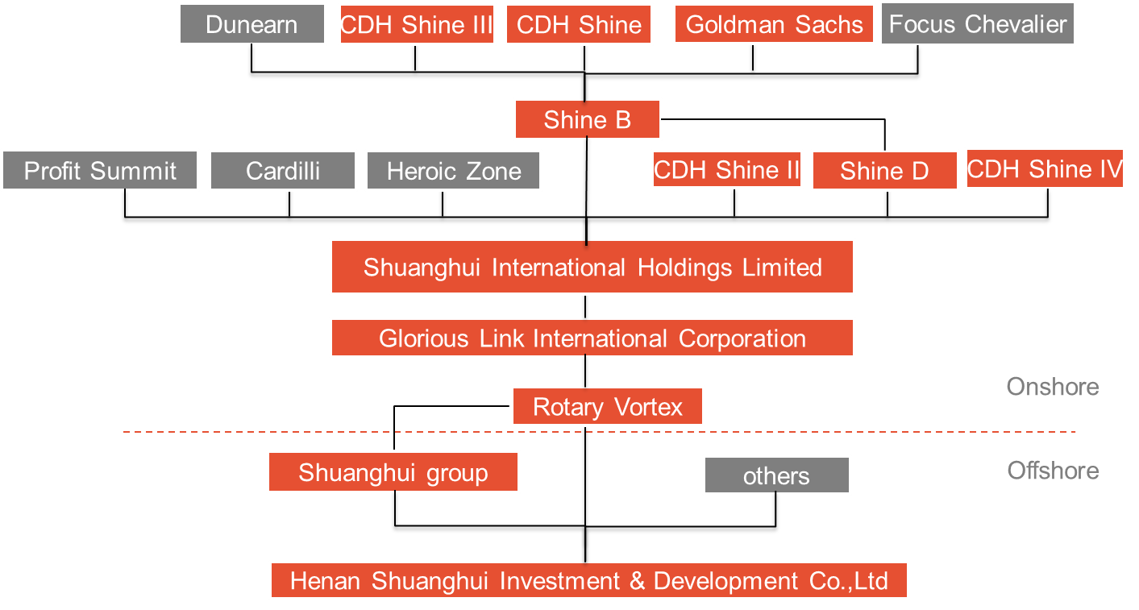
Questions
What taxation principles should Chinese tax authorities adopt when they determine the tax liabilities of Goldman Sachs and CDH?
Why did GSand CDH design such a complex transaction structure?
GS and CDH did not pay tax to Chinese tax authorities for the share transfers in the end. What might be the cause?
What are the main features of the aforementioned share transfers by GS and CDH?

Slide 16
Questions (cont’d)
To answer these questions, you may need to refer to the following materials:
The Law of the People’s Republic of China on Enterprise Income Tax,
Regulation on the Implementation of the Enterprise Income Tax Law of the People's Republic of China,
Notice of the State Administration of Taxation on Strengthening the Administration of Ent-erprise Income Tax on Nonresident Enterprises’ Equity Transfer Income (Circulation 698 [2009]), and
The OECD Model.

Slide 17
Contents
Overview
Questions
Answers

Slide 18
Answers ——Tax liability determination
1. Source tax jurisdiction
According to territorial tax jurisdiction, income generated within the concerned country is taxed regardless of who earns the income.
China applies source tax jurisdiction for non-resident companies’ equity transfers.
‘A non-resident enterprise with an establishment or place of business in the PRC shall pay CIT on its PRC-sourced income derived by such establishment or place of business and on its foreign-sourced income which is effectively connected with such establishment or place of business’.
‘The incomes indicated in the Article 3 of the Enterprise Income Tax Law include the income from selling goods, the income from providing labor service, the income from property transfer, the income from equity investment such as the dividends and bonus, the income from interest, the income from rental, the income from royalty fee, the income from donation and other incomes’.
Source: PRC CIT Law and Implementation Regulations
Citizenship tax jurisdiction
Residence Principle
Residence tax jurisdiction
Tax Jurisdiction
Territorial Principle
Source tax jurisdiction

Slide 19
Answers ——Tax liability determination (cont’d)
2. Look-through approach
Look through approach should be used to determine the source country when non-resident companies indirectly transfer the shares of a resident company. We regard the location of the closest intermediate company with commercial substance as the source country.
‘Model convention for the avoidance of double taxation with respect to taxes on income and on capital” (the OECD Model) proposes the Look-through Approach. At present, this approach is applied by China, the United States and many other countries.
General anti-avoidance rules are also adopted in China.
Offshore Shareholder
Offshore Shareholder
Offshore Shareholder
Look-through Approach
Cannot look through
Source
Intermediate Company without commercial substance（Tube Company）
Intermediate Company with commercial substance（Not Tube Company）
Residence Company
Residence Company
Residence Company

Slide 20
Answers ——Tax liability determination (cont’d)
3. Use anti-avoidance rules to define the source country when non-resident companies indirectly transfer the shares of a resident company in China
The Law of the People’s Republic of China on Enterprise Income Tax
Article 47 – ‘Where an enterprise lessens its taxable income or amount of income taxable because it implements plans other than the ones designed to achieve reasonable business objectives, the taxation authority shall have the right to make adjustments in a reasonable way’.
Regulation on the Implementation of the Enterprise Income Tax Law of the People's Republic of China
Article 120 – ‘ “Without reasonable business purposes” as mentioned in Article 47 of the CIT Law refers to having reducing, avoiding or deferring paying taxes as primary purposes’.
Notice of the State Administration of Taxation on Strengthening the Administration of Enterprise Income Tax on Nonresident Enterprises’ Equity Transfer Income (Circulation 698 [2009] by the State Administration of Taxation)
‘VII. Where a non-resident enterprise transfers the equity of a Chinese resident enterprise to its affiliated party and the taxable income decreases because the transfer price does not conform to the arm 's length principle the taxation, authority shall be entitled to make adjustment according to reasonable methods’.

Slide 21
Answers ——Tax liability determination (cont’d)
3. Use anti-avoidance rules to define the source country when non-resident companies indirectly transfer the shares of a resident company in China
According to related laws and regulations, the criterion to determine if the non-resident company should be taxed is listed below.
When the two conditions are met, the non-resident company should be taxed in China. However, the criterion of “Commercial Substance” has not been clearly defined.
To find out whether GS and CDH should be taxed in China, we need to analyze if the intermediate company meet the conditions listed above.
Local tax rate below12.5%
Need to be taxed in China
or
Without commercial substance

Slide 22
Answers ——Tax liability determination (cont’d)
4. Taxation principles applied in this case
There are four intermediate companies in this equity structure: Rotary Vortex, Glorious Link, Shuanghui International and Shine B.
To determine if GS and CDH should pay an overdue tax in China, we need to analyze whether those four intermediate companies meet the criteria for Tube Company. As long as one of them cannot be defined as a tube company, GS and CDH do not need to pay an overdue tax.

Slide 23
Answers ——Tax liability determination (cont’d)
4. Taxation principles applied in this case
Rotary Vortex, Shuanghui International and Shine B are registered in Hong Kong, the Cayman Islands and the British Virgin Islands respectively, where the income tax rates are above 12.5%. The registration location of Glorious Link hasn’t been disclosed.
GS and CDH did not pay the overdue tax in the end probably because all of the intermediate companies had commercial substance.
For example, Rotary Vortex’s registered capital is 1.5 billion. It not only holds 51.45% shares of Shuanghui International but also controls several meat processing plants.
Shuanghui International is an important channel for Shuanghui Group to expand its overseas businesses. It was renamed as WH Group and went public in Hong Kong in April, 2014.

Slide 24
Answers ——Features of the share transfers
All of the share transfers were conducted overseas.
Complicated offshore share structure, simple tax-avoidance structure
GS and CDH designed a complicated offshore equity structure to enable other investors to enter or exit conveniently, and to create conditions for the management buyout of Shuanghui Investment & Development.
Heroic Zone, whose shares were hold by 300 employees of Shuanghui, became the third largest shareholder of Shuanghui Investment & Development with a 16.37% stake as of 31 Dec, 2009.
In Nov, 2010 Shuanghui Investment & Development announced plan for MBO
Meanwhile, GS and CDH used only one simple method (setting intermediate companies) to avoid tax. Using complicated methods, on the contrary, may attract tax bureau’s attention.

Slide 25
Summary
Goldman Sachs and CDH Investment respectively tranferred 23.02% and 6.97% shares from Shanghui Investment & Development between 2006 and 2009.
‘Tax Bureau in Luohe tends to charge Goldman Sachs 400 million income tax for its share transfers’, as reported by 21 Century Economy.
Such a complex share structure was designed not only to avoid tax, but also to facilitate Shuanghui Investment & Development’s MBO plan by placing Shuanghui International as of the intermediate companies.
Whether Goldman Sachs and CDH Investment should pay the overdue tax depends on the determination of the business substance of Rotary Vortex, Glorious Link, Shuanghui International and Shine B by the tax bureau. Only when all of the four companies are determined to be without commercial substance should GS and CDH pay the CIT.

Slide 26
End of the case

