Slide 1
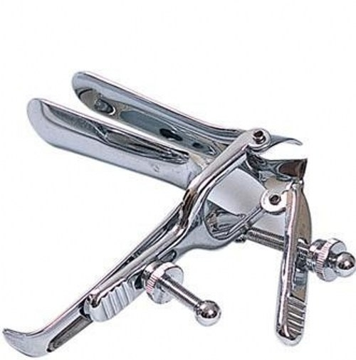
Artificial abortion
10301010075
刘丝雨

Slide 2
Key words
Suction curettage 抽吸刮除术
D&E
（Dilation & Evacuation） 扩张和吸取
forcep 钳子
scrape 刮
Saline method 盐水法
Caesarean section 剖腹产

Slide 3
Staging
The first trimester
The second trimester
The third trimester
Early Term
Abortion
1～3 months
(1～12weeks)
4～6 months
(13～28weeks)
Late Term
Abortion
7～9 months
(29～40weeks)

Slide 4
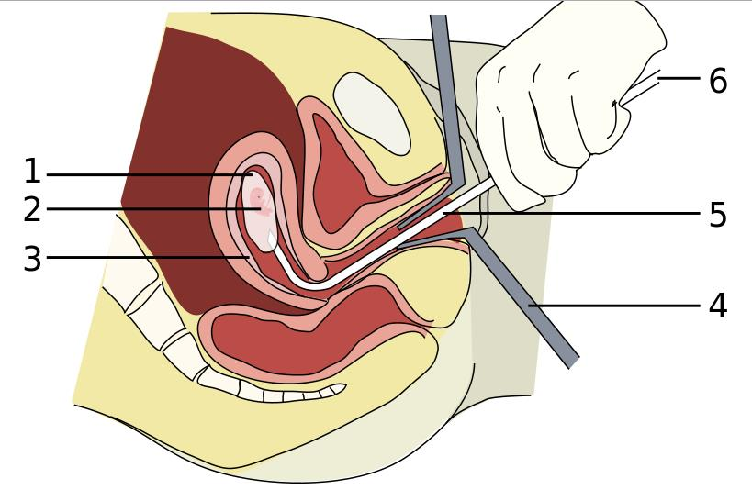
Methods
suction curettage
· early term abortion
(＜12weeks)
· local anesthetic
dilate
insert
suction
scrape（curettage 刮除术）
1.Amniotic sac
2.Embryo
3.Uterine lining
4.Speculum
5.Vacurette
6.Attached to a suction pump

Slide 5
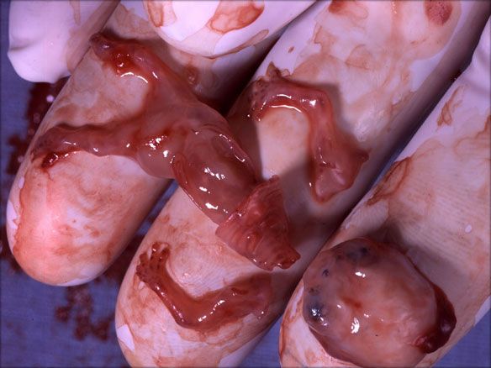
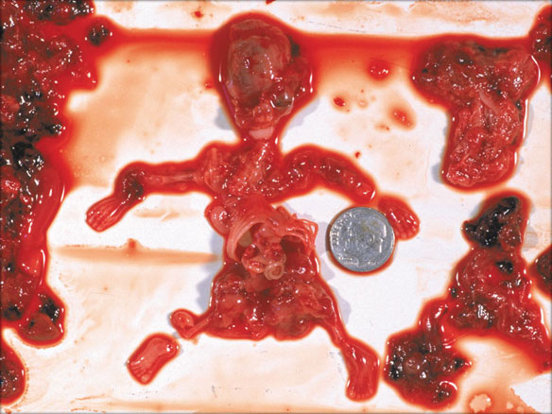
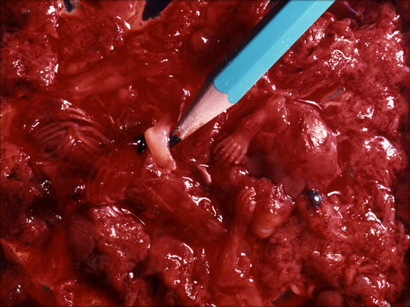
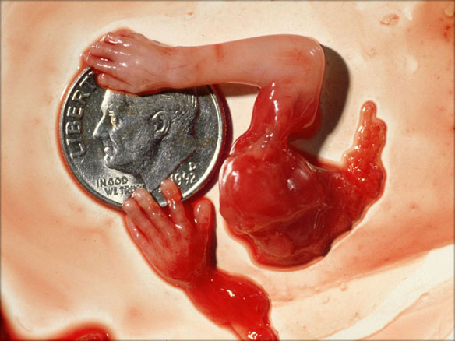
7w
9w
10w
11w

Slide 6
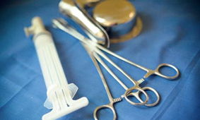
D&E
(dilation and evacuation)
· late term abortion
(M4～Ｍ８)
· local/general anesthetic
dilate
insert
shred (forcep)
suction
scrap (curettage)

Slide 7
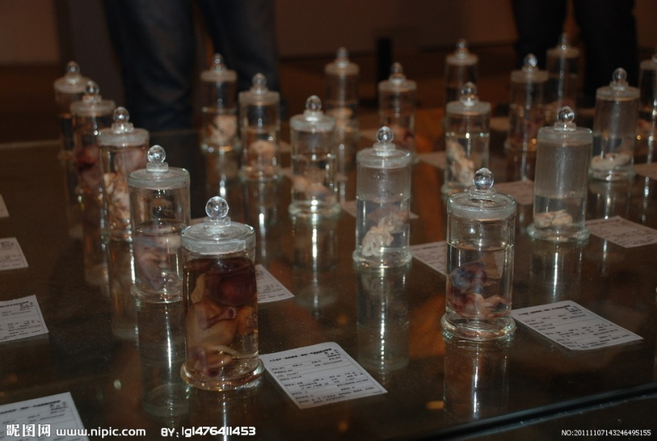
Other：
·Saline method
M4～Ｍ7
hypertonic saline solution
·hysterotomy
M7～Ｍ9
similar to Caesarean section
different purpose

Slide 8
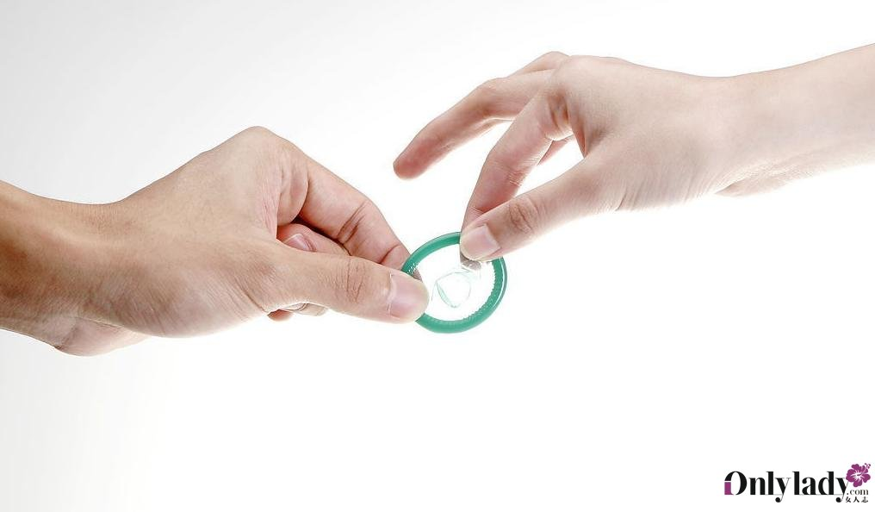
Summary
·Suction curettage
D&E
Saline method
Hysterotomy abortion
harmful
·prevent accidental pregnancy

Slide 9
Reference
http://en.wikipedia.org/wiki/Abortion#By_gestational_age_and_method
Roche, Natalie E. (28 September 2004). "Therapeutic Abortion". E Medicine. Archived from the original on 14 December 2004. Retrieved 19 June 2011
Healthwise (2004). "Manual and vacuum aspiration for abortion". Web MD. Archived from the original on 28 October 2008. Retrieved 2008-12-05.
4. World Health Organization (2003). "Dilatation and curettage". Managing Complications in Pregnancy and Childbirth: A Guide for Midwives and Doctors. Geneva: World Health Organization. ISBN 978-92-4-154587-7.OCLC 181845530. Retrieved 2008-12-05.

