Slide 1
CHINA’S POPULATION AND DEVELOPMENT
SHEN KE

Slide 2
Course description
Study of demography: the systematic and scientific study of human populations
Origin of the word demography
The term demography was first used in 1855 by the Belgian statistician Achille Guillard in his book Elements of Human Statistics
Demography is the social science that studies
the size, composition, and distribution of the human population
changes in population size and composition;
the components of these changes (fertility, mortality, and migration)

Slide 3
Course description
Connection between population transition and socio-economic development.
China has been undergoing two exceedingly rapid transformations in the past half a century: a demographic transition with dramatic decrease in fertility and mortality, and an economic transition from a planned economy to a market economy.

Slide 4
Beginning of a New Era: Slowing down economic growth and the end of demographic dividend
Economically
Three decades of economic hyper-growth
In 2012, China registered its annual economic growth rate below 8 percent
Demographically
The size of population aged 65 and above reached 126 million in 2012
A decline of labor force population by 3. 5 million in 2012
Exhaustion of its demographic dividend in 2012 (Wang and Mason, 2008)

Slide 5
Outline
Mortality
Demographic Transition
Fertility
Population
Urbanization and Migration
Marriage
Education
Economic Growth

Slide 6
What to learn in this course?
Basic demographic concepts and theories
How to get access to demographic data
Formulate a picture of China’s population and its connection with social and economic development

Slide 7
Course Requirements
Class attendance
Discussion
Presentations
Presentation: progress report of the term paper
3000-word Term paper
Population-related issues in your country
Criteria
Originality
Integral and logistic
Punctuality

Slide 8
Grading
Class attendance and discussion 20%
Presentation 40%
Term paper 40%.

Slide 9
Reference Books
Weeks, J.R. (2008). Population: An Introduction to Concepts and Issues (10th Edition). Belmont, California: Wadsworth Publishing Company.
Dudley, P.L. and Bouvier, L.F. (2010). Population and Society: An Introduction to Demography. New York: Cambridge University Press.
Reading materials for each session

Slide 10
A Big Day of Oct. 31st, 2011?

Slide 11
World Population Reaches 7 Billion

Slide 12
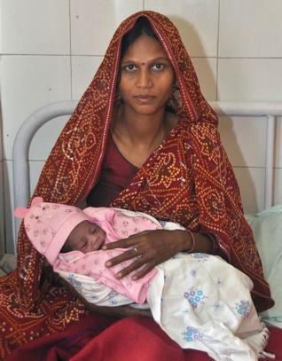
World Population Reaches 7 Billion
Countries are vying for the symbolic 7 billionth baby.
India, Philippines, Russia

Slide 13
The Journey to 7 Billion

Slide 14
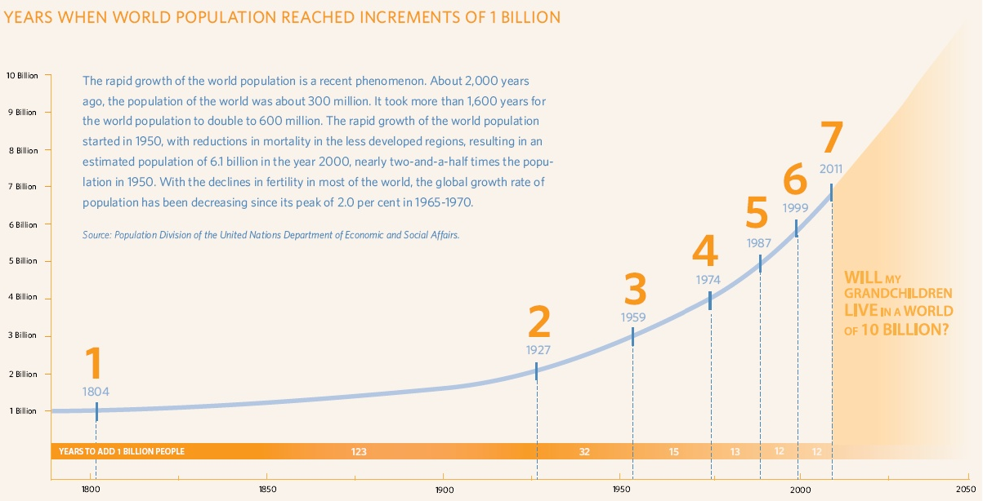
The Journey to 7 Billion

Slide 15
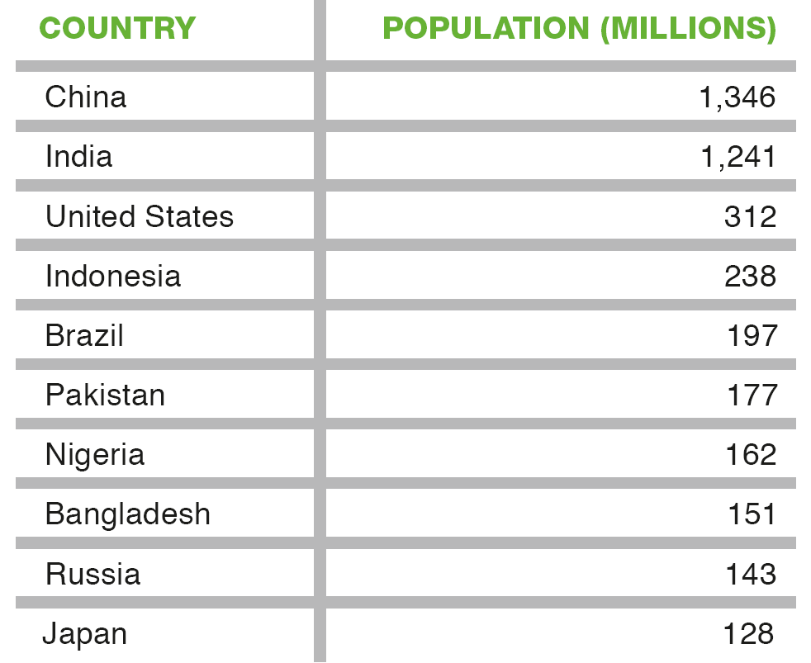
World’s 10 most populous countries, 2011

Slide 16
World Population
Year | Population (Millions) | Average Annual Growth Rate | Doubling Time
–2000 | 27 | 0.07 | 1,051
0 | 211 | 0.15 | 463
1800 | 945 | 0.42 | 163
1960 | 3,039 | 1.33 | 52
2000 | 6,071 | 1.25 | 55
5000 B.C. Agricultural Revolution
23.8 million in Shanghai, 2012

Slide 17
World Population
1750 Industrial Revolution
Between 1700 and 1900, Europe’s population increased from about 100 million to over 400 million

Slide 18
World Population
2010, 1.2%
In early 1960s, 2.2%

Slide 19
Population Profiles in the world, 1950-2050
Year | World | More developed regions | Less developed regions
 | Population (billion)
1950 | 2.5 | 0.8 | 1.7
2000 | 6.1 | 1.2 | 4.9
2011 | 7.0 | 1.2 | 5.7
2050 | 9.3 | 1.3 | 8.0
 | Annual Average population growth rate, %
1950-2000 | 1.8 | 0.8 | 2.1
2000-2050 | 0.8 | 0.2 | 1.0
68%
82%
86%

Slide 20
Population Profiles by Regions, 1950-2050
Year | Africa | Asia | Europe | Latin America | North America | Oceania
 | Population (billion)
1950 | 0.2 | 1.4 | 0.5 | 0.2 | 0.2 | 0.0
2000 | 0.8 | 3.7 | 0.7 | 0.5 | 0.3 | 0.0
2011 | 1.0 | 4.2 | 0.7 | 0.6 | 0.3 | 0.0
2050 | 2.2 | 5.1 | 0.7 | 0.8 | 0.4 | 0.1
 | Annual Average Population Growth (%)
1950-2000 | 2.5 | 1.9 | 0.6 | 2.3 | 1.2 | 1.8
2000-2050 | 2.0 | 0.6 | 0.0 | 0.7 | 0.7 | 1.1

Slide 21
Nearly All Future Population Growth Will Be in the World's Less Developed Countries.

Slide 22
Different Growth Rates across the World
world

Slide 23
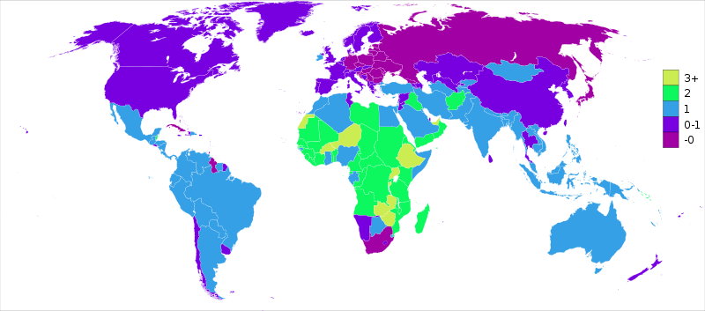
Population growth rate (%), 2010
Ethiopia
South Africa
Highest: Qatar: 9.56%, Liberia: 4.17%, Niger: 3.91%
Lowest: Lithuania: -0.55%, Ukraine: -0.54%, Bulgaria: -0.5%

Slide 24
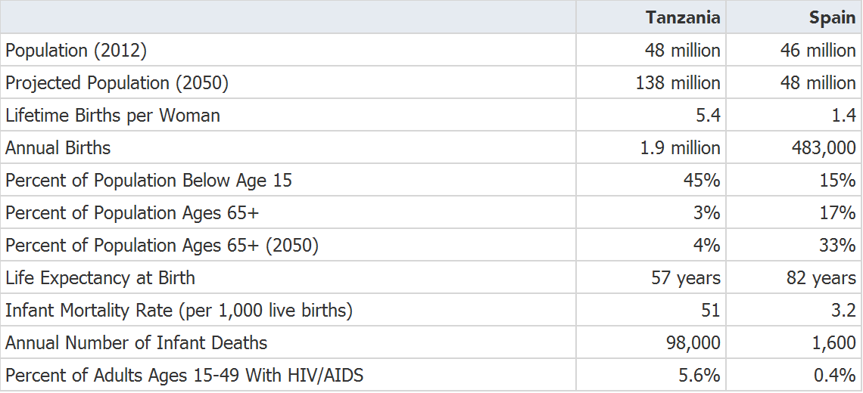
Comparison in Population profiles between Tanzania and Spain

Slide 25
Tales of two extremes
“In developing nations, where improvements in health care and sanitation are seeing death rates fall, birth rates still remain relatively high. This is leading to rapidly rising populations. In fact, 97 out of every 100 new people on the planet are currently born in developing countries.”
“In richer economies, although death rates are also low, widely-available birth control and a desire for smaller families keep birth rates subdued. Fewer babies ensures populations level off or even decline”

Slide 26
Government View on the rate of population growth (%)

Slide 27
Government View on the rate of population growth (%), by region, 1976

Slide 28
Government View on the rate of population growth (%), by region, 2009
35% in 1976
71% in 1976
38% in 1976
48% in 1976
14% in 1976

Slide 29
Population Growth of China and the World 1950-2010

Slide 30
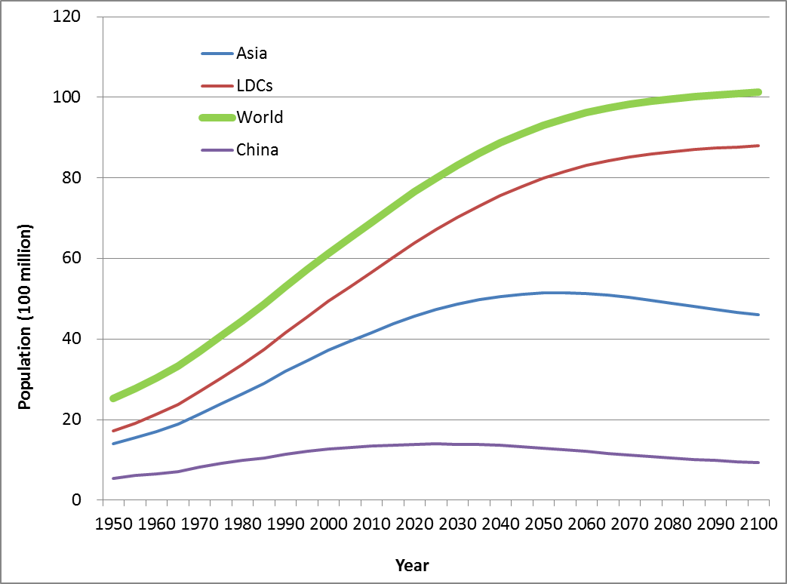
Population trends in China as compared to Asia, LDCs and the World, 1950-2100

Slide 31
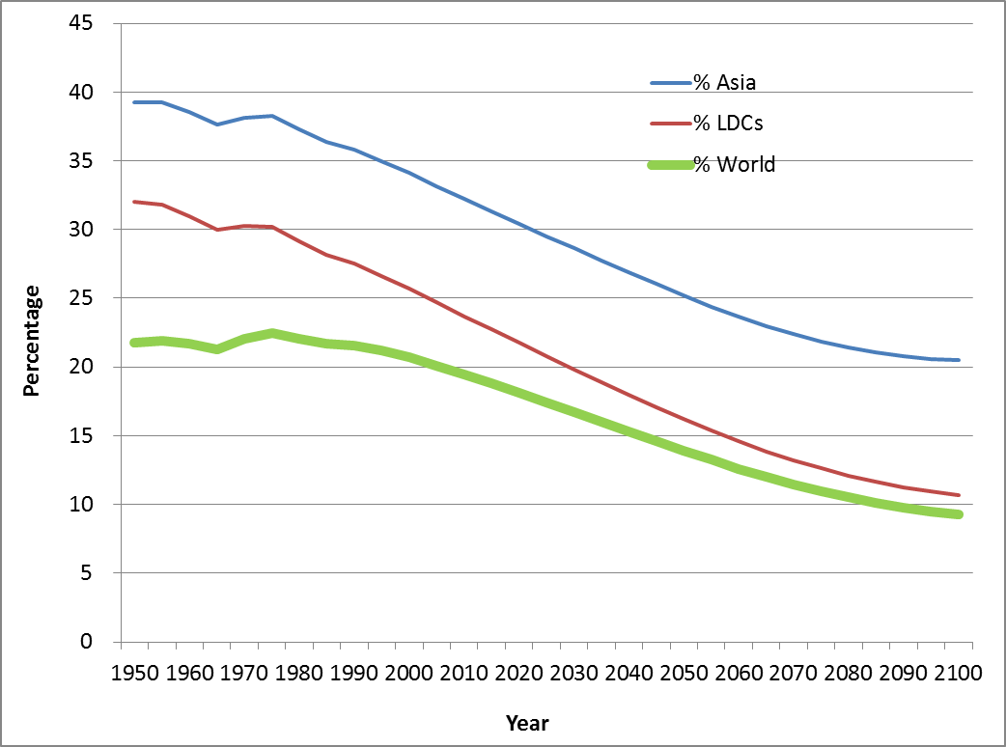
Share of China’s population in the world
32%
24%
20%

Slide 32
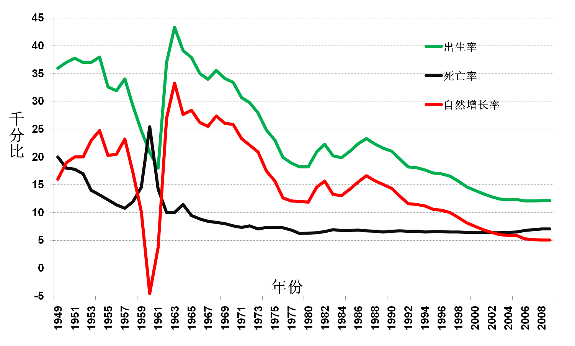
China's population growth, 1949- 2008
1970
25.8‰
1990
14.4‰
1950
16 ‰
1980
11.9‰
2000
7.6‰
2005
5.9‰

Slide 33
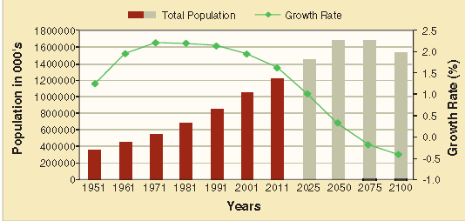
Indian Population Profile

Slide 34
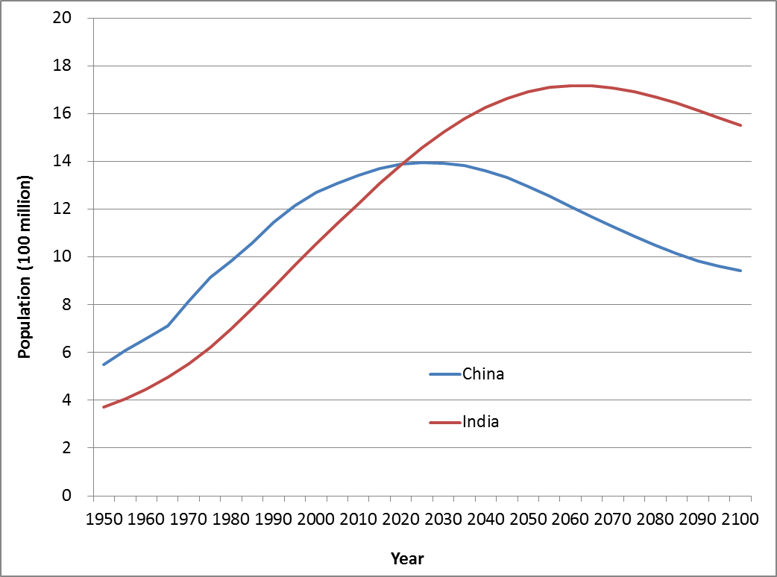
Population in China and India
1.72 billion, 2060
1.56 billion, 2100

Slide 35
Schedules for the 2nd Lecture
Measures of fertility
Fertility trends
Provincial variations in fertility
Fertility intension

Slide 36
Reading materials for the 2nd lecture
Morgan, S. Philip, Guo, Zhigang, and Hayford, R. Sarah. 2009. China’s Below Replacement Fertility: Recent Trends and Future Prospects. Population and Development Review 35 (3): 605-629.
Cai, Yong. 2010. China’s Below Replacement Fertility: Government Policy or Socioeconomic Development. Population and Development Review 36 (3): 419-440.

