Slide 1
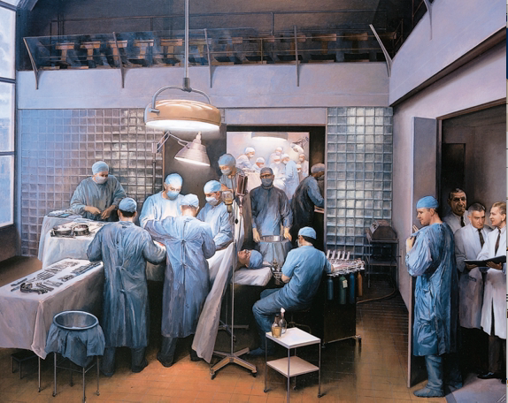
Every 30 seconds, a patient dies from diseases that could be treated with tissue replacement
3D Printing Organs

Slide 2
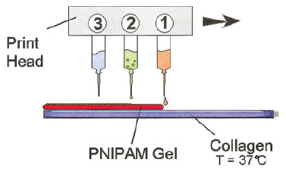
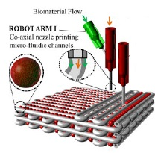
Organ Printing
Computer-aided additive biofabrication
of 3-D cellular tissue constructs
Cell + Gel

Slide 3
Step 1: Preprocessing

Slide 4
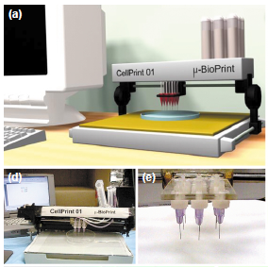
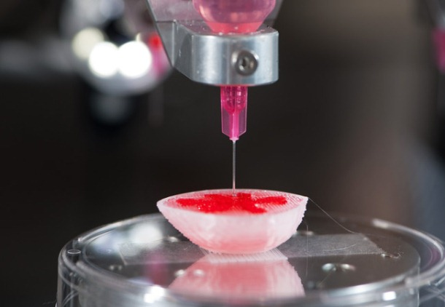
Step 2: Processing
Cell
9 solutions of cells
Gel
Thermo-reversible gels

Slide 5
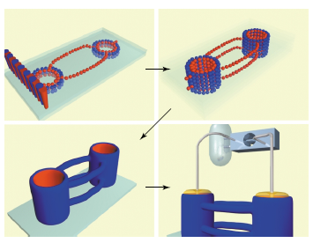
Step 3: Postprocessing
Pre-seeding
Post-implant
Vascularization

Slide 6
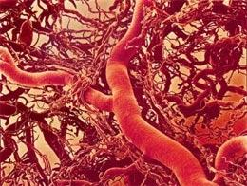
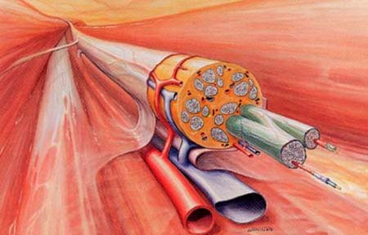
Challenges
Stem Cell
Blood Vessel
Nerve fiber

Slide 7
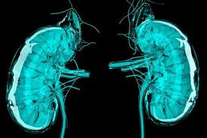
Conclusion
video
Challenging
Promising

Slide 8
References
[1] Ozbolat I T, Yu Y. Bioprinting Toward Organ Fabrication: Challenges and Future Trends[J]. IEEE TRANSACTIONS ON BIOMEDICAL ENGINEERING, 2013,60(3):691-699.
[2] Shu W W, King J. Organ Printing from Stem Cells[J]. GENETIC ENGINEERING & BIOTECHNOLOGY NEWS, 2012,32(13):48.
[3] Mironov V, Kasyanov V, Drake C, et al. Organ printing: promises and challenges[J]. REGENERATIVE MEDICINE, 2008,3(1):93-103.
[4] Boland T, Mironov V, Gutowska A, et al. Cell and organ printing 2: Fusion of cell aggregates in three-dimensional gels[J]. ANATOMICAL RECORD PART A-DISCOVERIES IN MOLECULAR CELLULAR AND EVOLUTIONARY BIOLOGY, 2003,272A(2):497-502.
[5] Mironov V, Boland T, Trusk T, et al. Organ printing: computer-aided jet-based 3D tissue engineering[J]. TRENDS IN BIOTECHNOLOGY, 2003,21(4):157-161.

