Slide 1
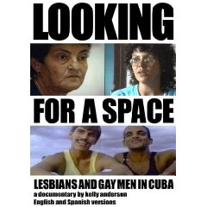
Recent documentary on Lesbian and Gay visibility in Cuba
媒介与社会性别精品课程专题演讲

Slide 2
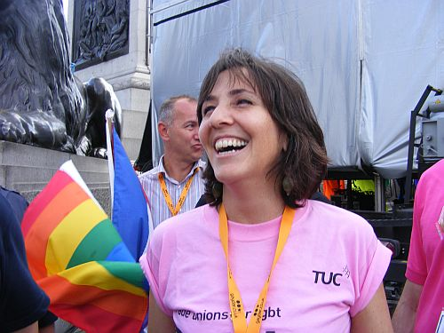
Mariela Castro Espín, Director of Cuba’s National Center of Sexual Education (CENEX) in a March for LGBT Rights in 2009

Slide 3
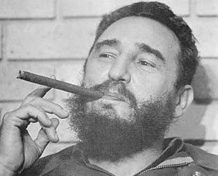
Fidel Castro

Slide 4
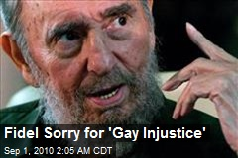
Castro recognizes and regrets injustice against gay people, 2010

Slide 5
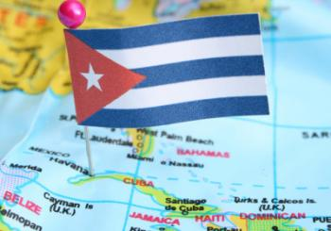
The island of Cuba, just off the coast of Florida, USA

Slide 6
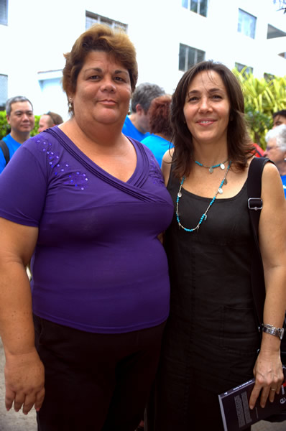
Cuba's first open, state-accepted male-to-female transsexual Mavi Suzell and Mariela Castro Espin

Slide 7
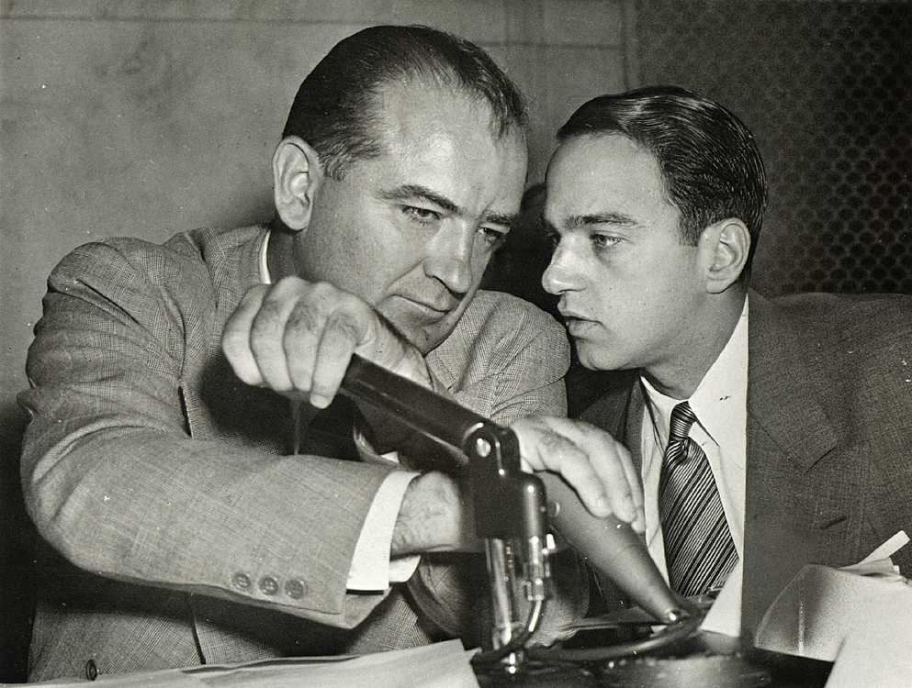
Eugene McCarthy and Roy Cohen,

Slide 8
The “Red Scare”: U.S. Anti-Communist Poster (late 1950s)

Slide 9
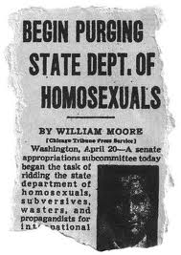
1960s Newspaper report on U.S. State Department “purges” of homosexuals,

Slide 10
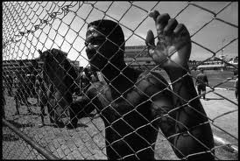
UMAP (Unidades Militares de Ayuda a la Produccion/Military Units to Assist Production, 1965-1968)

Slide 11
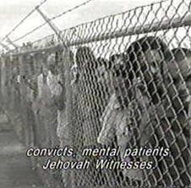
UMAP

Slide 12
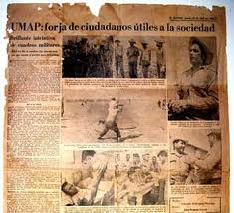
UMAP: forja ciudadanos útiles a la sociedad (forges citizens useful to society); contemporary Cuban newspaper report

Slide 13
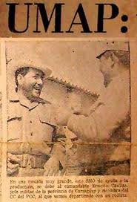
Cuban pamphlet celebrating the UMAP

Slide 14
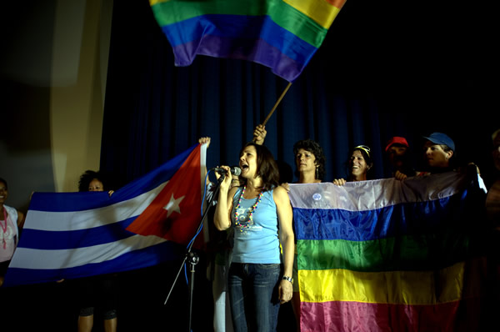
Mariela Castro Espín at a recent rally in Cuba for equal rights for queer people

Slide 15
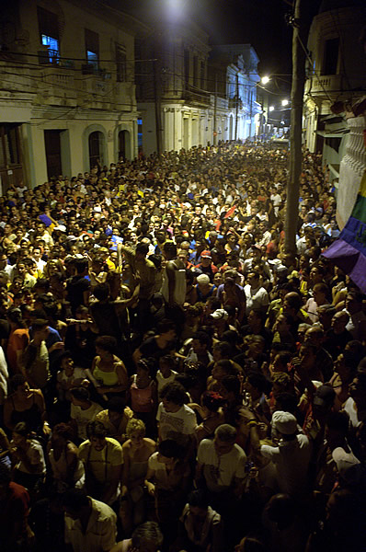
Recent officially supported rights-rally in Havana, Cuba (International Day Against Homophobia)

