Slide 1
PHIL110045 Artistic Charms of Chinese Traditional Culture
CHEN, Jia
School of Philosophy
Oct. 16, 2018

Slide 2
The Temple of Heaven

Slide 3
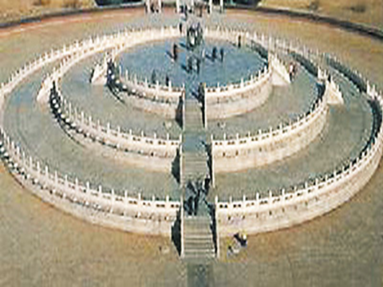
The Mysterious Number

Slide 4
The number of Nine
The quantity of alter faces, steps and components on the hand rail is nine or multiples of nine. So are the steps of the base of the Hall of Prayer for Good Harvest.
The surface of the uppermost terrace of the Circular Mound is paved with nine concentric rings of stone slabs; the round slab in the center is called the heavenly heart stone.
It is surrounded by 9 stones in the first ring, 18 in the second, up to 81 in the ninth ring, symbolizing the nine heavens.

Slide 5
Nine is the largest odd number : symbolizing the dignity of heaven;
When one ascends the steps to the alter, one enters a centripetal world to conduct a heaven and men communication.

Slide 6
The adoration of numbers had a long history in Chinese tradition
Since the divination through the use of stalks of the milfoil plant was based on the combination of varying numbers, it was not uncommonly held that the mystery of the universe is to be found in numbers.
Numbers were used to express the thought and wishes.

Slide 7
Week 5 The Eight Diagrams and Yin/Yang: the Idea of Changes
I. Two Ancient Models of Explaining the World: Yin/Yang and The Five Elements
II. The Formation of Eight Diagrams
III. The Book of Changes: The Unique Structure and the Idea of Changes

Slide 8
I. Two Explanatory Models
Views of the nature——explanations of the origin of cosmos and the classification of things in the world
—shaped in Shang/Western Zhou transition (1100 BCE)
—the beginning of the Chinese classical philosophy
—the philosophical foundation for Chinese aesthetics in remote ages.

Slide 9
Yin/Yang (阴阳): Yin/Yang school had its origin in the occultists. The occult arts share with science the desire to interpret nature in a positive manner, and to acquire the services of nature through its conquest by man.
The Five Elements/Five Phases (五行):
a preliminary learning of astronomy and geography based on the Yin/Yang idea； arises from the revolutions of the Five Power

Slide 10
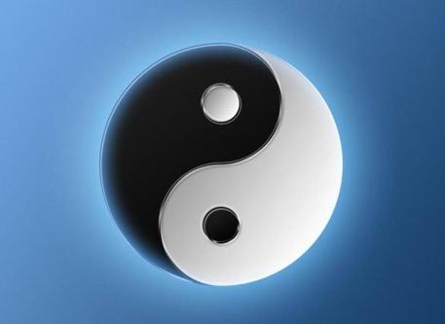
1、Complementary position of Yin/Yang
Yang (masculine principle of cosmology): positive, upward, progress
Yin (feminine principle): negative, downward, retreat
Complimentary and interchangeable relations between the two;
Mark the beginning of learning the world through an abstract, and theorized manner.

Slide 11
The school represents a scientific tendency in the sense that it tried to give a positive interpretation to natural events in terms solely of natural force.
During the Eastern Zhou Period (770 BCE-222BCE) , due to the dramatic social changes, a descending position of the “gods” was followed by the uprising position of the people.
The scope of concerns were no longer limited to the origin of cosmos and the classification of things, but more closely related to political issues.

Slide 12
2、the Five Elements 五行
Five avenues (literal meaning）
Five types (categorizations represented by five objects)—extended meaning
View of the nature—shaped in Shang/Zhou transition.
The first authentic account of the Five Elements—the Book of History, known as “Great Plan”. It is said to be the record of a speech delivered to King Wu of the Zhou dynasty by the viscount of Ji.

Slide 13
Five elements | Type | Nature of the element | Application
Water | Fluidity | to moisten and descend | Irrigation
Fire | Burning | to flame, ascend | Cooking
Wood | Plants | be crooked and straighten | Production
Metal | Melting | to yield and to be modified | Manufacture
Earth | Soil | to provide for sowing and reaping | Planting

Slide 14
A general classification of the cosmos phenomena, not merely referring to five actual objects, but five dynamic and interacting types/forces represented by five elements or categories.
“Harmony creates variety”—the origin of the world
Harmony: to blend different things for a mutual balance
Sameness: a simple unification lack of variety; unbeneficial to the development

Slide 15
The earliest systematic descriptions of the idea of Yin and Yang were developed in Zhouyi 《周易》—the Book of Changes
The idea of Five Elements—earliest appearance in the Book of Documents《尚书》 (historical records of Zhou Dynasty), one of the nine major laws of governance
During the middle and late age of the Warring Sates Period, these two studies were merged.
Till the Hanwudi (Emperor of Han, 156-87 BCE) , Zhouyi was regarded as the top of the Five Classics.

Slide 16
II. The Formation of Eight Diagrams

Slide 17
Eight Diagrams 八卦: An ancient Chinese system of divination based on symbolic trigrams and hexagrams； An encyclopedia of ancient Chinese cultural symbols.

Slide 18
Three Sages participated its creation
A) Fu Xi—created the Eight Diagrams
legendary figure, god of Chinese ancient culture
One day Fu Xi took a walk along the Yellow River, seeing a giant tortoise moving above the water. Inspired by the irregular cracks on the tortoise shell, Fu Xi created the Eight Diagrams.

Slide 19
A set of ancient meaningful symbols
UnDivided lines “——”: the element of Yang
Divided lines “— —”: the element of Yin
eight combinations of three divided or undivided lines formerly used in divination
each combination represented a certain type of things

Slide 20
1) Qian 乾—three Yang strokes—as Heaven (vigorous)
2) Kun 坤—three Yin strokes —as Earth (submissive)
3) Zhen震—one Yang stroke at the bottom, two Yin strokes above—as Thunder
4) Gen 艮—one Yang stroke on the top, two Yin strokes beneath—as Mountain (still)

Slide 21
B) King Wen of Zhou Dynasty — expanded the Eight Diagrams and developed into Sixty-four Hexagrams based on the rich record of divination since Shang Dynasty
Sixty-four Hexagrams—combining any two of the eight trigrams with one another into diagrams of six lines each.
clear political awareness of being prepared for unexpected development

Slide 23
C) Confucius — a new development — theorized studies
—philosophical ideas were entirely drawn from symbols and descriptions; no connection to divination any more
—this method of interpretation established the foundation for writing the Record of I Ching

Slide 24
III. The Book of Changes: The Unique Structure and the Idea of Change
1. Unique Structure
2. Images
3. The Idea of Change

Slide 25
1. The Unique Structure: words and images
1) Gua 卦 (divinatory symbols)—basic unit; 64 symbols in total (30 in the first part of book, and 34 in the second part)
2) Images of divinatory symbols (卦象) and divinatory lines (爻象)— the core of the Book
3) Explanatory descriptions of divinatory symbols and lines—words following images

Slide 26
Each symbol: six lines in total
names are assigned for each line as well as the symbol
From bottom-up: beginning, two, three, four, five, up
The Yang line was named as “nine”—beginning line of nine, nine two, nine three, nine four, nine five, up nine
The Ying line was named as “six”—beginning six, six two, six three, six four, six five, up six

Slide 27
Divinatory Line: means movement and change
Each line was a temporal and spatial point: a space-time unit. Lines were read from bottom-up, which demonstrated a developing process from the lower stage to a more advanced position, from the beginning to the mature.
It demonstrated the flow of life, not a still life

Slide 28
2. Image
Artificial images represent important human effort .
Entirety
Iconicity
Polysemy
Symbolic (instead of physical) representations: supplementary to the conceptualization of words and their limits
Symbolic significance: small/less/finite can be symbolic of large/more/infinite
A combination of concrete and generalized, perceptual and abstract

Slide 29
3. The idea of change
Based on the complimentary relation of Yin/Yang, the Book of Changes further developed the idea of change as the result of contradiction.
The change can be witnessed in the developing process of the order of 64 hexagrams.
Different meanings were rendered according to the change in the alignments of lines.

Slide 30
Example: the description of the lines in the divinatory symbol of “Qian” : using a dragon as the analogy to explain a philosophy of life
The 1st line—“hidden dragon had no appearance”—one should wait for the right times, just like a hidden dragon beneath the water
The 2nd line —one should display only a small part of her talent
The 3rd line—a well-cultivated person should always act with caution

Slide 31
The 4th line—observe the times and judge the occasion; wait for the proper moment to act—just as a dragon jumps out and then hides again so as not to be recognized its head and tail
The 5th line—the best timing—like a dragon flying in the sky
The 6th line—the dragon flies to a place too high to be safe—a lesson of not going too far

Slide 32
From hidden under the water to realize one’ s ambition, and then to the warning of not to be over conceited: as the timing change constantly, one should adjust her behavior and manner accordingly
The Book was actually teaching lessons of the adaptation to changes.
Cosmos, as a space for lives, was a living space featured by a process of changing.

Slide 33
Also, the principles of artistic creation were embodied in the Book of Changes.
—pursuit of artistic conception of vividness
—expression of living life
Chinese calligraphy was in its essence the embodiment of the principle of Yin/Yang.
Yang: agile, nimble;
Yin: slow-moving

Slide 34
Thanks！
And to be continued…

