Slide 1
英语口译
4
Education and Campus

Slide 2
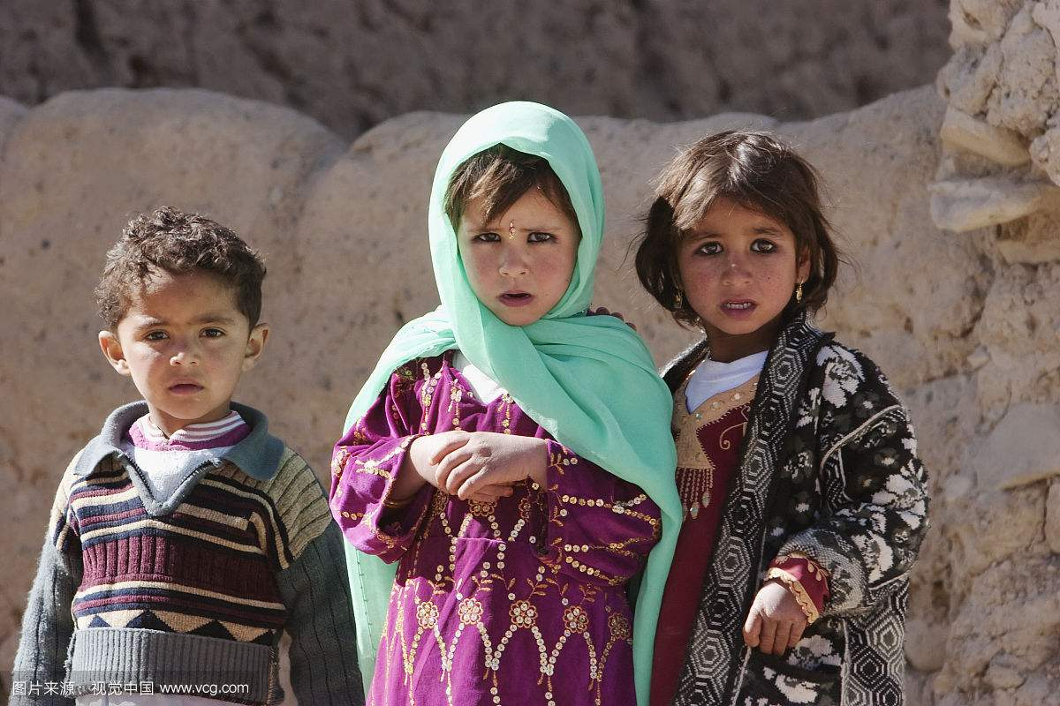
Warming up: listen, understand and retell
Educating girls in Afghanistan

Slide 3
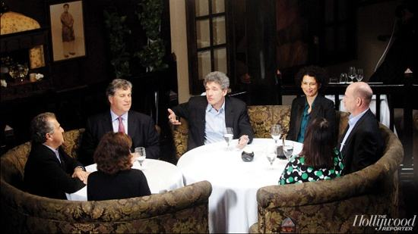
Warming up: Listen and Understand
“Vocational Education Becoming a Better Choice?” (from CRI)
a. What is the main idea of the news story?
b. How many parts can you divide the story into?
c. Can you retell as much info as possible in each part?

Slide 4
One-on-one interpreting
a. E-C, and ask the speaker:
How do you rate your partner?
Any mistakes to correct?
Can you explain the logic flow in your report?
b. C-E, and ask the speaker:
How do you rate your partner?
Any mistakes to correct?
Can you suggest ways of interpreting Chinese-specific expressions in your report?

Slide 5
Vocabulary: Vie to answer first!
key words:
future-oriented, diversity, well-balanced, sustainable, to eliminate, illiteracy, science-illiterate, compulsory education, revenue, to be powered by, human capital, the under-privileged, access to education, tuition, student grant, frontier technology, cutting-edge science, boarding school, interdisciplinary, to specialize in, extra-curricular

Slide 6
Important Skill: Take Notes
listen and understand tell key information take notes
Q: in what language?
Using short-hand:
1) fr, mo
econ, eco
dev, dec (↓)
inc (↑)
2) CHN
MKT

Slide 7
Using symbols
∵
∴
:
//
☆
。y
D。
()
√
⊙
O (So)
↑
↓
←
→
＋
－
×
∧ (∧o)
﹠
□
□.
﹥﹤
U

Slide 8
practice
袋鼠共和国去年遭遇了青草(歉收)，再加上与其他动物种族的冲突，造成了许多未成年袋鼠的(死亡)。议会召开紧急会议，通过了进口粮食、签署停战协议等措施，今年国内形势已经出现(好转)。

Slide 9
The traditional and the new ways of classroom education are somewhat at conflict with each other, as the former approaches education from the perspective of how teachers plan, teach, and evaluate; while the latter does so from the perspective of how students query, learn, and answer. However, it is hard to judge which way is better. More often, teachers of the 21 century combine both in their classrooms.

Slide 10
我们同英国朋友，再次聚首在美丽的泰晤士河畔，召开我们的第三次大会， 我谨代表参加此次会议的中方代表，感谢英方的盛情邀请和精心安排。自去年的大会以来，中国又发生了很大变化。

Slide 11
Practice
  C-E P-3
 E-C P-6
(from course audio archive)

Slide 12
Talk, listen and interpret
Are you happy about the schooling system in China? Say one thing that you like/dislike most about it. (in either Chinese/English)
An interpreter will render your words into English/Chinese!

Slide 13
Homework
1) Vocabulary for “Ecological Environment”
2) One-on-one interpreting

Slide 14
Important Skill 2: Interpreting proper nouns
Example -- an interesting difference:
“Giant” (bicycle brand)
Translation in Taiwan China: 巨人牌
（strategy 2:paraphrasing and explaining）
Transliteration in mainland China: 捷安特牌
（strategy 1:transliteration）

Slide 15
Important Skill: Noting the structure of source passage
 E-C Audio-3 (from course video archive)
1. Quick analysis while you listen:
parallel structure √
Ladder structure ×
2. Report on the features of the different kinds of universities you hear, with the help of the parallel structure.

Slide 16
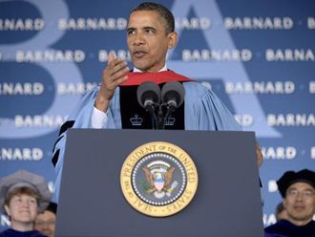
Interpret for Obama!
 Obama’s speech at Barnard Commencement
Take turns to interpret.
Question: what does an interpreter do when he/she has not fully understood the speaker?

