Slide 1
HEART TRANSPLANT
10301010046 宋子贤
10301010045 曲扬

Slide 2
Keyword
Heart transplantation
Cyclosorin A (CsA)
Immunosuppressant（Immunosuppressive medication）
Complication
Prognosis
Orthotopic procedure
Heterotopic procedure
心脏移植
环孢菌素A
免疫抑制剂 爱上大开发框架阿三dv卡深v为vnw阿斯顿话费卡收费会卡死
并发症
预后
原位过程
异位过程

Slide 3
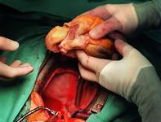
History
Bible and some Chinese myth
First adult heart transplant: December 3, 1967

Slide 4
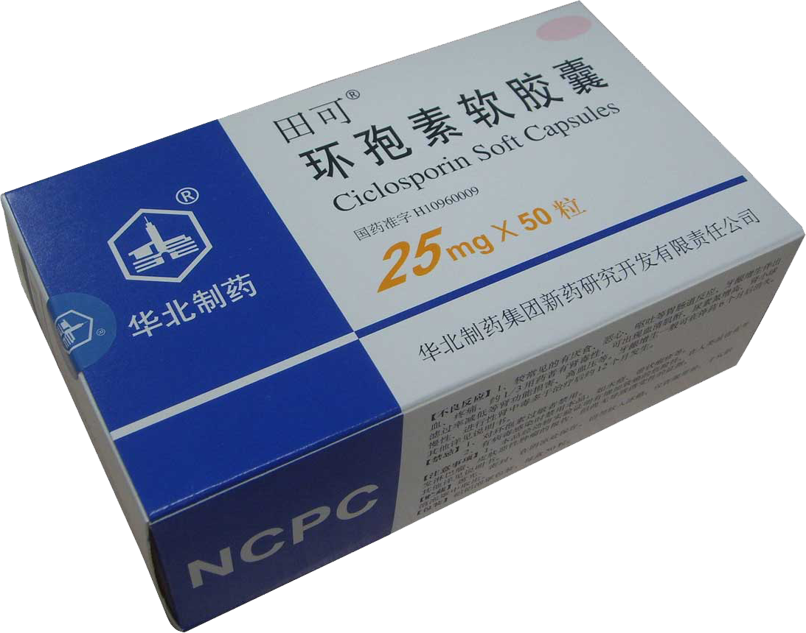
History
Breakthrough : Cyclosporin A in 1994

Slide 5
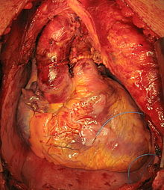
Procedures
Operative
Orthotopic procedure
Heterotopic procedure
'Living organ' transplant

Slide 6
Limitation
Not suitable for：
Patients with
kidney disease
lung disease
liver disease
some vascular disease

Slide 7
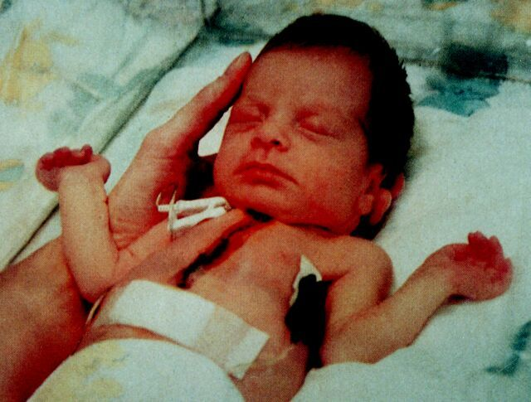
Complication
Side-effects of the immunosuppressive medication
Increased likelihood of infections
Fever
Pain

Slide 8
Prognosis
 | Male | Female
1 year survival rates | 88.0% | 86.2%
5 year survival rates | 73.2% | 69.0%
More than 30200 people have been benefited from heart transplant.

Slide 9
Reference
1 ª ^{b} Till Lehmann (director) (2007). The Heart-Makers: The Future of Transplant Medicine (documentary film). Germany: LOOKS film and television.
2 "Memories of the Heart". Doylestown, Pennsylvania: Daily Intelligencer. November 29, 1987. p. A–18.
3 Reiner Körfer (interviewee) (2007). The Heart-Makers: The Future of Transplant Medicine (documentary film). Germany: LOOKS film and television.
4 Custodiol Htk Solution patient advice including side effects
5 "Bad Oeynhausen Clinic for Thorax- and Cardiovascular Surgery Announces First Successful Beating Human Heart Transplant". TransMedics. 23 February 2006. Retrieved 2007-05-14.
6 Bishay, R. The ‘ Mighty Mouse’ Model in Experimental Cardiac Transplantation. Hypothesis 2011, 9(1): e5.
7 Heart Disease and Stroke Statistics--2012 Update The American Heart Association. Retrieved 27 November 2012.

Slide 10
Q & A
Thank you for listening！！

