Slide 1
英语口译
I
Introducing Interpreting

Slide 2
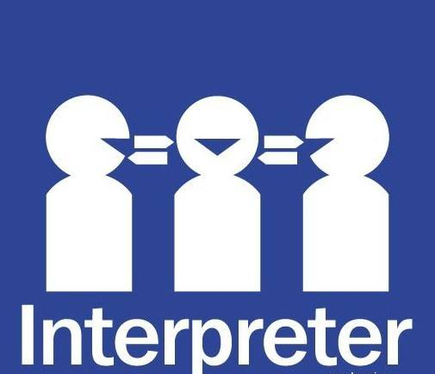
Relating to your experience
Do you have any experience translating/interpreting for people?
What, in your understanding, is translation/interpreting?

Slide 3
Brainstorm and talk
1. Do you think a bilingual person is naturally an interpreter?
unbalanced/balanced bilingual
2. Which is more difficult, translating or interpreting?
3. Interpreting is normally divided into two types, what are they?
4. Can you make a living as interpreter?
5. Will AI replace human beings as interpreters?
6. What are the key skills for one to be an interpreter?
听辩与理解，脱离词语外壳，贮存与笔记，译语表达
7. Does practicing interpreting help learning English?

Slide 4
What we do
How we arrange the course
Training basic qualities of an interpreter
 Equipping you with skills & vocabulary
 in the order of thematic situations

Slide 5
Evaluation
Attendance & performance (10%)
One-minute Reciprocal interpreting (10%)
2 Quizs (20%)
1 final exam(60%)
Please refer to course schedule!

Slide 6
Instructor’s Information
Experience
Contact info: ddxiang@fudan.edu.cn
Office hour: Thur. 14:00-16:00
文科楼 506

Slide 7
Textbook and Materials
向丁丁，丁小龙：《英语口译教程》，复旦大学出版社，2011
You are expected to bring something into the class!
bilingual news report

Slide 8
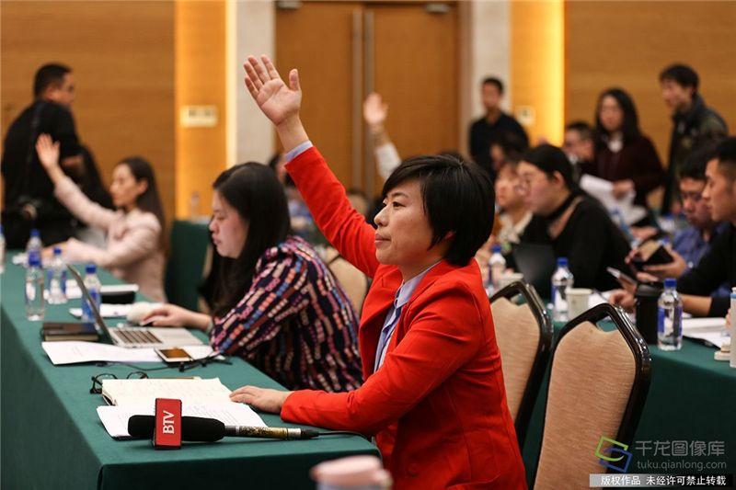
Mock press conference
Please raise questions about and Comments on the Course, and an interpreter will assist our talk.
(Journalists and interpreter)

Slide 9
Try it out!
1. from English to Chinese
(Without/with note-taking)
 郝景芳雨果奖获奖演说
(videos/教学用的视频)

Slide 10
What happens on the scene?
What if you didn’t catch what the speakers say?
Will speakers pause for you?
Will you get the script beforehand?
How do you want to impress the audience?

Slide 11
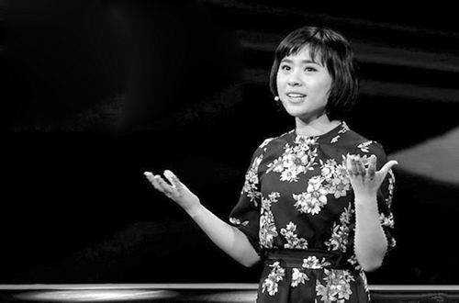
2. from Chinese to English
 北大刘媛媛演讲http://www.dxsbb.com/news/3919.html

Slide 12
How do you feel about it?
Are you excited/nervous/… as an interpreter?
Which is more difficult?
What are your difficulties?

Slide 13
Pair work
Interpret for each other:
Self-introduction
Major
A theory
A story

Slide 14
Homework
1. Preview vocabulary for “visit and reception”
2. Prepare for “one minute report for interpreting”

