Slide 1
Security Dilemma
-A brief introduction
Xu Ting 14307090136 International Politics

Slide 2
Contents
01
Definition of Security Dilemma
02
Features of Security Dilemma
03
Typical Examples of Security Dilemma
04
Remedies for the dilemma

Slide 3
Definition
The growth of Athenian power, which putting the Lacedamonians into FEAR, necessitated the war.
THUCYDIDES, BOOK I , XXVI

Slide 4
Definition
- Coined by John H. Herz in his 1951 book Political Realism and Political Idealism
- Also referred as the spiral model
Conflicts
Tensions Increase
States B responds with similar measures
State A intends to heighten its security

Slide 5
Features
A
benign intention
B
unresolvable uncertainty
C
self-defeating/paradoxical policies

Slide 6
Examples
Major European powers' fear
Germany's fear
World War I
In turn, the onset of German mobilization put pressure on other states to start mobilizing early as well.
War broke out in 1914.
Notes:
模板来自于 http://docer.wps.cn

Slide 7
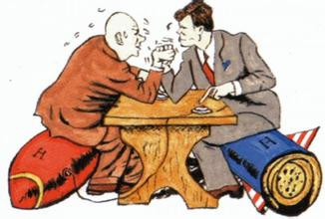
Another Example: The Cold War
Armament of United States & Soviet Union from 1968 to 1978

Slide 8
Remedies
Barry Buzan: mature anarchy
Robert Jervis: security regimes
Aleksander Vinter: perception rebulit

Slide 9
@Xu Ting

