Slide 1
Regionalism in Asia (GOVT 518) May 2015

Slide 2
Topics
What is Regionalism?
What is the ASEAN Regional Architecture?
How do APEC and ASEAN work?
Underlying factors causing regional integration?

Slide 3
Regionalism and Regionalization
Regionalization: conceived as an undirected process of growing interdependence which originates in the actions of individuals, groups and corporations rather than through the deliberate actions of national governments
Regionalism: refer to the conscious and deliberate attempts by national states to create formal mechanism for dealing with common transnational issues through intergovernmental dialogue and treaty.
These two types of processes are not necessarily mutually exclusive. Some see regionalism as a response to regionalization. (Breslin, 2004).

Slide 4
When and how did the term ‘Asia-Pacific’ arise?
Asia-Pacific is a relatively new name. The new century has been called ‘the Pacific Century’
“Asia-Pacific” constitutes an imprecise geographical descriptor. popular from the late 1980s
The inclusion of other countries is largely based upon the economic relationships between them and their East Asian trading partners
United States constitutes the hegemonic power within the Pacific Rim
APEC has helped to understand and define the notion of a wide Asia-Pacific region.

Slide 5
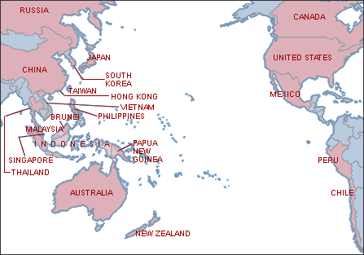
Asia-Pacific Regional Map and APEC Members
This region would comprise approximately 41% of the world's population, approximately 56% of world GDP and about 49% of world trade. (APEC estimations)

Slide 6
What is multilateralism?
“the practice of coordinating national policies in groups of three or
more states.”
(Robert Keohane in “Multilateralism: An Agenda for Research.” International Journal, 45,
Autumn 1990)
Why…multilateralism?
The challenges of security, peacekeeping, disease control, human rights
violations, and pollution, among others, are too vast and complex for any
nation or group of nations, no matter how powerful, to effectively manage on
its own.
{terrorism, cross-border drug trafficking, human trafficking, pandemics,
environmental disasters etc.}
What examples in your countries where multilateralism is occurring? Should be occurring?
Objectives of multilateralism
to foster constructive dialogue and regular consultations on political, economic
and security issues of common interest and concern; and,
to make significant contributions to efforts towards confidence-building and
preventive diplomacy

Slide 7
Three Pillars of Multilateralism
Indivisibility –
the scope (both geographic and functional) over which costs and benefits are
spread
Generalized principles of conduct -
norms exhorting general if not universal modes of relating to other states
Diffuse reciprocity -
Emphasizes the need for a long term perspective and the need for mutual
benefit on many issues rather than on a case by case basis.

Slide 8
Driving forces in Asia-Pacific -1
Increased economic integration/ interdependence of trade, financial flows, direct investment/production, and other forms of economic/social exchange (e.g. migrant labor, educational qualifications). (‘markets lead, governments lag’? ), sometimes involving security risks, too (biosecurity, flight safety)
Continuing national security concerns that affect multiple countries (North Korea, South China Sea, terrorism), as well as non-traditional security issues (e.g. water)
Regionalism is a relatively new aspect of Asia’s rise.

Slide 9
Driving forces in Asia-Pacific -2
Asia is endowed with factor advantages: large and diverse labor forces, ample investment resources, growing technological capabilities, as well as developed transport links, communication, and banking. Also, entrepreneurial spirit and, in some countries, good security.
Countries upward development and participation in different stages of the production networks.
Pattern of FTAs, but recognized need for greater financial development and stability. Also, need for sustainability.

Slide 10
East Asian Developmental Phenomenon: Flying Geese
Theories based on the Western experiences are of little use in explaining Asia-Pacific development.
Flying Geese Pattern is the most prominent theoretical model of East Asian economic development to explain the catching-up process led by Japan as the first newly industrializing economies (NIEs).
Alignment of the economies in this pattern is according to their level of industrialization, and the hierarchical connotation.
China’s leapfrogging due to its privileged position as a latecomer, with both its huge economy and growing domestic market, signifies a challenge to this formation.

Slide 11
Integration in East-Asia
Market forces are a major promoter of regional economic integration in East Asia, opposing to a more institutionalized integration in other regions in the world.
East Asian integration is driven by the interaction of three majors elements: regional production networks, ethnic business networks and sub regional economic zones.
Now, need to address issues :
of free people movement
health issues (infectious diseases)
water management
human trafficking
refugees
financial reform/coordination
security disputes (South China sea, etc)

Slide 13
Features of Multilateralism – Positive & Negative
Positive features
Multilateralism is based largely upon the principle of ‘diffuse reciprocity.’ Nations cooperate because they will benefit in the aggregate.
Multilateralism provides developing states with a greater voice in international matters.
Multilateralism facilitates mutually beneficial trade-offs between developed and developing states.
Multilateralism is the most egalitarian form of international cooperation and decision-making.
Multilateralism and multilateral institutions provide a more democratic means of determining which global issues should be addressed and how states should address them.

Slide 14
Cont’d
Negative features
Multilateral agreements for developing countries are a risk as they sign and enter a regulatory framework favoring organized systems and are legal instruments drafted by successful states to maintain their absolute advantages
Multilateralism has its positive features but exposes the weak and tardy financial and technological resource base of developing countries to that of advanced countries. (ex. International Law and Developing countries…the lack of resources) (i.e., welcome foreign investment, but want to maintain control)
Industrialized nations dominate the policy making processes of multilateral institutions and thrust policies on developing countries through the instrument of multilateral institutions ex. World Bank (Structural Adjustment Programs).

Slide 15
Jan-Erik Lane: Regionalism in Asia-Pacific
Politics is the driving seat, especially foreign policy
SAARC (South Asian Association for Regional Cooperation), Association of South-East Asian Nations (ASEAN), and Asia-Pacific Economic Cooperation (APEC) endorse free trade and do not favor strong regionalism (institutions above the state) - example of weak and open regionalism.
Pacific Islands Forum – group of island states with high tariffs, not yet a free trade agreement (PICTA)
Update: TPP, RCEP in the near future?

Slide 16
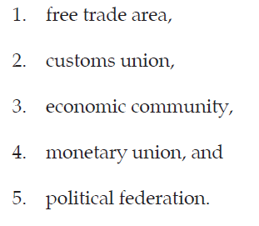
Balassa’s 5-stage model of region integration:
Economic benefits from cooperation leads to greater integration for four (4) “liberties:” people, capital, goods and services.
EU follows this five-step model, but closed and profound institutional cooperation need not always occur:
← APEC, SAARC aims
← ASEAN aim

Slide 17
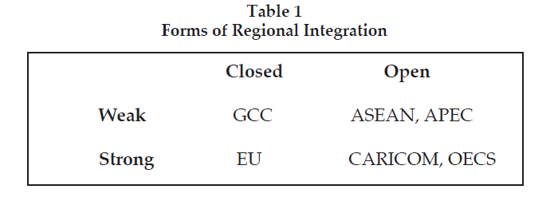
Free trade is easy to set up, but strong economic integration includes customs unions and economic regulation which states may not wish to give up.
GCC = Gulf Coop Council; CARICOM = Caribbean Common Market; OECS= Org of East Caribbean States

Slide 18
Types of Regional Economic Integration
Regional economic integration (EI) refers to Regional Trading Agreements, which are used as a way to promote competition within the region and also make the region more competitive at a global level.
 | Free Trade among members | Common external tariffs | Free mobility of production factors | Coordination of all economic policies, including fiscal and monetary policy
Free Trade Area (FTA) | V
Customs Union | V | V
Common Market | V | V | V
Economic Union | V | V | V | V

Slide 19
Economic Integration
Process of building regional systems that increase the economic interaction whereby economic exchanges increasingly transcend national boundaries. More inclusive that the conventional definition, which defines EI as just different levels of trade of blocs.
The deepening on intra-regional economic interdependence in a given region, through intra-regional trade, FDI and harmonization of commercial regulations, standards and practices.
The study of regional integration is not always efficacious for studying Asia-Pacific. Regionalism as a sub-set of political economy has been heavily influenced by the European experience.

Slide 20
Political Factors in Regionalization
Political stability and predictability are major priorities of governments (also further democracy/regime, human rights)
Governments want/need to engage with neighboring states, even when there is disagreement.
Meetings may not resolve deep differences, but provide time for solutions to occur, or events to pass by.
Regional forums bring many heads-of-state in direct contact with each other – more direct than embassies, etc .
Democracy and human rights may be important priorities.
Some matters are of bi-lateral nature, such as border crossings, air traffic, etc.

Slide 21
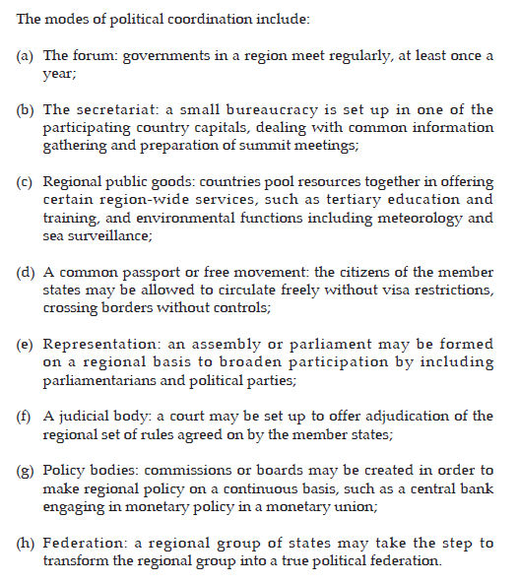
Asian political integration not yet very far…..just (a) and (b)….

Slide 22
ASEAN Regional Forum
An informal multilateral dialogue of 27 members about security issues in the Asia-Pacific region.
Includes ASEAN members +3 (PRC, Japan S. Korea) + “EA Summit” (Australia, India, NZ, Russia and USA) + other: Bangladesh, Canada, Mongolia, North Korea, Pakistan, Sri Lanka, and European Union + observer states (PNG, Timor- Leste)
Working groups (“track two” meetings) may include Taiwanese specialists (in individual capacity). (“track one” meetings are among foreign ministers)
ASEAN Asian Regional Forum (ARF) meetings may reduce the opportunity and desire for using power

Slide 23
Why the Asia-Pacific region should promote its integration in a more institutionalized way?
The lack of formal trade agreements began to change rapidly, mainly because of two factors: the AFC in 1998 and the arrival of China as a major player in the region.
The AFC showed that Asia-Pacific economies are highly regionalized, since the linkages among Asian economies, mostly informal in nature, often appears “invisible” to many in the West.
Regional cooperation by generating intra-regional demand could supplement the external demand and reduce the vulnerability of the region due to over dependence on outside regions.
The Asian region combines some of the fastest growing economies in the world. Together they form a huge market that is growing faster than any other region in the world and could form a vibrant regional grouping that would be roughly of the size of the EU in terms of GDP, will have larger magnitude of trade than NAFTA and international reserves bigger than those of the EU and NAFTA put together.”

Slide 24
ASEAN
1961:- Association of Southeast Asia (ASA), The Philippines, Malaysia and Thailand.
1967: ASA+ Indonesia and Singapore form ASEAN (anti-communism, econ development)
1984: add Brunei, 1995, Vietnam, 1997 Laos, Myanmar, 1999 Cambodia.
1997: ASEAN +3 (PRC, South Korea, Japan)
Economic Area:
1992: Common Effective Preferential Tariff (CEPT), later ASEAN Free Trade Area (FTA)
2009: Free Trade Agreement with ASEAN block and Australia + NZ

Slide 25
2015: ASEAN Economic Community almost fully created: goals of being a single market and production base, fully integrated in global economy, equitable development, competitive region, and economies open to foreign investment. (For example, unified aviation market, etc)
Security
The ASEAN way: ideals of non-interference, informality, minimal institutionalisation, consultation and consensus, non-use of force and non-confrontation
1995: Southeast Asian Nuclear-Weapon-Free Zone Treaty
ASEAN Regional Forum as dialogue (excl. Taiwan and cross-strait issues).
Other
2002-: ASEAN Agreements on Transboundary Haze Pollution
2005: ASEAN Wildlife Enforcement Network
1995- Human Rights working group

Slide 26
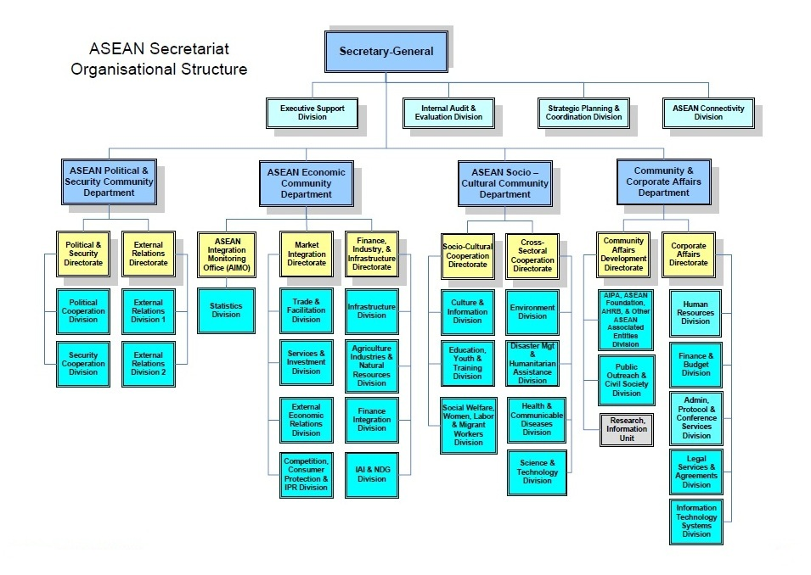
ASEAN Operations
Secretariat (Jakarta), supporting Three Communities of Activity.

Slide 27
ASEAN Political-Security Community
ASEAN Intergovernmental Commission on Human Rights (AICHR)
ASEAN Ministerial Meeting (AMM)
ASEAN Regional Forum (ARF)
ASEAN Defence Ministers Meeting (ADMM)
ASEAN Law Ministers Meeting (ALAWMM)
ASEAN Ministerial Meeting on Transnational Crime (AMMTC)
ASEAN Economic Community
ASEAN Economic Ministers (AEM)
ASEAN Free Trade Area (AFTA Council)
ASEAN Ministers on Energy Meeting (AMEM)
ASEAN Ministerial Meeting on Agriculture and Forestry (AMAF)
ASEAN Finance Ministers Meeting (AFMM)
ASEAN Investment Area (AIA) Council
ASEAN Ministerial Meeting on Minerals (AMMin)
ASEAN Ministerial Meeting on Science and Technology (AMMST)
ASEAN Mekong Basin Development Cooperation (AMBDC)
ASEAN Transport Ministers Meeting (ATM)
ASEAN Telecommunications and IT Ministers Meeting (TELMIN)
ASEAN Tourism Ministers Meeting (M-ATM)
Initiative for ASEAN Integration (IAI) and Narrowing the Development Gap (NDG)
Sectoral Bodies under the Purview of AEM
Scorecard: http://www.asean.org/resources/publications/asean-publications/item/asean-economic-community-scorecard-3

Slide 28
ASEAN Socio - Cultural Community
ASEAN Ministers Responsible for Culture & Arts (AMCA)
ASEAN Ministerial Meeting on Disaster Management (AMMDM)
ASEAN Education Ministers Meeting (ASED)
ASEAN Ministerial Meeting on Environment (AMME)
COP to AATHP (Conference of the Parties to the ASEAN Agreement on Transboundary Haze Pollution)
ASEAN Health Ministers Meeting (AHMM)
ASEAN Ministers Responsible for Information (AMRI)
ASEAN Labour Ministers Meeting (ALMM)
ASEAN Ministers Meeting on Rural Development and Poverty Eradication (AMRDPE)
ASEAN Ministerial Meeting on Science and Technology (AMMST)
ASEAN Ministerial Meeting on Social Welfare and Development (AMMSWD)
ASEAN Ministerial Meeting on Women (AMMW)
ASEAN Ministerial Meeting on Youth (AMMY)
Videos about ASEAN:
https://www.youtube.com/watch?v=8fU_n2g60q4 (example issue: haze)
https://www.youtube.com/watch?v=-cz2LvpS_z8 (single market)
https://www.youtube.com/watch?v=d47--SRYYNo (disaster relief)
https://www.youtube.com/watch?v=i1ZJbtvaZjw (organizing)
World Economic Forum/Fareed Zakaria: https://www.youtube.com/watch?v=DZX2fdVW3XU

Slide 29
APEC
1989: Australia calls for more better economic cooperation and hosts a 12-country meeting in Canberra.
Annual leaders’ meetings since 1993, with many meetings leading up that.
1994: APEC leaders adopt goals for free and open trade (“Bogor Goals”). Three Pillars: (i) trade and investment liberalization, (ii) business facilitation, (iii) economic and technical cooperation.
2001: Broadening the APEC Vision, Clarifying the roadmap to Bogor, e-APEC Strategy, promote entrepreneurship and human capacity building.
2006: Formal proposal for Asia-Pacific Free Trade Area, WTO Doha Round discussion.

Slide 30
2011: commit to taking concrete steps toward a seamless regional economy; addressing shared green growth objectives; and advancing regulatory cooperation and convergence. To reach these goals, APEC resolves to reduce, by the end of 2015, applied tariff rates of environmental goods to 5 percent or less.
2013: APEC Leaders endorse a multi-year plan on infrastructure development and investment. To encourage people-to-people connectivity, APEC seeks to promote cross-border cooperation with the target of 1 million intra-APEC university students per year by 2020. APEC holds its first joint Ministerial Meeting on Women and SMEs to promote women entrepreneurship.

Slide 31
APEC Operations
APEC Secretariat and Policy Support Unit, located in Singapore.
Secretariat supports approx. 40+ APEC (working) groups. For example, Rules of Origin, Sub-Committee on Customs Procedures, Food Security, Ocean and Fisheries Working Group, Mining Task Force, Market Access Group, Intellectual Property Rights Experts Group, Human Resources Development Working Group, Health Working Group, Finance Ministers' Process, Energy Working Group, Emergency Preparedness Working Group, Electronic Commerce Steering Group, Counter-Terrorism Working Group, Competition Policy and Law Group, Automotive Dialogue, Anti-Corruption and Transparency Experts' Working Group, etc etc etc.

Slide 32
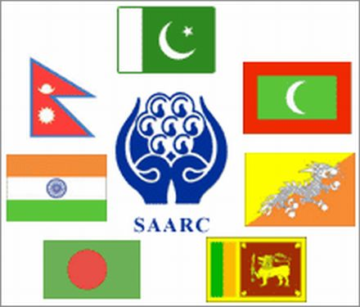
SAARC – South Asian Association for Regional Cooperation

Slide 33
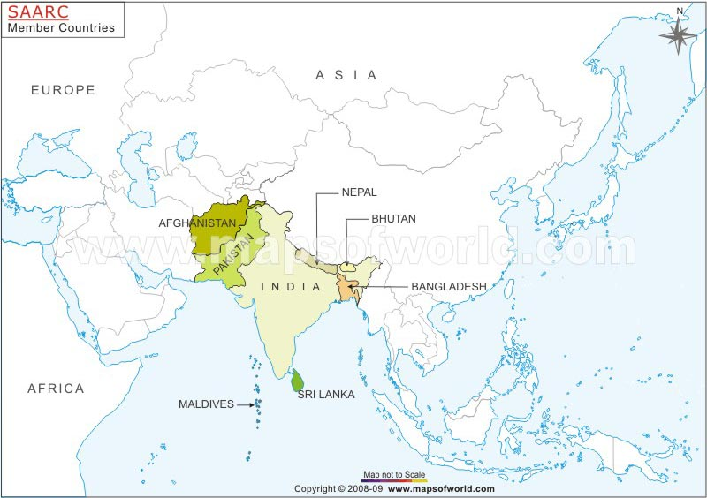
Member countries of SAARC

Slide 34
SAARC in action…
Founding of SAARC – 8 December 1985
Members – Afghanistan, Bangladesh, Bhutan, India, Maldives, Nepal, Pakistan and
Sri Lanka (8)
Observers – Australia, China, European Union, Iran, Japan, Mauritius, Myanmar,
South Korea and United States (9)
Areas of Cooperation – Field/Policy:
Agriculture – Technical committees / Minister’s meetings
Biotechnology - Working groups
Culture – Agenda for Culture
Economy - SAFTA (2004) and SAPTA (1993)
Environment - South Asia Environment Outlook 2009
Energy – Working group
HRD – South Asia University (N. Delhi)
Information, Communication, Media – Working groups
People to people contacts - Visa / Cultural troupes etc.
Poverty alleviation – goals set for 2015
Science &Technology – SAARC Meteorological Research Centre , Bangladesh / SAARC Coastal Zone Monitoring, Maldives / SAARC Forestry Centre, Bhutan
Security Aspects – Narcotic control/ Terrorist Offences Monitoring Desk, Colombo/ Interior Ministers Meeting – (Weak link!)
Social development - Gender related issues / Youth and Children / Health and Population
Tourism – Working group

Slide 35
Summary
*SAARC at 25
An indifferent existence
No tangible gains
Mutual suspicions and lack of clarity of purpose as an organization
Bureaucracy heavy – people unfriendly
Shying away from ‘security’ concerns and realities
Talking shop
India-Pakistan rivalry has stunted SAARC
*Other alternatives:
BIMSTEC – Bangladesh, Bhutan, India, Myanmar, Nepal, Sri Lanka, Thailand
BCIM – Bangladesh, China, India, Myanmar
ARF – Bangladesh, India, Pakistan, Sri Lanka
ASEAN + 6 - (India)
EAS - (India)
SCO - (India & Pakistan as observers / Sri Lanka as dialog partner)
*Looking outwards a feature peculiar to South Asia?

Slide 36
New Trade Agreements?
Regional Comprehensive Economic Partnership: RCEP is an FTA between ASEAN and ASEAN’s FTA partners. China-backed, covers trade in goods, trade in services, investment, economic and technical co-operation, intellectual property, competition, dispute settlement and other issues. Focus on high level of tariff liberalisation, all service sectors will be subject to negotiations (WTO), promotion, protection, facilitation and liberalisation of investment. ASEAN-focused.

Slide 37
New Trade Agreements?
Trans-Pacific Partnership: US-backed, to "enhance trade and investment among the TPP partner countries, to promote innovation, economic growth and development, and to support the creation and retention of jobs.” “WTO-plus approach.” Affecting trade in goods, rules of origin, trade remedies, food safety, technical barriers to trade, trade in services, intellectual property, government procurement and competition policy. Incl. regulatory coherence, competitiveness and business facilitation (incl. supply chain development), encourages trade by small and medium size business. APEC-focused. : TPP is said to have a more demanding set of commitments—intellectual property rights, labor standards, competition policy, investment rules, the environment, and the role of state-owned enterprises.”

Slide 38
Investment Banks
Asian Development Bank: est. 1966, 67 members, capital $165 bln, lending about $10-12 bln/yr. (hard/soft loans) . Based in Manila.
Asian Infrastructure Investment Bank: est. 2014, 57 members, capital base $50 bln growing to $100 bln. (ADB: region needs est. $8 trillion infrastructure investment 2010-20), based in Beijing.
New Development Bank (aka BRICS Bank): est. 2014, 5 members, capital base $50 bln ($10 bln paid-in, rest on demand) bln growning to $100 bln (of which China contr. $41 bln). Lending to start in 2016. Based in Shanghai.

Slide 39
END

