Slide 1
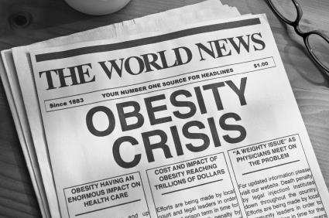
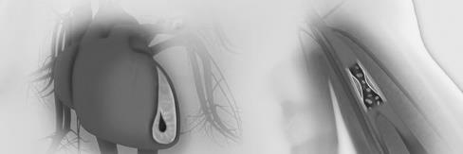
IKKβ/NF-κB
Uncoupling obesity with hypertension
Courtesy of Sudarshana Purkayastha, Guo Zhang, and Dongsheng Cai.
Department of Molecular Pharmacology and Diabetes Research Center, Albert Einstein College of Medicine, Bronx, NY 10461

Slide 2
obesity
-related
hypertension

Slide 3
Key words
SNS(sympathetic nervous system)
Arcuate nucleus
Fat tissue
Leptin and TNF-α
C57BL/6 mice
Chow(standard laboratory rat food)
HFD(high fat diet)
IKKβ/NF-κB pathway

Slide 4
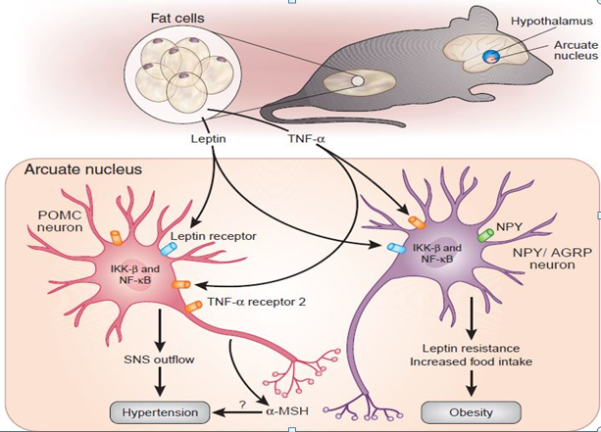
How obesity is related with hypertension
Figure from Nature Medicine volume 17 | number 7 | July 2011

Slide 5
Methodology
mice
chow
HFD
IKKβ/NF-κB activation
IKKβ/NF-κB inactivation
occurrence of hypertension ?
Relief of hypertension ?

Slide 6
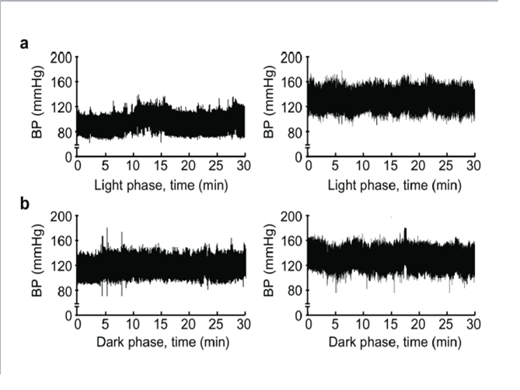
Results
Control l
activation
Control
activation
Figure from Nature Medicine volume 17 | number 7 | July 2011

Slide 7
Results
Light phase
Dark phase
BP
BP
Figure from Nature Medicine volume 17 | number 7 | July 2011

Slide 8
Implications
The battle against hypertension is long and hard, but there’s always new
hope
of
New drugs

