Slide 1
The role of NO(nitrate oxide) in cerebral ischemia
11307120252
Betty Zhu

Slide 2
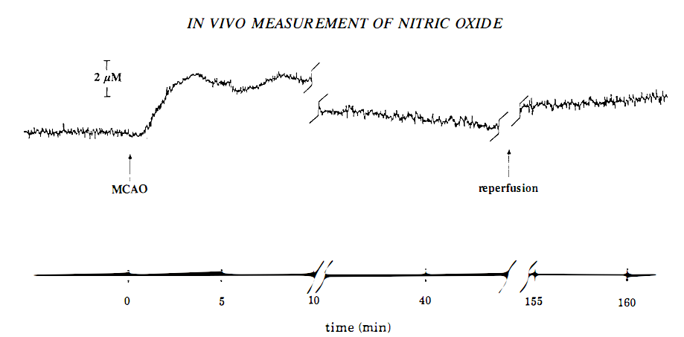
NO level in the ischemic brain
Notes:
Fig.Continuous amperometric monitoring of nitric oxide production in rat brain during middle cerebral artery occlusion(MCAO) and reperfusion.
Malinski T, Bailey F, Zhang ZG, Chopp M (1993) Nitric oxide measured by a porphyrinic microsensor in rat brain after transient middle cerebral artery occlusion. J Cereb Blood Flow Metab 13:355–8

Slide 3
NO deriving from different NO synthases in cerebral ischemia
eNOS(a minor part)：
regulation of hemodynamics; protection of endothelium integrity; inhibition of cellular adhesion
nNOS(early phase of ischemia):
excitotoxicity; nitrosative stress; free radical production
iNOS(during reperfusion):
brain injury; peroxynitrite production; nitrosative damage
Notes:
Niwa M, Inao S, Takayasu M, Kawai T, Kajita Y, Nihashi T, Kabeya R, Sugimoto T, Yoshida J (2001) Time course of expression of three nitric oxide synthase isoforms after transient middle cerebral artery occlusion in rats.Neurol Med Chir (Tokyo) 41:63–72
Godinez-Rubi, Marisol; Rojas-Mayorquin, Argelia E . Nitric Oxide Donors as Neuroprotective Agents after an Ischemic Stroke-Related Inflammatory Reaction. Oxidative Medicine and Cellular Longevity. 2013(1-16)

Slide 4
The dual role of NO in pathophysiology in stroke
Beneficial NO
Oxidative stress:
ATP,Ca²⁺
eNOS
Cerebral ischemic
Generation
Concentration
Redox state
Evolutive stage
Blood flow
Angiogenesis
Neurogenesis
nNOS
iNOS
inflammatory response:
mediator
Toxic NO
Notes:
Sum-up according to references but incompletely

Slide 5
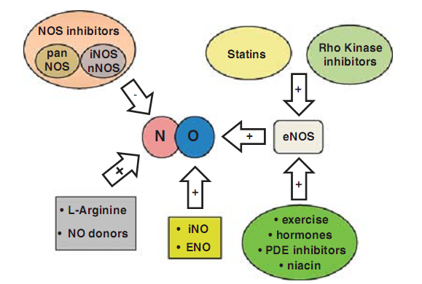
Therapeutical strategies influencing NO signaling in ischemic stroke
Notes:
Nicole A Terpolilli ,Michael A Moskowitz , Nikolaus Plesnila. Nitric oxide considerations for the treatment. Journal of Cerebral Blood Flow & Metabolism(2012) 32, 1332-13

Slide 6
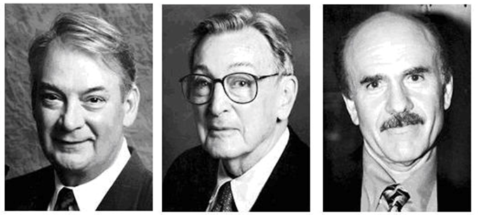
Ferid Murad Robert F.Furchgott Louis J.Ihnarro
Small molecular compound, Great wisdom!

Slide 7
Reference
Malinski T, Bailey F, Zhang ZG, Chopp M (1993) Nitric oxide measured by a porphyrinic microsensor in rat brain after transient middle cerebral artery occlusion. J Cereb Blood Flow Metab 13:355–8
Niwa M, Inao S, Takayasu M, Kawai T, Kajita Y, Nihashi T, Kabeya R, Sugimoto T, Yoshida J (2001) Time course of expression of three nitric oxide synthase isoforms after transient middle cerebral artery occlusion in rats.Neurol Med Chir (Tokyo) 41:63–72
Nicole A Terpolilli ,Michael A Moskowitz , Nikolaus Plesnila. Nitric oxide considerations for the treatment. Journal of Cerebral Blood Flow & Metabolism(2012) 32, 1332-1346
Godinez-Rubi, Marisol; Rojas-Mayorquin, Argelia E . Nitric Oxide Donors as Neuroprotective Agents after an Ischemic Stroke-Related Inflammatory Reaction. Oxidative Medicine and Cellular Longevity. 2013(1-16)

