Slide 1
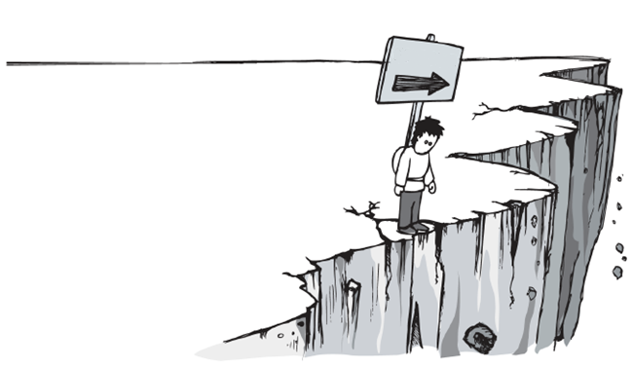
Hypertension
& Exercise
杨晓冬
10301010022
2010 级临床医学（八年制）

Slide 2
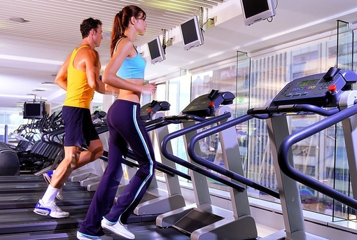
Exercise
Sympathetic Nervous System
Mechanism
Endothelial Function
HTN
?
Possible Danger
Coronary Artery Disease

Slide 3
Sports
Different
Effect
Endurance training
Resistance Training
Power Training
Isometric Exercise
Conventional Exercise
(Qigong Or T’ai Chi)

Slide 4
Is Exercise
To Manage Hypertension
Enough
?
Moderate Salt Restriction
Increasing in Fruit and Vegetable
Intake
Limitation of Alcohol Consumption
Smoking Cessation
Control of Body Weight

Slide 5
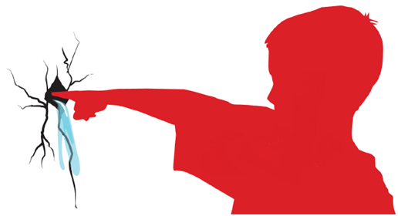
Choice of Drugs
For
Patients Who Exercise
Diuretics
β-blockers (BBs)
Calcium-channel Blockers
Angiotensin-converting Enzyme Inhibitors
Angiotensin II Receptor
Blockers

Slide 6
Summary

Slide 7
Key Words and Useful Terms
Hypertension, Blood Pressure, Exercise,
Cardiovascular Disease, Antihypertensive Therapy, Normotensive
References
Fagard R H. Exercise Therapy in Hypertensive Cardiovascular Disease[J]. PROGRESS IN CARDIOVASCULAR DISEASES, 2011,53(6):404-411.
Manfredini F, Malagoni A M, Mandini S, et al. Sport Therapy for Hypertension: Why, How, and How Much?[J]. ANGIOLOGY, 2009,60(2):207-216.
Lee M S, Lee E N, Kim J I, et al. Tai chi for lowering resting blood pressure in the elderly: a systematic review[J]. JOURNAL OF EVALUATION IN CLINICAL PRACTICE, 2010,16(4):818-824.
Leddy J J, Izzo J. Hypertension in Athletes[J]. JOURNAL OF CLINICAL HYPERTENSION, 2009,11(4):226-233.

Slide 8
Thank You !

