Slide 1
Passing Lines: Immigration and Sexuality Professor Brad Epps Harvard University 媒介与社会性别精品课程专题演讲

Slide 2
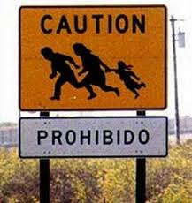
Border Crossing Sign: Prohibido (Prohibited)

Slide 3
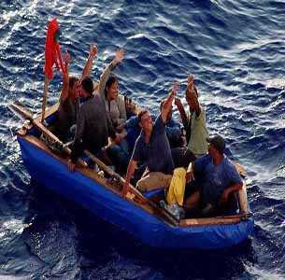
“Boat People” to United States

Slide 4
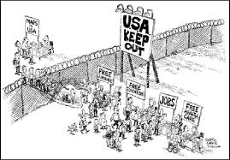
Anti-Immigration Cartoon

Slide 5
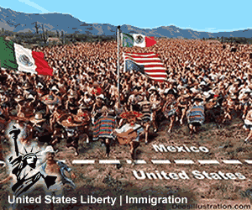
Anti-Immigration propaganda

Slide 6
Line
1) a long, narrow mark, band, boundary, or border (as in “borderline,” which also means: “barely acceptable in quality or as belonging to a category”)
2) a horizontal row of written or printed words
3) the words of an actor's part in a play or film (usually plural: lines)
4) a false or exaggerated account or story: He feeds me a line about his past.

Slide 7
To pass
1) to change from one state or condition to another
2) to cross; to leave behind or on one side (as with a border)
3) to go unnoticed; to fit in
4) to be accepted as or taken for: His Chinese is so good that he could pass for a native of China; her color is so dark she could pass for Black.

Slide 8
The phrase “passing lines” is a play on words that signals the quite serious play of people as they move—or attempt to move—across geopolitical borders as well as the discursive and bodily acts by which one person “relates” to another not as an other but as fundamentally the same or, perhaps more accurately, as “almost the same, but not quite.”

Slide 9
Mimicry
1) the action or art of imitating someone or something, typically in order to entertain or ridicule but also in order simply to resemble, to hide, camouflage, or pass
2) the close external resemblance of an animal or plant (or part of one) to another animal, plant, or inanimate object (often in order to hunt or to escape being hunted)

Slide 10
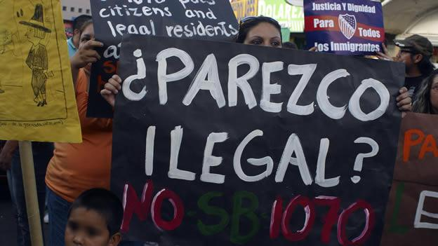
¿Parezco ilegal? Do I look illegal?

Slide 11
Green card
a permit allowing a foreign national to live and work permanently in the United States

Slide 12
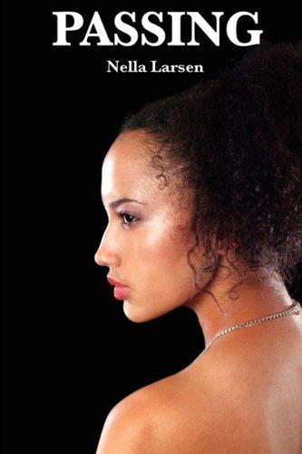
Recent cover for Nella Larson’s novel, Passing

Slide 13
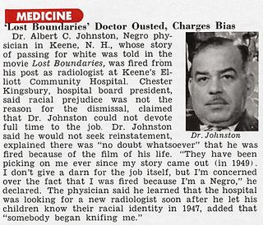
Newspaper clipping of Dr. Albert C. Johnston, who passed for white

Slide 14
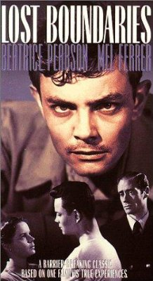
Lost Boundaries, 1949 film starring Mel Ferrer

Slide 15
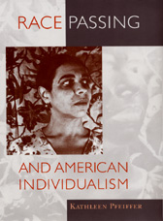
Race Passing: a study by Kathleen Pfeiffer of the ambiguities of racial identity in American culture

Slide 16
Poster for Europa, Europa (1990 German film directed by Agnieska Holland about a young Jew who passes as Aryan in Nazi Germany)

Slide 17
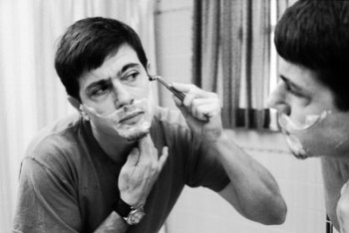
Deborah becomes Jake: Snapshot from photo essay that chronicles a female-to-male transition and interprets transgender identities through narratives of racial passing

Slide 18
Profiling
1) The act of making a “profile,” that is to say, of making an outline of something, especially a person's face, as seen from one side
2) In police and legal terms, a form of stereotypical identification, often used to detain and interrogate, as in: People wearing Muslim dress are often profiled in airports in the United States.

Slide 19
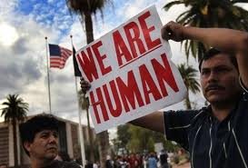
Immigrants’ Rights: We are human

Slide 20
Intersectionality
The complex coexistence and “crisscrossing” of two or more signs of identity (from “intersection,” a point or line common to surfaces that cross each other)

Slide 21
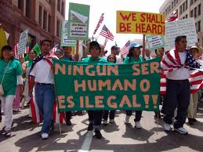
Ningún ser humano es ilegal (No human being is illegal)

Slide 22
Queer, queerness
1) strange, odd, different, bent
2) (informal, usually offensive) homosexual
3) anyone who does not abide by, fit into, or accept the norms of heterosexuality or heteronormativity (this can include heterosexual people who have multiple sexual partners, or who refuse marriage, or who refuse to have children, or who prefer to live alone, etc., etc.)

Slide 23
Miscegenation
The “intermixing” of people considered to be of different racial types (first used in the mid-19th century: formed irregularly from Latin miscere ‘to mix’ + genus ‘race’ + -ation). In the United States miscegenation was once considered a criminal offense.

Slide 24
Chinese Immigrants in Detention Centers (19th Century)

Slide 25
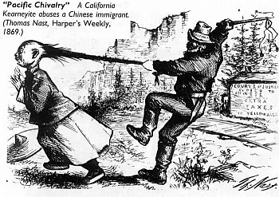
“Pacific Chivalry”: 1869 Cartoon that criticizes the “un-chivalrous” or discourteous treatment of Chinese immigrants

Slide 26
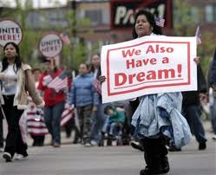
March in support of Immigrants’ Rights

Slide 27
For a World without Imperialism and Restrictive Borders; for Humanity as Humanity

