Slide 1
英语口译
3
Culture and Language

Slide 2
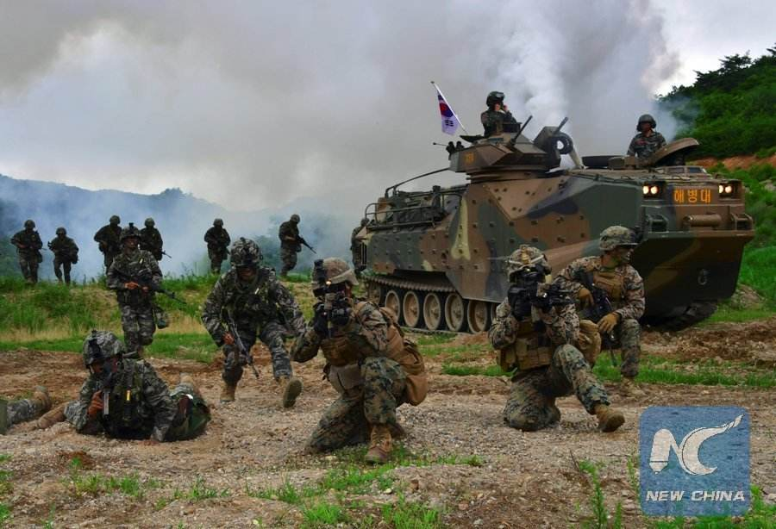
Listen and understand
SK-US military drill
Main idea
Chunks of info

Slide 3
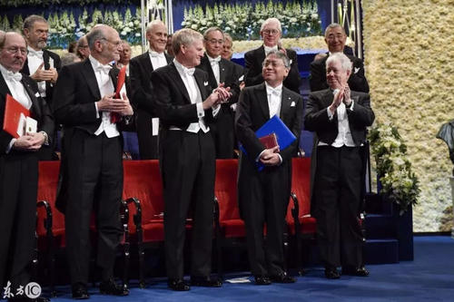
Warming up: Listen and understand
 “ISHIGURO’s Nobel Prize Winning Speech” (from VOA)
a. What is the main idea of his speech?
b. How many parts can you divide the speech into?
c. Can you recall as much info as possible in each part?

Slide 4
One-on-one interpreting
a. E-C, and ask the speaker:
How do you rate your partner’s performance?
Any mistakes to correct?
Can you elaborate on the information flow of your report?
b. C-E, and ask the speaker:
How do you rate your partner’s performance?
Any mistakes to correct?

Slide 5
Vocabulary: Vie to answer first!
Listen to single sentences that contain key words and make quick responses!
key words:
strength, to shape, to take shape, humanity, spontaneous, host city, to be appreciative of, to depreciate, closely related, indivisible, exhibitions, visual art, royalty payment, subsidy, cultural industries, local operas, advisor, publicity, top-grossing movie, reality show, to enjoy a phenomenal growth, to preserve, to make one’s way into, to give rise to, to prolong

Slide 6
Important Skill 1: Focus on key info only!
Theory:
1. Why not “have it all”?
2. Which words are possibly key words?
nouns√ prep.× adj. ⊙ adv. ⊙
nmb. √ verb. √ artc. × conj. ×
3. How to reconstruct the entire picture?
key info + mental association

Slide 7
Drill
Listen, note down key info
Retell what you heard to your partner, compare notes.

Slide 8
Example1: tell the key info from the non-key
Mock news report:
巨人国的经济形势最近有所好转。机械的引进使得农业获得了丰收，而银行业的发展使得巨人们余下的财产有了去处。富裕起来的巨人们开始发展科学和艺术，科学家人数已达30名，而艺术家的作品在国际市场上最高能卖出50万玉米币。

Slide 9
Example 2
P.8 Swedish art scene

Slide 10
Example 2: Tell the key info from the rest
 Listen to “Patchwork America” and tell the key info!

Slide 11
Drill： Grasp the key info only!
a.  Audio 2 (from course video archive)
b.  Round table talk: post vacation blues (from China Radio International)

Slide 12
Important Skill 2: Interpreting idioms and proverbs
Brainstorm: “读万卷书，行万里路”
Compare the two versions:
1) The world is a book and those who do not travel turn only one page.
 ☺ Strategy 1:
finding equivalent expressions in target language
2) Reading ten thousand book and travel ten thousand miles makes a man well and wise.
☺ Strategy 2:
Paraphrasing and explaining meaning and connotation

Slide 13
Challenge each other
Pair work
Invent a news report and challenge each other to retell the information!

Slide 14
Practice
 E-C 1 (D/Video)
☺ Did you notice the following expressions?
Thank you for
Cradle
Long been my dream
Give…an opportunity to…
Delighted and privileged to
Grateful for

Slide 15
 C-E 1 (D/Video)
对外汉语
学习班
使用人数最多
热潮
早该出现了
有……的历史
随着……
……对……产生的影响

Slide 16
Homework
1. Preview vocabulary of “Education and Campus”
2. Prepare for one-on-one interpreting

