Slide 1
Sports & HEALTH
Return To The Field
吴俊龙 10301010020
杨晓冬 10301010022

Slide 2
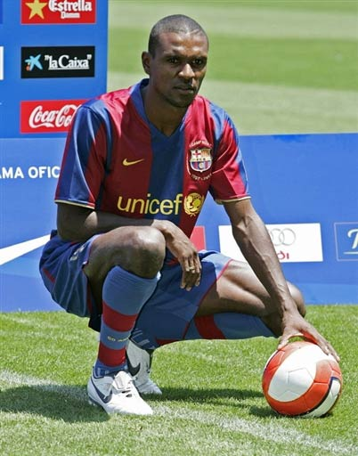
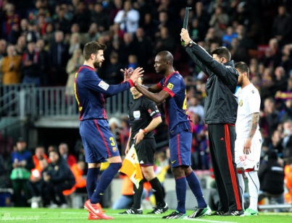
Sports & health
Athlete:
Eric Abidal
33 Years Old, Barcelona Defender
---- Undergoing Liver Transplant
in March 2012
---- Resuming the recovery
since May 2012
---- Starting training
since December 2012

Slide 3
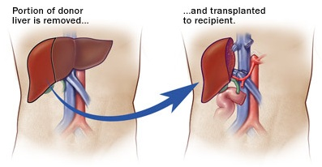
Sports & health
Introduction:
Definition:
History:
Since 1963 in the United States.

Slide 4
Current Situation
A well accepted option
A high degree of risk
A lot of top liver surgeons

Slide 5
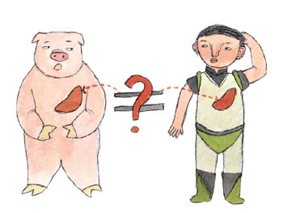
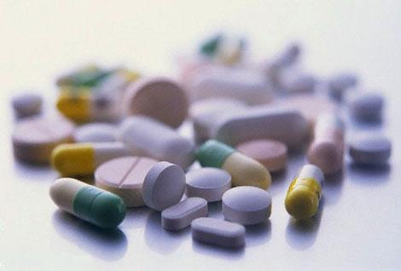
Sports & health
Key point:
Graft Rejection
Immunosuppressive Drugs

Slide 6
Sports & health
Indications & Contraindications:
Irreversible Liver Dysfunction
Uncontrolled Metastatic Cancer outside liver
Infection with HIV
Serious Heart Diseases

Slide 7
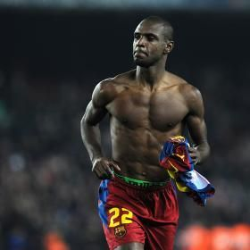
Sports & health
Prognosis
Chance of surviving 15 years: 60%
Miracle For Eric Abidal

Slide 8
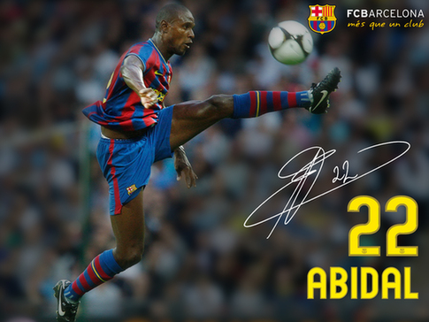
Sports & health
To fight hard, to be grateful to God and to pray a lot !
---- Eric Abidal

Slide 9
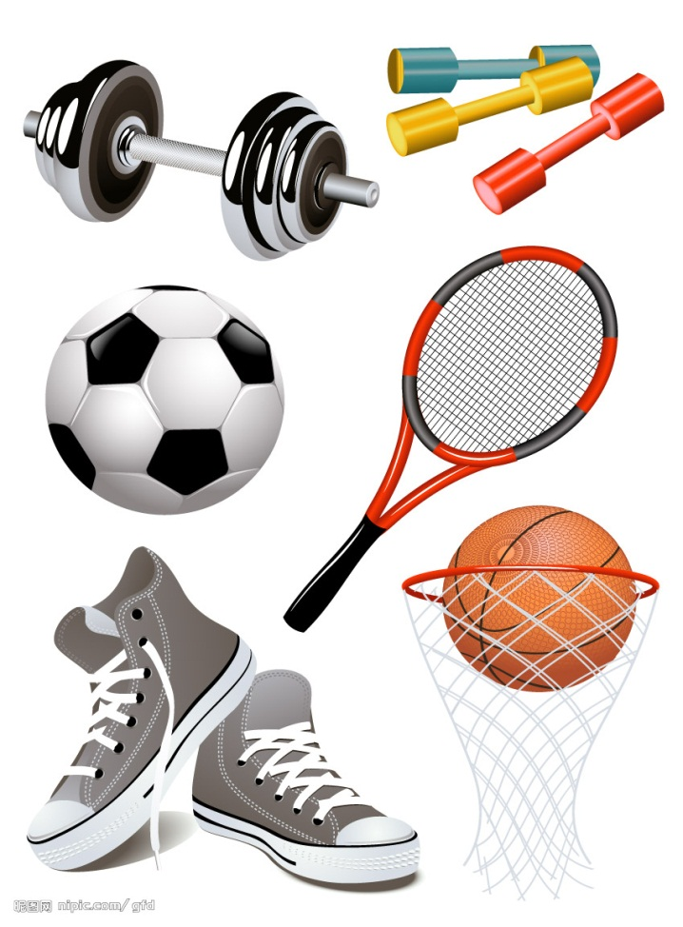
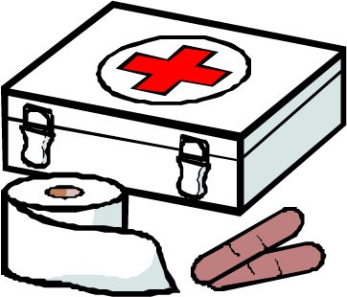
Sports & health
Thank You !

