Slide 1
Cancer in Transplantation Is transplantation a final end, or a new start?
10302010078
Liu Wangyuan

Slide 2
Key Words
Allograft: grafts transplanted between individuals of the same species
MHC: major histocompatibility complex
mHC: minor histocompatibility complex
De Novo Malignancy
Kaposi’s Sarcoma
Lymphoma

Slide 3
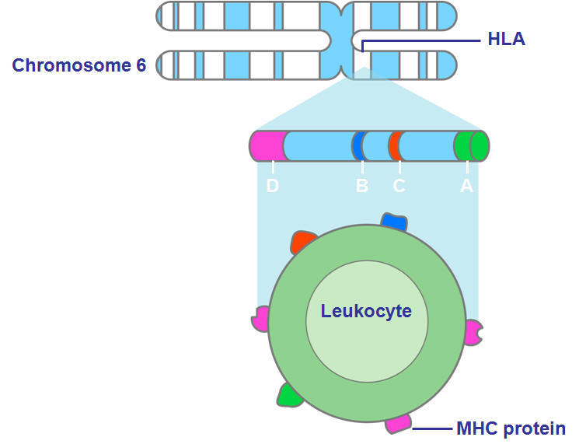
Graft Rejection Antigens^{[1]}
Blood group antigens
MHC molecules
mHC molecules
Notes:
Pic：MHC

Slide 4
Pharmacological Method of Immunosuppression^{[2]}
Depletion of lymphocytes
Inhibition of lymphocyte activation
Inhibition of new nucleotide synthesis
Notes:
Pic：Medicine

Slide 5
To Be or Not To Be
Tumor
Allograft
？
Immune System

Slide 6
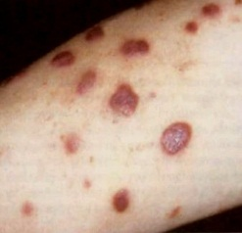
Common De Novo Malignancies^{[3]}
Non-melanoma skin cancers
squamous cell carcinoma (SCC)
basal cell carcinoma(BCC)
Lymphoma
Kaposi’s sarcoma
Notes:
Pic：Kaposi’s Sarcoma

Slide 7
Statistics of Skin Cancer^{[4]}
30 years earlier
65 -100 times’ risk
43% of patients in 10 years (Australia)
7-8% metastatic rate
39% one-year survival rate
Notes:
Skin Cancer

Slide 8
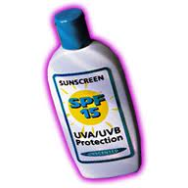
Prevention^{[4]}
Early detection
Self-examination
Self-protection
use of UVB/UVA sunscreen on a daily basis
use of hats and other protective clothes
mTOR inhibitors^{[5]}
Immunosuppression reduction

Slide 9
Summary
Mechanism of Cancer in Transplantation
Common De Novo Malignancies
Prevention of Post-transplant Cancers
The End

Slide 10
Reference
[1] Qiquan Sun, Primer on Transplantation[M], John Wiley & Sons Ltd: Donald Hricik, 2011: 1-10
[2] Ian AC Rowe, Primer on Transplantation[M], John Wiley & Sons Ltd: Donald Hricik, 2011: 20-25
[3] Emma L. Lanuti, Transplantation Pathology[M], Cambridge University Press: Phillip Ruiz, 2009:26-45
[4] John McCartney, Primer on Transplantation[M], John Wiley & Sons Ltd: Donald Hricik, 2011: 40-51
[5] Josep M. Campistola, New concepts and best practices for management of pre- and post-transplantation cancer[J], Transplantation Reviews 2012 (26): 261–279

