Slide 1
Chapter 4 Processor Architecture
Guobao Jiang
11210240049@fudan.edu.cn

Slide 2
Outline
4.1 The Y86 Instruction Set Architecture
4.2 Logic Design and the HCL
4.3 Sequential Y86 Implementations
4.4 General Principles of Pipelining
4.5 Pipelined Y86 Implementations
4.6 Summary

Slide 3
Problem 4.1 (P262)
Determine the byte encoding of the Y86 instruction sequence that follows.
.pos 0x100 #start at address 0x100
irmovl $15, %ebx
rrmovl %ebx, %ecx
loop:
rmmovl %ecx, -3(%ebx)
addl %ebx, %ecx
jmp loop
0x100: 30 83 0F 00 00 00
0x106: 20 31
0x108:
0x108: 40 13 FD FF FF FF
0x10E: 60 31
0x110: 70 08 01 00 00

Slide 4
Problem 4.2 (P263)
For each byte sequence listed, determine the Y86 instruction sequence it encodes.
A. 0x100:3083FCFFFFFF40630008000010
0x100: 3083FCFFFFFF irmovl $-r, %ebx
0x106: 406300080000 rmmovl %esi, 0x8000(%ebx)
0x10C: 10 halt

Slide 5
Problem 4.2+ (P263)
B. 0x200:A0 68
80080200001030830A00000090
0x200: A068 pushl %esi
0x202: 80 08020000 call proc
0x207: 10 halt
0x208: proc:
0x208: 3083 0A000000 irmovl $10, %ebx
0x20E: 90 ret

Slide 6
Problem 4.2 +(P263)
Exercise
C. 0x300:5054070000000F0B018
D. 0x400:6113730004000010
E. 0x500:6362A080

Slide 7
Problem 4.3 (P269)
Write Y86 code to implement a recursive sum function rSum, based on the following C code:
int rSum(int *Start, int Count)
{
if (Count <= 0)
return 0;
return *Start + rSum(Start+1, Count-1);
}
P178 Recursive Procedures

Slide 8
Problem 4.3+ (P269)
rSum: push1 %ebp
rrmovl %esp, %ebp
irmovl $20, %eax
subl %eax, %esp
pushl %ebx
mrmovl 8(%ebp), %ebx
mrmovl 12(%ebp), %eax
addl %eax, %eax
jle L38
irmovl $-8, %edx
addl %edx, %esp
irmovl $-1, %edx
addl %edx, %eax
pushl %eax
irmovel $4, %edx
rrmovl %ebx, %eax
addl %edx, %eax
pushl %eax
call rSum
mrmovl (%ebx), %edx
addl %edx, %eax
jmp L39
L38: xorl %eax, %eax
L39: mrmovl -24(%ebp), %ebx
rrmovl %ebp, %esp
popl %ebp
ret

Slide 9
Problem 4.4 (P270)
int pushtest()
{
int rval;
/* Insert the following assembly code:
movl %esp, %eax #save stack pointer
pushl %esp #push stack pointer
popl %edx #pop it back
subl %edx, %eax # 0 or 4
movl %eax, rval # set as return value
*/
…
return rval;
}
In our experiments, we find that the function pushtest return 0. What does this imply about the behavior of the instruction pushl %esp under IA32?
It implies that push the original value of %esp (old value)

Slide 10
Problem 4.5 (P270)
int poptest()
{
int rval;
/* Insert the following assembly code:
pushl tval # save tval on stack
movl %esp, %edx # save stack pointer
popl %esp # pop to stack pointer
movl %esp, rval # set popped value as return value
movl %edx, %esp # restore original stack pointer
*/
…
return rval;
}
We find this function always returns tval, the value passed to it as its argument. What does this imply about the behavior of popl %esp ? What other Y86 instruction would have the exact same behavior?
It implies that popl %esp set the stack pointer to the value read from memory.
mrmovl 0(%esp), %esp

Slide 11
Outline
4.1 The Y86 Instruction Set Architecture
4.2 Logic Design and the HCL
4.3 Sequential Y86 Implementations
4.4 General Principles of Pipelining
4.5 Pipelined Y86 Implementations
4.6 Summary

Slide 12
Problem 4.6 (P273)
Write an HCL expression for a signal xor, equal to the EXCLUSIVE-OR of inputs a and b. What is the relation between the signals xor and eq defined above ?
bool eq = (!a && b) || (a && !b)
bool eq = !((a && b) || (!a && !b)) is it OK?
The signals eq and xor will be complements of each other.

Slide 13
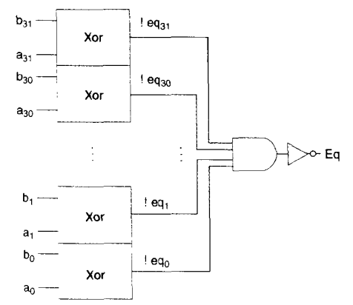
Problem 4.7 (P263)
Suppose you want to implement a word-level equality circuit using the EXCLUSIVE-OR circuits from Practice Problem 4.6 rather than from bit-level equality circuits. Design such a circuit for a 32-bit word consisting of 32 bit-level EXCLUSIVE-OR circuits and two additional logic gates.

Slide 14
Problem 4.8 (P277)
Write HCL code describing a circuit that for word inputs A, B, and C selects the median of the three values. That is, the output equals the word lying between the minimum and maximum of the three inputs.
int Med3 = [
A <= B && B <= C : B;
B <= A && A <= C : A;
1 : C:
];

Slide 15
Outline
4.1 The Y86 Instruction Set Architecture
4.2 Logic Design and the HCL
4.3 Sequential Y86 Implementations
4.4 General Principles of Pipelining
4.5 Pipelined Y86 Implementations
4.6 Summary

Slide 16
Problem 4.9 (P285)
Stage | Generic | Specific
 | irmovl V, rB
Fetch | icode:ifun←M1[PC] rA:rB ← M1[PC+1] valC ← M4[PC+2] valP ← PC +6
Decode
Execute | valE ← 0 + valC
Memory
Write back | R[rB] ← valE
PC update | PC ← valP
irmovl $128, %esp
icode: ifun← M1[0x00e]=3:0
rA: rB← M1[0x00f]=8:4
valC ← M4[0x010]=128
valP ← 0x00e + 6 = 0x014
valE ← 0 + 128 = 128
R[%esp] ← valE = 128
PC ← valP = 0x014

Slide 17
Problem 4.10 (P288)
Stage | Generic | Specific
 | popl rA
Fetch | icode:ifun←M1[PC] rA:rB ← M1[PC+1] valP ← PC +2
Decode | valA ← R[%esp] valB ← R[%esp]
Execute | valE ← valB + 4
Memory | valM ← M4[valA]
Write back | R[%esp] ← valE R[rB] ← valM
PC update | PC ← valP
popl %eax
irmovl $128, %esp
…
pushl %edx (%edx=9)
icode: ifun← M1[0x01C]=b:0
rA: rB← M1[0x01D]=0:8
valP ← 0x01C + 2 = 0x01E
valA ← R[%esp] = 124
valB ← R[%esp] = 124
valE ← 124 + 4 = 128
valM ← M4[124]= 9
R[%esp] ← valE = 128
R[%eax] ← valM = 9
PC ← valP = 0x01E

Slide 18
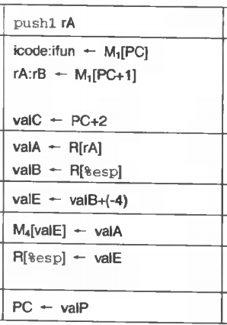
Problem 4.11 (P288)
What would be the effect of the instruction pushl %esp according to the steps listed in Figure 4.18 (P284)? Does his conform to the desired behavior for Y86, as determined in Practice Problem 4.4 ? (old value)
Yes

Slide 19
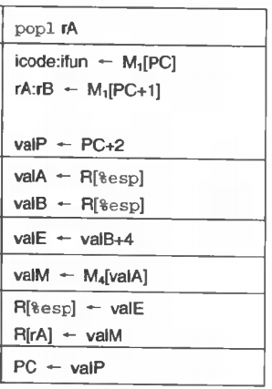
Problem 4.12 (P288)
Assume the two register writes in the write-back stage for popl occur in the order listed in Figure 4.18. What would be the effect of executing popl %esp ? Does this conform to the desired behavior for Y86, as determined in Practice Problem 4.5?
mrmovl 0(%esp), %esp
Yes

Slide 20
Problem 4.13 (P289)
Stage | Generic | Specific
 | call Dest
Fetch | icode:ifun←M1[PC] valC ← M4[PC+1] valP ← PC +5
Decode | valB ← R[%esp]
Execute | valE ← valB + (-4)
Memory | M4[valE] ← valP
Write back | R[%esp] ← valE
PC update | PC ← valC
call 0x029
icode: ifun← M1[0x023]=8:0
valC ← M4[0x024]=0x029
valP ← 0x023 + 5 = 0x028
valB ← R[%esp] = 128
valE ← 128 – 4 =124
M4[124] ← 0x028
R[%esp] ← 124
PC ← 0x029

Slide 21
Problem 4.14 (P300)
Write HCL code for the signal need_valC in the SEQ implementation.
bool need_valC=
icode in {IIRMOVL, IRMMOVL, IMRMOVL,
IJXX, ICALL};

Slide 22
Problem 4.15 (P301)
The register signal srcB indicates which register should be read to generate the signal valB. The desired value is shown as the second step in the decode stage in Figures 4.16 to 4.19. Write HCL code for srcB.
Figure 4.16-4.19 the decode stage
int srcB = [
icode in {IOPL, IRMMOVL, IMRMOVL} : rB;
icode in {IPUSHL, IPOPL, ICALL, IRET} :RESP;
1 : RNONE;
];

Slide 23
Problem 4.16 (P301)
Register ID dstM indicates the destination register for write port M, where valM, the value read from memory, is stored. This is shown in Figures 4.16 to 4.19 as the second step in the write-back stage. Write HCL code for dstM
int dstM = [
icode in {IMRMOVL, IPOPL} : rA;
1 : RNONE;
];

Slide 24
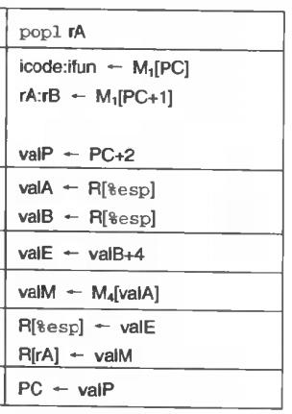
Problem 4.17 (P302)
Only the popl instruction uses both of the register file write ports simultaneously. For the instruction popl %esp, the same address will be used for both E and M write ports, but with different data. To handle this conflict, we must establish a priority among the two write ports so that when both attempt to write the same register on the same cycle, only the write from the higher priority port takes place. Which of the two ports should be given priority in order to implement the desired behavior, ad determined in Practice Problem 4.5?
As problem 4.5
mrmovl 0(%esp), %esp. So, give priority to M

Slide 25
Problem 4.18 (P302)
Based on the first operand of the first step of the execute stage in Figure 4.16 to 4.19, write an HCL description for the signal aluB in SEQ.
int aluB = [
icode in {IOPL, IRMMOVL, IMRMOVL, IPUSHL, IPOPL, ICALL, IRET} : valB;
icode in {IIRMOVL, IRRMOVL} : 0;
];

Slide 26
Problem 4.19 (P304)
Looking at the memory operations for the different instructions shown in Figures 4.16 to 4.19, we can see that the data for memory writes is always either valA or valP. Write HCL code for the signal mem_data in SEQ.
mem_data = [
icode in {IRMMOVL, IPUSHL} : valA;
icode == ICALL : valP;
];

Slide 27
Problem 4.20 (P304)
We want to set the control signal mem_write only for instructions that write data to memory. Write HCL code for the signal mem_write in SEQ.
bool mem_write =
icode in {IRMMOVL, IPUSHL, ICALL} ;

Slide 28
Outline
4.1 The Y86 Instruction Set Architecture
4.2 Logic Design and the HCL
4.3 Sequential Y86 Implementations
4.4 General Principles of Pipelining
4.5 Pipelined Y86 Implementations
4.6 Summary

Slide 29
Problem 4.21 (P314)
A. Inserting a single register gives a two-stage pipeline. Where should the register be inserted to maximize throughout? What would be the throughout and latency ?
throughput =1000/190=5.26GOPS
latency = (170+20)*2=380s

Slide 30
Problem 4.21+ (P314)
D. What is the minimum number of stages that would yield a design with the maximum achievable throughput? Describe this design, its throughput and its latency.
throughput =1000/100=10GOPS
latency = (80+20)*5=500ps

Slide 31
Problem 4.22 (P315)
Suppose we could take the system of Figure 4.32 and divide it into an arbitrary number of pipeline stages, all having the same delay. What would be the ultimate limit on the throughput, given pipeline register delays of 20 ps ?

Slide 32
Outline
4.1 The Y86 Instruction Set Architecture
4.2 Logic Design and the HCL
4.3 Sequential Y86 Implementations
4.4 General Principles of Pipelining
4.5 Pipelined Y86 Implementations
4.6 Summary

Slide 33
Problem 4.23 (P340)
int new_E_dst = [
D_icode in {IRRMOVL,
IIRMOVL, IOPL}:D_rB;
D_icode in {IPUSHL, IPOPL
,ICALL,IRET}:RESP;
1:NONE;
] See P301 dstE
The block labeled “dstE” in the decode stage generates the dstE signal based on fields from the fetched instruction in pipeline register D. The resulting signal is named new_E_dstE in the HCL description of PIPE. Write HCL code for this signal, based on the HCL description of the SEQ signal dstE. (see the decode stage in Section 4.3.4)

Slide 34
Problem 4.24 (P342)
Suppose the order of the third and fourth cases (the two forwarding sources from the memory stage) in the HCL code for new_E_valA (P340) were reversed. Describe the resulting behavior of the rrmovl instruction (line5) for the following program:
1 irmovl $5, %edx
2 irmovl $0x100, %esp
3 rmmovl %edx, 0(%esp)
4 popl %esp
5 rrmovl %esp, %eax
mrmovl 0(%esp), %esp
P334

Slide 35
Problem 4.25 (P342)
Suppose the order of the fifth and sixth cases (the two forwarding sources from the write-back stage) in the HCL code for new_E_valA were reversed. Write a Y86 program that would be executed incorrectly. Describe how the error would occur and its effect on the program behavior.

Slide 36
Problem 4.25+ (P342)
1 irmovl $5, %edx
2 irmovl $0x100, %esp
3 rmmovl %edx, 0(%esp)
4 popl %esp
5 nop
6 nop
7 rrmovl %esp, %eax
Answer: The popl instruction to be in the write-back stage when the rrmovl instruction is in the decode stage. If the two forwarding sources in the write-back stage are given the wrong priority, then register %eax will be set to the incremented program counter rather than the value read from memory.

Slide 37
Problem 4.26 (P342)
Write HCL code for the signal new_E_valB, giving the value for source operand valB supplied to pipeline register E.

Slide 38
Problem 4.26 +(P342)
P340 new_E_valA
int new_E_valB = [
d_srcB == E_dstE: e_valE;
d_srcB == M_dstM: m_valM;
d_srcB == M_dstE: M_valE;
d_srcB == M_dstM: W_valM;
d_srcB == W_dstM: W_valM
d_srcB == W_dstE: W_valE;
]

Slide 39
Problem 4.27 (P350)
Write a Y86 assembly language program that causes combination A to arise and determines whether the control logic handles it correctly.

Slide 40
Problem 4.27+ (P350)
irmovl Stack, %esp
irmovl rtnp, %eax
pushl %eax
xorl %eax, %eax
jne target
irmovl $1, %eax
halt
target: ret
irmovl $2, %ebx
halt
rtnp: irmovl $3, %edx
halt
.pos 0x40
Stack:

Slide 41
Problem 4.28 (P350)
Write a Y86 assembly language program that causes combination B to arise and completes with a instruction if the pipeline operates correctly.

Slide 42
Problem 4.28+ (P350)
irmovl mem, %ebx
mrmovl 0(%ebx), %esp
ret
halt
rtnpt: irmovl $5, %esi
halt
.pos 0x40
mem: .long stack
.pos 0x50
stack: .long rtnpt

Slide 43
Problem 4.29 (P352)
Write HCL code for the signal D_stall in the PIPE implementation.
bool D_stall =
E_icode in {IMRMOVL, IPOPL} &&
E_dstM in {d_srcA, dsrcB};
# for a load/use hazard

Slide 44
Problem 4.30 (P352)
Write HCL code for the signal E_bubble in the PIPE implementation.
bool E_bubble =
# Mispredicted branch
(E_icode == IJXX && ! e_Bch) ||
# for a load/use hazard
E_icode in {IMRMOVL, IPOPL} &&
E_dstM in {d_srcA, d_srcB};

Slide 45
Problem 4.31 (P354)
Suppose we use a branch prediction strategy that achieves a success rate of 65%, such as backward taken, forward not-taken, as described in Section 4.5.3. What would be the impact on CPI, assuming all of the other frequencies are not affected ?
mp=0.20x0.35x2=0.14
overall CPI equals 1.25

Slide 46
Q&A ?
Thank you!

Slide 47
website
http://jpkc.fudan.edu.cn/s/258/main.htm
http://10.108.0.74/s/258/main.jspy
ftp: 10.141.247.12

