Slide 1
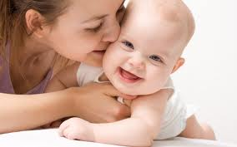
Neonatal Arterial Ischemic Stroke(NAIS)
Student: 刘丝雨
ID： 10301010075

Slide 2
Key words
RDS 呼吸窘迫综合症
Cerebral palsy 脑瘫
homocysteine 同型半胱氨酸
AIF 凋亡介导因子
Ultrasound 超声
Doppler sonography 多普勒超声技术
MRI 核磁共振
BBB 血脑屏障

Slide 3
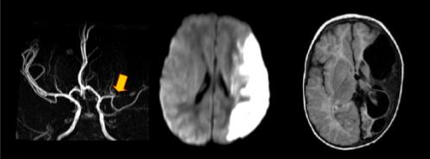
Definition[1][2][3]
· perinatal stroke
· symptomatic
· focal cerebral infarction
· in the artery
· in the first 28 days of life

Slide 4
Symptom[4]
60%
early symptoms:
seizures
RDS
cerebral palsy
neurologic morbidity
40%
·No early symptom
· sequelaes :
motor impairment
development delay
specific cognitive deficiency

Slide 5
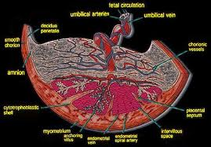
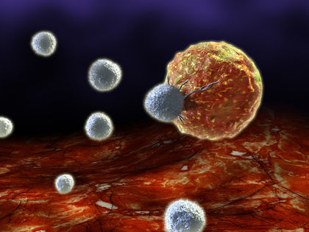
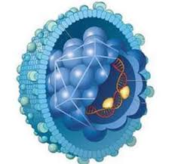
Risk Factors[4]
· Maternal
· Placental
· Blood、homocysteine and lipid
· Other infections

Slide 6
Mechanism
hypoxia
ischemia
Caspase-(in)dependent execution pathways ↑
Neurocyte
inflammatory response↑↑
AIF↑
Cytochrome C ↑

Slide 7
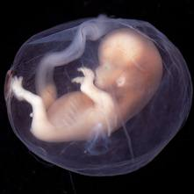
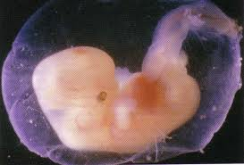
Diagnosis & Prevention
·Drug treatment[5]
eg. endogenously occurring substances
·After-birth treatment
…
·Prenatal-
Examination
· Ultrasound
· Doppler Sonography
· CT scan
· MRI
Always delayed

Slide 8
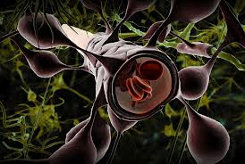
Treatment
· Improve neuronal environment[5]
Enhance the growth of
axons
dentrites
synaptogenesis
myelination
Neurotrophins
BBB √
growth factors
Transplantation of neuron
…

Slide 9
1. Sehgal, A. (2011). Perinatal Stroke: a case-based review. European Journal of Pediatrics
Chauvier, D., Renolleau, S., Holifanjaniaina, S., Ankri, S., Bezault, M., Schwendimann, L., et al. (2011). Targeting neonatal ischemic brain injury with a pentapeptide-based irreversible caspase inhibitor.Cell Death & Disease, 2, 203
Chabrier S, Husson B, Dinomais M, Landrieu P, Nguyen The Tich S. New insights (and new interrogations) in perinatal arterial ischemic stroke. Thromb Res. 2011 Jan;127(1):13-22. doi: 10.1016/j.thromres.2010.10.003. Epub 2010 Nov 4.
van der Aa NE, Dudink J, Benders MJ, Govaert P, van Straaten HL, Porro GL, Groenendaal F, de Vries LS. Neonatal posterior cerebral artery stroke: clinical presentation, MRI ﬁndings, and outcome Dev Med Child Neurol. 2013 Mar;55(3):283-90. doi: 10.1111/dmcn.12055. Epub 2013 Jan 22.
Rees, S., Harding, R., Walker, D. (2011). The biological basis of injury and neuroprotection in the fetal and neonatal brain. International Journal of Developmental Neuroscience, 29, 551-563.

