Slide 1
Chapter 3. Basic Instrumentation for Nuclear Technology
Outline of experiment:
􀂄 get particles (e.g. protons, …)
􀂄 accelerate them
􀂄 throw them against each other
􀂄 observe and record what happens
􀂄 analyse and interpret the data
  Accelerators
  Detectors
  Reactors

Slide 2
  1.Accelerators
History-Why
Particle Sources
Acceleration stage
Space charge
Diagnostics
Application

Slide 3
  2. Detectors
Gas-Filled Radiation Detectors
Scintillation Detectors
Semiconductor Detectors
Personal Dosimeters
Others
Particle identification
Measurement theory
Detection Equipment
ionization chambers
proportional counters
Geiger-Muller counters
Photomultiplier tube
  photographic films photographic emulsion plates
  Cloud and Bubble Chambers
E-ΔE, TOF

Slide 4


Ionization Chambers
the voltage must be sufficiently high for effective collection of electrons.
The average energy required to ionize a gas atom 30 eV/ion.
If particles entering an air-filled
detector deposit an average of 1 GeV S⁻¹ in the gas, the average current flowing through the chamber
Current (A) is proportional to charges collected on electrode in ionization chambers.
The current registered in the ionization chamber is proportional to the number of ion pairs generated by radioactivity

Slide 5
Proportional Counters
How can the sensitivities of ionization chambers be improved?
What happens when the voltage is increased?
Gas Multiplication
–+
↓
–+–+–+
↓
–+–+–+–+–+–+–+–+–+
↓
–+–+–+–+–+–+–+–+–+–+–+–+–+–+–+–+–+–+–+–+–+–+–+–+–+–+–+–+–+–+–+–+–+–+–+–+
X00 V
Proportional counters
Gas multiplication due to secondary ion pairs when the ionization chambers operate at higher voltage.
not only collect but also accelerate electrons

Slide 6
It should be noted, however, that the small mass and high energy of electrons make them drift 100,000 times faster than ions. Thus, the current is mainly due to the drifting electrons with only a small fraction due to the drift of ions.
Despite the multiplication due to secondary ion pairs, the ampere-meters register currents proportional to the numbers of primary electrons caused by radiation entering the detectors. Thus, currents of proportional chambers correspond to amounts of ionization radiation entering the proportional chamber.

Slide 7
Geiger-Muller Counters
1X00 V
Geiger counters count pulses. After each pulse, the voltage has to return to a certain level before the next pulse can be counted.
Every ionizing particle causes a discharge in the detector of G-M counters.

Slide 8
high sensitivity
No characterization of radioactivity.
When the source has a very strong radioactivity, the pulses generated in the detectors are very close together. As a result, the Geiger counter may register a zero rate. In other words, a high radioactive source may overwhelm the Geiger counter, causing it to fail.
keep this in mind. The zero reading from a Geiger counter provides you with a (false) sense of safety when you actually walk into an area where the radioactivity is dangerously high.

Slide 9
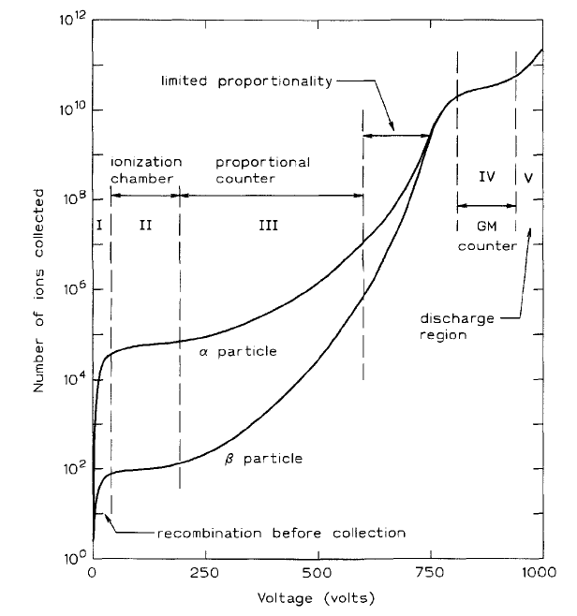
Operational regions for gas-filled radiation detectors.
9

Slide 10
Scintillation Counters
not based on ionization, but based on light emission.
sodium iodide (NaI) crystal, contains 0.5 mole percent of thallium iodide (TlI) - activator,
.
Photons cause the emission of a short flash in the Na(Tl)I crystal.
The flashes cause the photo-cathode to emit electrons.
10

Slide 11
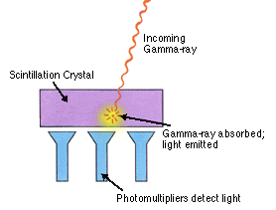
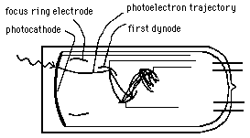
Scintillation Detector and
Photomultiplier tube
Ionizing Radiation
11

Slide 12
The output pulses from a scintillation counter are proportional to the energy of the radiation.
Electronic devices have been built not only to detect the pulses, but also to measure the pulse heights.
The measurements enable us to plot the intensity (number of pulses) versus energy (pulse height), yielding a spectrum of the source.

Slide 13
Gamma ray spectrum of ^{207m}Pb (half-life 0.806 sec)
^{207m}Pb Decay Scheme
¹³/₂+____________1633.4 keV
- Intensity (log scale)
1063
-1e4
569
⁵/₂-____________569.7 keV
1063
-1e3
569
¹/₂-____________0.0 stable
-1e2
-10 569 + 1063
-1 Energy
γ-ray
spectrum of ^{207m}Pb
Ionizing Radiation
13

Slide 14
Fluorescence Screens
Fluorescence materials absorb invisible energy and the energy excites the electron. De-exciting of these electrons results in the emission of visible light.
J.J. Thomson used fluorescence screens to see electron tracks in cathode ray tubes. Electrons strike fluorescence screens on computer monitors and TV sets give dots of visible light.
Röntgen saw the shadow of his skeleton on fluorescence screens.
Rutherford observed alpha particle on scintillation material zinc sulfide.
Fluorescence screens are used to photograph X-ray images using films sensitive visible light.
14

Slide 15
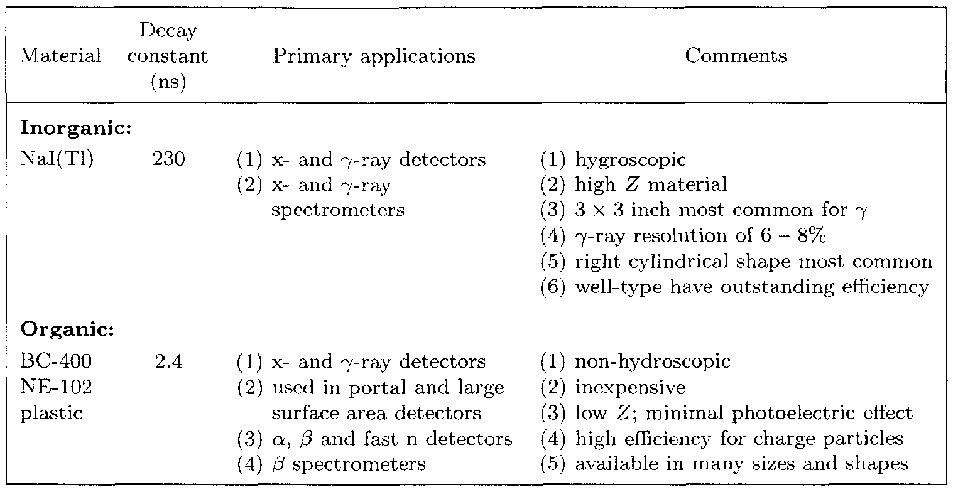
Common scintillation materials.

Slide 16
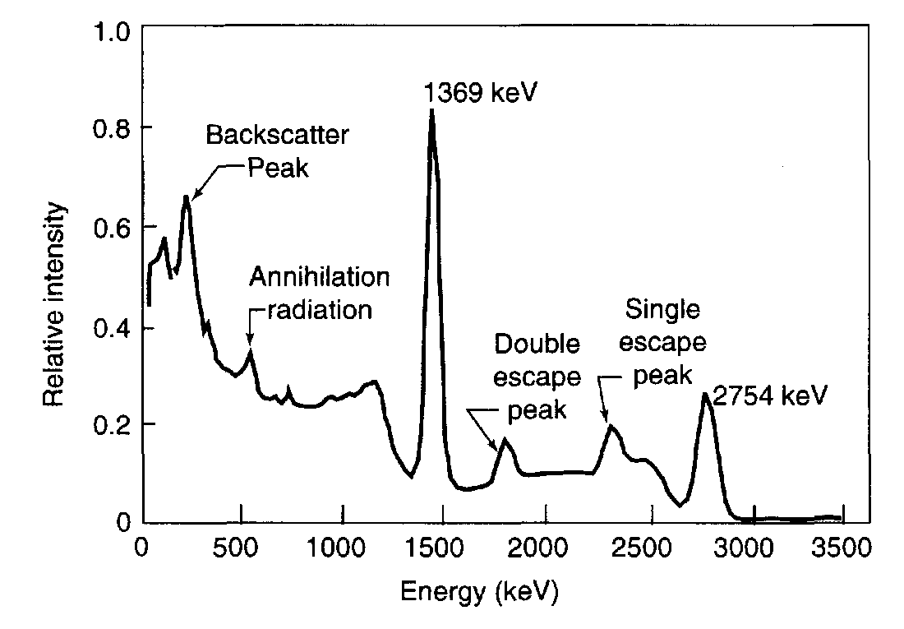
Pulse height distribution of the gamma rays emitted by the radioactive decay of ²⁴Na as measured by a Nal(Tl) scintillation detector.

Slide 17
  2. Detectors
Gas-Filled Radiation Detectors
Scintillation Detectors
Semiconductor Detectors
Personal Dosimeters
Others
Particle identification
Measurement theory
Detection Equipment
ionization chambers
proportional counters
Geiger-Muller counters
Photomultiplier tube
  photographic films photographic emulsion plates
  Cloud and Bubble Chambers
E-ΔE, TOF

Slide 18
Solid-state Detectors
based on ionization, but different from ionization chambers
A P-N junction of semiconductors placed under reverse bias has no current flows. Ionizing radiation enters the depleted zone excites electrons causing a temporary conduction. The electronic counter register a pulse corresponding to the energy entering the solid-state detector.
+ + depleted - -
P + - N
+ + zone - -
Negative
Positive
electronic counter
See: bo.iasf.cnr.it/ldavinci/programme/Presentazioni/Harrison_cryo.pdf

Slide 19
A simple view of solid-state detectors
Energy required to free an electron from the valance band into the conduction band is called the band gap, which depends on the material: diamond, 5 eV; silicon, 1.1 eV; germanium, 0.72 eV. At room temperature, the thermal energy gives rise to 1010 carriers per cc. At liquid nitrogen temperature, the number of carriers is dramatically reduced to almost zero. At low temperature, it is easier to distinguish signals due to electrons freed by radiation from those due to thermal carriers.
Solid-state detectors are usually made from germanium or cadmium-zinc-telluride (CdZnTe, or CZT) semiconducting material. An incoming gamma ray causes photoelectric ionization of the material, so an electric current will be formed if a voltage is applied to the material.

Slide 20
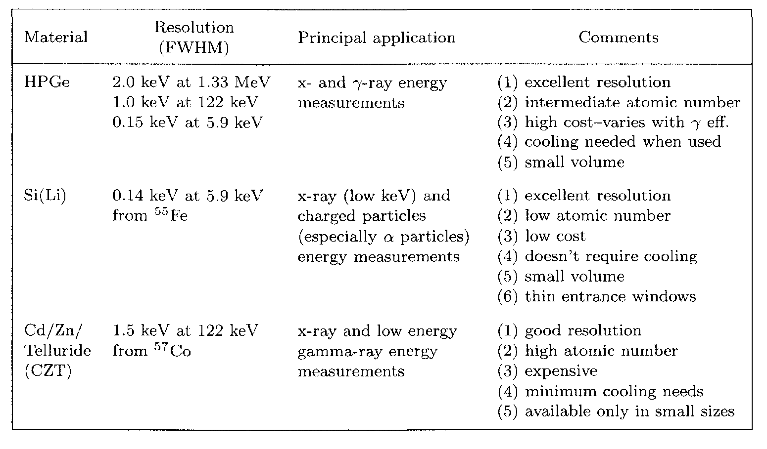
Common semiconductor ionizing-radiation detectors.

Slide 21
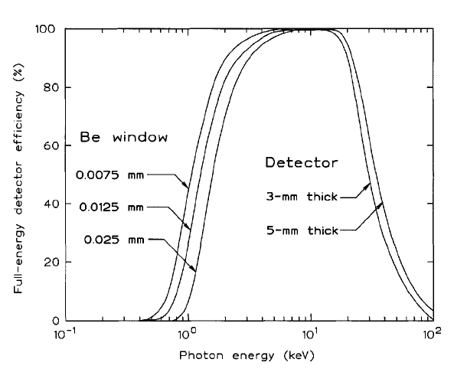
Full energy peak efficiency of Si(Li) detectors.

Slide 22
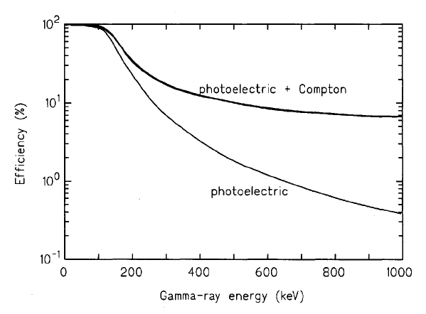
Gamma-ray efficiency for a 2 mm thick CZT detector.

Slide 23
a CZT detector, an average of one electron/hole pair is produced for every 5 eV of energy lost by the photoelectron or Compton electron. This is greater than in Ge or Si, so the resolution of these
detectors is not as good as HPGe or Si(Li) detectors.

Slide 24
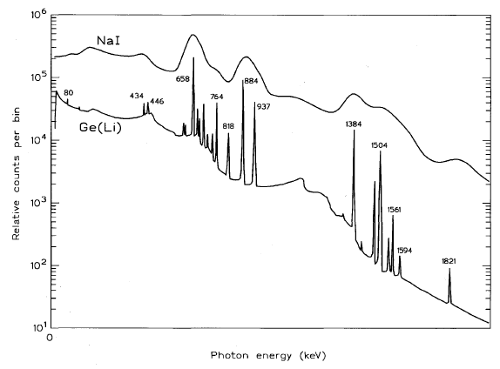

Slide 25
Average Ionization Energy (IE eV) per Pair of Some Common Substances
Material Air Xe He NH3 Ge‑crystal
Average IE 35 22 43 39 2.9

Slide 26
Photographic Emulsions and Films
Personal Dosimeters
Sensitized silver bromide grains of emulsion develope into blackened grains. Plates and films are 2-D detectors.
Roentegen used photographic plates to record X-ray image.
Photographic plates helped Beckerel to discover radioactivity.
Films are routinely used to record X-ray images in medicine but lately digital images are replacing films.
Stacks of films record 3-dimensional tracks of particles.
Photographic plates and films are routinely used to record images made by electrons.

Slide 27
Cloud and Bubble Chambers
The ion pairs on the tracks of ionizing radiation form seeds of gas bubbles and droplets. Formations of droplets and bubbles provide visual appearance of their tracks, 3-D detectors.
C.T.R. Wilson shared the Nobel prize with Compton for his perfection of cloud chambers.

Slide 28
At age 15, the Scottish physicist C.T.R. Wilson (1869-1959) spent a few weeks in the observatory on the summit of the highest Scottish hill Ben Nevis. He was intrigued by the color of the cloud droplets. He also learned that droplets would form around dust particles.
Between 1896 and 1912, he found dust-free moist air formed droplets at some over-saturation points - ions

Slide 29
Image Recorded in Bubble Chambers
Charge exchange of antiproton produced neutron-antineutron pair.
p + p → n + n (no tracks)
Annihilation of neutron-antineutron pair produced 5 pions.
n +n → 3π⁺ + 2π⁻ + ?
Only these tracks are sketched.

Slide 30
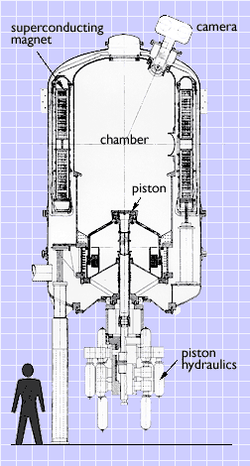
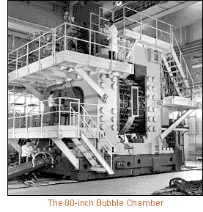
Bubble Chambers
←The Brookhaven 7-foot bubble chamber
and
the 80-inch bubble chamber ↓

Slide 31
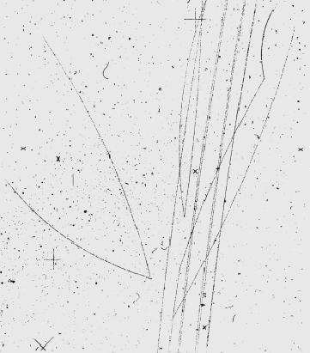
Image from bubble chamber
This image shows a historical event: one of the eight beam particles (K⁻ at 4.2 GeV/c) which are seen entering the chamber, interacts with a proton, giving rise to the reactions
K– p → Ω– K⁺ K⁰
K⁰ → π⁺ π–
Ω– → Λ⁰ K–
K⁺ → π⁺ π⁰
Λ⁰ → p π–

Slide 32
  2. Detectors
Gas-Filled Radiation Detectors
Scintillation Detectors
Semiconductor Detectors
Personal Dosimeters
Others
Particle identification
Measurement theory
Detection Equipment
ionization chambers
proportional counters
Geiger-Muller counters
Photomultiplier tube
  photographic films photographic emulsion plates
  Cloud and Bubble Chambers
E-ΔE, TOF

Slide 34
2. TOF

Slide 35
5.9m
1.4m
TOF 1
TOF 2
magnet
0.2m
Gas cell
cooling
Test detector
Solid target
Start detector 1
Stop detector 2
Start detector 2
Collimators
UNILAC beam
Stop detector 1
Energy degrader
Intensity attenuator
Fig.1 Experimental set-up for the double time-of-flight (DTOF) system

Slide 36
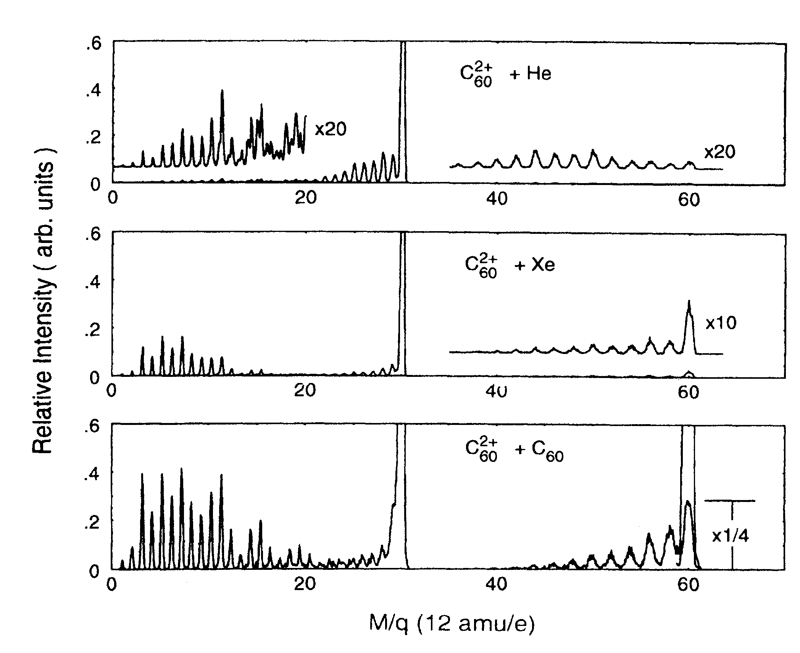
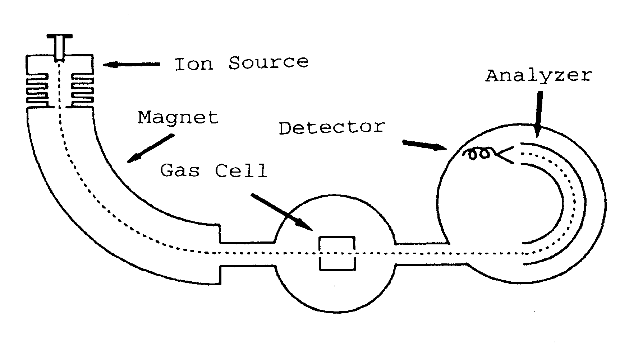
electrostatic analyzer

Slide 37
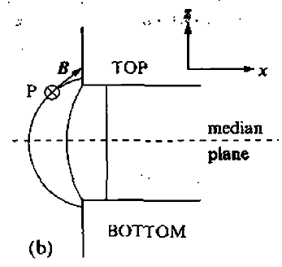
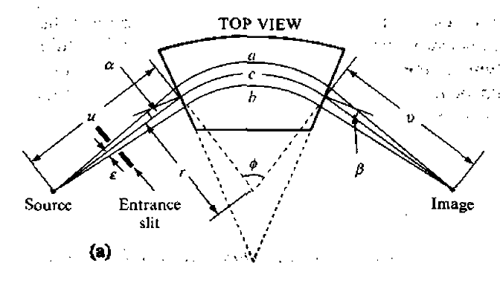

Slide 38
Gas-Filled Radiation Detectors
Scintillation Detectors
Semiconductor Detectors
Personal Dosimeters
Particle identification
Measurement theory
Detection Equipment
ionization chambers
proportional counters
Geiger-Muller counters
Photomultiplier tube
  photographic films photographic emulsion plates
E-ΔE, TOF

Slide 39
Types of Measurement Uncertainties
inherent stochastic uncertainty
Systematic errors
Sampling errors
introduced by some constant bias or error in the measuring system and are often very difficult to assess since they arise from biases unknown to the experimenter.
arise from making measurements on a different population from the one desired.
Control of target parameters
ensuring target homogeneity and stability is crucial and quite often more difficult to achieve than a high-quality beam.

Slide 40
Accuracy and precision
Precision refers to the degree of measurement quantification as determined, for example, by the number of significant figures.
Accuracy is a measure of how closely the measured value is to the true (and usually unknown) value.
A very precise measurement may also be very inaccurate.

Slide 41



Uncertainty Assignment Based Upon Counting Statistics
estimated using the binomial distribution
Gaussian distribution.
x ± s
standard deviation of x.
for replicate measurements the error is reduced by the square root of N.

Slide 42
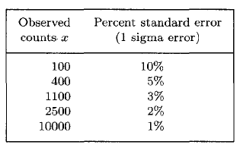

Slide 43
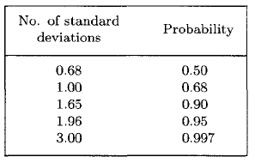

Slide 44

Dead Time
All radiation detection systems operating in the pulse mode have a limit on the maximum rate at which data can be recorded.
significant dead time losses (m)
Г is the dead time of the detector.
mГ is the fraction of the time that the detector is unable to respond to additional ionization in the
active volume of the detector
When designing an experiment, it is advisable to
keep these losses to a minimum. If possible, this means that mΓ < 0.05. For example, for a GM counter with a typical dead time of Γ = 100 μs,
maximum count rate would be 500 counts/s.

Slide 45
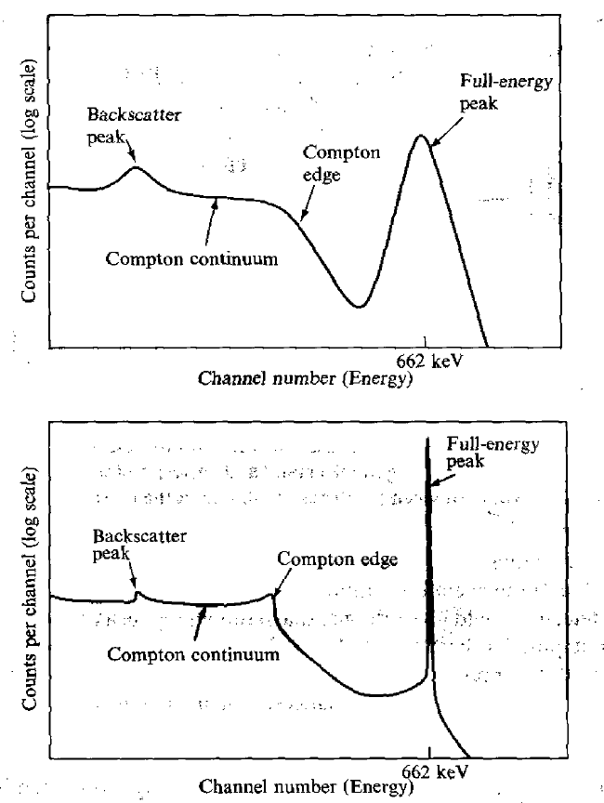
Energy resolution
the resolution of a semiconductor (Ge)
detector is far superior to that of a NaI(T1) scintillation detector.
energy spectra)recorded with a scintillation
detector (upper graph) and a Ge detector (lower graph) of 662-keV y rays from a ^{I37}Cs source.

Slide 46
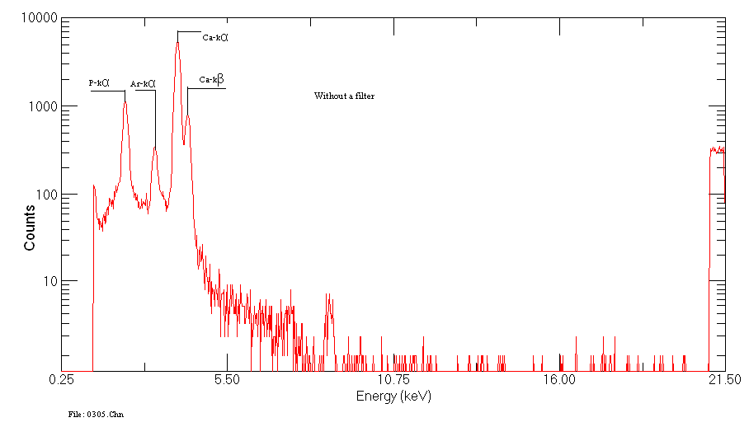
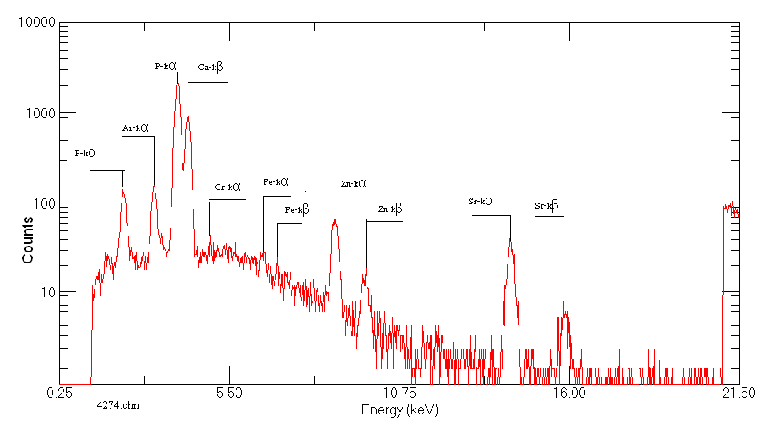
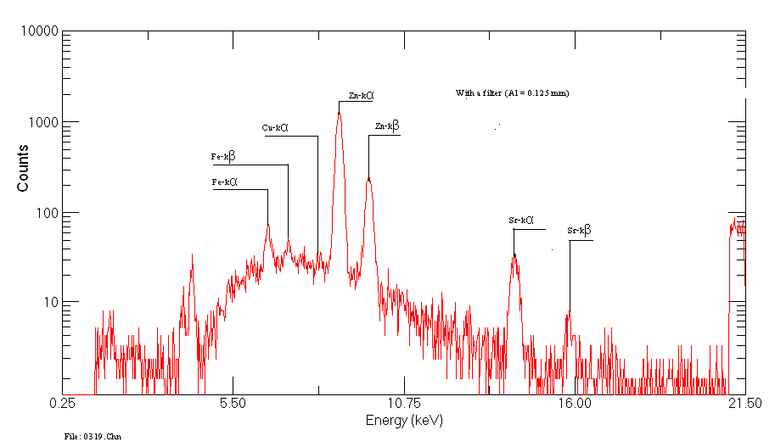
Absorption filter

Slide 47
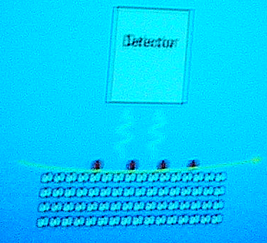

”Total reflection”
TPIXE
Grazing-exit PIXE
p
X-rays

Slide 48
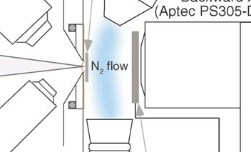
Non-destructive (damage)‏
cooling
Low beam current
< 10 pA / 1μm
0.5 nA/ 1 mm
3 MeV Protons
100pA/μm
10 min
No damage observed
T. Sakai et al. / Nucl. Instr. and Meth. B 231 (2005) 112
SPE-File
Sample
P (g/kg)‏
S (mg/kg)‏
Ca (g/kg)‏
Fe (mg/kg)‏
Zn (mg/kg)‏
Sr (mg/kg‏)‏
4043
CFD2
84
20
199
758
1229
69
4044
CFD2
83
22
209
748
1088
79

Slide 49
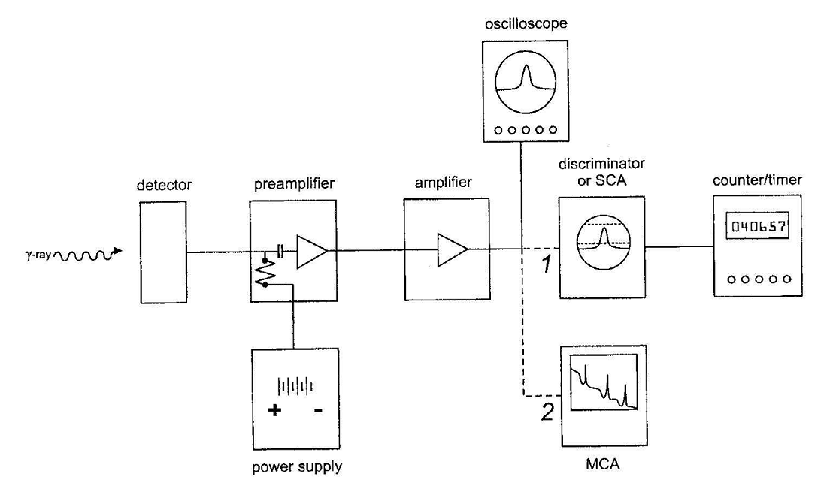

Slide 50
  2. Detectors
Gas-Filled Radiation Detectors
Scintillation Detectors
Semiconductor Detectors
Personal Dosimeters
Others
Particle identification
Measurement theory
Detection Equipment
ionization chambers
proportional counters
Geiger-Muller counters
Photomultiplier tube
  photographic films photographic emulsion plates
  Cloud and Bubble Chambers
E-ΔE, TOF

