Slide 1
Viet Anh Nguyen
10301016022

Slide 2
Placebo Effect

Slide 3
Placebo
“any inactive subtance or other intervention given as a real treatment”

Slide 4
How?

Slide 5
“We found that when people experience pain relief due to a placebo administration, they also show reduced neuronal activation to painful stimulation in their spinal cord.”
- team member Falk Eippert, a neuroscientist with the University Medical Centre Hamburg-Eppendorf, Hamburg, Germany.

Slide 6
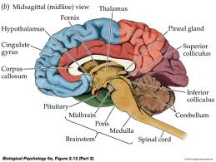
Brain
Cingulate cortex+Thalamus+ frontal region

Slide 7
Endorphins
- Neurotransmitters.
- Produced by the pituitary gland and the hypothalamus
- Secreted during excitement, pain, consumption of spicy food, laughter, love and orgasm
- Can resemble the opiates in their abilities to produce analgesia and a feeling of well-being.

Slide 8
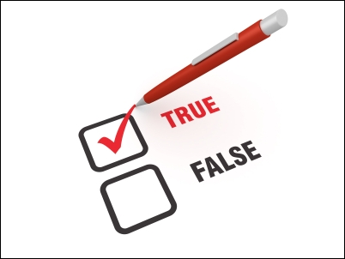

Slide 9
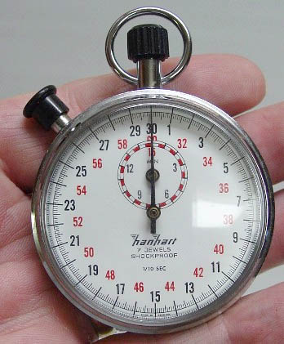
Short time

Slide 10
Conclusion
Sham treatment
Mind over the body
Expectation
Relieve pain

Slide 11
References
en.wikipedia.org
Blakeslee, S. (1998 a). Enthusiasm of doctor can give pill extra kick. New York Times, Science Times, October 13, p. D4.
S.Blakeslee, (1998 b). Placebos prove so powerful even experts are surprised. New York Times, Science Times, October 13, pp. D1, D4.
Brown, W.A. (1998). The placebo effect. Scientific American, 278:1, 90-95.
Harrington, A. (Ed.)(1997). The placebo effect: An interdisciplinary exploration. Cambridge, MA: Harvard University Press.
Matre D, Casey KL, Knardahl S (2006). "Placebo-induced changes in spinal cord pain processing". J Neurosci 26 (2): 559–63. doi:10.1523/JNEUROSCI.4218-05.2006. PMID 16407554
Holden, C. (2002). Drugs and placebos look alike in the brain. Science, 295, 947-948.
Wager TD, Rilling JK, Smith EE, Sokolik A, Casey KL, Davidson RJ, Kosslyn SM, Rose RM, Cohen JD (2004). "Placebo-induced changes in FMRI in the anticipation and experience of pain". Science 303 (5661): 1162–7.

