Slide 1
Childhood Cancer
Name: Xu heyang
Stu. ID: 10301010042

Slide 2
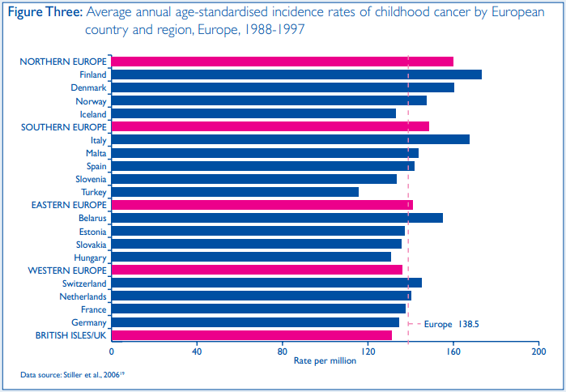
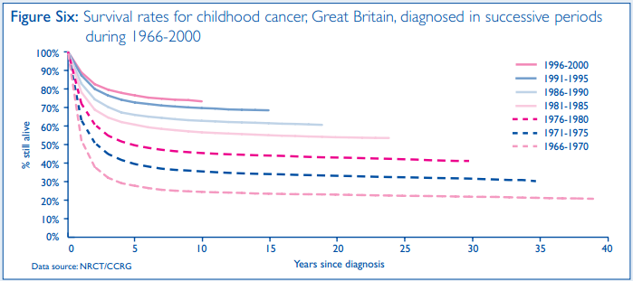
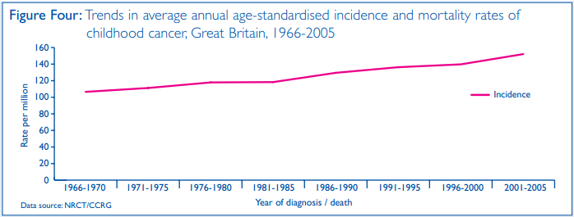
Current Situation
Time trend
Global burden

Slide 3
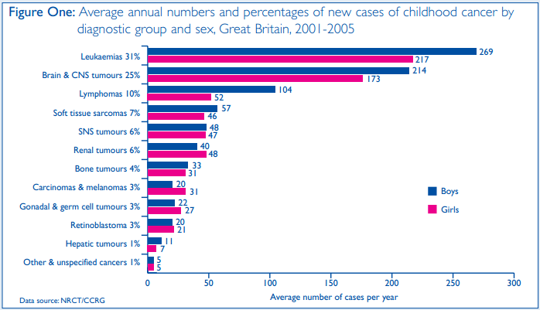
Common Type
Leukemia
Brain & CNS tumors
Lymphomas

Slide 4
Risk Factors
Breastfeeding
Drugs
Radiation
Smoking
Parental age
Infections
Birthweight
Allergies

Slide 5
Reference
1. http://www.childhoodcancer2012.org.uk/childhoodcancer.asp
2. http://en.wikipedia.org/wiki/Pediatric_oncology
3. http://www.cancerresearchuk.org/cancer-info/cancerstats/childhoodcancer/
4. http://www.cancerresearchuk.org/cancer-info/cancerstats/childhoodcancer/riskfactors/
5. CancerStats Childhood Cancer – Great Britain & UK
6. Key Facts of Childhood Cancer
Thank You

