Slide 1
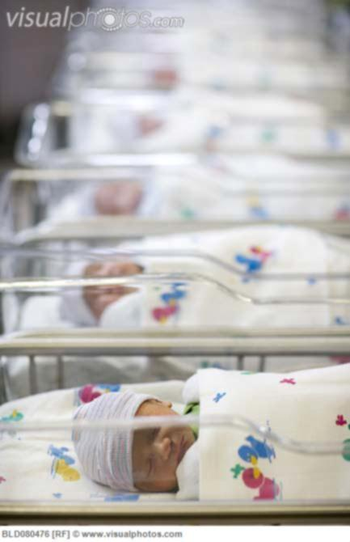
Importance of Immigration to Singapore
周英南 08300606002
12 Dec 2012

Slide 2
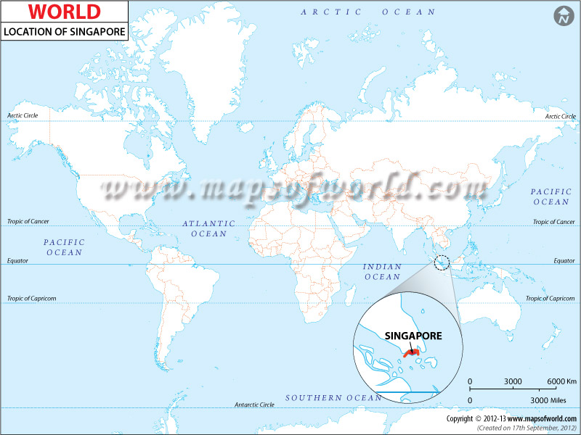
Location & Size of Singapore

Slide 3
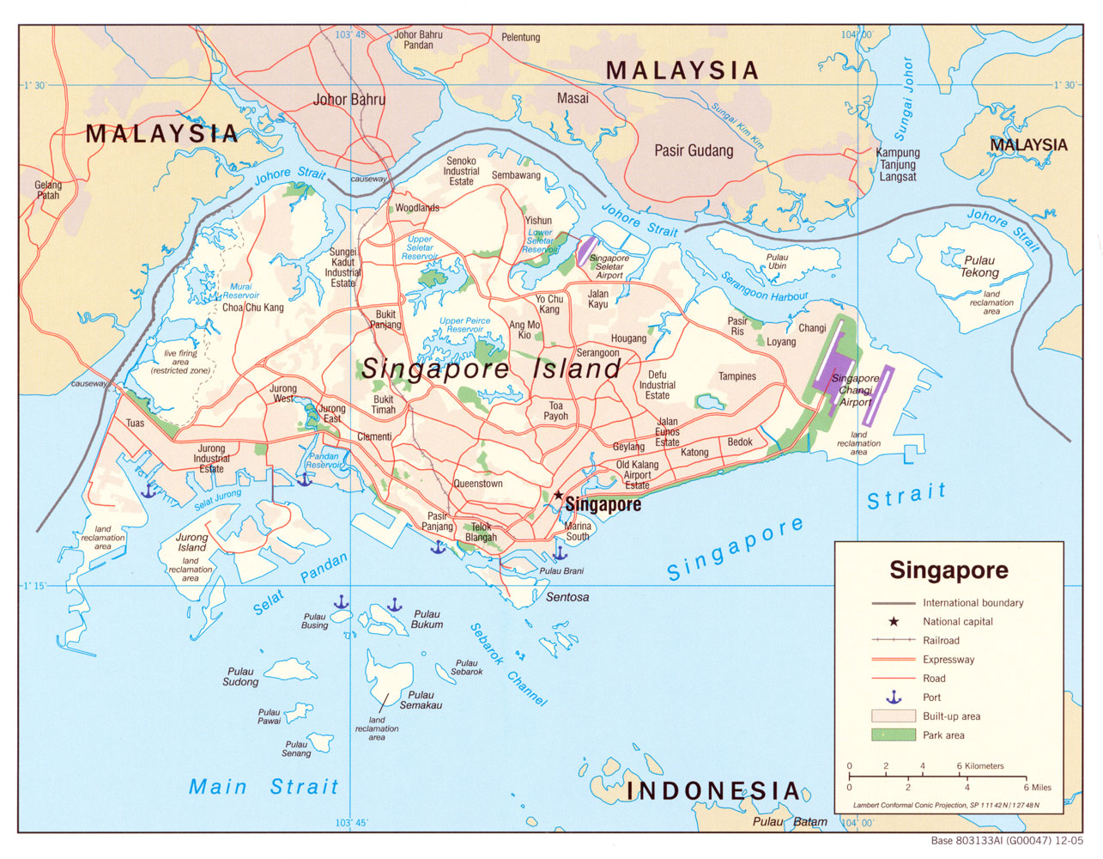
Area:
710 km²
Population:
(2012 census)
5,312,400
Density:
7,315/km²

Slide 4
TFR
Population
An explanation to Singapore’s growing population despite low total fertility rate

Slide 5
Population

Slide 6
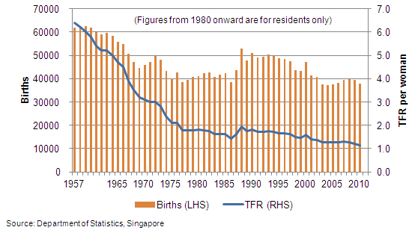
CBR & TFR

Slide 7
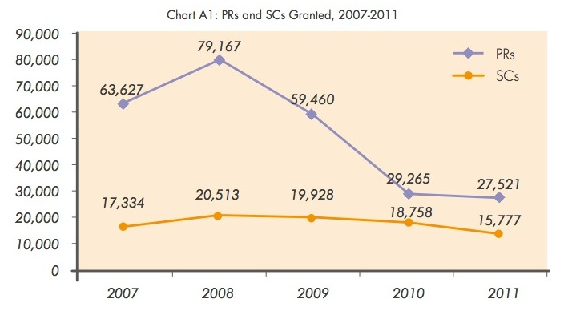
Immigration

Slide 8
1 : 1.091

Slide 9
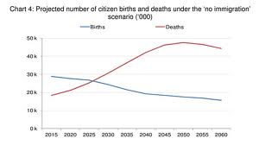

Slide 10
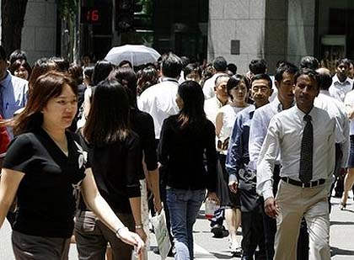

Slide 11
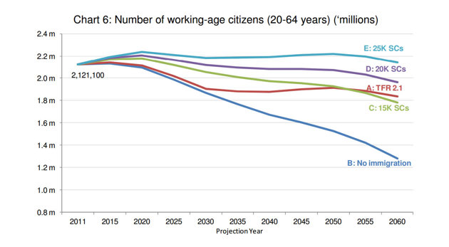
Workforce

Slide 12
Status Quo
An inflow of between 20,000 and 25,000 new citizens will be needed to keep the population of Singaporeans stable
However In-migration become an emotive topic. Competing with locals for jobs, education, housing, and other resources.

Slide 13
Thank you!

