Slide 1
Research Proposal: Effectiveness of Finland’s Measures to Promote Fertility
马洛塔 (10349086065)

Slide 2
Agenda
Background
Research Purposes
Methodological Issues
Implications
Notes:
Background -> why, history
Research Purposes -> what
Methodological Issues -> how
Implications -> significance

Slide 3
Finland’s Total Fertility Rate 1900-2011¹
TFR
1969: 1,94
Civil War
2011: 1,83
World Wars
Year
¹ Statistics Finland 2012
Notes:
EU average nowadays about 1.5

Slide 4
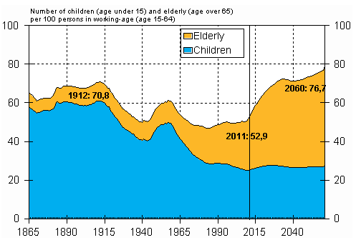
Demographic Dependency Ratio 1865-2060 ¹

Slide 5
Implications of Low Fertility
Impacts on the labor market – shortage of labor
Growing share of elderly
How to maintain the social security system with less resources
Notes:
Picture: http://selkosanomat.fi/kotimaa/vanhusten-hoito-saa-lisaa-rahaa/

Slide 6
Main Reasons for Decline in Fertility
1960s and 1970s: family planning, contraceptives, abortions ²
Later age of marriage and childbearing
Average age of first child bearing in 1968: 23.5 years ²
Average age of first child bearing in 2007: 28 years
High female employment ratio (2011: 67% of which 80% work fulltime ¹)
How to combine career and children
Continuing challenge in workplace atmosphere for both genders
Debates on the sufficiency of governmental financial support ²
Prolonged studies – average age of master level graduation 27.5 years ²
More women do not get children – 27% of highly educated women in their 40s ETLA ³
² Wallenius 2003 (EVA)
³ Kellokumpu 2006 (ETLA)
Notes:
Tapio Wallenius. 2003. Tuomitut vähenemään? Suomalaiset ja lisääntymisen vaikea taito. EVA. Publisher: Taloustieto Oy. ISBN 951-628-395-0 Available: http://www.eva.fi/wp-content/uploads/files/195_tuomitut_vahenemaan.pdf
ETLA. 2006. Available: http://www.etla.fi/to/perhejaura/muuta/103_web.pdf

Slide 7
Measures to Promote Fertility⁴
Promoting child bearing
Defraying the cost of raising a child
Monthly child benefit (1st child 104€, 2nd child 115€ … 5th child 190€)
Maternity grant (package or cash)
Parenthood allowances (mother 105 days, father 18 days, parental 158 days)
Supporting the raising up and development of children
Free education and e.g. school transport subsidies
Free and easy access to healthcare
Improving ways to combine career and children
Part-time work
Child day care subsidies
⁴ KELA 2012

Slide 8
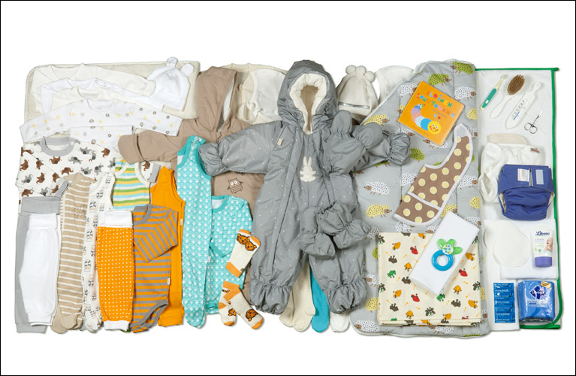
Maternity Package 2013
Notes:
Picture: http://www.kela.fi/in/internet/kuva.nsf/NET/100812144725AS/$File/13877.01_iso.jpg?OpenElement

Slide 9
Research Purposes
Purposes
Exploring comprehensiveness of fertility promotion measures in terms of socioeconomic changes
Investigating correlations between fertility promotion measures and changes in fertility
Specific Research Questions
Which factors are responsible for low fertility and which measures have been created to promote fertility in terms of the specific factors?
How have the promoting measures impacted fertility? Can cause-effect relationships be found?
How should the system be further developed?

Slide 10
Methodological Issues
Through a review of literature, previous research and statistical data (Statistics Finland, KELA - The Social Insurance Institution of Finland, United Nations, OECD)
Conceptualizing relationships between fertility promotion measures and socioeconomic factors
Building relationships between promotion measures and actual fertility development

Slide 11
Implications
Analysis can help evaluate effectiveness of current measures
Important to try to understand correlations between promoting measures and factors impacted
Efficient allocation of resources
Basis of improvement

Slide 12
Thank You

