Slide 1
Obesity in the US and effects on Life Expectancy
Christina Javier
UC Berkeley
Notes:
About 1/3 of adult americans
Approximately 17% of children and adolescents
Obesity is the one of the main factors in explains.
President Obama noted in one of his speeches that the US the highest per capita expenditure on healthcare in the world along with US’s low ranking of life expectancy among other industrialized countries
The prevalence of obesity is one of the biggest factors in explaining relatively low life expectancy.

Slide 2
42% of American adults will be obese by 2030, study says
By Melissa Healy, Los Angeles Times
May 8, 2012, 1:10 a.m.
Notes:
I wanted to begin my presentation by stressing the importance and prevalence of this issue to the American population.

Slide 3
Table of Contents
1
Definition of Terms
2
Disparity of Obesity based on Population Characteristics
3
Effects on Mortality
4
Trend of Obesity
5
Obesity and Life Expectancy
6
Economic Implications and Potential Solutions

Slide 4
Important Terms Defined
Body Mass Index (BMI)
Weight in kg divided by height in m²
Obesity
An Adult with a BMI of 30 or greater
Centers for Disease and Control Prevention (CDC)
US Federal Agency
Life Expectancy
avg. expected # of years to be lived from age x by a particular pop.

Slide 5
Obesity Trends Among U.S. Adults BRFSS, 2010
No Data <10% 10%–14% 15%–19% 20%–24% 25%–29% ≥30%
The South has the highest prevalence of obesity (29.4%) followed by the Midwest (28.7%), Northeast (24.9%) and the West (24.1%)

Slide 6
Obesity by Race

Slide 7
Health Risks
Obesity
Type 2 diabetes
Cardiovascular disease →
Heart Attacks
Cancer
Stroke
Notes:
Effects of obesity, obesity and mortality
Elevated risks for a number for chronic medical decisions

Slide 8
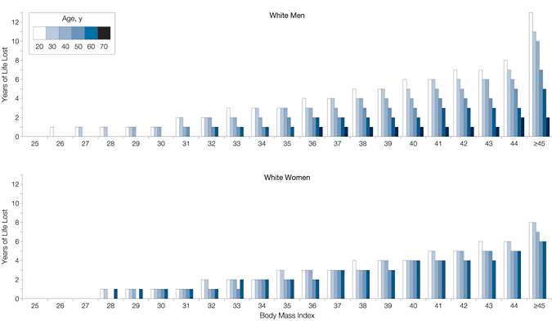
Obesity and Mortality
Years of Life Lost Due to Obesity
Fontaine et al.
Years of Lost Life (YLL): the difference between # of years a person is expected to live if he/she was not obese and the # of years expected to live if the person were obese.
Largest Effect of Obesity on Mortality
White Males aged 20 years with BMI's greater than 45 | Expected YLL of 13
White Females aged 20 years with BMI's greater than 45 | Expected YLL of 8
Notes:
YYL- years of lost life

Slide 9
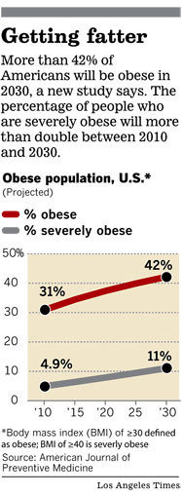
Obesity Trend
As early as January 2012, there were two CDC that claimed obesity rates were stabilizing.
Yesterday, at the Weight of the Nation Conference, it was announced that number of obese Americans is expected to swell from 36% of current adult population to 42% by 2030.
Severely obese is defined as having a BMI of 35 or higher.

Slide 10
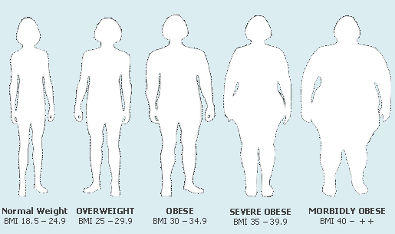
Image of Obese and Severely Obese
Notes:
5’9” -203 lb or more
1.75 m -92 kg

Slide 11
Obesity and Life Expectancy of US Population
A Potential Decline in Life Expectancy in the United States in the 21st Century
Olshansky et al.
Calculated as reduction of rates of death that would occur is everyone who is obese were to lose enough weight to be at a healthy level.
→ BMI of 24
Conditional probability of death at age x for non-obese population
q(xno)=[q(x)–q(xo)P(xo)]÷P(xno)
q(x)- conditional probability of death at age x for entire pop.
q(xo)-conditional probability of death at age x for obese pop.
P(xo)-proportion of pop. At age x that is obese
P(xno) )-proportion of pop. At age x that is not obese
Obesity-adjusted conditional probability of death at age x
q(xa)=q(xno)P(xno)+q(x24)P(xo)
Everyone who is obese acquires mortality risk of those with BMI of 24

Slide 12
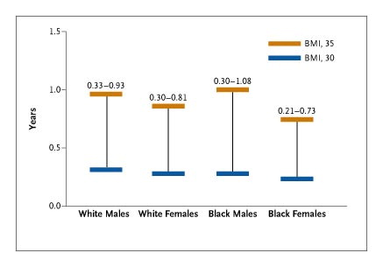
A Potential Decline in LE cont.
Conservative Estimates of Increase in LE at Birth in US
White Males: | .33-.93 year | Black Males | .30 to 1.08 years
White Females | .30-.81 year | Black Females | .21 to .73 year
Conclusion
As a result of substantial rise in prevalence of obesity, life expectancy at birth could level off or decline.

Slide 13
Contribution of Obesity to International Differences in Life Expectancy
Preston et al.
Focused on persons aged 50+, because currently 94% of newborns survive to 50 , and variation in life is dominated by variation in mortality above 50.
Population Attributable Fraction (PAF)- the proportional reduction in mortality that would occur if population above optimal category of BMI moved to the optimal category of BMI
→ BMI of 22.50-24.99
Life Expectancy at Age 50 years With and Without All-Cause Mortality Attributable to Obesity, by Country and Sex: 2006
 | e₅₀ for Women |  |  | e₅₀ for Men
Country | Actual | Without Obesity | Difference (95% CI) | Actual | Without Obesity | Difference (95% CI)
Estimates based on measured height and weight
Comparison countries
Canada | 34.50 | 35.66 | 1.15 (1.00, 1.51) | 30.72 | 32.09 | 1.37 (1.18, 1.59)
England | 33.31 | 34.54 | 1.23 (1.07, 1.60) | 29.84 | 31.18 | 1.34 (1.13, 1.53)
United States | 32.95 | 34.49 | 1.54 (1.37, 1.93) | 29.20 | 31.05 | 1.85 (1.62, 2.10)
Notes:
We focused on persons aged 50 years
and older because 94% of newborns survive to
age 50 years in the current US life table, and
variation in life expectancy at birth is dominated
by variation in mortality above this
age.8,9
Table 3
impact there, obesity has contributed substantially
to the US longevity disadvantage,
which would be significantly reduced and in
some cases eliminated in the absence of
obesity.
High levels of obesity in the United States
appear to be strongly implicated in its relatively
low level of longevity. We believe that this
demonstration should add urgency to public
health efforts aimed at achieving healthier
weights for Americans
estimated the effects of obesity
on longevity in 15 other countries

Slide 14
Economic Implications
Age-Based Entitlement Programs
Medical Burden
Costs attributable to obesity are almost entirely a result of costs generated from treating the diseases that obesity promotes.
Per capital medical spending for the obese is $1429 higher per year → 42% higher.
In aggregate, annual medical burden of obesity has increased 6.5-9.1% of medical spending → up to $147 billion per year.
Notes:
the solvency of
age-based entitlement programs and tax rates levied
by the federal government.
Prooductivity decreased
positive and statistically significant correlation between
obesity and measures of absenteeism
a result, the costs attributable to obesity are almost entirely a result of costs generated from treating the diseases that obesity promotes.
Across all payers, per capita medical spending for
the obese is $1,429 higher per year, or roughly 42 percent higher, than for someone
of normal weight. In aggregate, the annual medical burden of obesity has increased
from 6.5 percent to 9.1 percent of annualmedical spending and could be as
high as $147 billion per year

Slide 15
Solutions?
Prevention
Better access to healthy food
Treatment
Increased education and distribution of information on health risks
Funding for physical activity centers
Tax incentives for weight loss
Education in nutrition
Taxes on junk food
Notes:
Prevention? Treatment?
Study after study showing disappointing results for programs to helping obese adults lose weight
80% of americans dieters regain their weight loss, with many gaining even more weight than before

Slide 16
Questions?

Slide 17
Resources
"Adult Obesity Facts." Centers for Disease Control and Prevention. Centers for Disease Control and Prevention, 27 Apr. 2012. Web. 08 May 2012.
"Defining Overweight and Obesity." Centers for Disease Control and Prevention. Centers for Disease Control and Prevention, 27 Apr. 2012. Web. 08 May 2012. <http://www.cdc.gov/obesity/adult/defining.html>.
Healy, Melissa. "42% of American Adults Will Be Obese by 2030, Study Says." Los Angeles Times 08 May 2012. Print.

