Slide 1
Demographic Transition and Population Aging
Shen Ke

Slide 2
Outline
Demographic transition
Consequences of population growth
Population age structure

Slide 3
Demographic Transition

Slide 4
Demographic Equation
The size of a population can change only through the processes of fertility, mortality, and migration.
Demographic Equation
The quantity (Bt to t+1 – Dt to t+1): natural increase
if Bt to t+1 < Dt to t+1, then the number of deaths exceeds the number of births during the interval t to t + 1, meaning negative natural increase, or natural decrease
The quantity (It to t+1 – < Et to t+1): net migration
If It to t+1 < Et to t+1, then more persons leave (emigrate from) the area than enter (immigrate into) the area, and the quantity is known as negative net migration

Slide 5
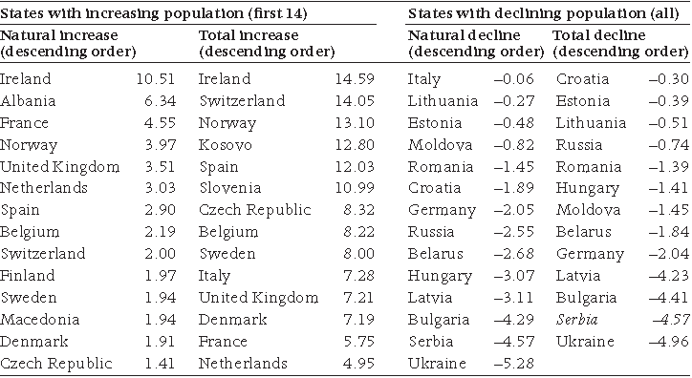
Natural and total population change in Europe, 2008 (‰)

Slide 6
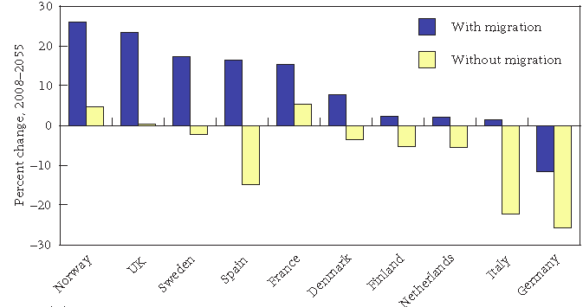
Population change in selected European countries 2008–2055, with and without migration (‰)
Notes:
In the medium-senario projection by United Nation, they assume that all countries will eventually converge to a TFR of
1.85 (UN 2009). They assume constant mortality. Migration, now the most important factor in Western population dynamics,
is the most volatile and the most difficult to project (Teitelbaum 2001).
The potential importance of future migration in Europe, assuming the continuation of current trends, can be gleaned from Figure
2. Those outcomes powerfully depend upon the often unpredictable factors behind the diverse components of migration flows.

Slide 7
Demographic Transition
"Population–The Long View” By Notestein, Frank W. in 1945.
Transition from high birth and death rates to low birth and death rates as a country develops from a pre-industrial to an industrialized economic system.

Slide 8
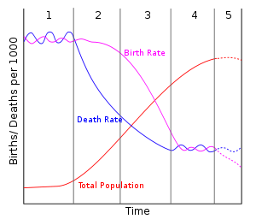
Five Stages of the Demographic Transition

Slide 9
Five Stages of Demographic Transition
Stage 1
High birth rates, high death rates, low growth rates
High birth rates: Little or no family planning; Parents have many children because few survive; Many children are needed to work the land.
High death rates: Disease and plague; Famine, uncertain food supplies, and poor diet; Poor hygiene, no piped clean water or sewage disposal
Stage for much of human history, pre-industrial societies
practically no country today

Slide 10
Five Stages of Demographic Transition

Slide 11
World Population
1750 Industrial Revolution
Between 1700 and 1900, Europe’s population increased from about 100 million to over 400 million

Slide 12
Five Stages of Demographic Transition
Stage 2
High birth rates, declining death rates, rising growth rates
More food supplies, improved sanitation (water) and access to basic health care, which increase life span and reduce childhood mortality
Started since the Industrial Revolution in the late 18th century and ended in the mid-20th century in Europe
Started in developing countries since the 1950s/60s and developed substantially faster
much of Sub-Saharan Africa today, some countries of Asia (Afghanistan, etc.)

Slide 13
Five Stages of Demographic Transition

Slide 14
World Population
2010, 1.2%
In early 1960s, 2.2%

Slide 15
Five Stages of Demographic Transition
Stage 3
Continued decline of death rates, declining birth rates, growth rates decline from high to lower levels
Declining birth rates:
Contraceptives, abortions; Family Planning polices;
Lower infant mortality rates means less pressure to have children
High childrearing cost
Increased mechanization means less need for labor
Increased desire for material possessions
India , Mexico, Egypt, Indonesia, Malaysia, Philippines today

Slide 16
Five Stages of Demographic Transition

Slide 17
Five Stages of Demographic Transition
Stage 4:
low birth rates, low death rates, low growth rates
China, South Korea, Singapore, United States, Canada
Stage 5:
Very low birth rate, and possibly increasing death rate, population decline.
West Europe and Japan.

Slide 18
Five Stages of Demographic Transition

Slide 19
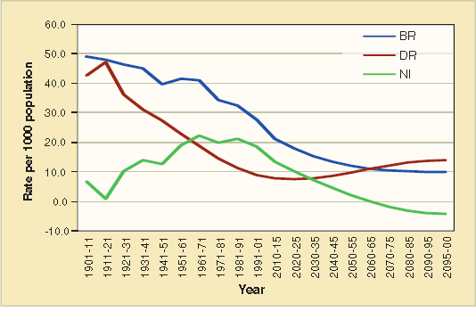
Demographic transitions in India

Slide 20
Consequences of population growth

Slide 21
Is population growth good or bad for economic development?

Slide 22
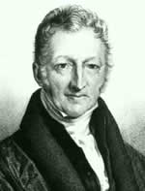
Malthusian population model
An Essay on the Principle of Population (1798)
Population tends to grow at a geometric rate, i.e. 2, 4, 8, 16, 32, etc
Food supplies, which is necessary for survival, only expand at an arithmetic rate due to diminishing returns to land. i.e. 1, 2, 3, etc.
Overpopulation forces wages to be low and decreases food available to people. Population growth leads to poverty.
1766-1834 England

Slide 23
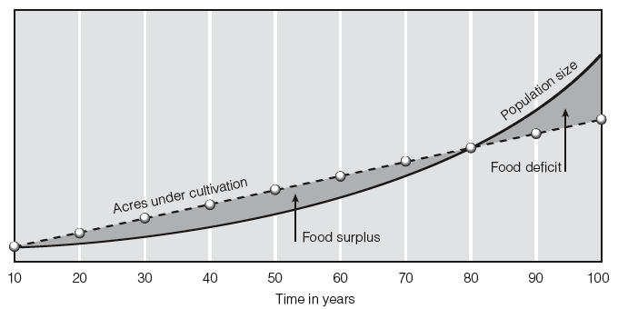
Population growth would always have the potential to outpace food growth!

Slide 24
Checks on Population Growth
Positive checks: through the rise in mortality.
famine, war, disease, and infanticide that would increase the death rate.
Societies where the positive check dominates have low average income
Preventive checks: through moral restraint.
people tend to restrain themselves, refraining from premarital intercourse and postponing marriage.
He was opposed to other types of preventive checks, such as contraception, and abortion.
Societies where the preventive check dominates have higher average income, since the birth rate falls if income drops and the fall in fertility relieves the population pressure, thereby, cushioning the income drop. (West European Countries)

Slide 25
Coments on Malthusian Theory
Malthus’ main contribution was determining that population has environmental consequences.
Critiques:
Radical technological progress is not considered.
It‘s inreasonable to assume that the agricultural output would increase at an arithmetic rate.

Slide 26
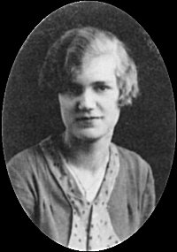
Ester Boserup
Danish agricultural economist, with field experience in India & other Asian countries.
In the Malthusian view, in times when food is not sufficient for everyone, the excess population will die.
Boserup argued that in those times of pressure, people will find ways to increase the production of food by increasing workforce, machinery, fertilizers.
(1910-1999)

Slide 27
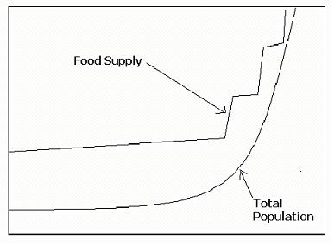
Ester Boserup’s notion
The growth rate of food supply may vary but never reaches its carrying capacity because every time it is getting near, there is an invention or development that causes the food supply to increase at a greater rate.

Slide 28
Julian Simon
1981 published Population: The Ultimate Resource
Simon argues that the population growth exerts its influence by increasing the tempo of innovation.
Don’t just consume resources,
but also create resources
1932-1998
University of Maryland

Slide 29
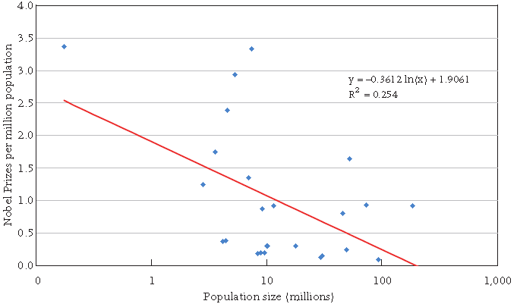
Relationship between Nobel Prizes 1901–2002 per million population and population size in 1960

Slide 30
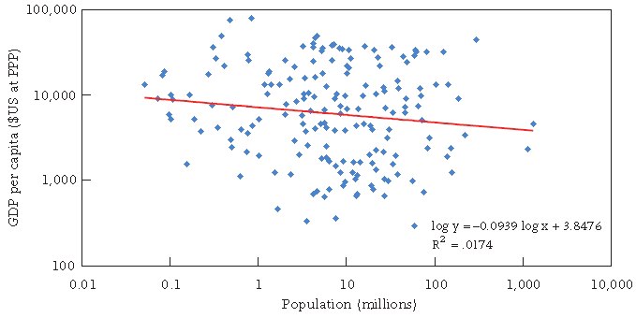
GDP per capita and population, 180 countries, 2006

Slide 31
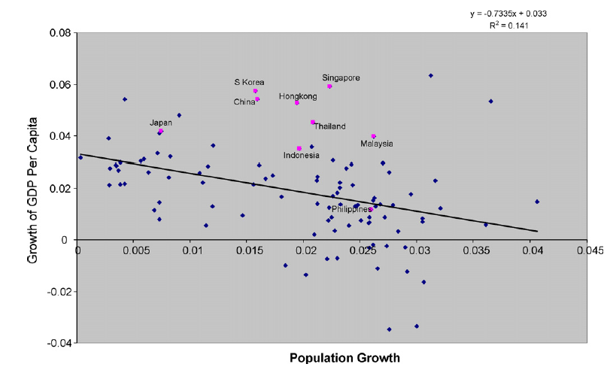
Population growth and economic growth, 1960–2000.

Slide 32
Population Age Structure

Slide 33
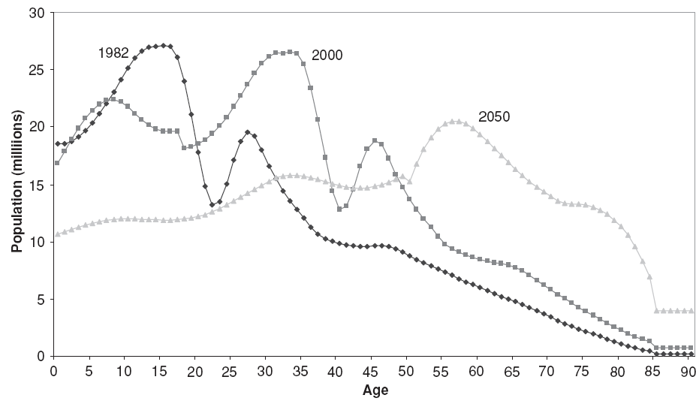
Population by Age, China, 1982-2050 (Wang and Mason, 2008)

Slide 34
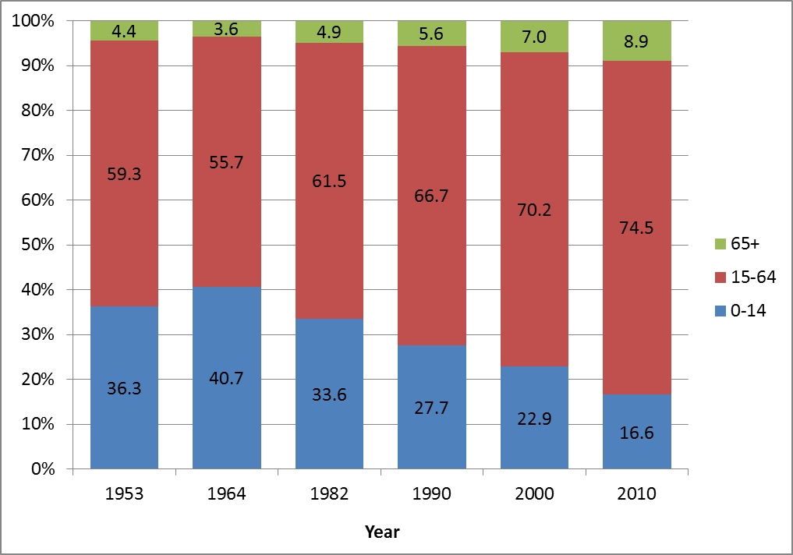
Age structure transition in China, 1953-2010

Slide 35
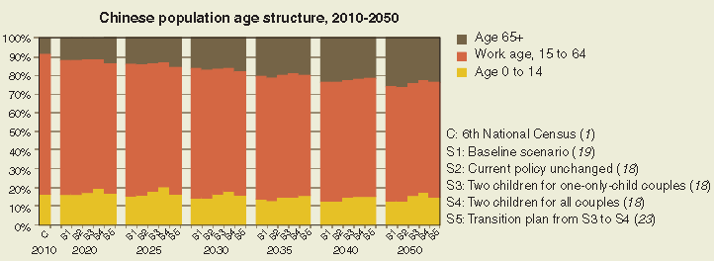
China’s Population structure, 2010-2050

Slide 36
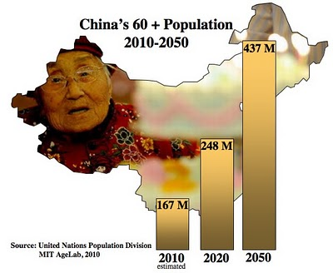
Expansion of elderly population

Slide 37
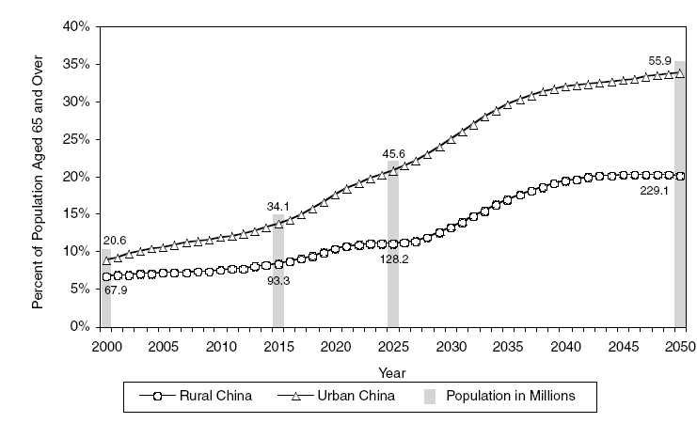
Rapid aging population
22.6% in Japan, 2010
20% in 2025
15% in 2015
15% in 2033

Slide 38
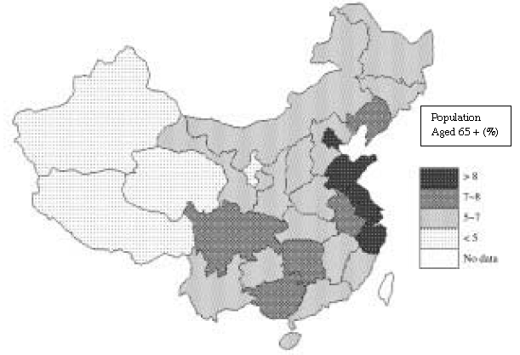
Regional Variations in Population Aging, 2000
Notes:
Regional variations in population aging are very similar to the regional variations in current fertility, indicating that the aging process is mainly
determined by the decline in fertility
Here it also does not take into account of the migration. Central provinces have the largest net outmigration, like henan and Anhui provinces.

Slide 39
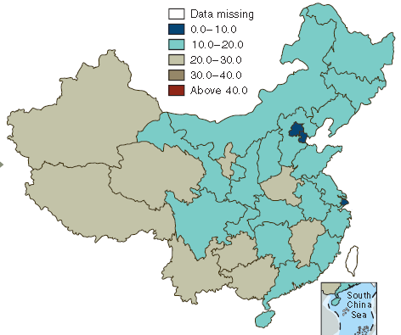
Proportion of population aged 0 to 14, 2010

Slide 40
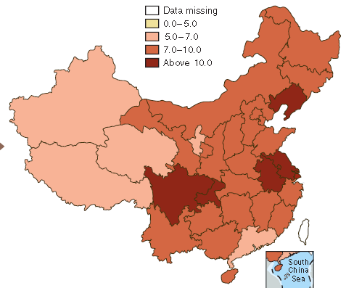
Proportion of elderly aged 65+ (%), 2010

Slide 41
Dependency Ratio
Dependency ratio=(# 0-14 + # 65 and older) / # 15-64
Youth dependency ratio= # 0-14 / # 15-64
Old-age dependency ratio= # 65 and older / # 15-64
The more younger and older people in the population, the higher the dependency ratio.
Measure the burden of the society: how many working people have to support the young and old who are consumers in the society.

Slide 42
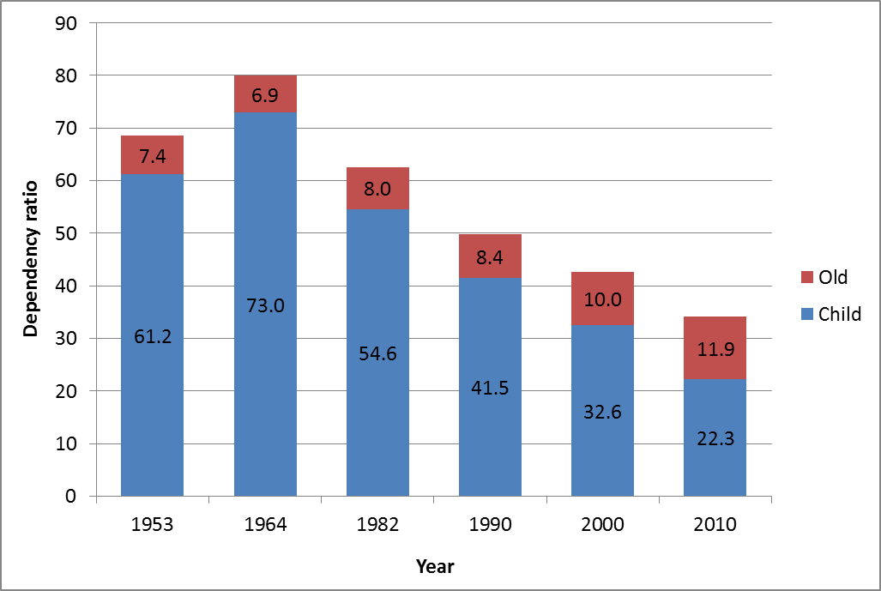
China’s dependency ratios, 1953-2010

Slide 43
China’s dependency ratio (1953-2050)
%
90
80
70
60
50
40
65+ dependency ratio
30
20
10
0-14 dependency ratio
0
2038
2040
2042
2044
2046
2048
1953
2036
2050
1964
1982
1990
2000
2002
2004
2006
2008
2010
2012
2014
2016
2018
2020
2022
2024
2026
2028
2030
2032
2034

Slide 44
Dependency Ratios for Six Countries, 2005

Slide 45
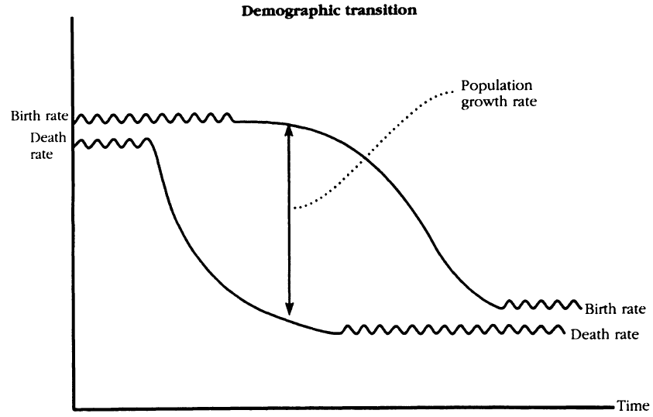
Demographic Transition

Slide 46
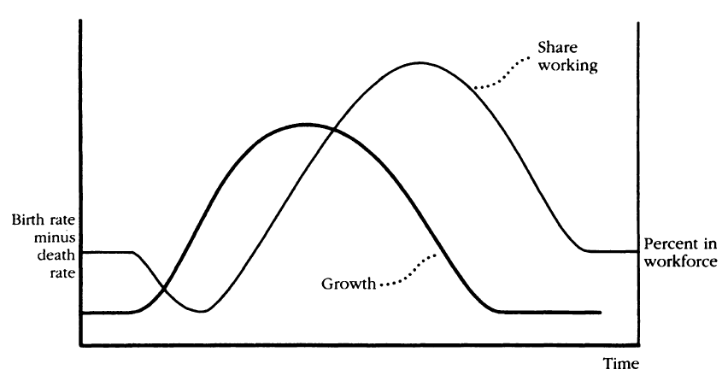
Population growth and age structure

Slide 47
Demographic Dividend
Demographic dividend is a rise in the rate of economic growth due to a rising share of working age people in a population.
It occurred in the third stage of demographic transition.
When the mortality continued to decline and fertility began to decline, the youth dependency ratio declines and the rise in old-age dependency has not started.
When the demographic transition proceeds, the demographic dividend will diminish.
Continuing low fertility leads to less young people entering the labor market
the previously large working age cohort grows older, population aging sets in and old-age dependency ratio increases

Slide 48
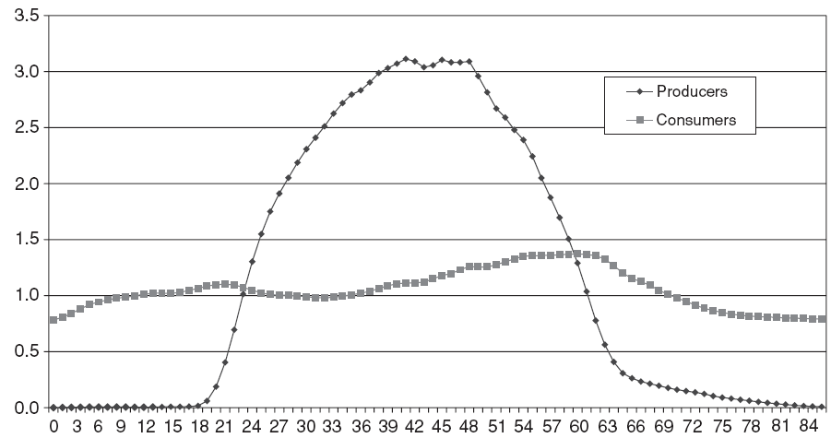
Age profiles of consumption and production, urban China, 2000
Surplus Ages
Deficit Ages
Deficit Ages

Slide 49
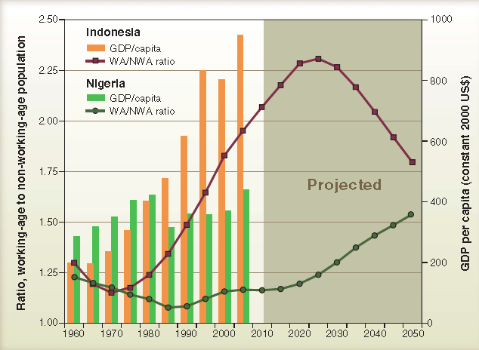
Close alignment between GDP per capita and ratio of working-age to non–working-age population

