Slide 1
Breast Cancer ————————— Prevention
CHEN WANNA
10301010094

Slide 2
Useful Language
Estrogen 雌激素
HRT/HT 激素代替疗法 /激素疗法
Asymptomatic无临床症状的
Menstruation 月经
Menopause 绝经期
Mammogram 乳房X线照片
Progestin 孕酮，孕激素

Slide 3
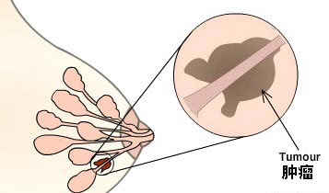
Breast Cancer
Breast cancer: A type of cancer originating from breast tissue, most commonly from the inner lining of milk ducts or the lobules that supply the ducts with milk.^{[1]}
Ductal carcinomas
Lobular carcinomas

Slide 4
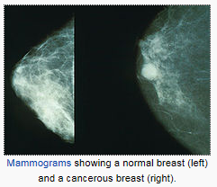
Risk Factors
Estrogen
Early menstruation: ≤11 years old
Late menopause: ≥50 years old
Late pregnancy(≥35) or never being pregnant
Exposure to radiation：BRCA1 and BRCA2
Hormone replacement therapy（HRT）/Hormone therapy（HT）

Slide 5
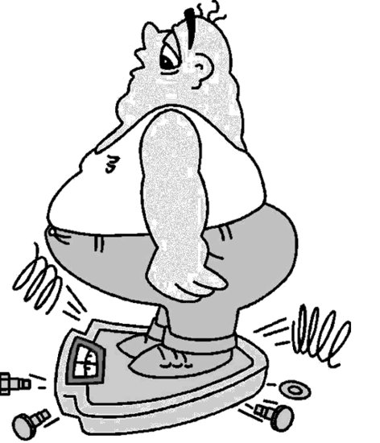
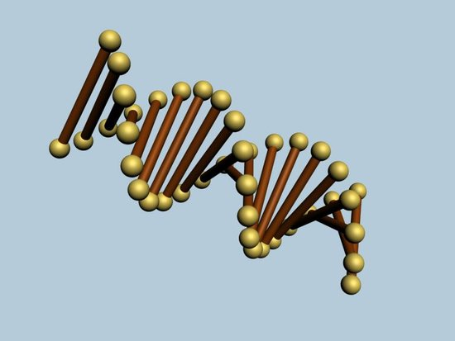
Risk Factors
Obesity
Alcohol
Genes^{[4]}

Slide 6
Prevention
Proper Diet
Exercise
Stay Slim
Stop Smoking

Slide 7
Prevention
Pregnancy Breastfeeding
(≤30)
Regular Checkup
Good Emotional Health
Early Detection^{[5]}

Slide 8
Early Detection
Early Detection of Breast Cancer in Asymptomatic Women:
Age 20-39
Clinical breast examination every three years
Monthly breast self-examination
Age 40 and over
Annual mammogram
Annual clinical breast examination
Monthly breast self examination
American Cancer Society
Breast Cancer
Facts & Figures 2001- 2002

Slide 9
References
[1]Sariego J (2010). "Breast cancer in the young patient". The American surgeon 76 (12): 1397–1401. PMID 21265355.
[2]http://english.peopledaily.com.cn/90001/90776/90882/7332581.html
[3]http://breastcancer.about.com/od/risk/a/bc_prevention.htm
[4]http://www.ncbi.nlm.nih.gov/pubmedhealth/PMH0032652/
[5]http://breastcancer.about.com/od/riskfactorsindetail/tp/top_10_prevent_bc.htm
[6]Food, Nutrition, Physical Activity and the Prevention of Cancer: a Global Perspective; American Institute for Cancer Research/ World Cancer Research Fund,
http://www.dietandcancerreport.org

Slide 10
Thank you!

