Slide 1
英语口译
5
Ecological Environment

Slide 2
Warming up: Listen, understand and remember
“WHO: Environmental Pollution Kills Millions of Children Every Year” (from NPR)
a. What is the main idea of the news story?
b. How many parts can you divide the story into?
c. Can you find the logic markers in the story?
d. Can you recall as much info as possible in each part?

Slide 3
One-on-one interpreting
a. E-C, and ask the speaker:
How do you rate your partner?
Any mistakes to correct?
Can you explain the logic flow in your report?
b. C-E, and ask the speaker:
How do you rate your partner?
Any mistakes to correct?
Can you suggest ways of interpreting Chinese-specific expressions in your report?

Slide 4
Vocabulary: Vie to answer first!
Step 1:
Identify key word in the sentences you hear & use it in a new sentence you create!
Step 2:
Vie to interpret the new sentence your classmate just created!
key words:
species, threatened, extinct, to erode, consistent with, Copenhagen Accord, sandstorm, haze, smog, at any cost, aim to, to give full consideration to, to eradicate, livelihood, predicament, marine environment, forest cover, low-carbon economy, sewage disposal, garbage sorting, pattern of growth, renewable, degradable, to be dedicated to, to restore, to curb, to pledge, meteorological, urbanization

Slide 5
Important Skill: Take Notes
listen and understand tell key information take notes
Q: in what language?
Using short-hand:
1) fr, mo
econ, eco
dev, dec (↓)
inc (↑)
2) CHN
MKT

Slide 6
Using symbols
∵
∴
:
//
☆
。y
D。
()
√
⊙
O (So)
↑
↓
←
→
＋
－
×
∧ (∧o)
﹠
□
□.
﹥﹤
U

Slide 7
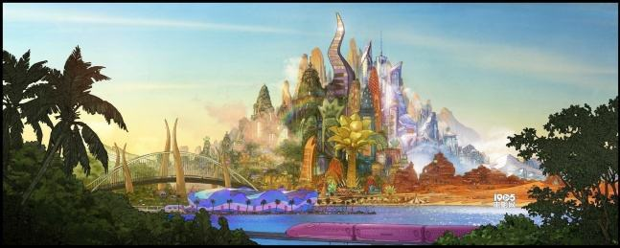
Important Skill 1: Retelling short chunks of message
1. Theory:
the working memory mechanism of interpreters
2. Example:
 Listen to the mock news story “reform at the kangaroo public school”, take turns to retell the major chunks of information!
问题
疑问
举措

Slide 8
在最具盛名的袋鼠公学，网络课程正在带来巨大的冲击。既然学生们在慕课、微课上能学到他们需要的占卜、打洞、觅食等各种技能，那么为什么还要住在学校，每天去教室听老师作长篇讲授呢？为了应对这些冲击，袋鼠公学校方及时作出了改革。课程设置变得更加注重实践性，校园建设变得更加注重舒适性，而校长在一次全校讲话中更是强调了在实体学校上学有助于塑造每一只袋鼠的社交性格。

Slide 9
Note-taking: more practice
The most devastating wildfires in Californian history are not only ripping through forests and communities but are also causing a wider public health crisis due to polluted air and unhealthy smoke from the burning.
Smoke from the wildfires has reached the wider San Francisco Bay area, and is causing an “evil glow” over the famous Golden Gate Bridge and “horrible haze” over the city.
Authorities are now warning people to stay indoors due to the “unhealthy” air outside.
If residents are venturing outside, many residents are wearing face masks to try and protect their health.
But there are also concerns about other contamination too. One of the fires is reported to have begun on, or close to, the heavily contaminated Santa Susana Field Laboratory (SSFL) site. A former nuclear and rocket engine testing site, it is seen as one of the most contaminated sites in the US, and local residents have long campaigned for it to be cleaned up.
Over the last few days there has been raging debate about possible additional air contamination from this site caused by the fires.

Slide 10
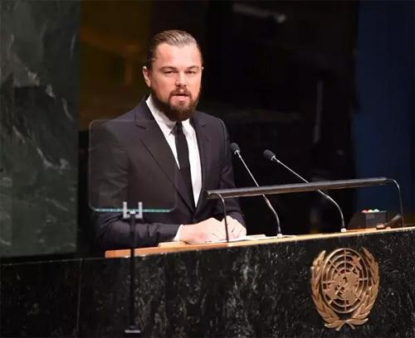
Have a try!
 “Leonardo’s UN climate change speech” (video/教学用的视频)
Pair work:
Student A: retell the chunk of meaning (1 min)
Student B: interpret for Leonardo!

Slide 11
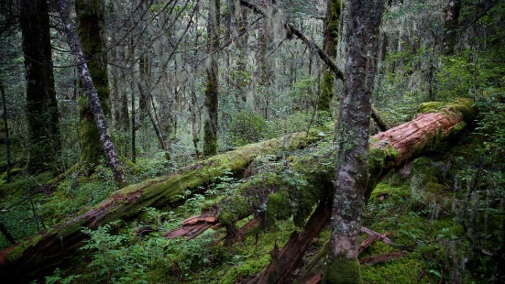
Important Skill 2: Interpreting connotation of words
1. Theory:
A myth: linguistic counterparts across languages
A truth: shades of difference in denotation and connotation
2. Example:
  Listen to “loss of species”.
Question: How do you understand the meaning of “harbor” and “be home to”?

Slide 12
Practice
 E-C: audio-1
 C-E: audio-2
 E-C: audio- 12
C-E: audio- 7
(from course audio archive)

Slide 13
Homework
1) Get prepared for Quiz 1
2) Vocabulary for “Tourism”

