Slide 1
学术英语（社会科学）课程与教学
张颖
复旦大学

Slide 2
学术英语（社会科学）
2011年春至今
大学英语选修课
每学期3-4个班，每班15-30位学生，每周两节45分钟课，2学分
同一班级有不同年级，不同专业，不同research水平，不同英语水平
经济学、新闻、政治学、社会学内容

Slide 3
复旦学术英语(社科)教学目标
Developing generic English skills in content-related activities
Developing academic language skills
e.g. formality, referencing and citation
Developing critical thinking
e.g. argument/voices/ what makes it science

Slide 4
Weekly Schedule Spring 2014
 | Content |  | Academic Skills & Strategies | Paper Writing Tasks
Week 1 | Induction: Ice-breaking Needs discussion |  | *academic culture *formal academic English | What is an academic paper?
Week 2 | How People Make Decisions 1 |  | *presentation skills (signpost language) *format of an academic paper *choosing a feasible research topic | Deciding on the topic of a small research project
Week 3 | How People Make Decisions 2 |  | *tips for academic listening * being polite in speaking | Writing introduction
Week 4 | Thinking like an economist 1 |  | *formal and informal English | Finding relevant literature
Week 5 | Thinking like an economist 2 |  | *paraphrase, summary, synthesis skills | Writing literature on your chosen topic
Week 6 | Unemployment 1 |  | *formal English rules | Describing how you are going to systematically collect and analyze data
Week 7 | Unemployment 2 |  | *distinguishing different voices in reading (criticizing Mankiw) | Collecting data
Week 8 | The Study of Society and People 1 |  | *transition, hooking and other basics of English writing | Collecting data
Week 9 | The Study of Society and People 2 |  | *describing graphs | Reporting and analysing research results
Week 10 | Sociology matters |  | *navigating academia | Discussing results EAP\Writing Discussion.ppt
Week 11 | Change in Journalism |  | *signpost language for academic writing *hedging in writing | Discussing results
Week 12 |  |  |  | First draft
Week 13 | Hard Power, Soft Power |  | *a real writing case (Berkeley) of Economics study | Second or more draft(s)
Week 14 | The Study of Politics as a Science |  | *round-up of the term
Week 15 | Tutorials

Slide 5
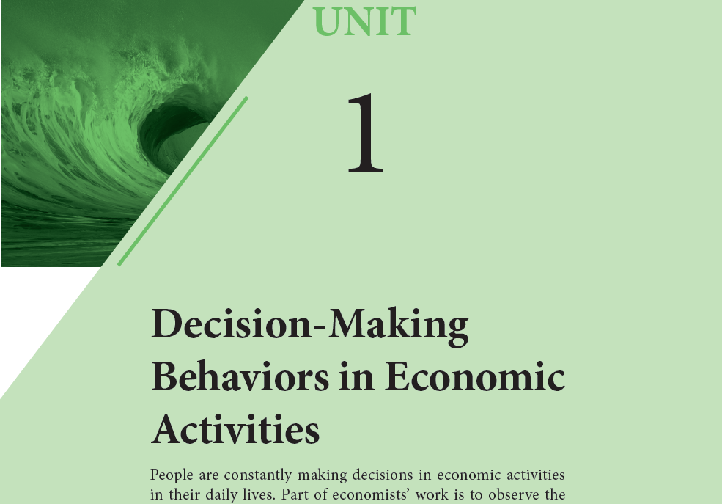
3
Unemployment
Unemployment has been a serious global social issue in recent years. Both politicians and economists are making great efforts to find ways to reduce the unemployment rate, though the result is not always satisfactory. The texts in this unit may give you some insights into this issue.

Slide 6
Unit 3 Unemployment
Text A
Language focus
Difficult Sentences
Collocations
EAP\collocation Unit 3.ppt
EAP\collocation Unit 4.ppt
Formal English
Critical reading and thinking

Slide 7
Unit 3 Unemployment
Text A
Critical reading and thinking – the global picture
Summary of Text A:
学生课前完成，上课检查

Slide 8
Unit 3 Unemployment
Text A
Critical reading and thinking – detailed reading
The key word to describe frictional unemployment
Mismatch
Causes of mismatch
Textbook examples / Chinese examples
1.
2.
3.
Solutions
The arguments about the solutions:

Slide 9
Unit 3 Unemployment
Text B
Language focus
Difficult Sentences （Why difficult?）
Collocations
Formal English
Critical reading and thinking

Slide 10
Unit 3 Unemployment
Text B
Critical reading and thinking – the global picture
Summary of Text B：

Slide 11
Unit 3 Unemployment
Text B
Suggested answers
Critical reading and thinking
Task 1 The tree diagram below illustrates the main points of the text. Complete it according to the text.
Debate topic: __________________________
Why unemployment is so high?
Argument by some economists:
______________________________________________________
Argument by most people: ____________________________
There are jobs out there, just not
Employers just aren't hiring enough.
the right candidates to fill them.
Supporting details: ________________________________
Supporting details:
____________________________

Slide 12
Unit 3 Unemployment
Text B
Critical reading: questions for discussion
The author’s position?
Although the writer seems to be objectively presenting the two sides of the argument, the way he presents the arguments of the two sides and the way he ends the article indicate that he is more in favor of the argument that the unemployment situation in the US is not just structural unemployment.

Slide 13
Critical Reading
Unit 3 Unemployment
Do not fall under the spell of the printed word as authority.
Very few of your instructors think of the texts they assign as the last word on the subject.
Remember that the author of every text has an agenda – something that he or she wants you to believe.

Slide 14
Unit 3 Unemployment
Critical reading: questions for discussion
How about Text A? How many voices do you find in Text A?
In text A there is only one voice.
Textbooks offer you a basic understanding of the major issues in a particular field, but not in-depth coverage of specific topic, nor the most recent developments.

Slide 15
Asking Yourself Questions
Unit 3 Unemployment
"What is the author trying to say?"
"What is the author assuming I will agree with?"
Do you agree with the author?
Does the author adequately defend her argument?
What kind of proof does she use?
Is there something she leaves out that you would put in?
Does putting it in hurt her argument?

Slide 16
Unit 3 Unemployment
Writing
Writing literature review
Writing tasks
Notes:
16

Slide 17
Unit 3 Unemployment
Writing
Literature review
Reviewing literature often involves summarizing the reading.
Find the main ideas which are often to be found in topic sentences.
Delete details and examples, unimportant or subsidiary information, anecdotes, illustrations, data etc.
Rearrange words and sentences. Combine your notes into a piece of continuous writing.

Slide 18
Unit 3 Unemployment
Writing
Literature review
In literature review what is most important however is not summarizing for its own sake. You summarize others’ work either to support your points or to criticize the work before you introduce your points.
In the end remember to make sure your purpose of summarizing is clear, the meaning is the same with the original, the writing is your own, and acknowledge other people's work.

Slide 19
An example Which sentences are the writer’s voice?
Unit 3 Unemployment
1. The relationship between price and perceptions of quality is not clear. 2. Alpert, Wilson, and Elliot (1993) observed that higher price alone did not create impressions of a higher quality facial moisturizer. 3. However, they found that a higher price, coupled with quality signals such as premium packaging and advertising did indicate higher quality to consumers.

Slide 20
An example Which sentences are the writer’s voice?
Unit 3 Unemployment
4. High price has been shown to have varied effects on the likelihood of trying a product as well. 5. Dodds et al. (1991) demonstrated that high prices reduced reported willingness to buy products. 6. This finding is consonant with the traditional notions of the demand curve, which suggest that price and demand are inversely proportional (Kreul, 1982). 7. Conversely, Rachman (1999) pointed out that high prices often increase demand for wine, another case in which consumers may equate high prices with high quality. 8. This phenomenon suggests that the impact of a high price on demand is affected by the type of product. 9. Lambert (1970) showed that high priced products were preferred when different brands of the product varied greatly in quality and when the product was socially significant, both of which seem to be the case with wine.

Slide 21
An Example
Unit 3 Unemployment
1. writer’s voice – introduces topic – the relationship between price and quality
2-3 indirect voice of source – the perceptions of quality and price with reference to moisturizer
4 writer’s voice – introduces topic 2 – relationship between price and likelihood of buying a product
5 indirect voice of source – findings of Dodds et al.: high prices reduced demand
6. writer’s voice – comment: the study by Dodds et al supports the traditional concept of the demand curve
7. indirect voice of source – Rachman’s study contradicts the study of Dodds et al.
8. writer’s voice – a possible implication of Rachman’s study
9. indirect voice of source – Lambert’s voice supports the implication

Slide 22
Unit 3 Unemployment
Homework
Check voices in your review of literature

Slide 23
学术英语课程教学手段和方法
Improving general English skills in content-related activities
例：incentive theory
Research policies dealing with traffic jam in the cities of Beijing, Shanghai, London, Tokyo and New York, then discuss the effectiveness of the policies with relation to incentives.
Developing academic language skills
例： formal English rules
Developing critical thinking
例: Recognising different voices

Slide 24
灵活使用教材
跨课文
Unit 3 A/B课文结合讨论voices
Unit 7A课文结尾体现在B课文
Unit 8 A/B课文文体比较哪个更学术？
跨单元
1.2.3单元 criticizing Mankiw
2.4.10单元 what make economics, sociology, political science studies scientific?
利用非学术写作材料
1单元B 新闻写作与学术写作对比
1,2,3,4都是教材写作，找出其中非学术写作的用法

Slide 25
考核
终结性和形成性考核结合
终结性：Final exam
（vocabulary，summary, formal English）
形成性：
1. presentation (师生共同讨论标准)
2. research paper
a small investigation project
step-by-step instruction: choosing a topic, explaining the background, reviewing others’ studies, explaining how to investigate the issue, report and analyze research results, discussion…
step-by-step feedback + several drafts

Slide 26
评估和反馈
匿名评分：满分5分，平均4.96
匿名评语：
您的课堂氛围特别好！本来想着社会科学应该会很枯燥，但听过课后感觉它还是很有意思的，我也了解了很多社科的知识。不过因为我英语水平不好，自己又没有胆量说，浪费了很多宝贵的机会。我会努力
备课认真，教学善于引导。谢谢老师一学期的教授，我收获很多～
老师很高兴这学期选了您的课，在这一学期里很愉快，也学了很多东西。谢谢您，老师辛苦了。
很有收获，老师备课、批改作业都很认真，也提供了很多资源，是门很好的课。
老师讲得太好了！学术英语也可以这么有趣！！

Slide 27
关于学术英语课程设置的几点建议
结合学校发展定位, 结合学生需求和现状确定目标
结合计算机技术，尤其是Corpus linguistics进行教学
在课程设置上和专业老师配合
给授课老师进修的机会和各种支持
课程设置和教学结合科研

