Slide 1
Economic miracle of China

Slide 2
Two parts
1. Basic facts of China’s economic miracle
2. Understanding China’s economic miracle

Slide 3
1. China’s economic miracle
Inflation being controlled, the average annual growth rate is 9%.

Slide 4
Since 1978, about 0.6 billion Chinese got out of poverty. In 2011, China adjusted its poverty standard (income per capita RMB2300), about 12.7% population was under the line. It decreased to 8.5% in 2013.

Slide 5
Burgeoning international trade (USD 100m)
China now has the biggest amount of international trade in goods.

Slide 6
The world’s major destiny of Foreign Direct Investment Total amount of Actually Utilized FDI (USD 100m)
In 2009, China’s FDI outflow may for the first time EXCEED its FDI inflow.

Slide 7
Capital outflow
Since 2009, capital outflow exceeded inflow.
Beyond capital outflow for business purposes, policy-driven investment and loan are beginning to play an important role
The Bricks Bank
The AIIB (Asian Infrastructure Investment Bank)

Slide 8
Top 10 car makers in 2011
Rank | Auto Manufacturer | Sales (10000) | Growth rate (%)
1 | Shanghai Auto | 270 | 57
2 | First Auto | 194 | 26
3 | Dong Feng | 189 | 43
4 | Chang An | 186 | 56
5 | Beijing Auto | 124 | 61
6 | Guangzhou Auto | 60 | 15
7 | Chery | 50 | 40
8 | BYD | 44 | 160
9 | Hua Chen | 34 | 22
10 | Geely | 32 | 48
Sum |  | 1183

Slide 9
In 2010, China’s GDP was USD 5878 billion, exceeding Japan’s USD 5474 billion and becoming the second largest national economic entity.

Slide 10
2. Understanding Chinese economic miracle
1) State-steered development
2) Investment driven economy
3) International and domestic consumption
4) Comparative advantages
5) Reform path and strategy

Slide 11
1) State-steered development
East-Asia Developmental State model
State-led quick economic development under political stability
A response to the lack of market economy history and capable enterprises
State is strong with the capacity of economic planning and coordination
Performance legitimacy
Major aspects of state steering
1. State planning and macro-control;
2. State-owned enterprises;
3. Local state corporatism (Oi, 1992)
4. Pro-growth local competition
GDPism, administrative efficiency

Slide 12
Fortune 2013 list of top 10

Slide 13
State-owned enterprises as a portion in China’s top 500 enterprises in 2004 and 2012
In 2012, the largest private enterprise was ranked 44 in the top 500. The no. 1 SOE was 9 times larger in its sales revenues.

Slide 14
The strong local incentive of economic growth
 | 2008 | 2009 | 2010 | 2011 | 2012
National data (A) | 316030 | 340320 | 399759 | 468562 | 516282
Sum of provincial GDP (B) | 333314 | 365303 | 437041 | 521441 | 576551
Gap (C=B-A) | 17283 | 24983 | 37282 | 52878 | 60269
Gap (C/B) | 0.05 | 0.07 | 0.09 | 0.10 | 0.10

Slide 15
2) Investment driven economy
Major drives of economic growth and development
Consumption, export (external consumption) and investment
Investment is from both domestic and international
China’s high savings rate facilitates capital accumulation
Policies that encourage foreign direct investment
Continuous decentralized investment approval decision
Tax and other benefits

Slide 16
The authority to approve the investment projects in 2008
 | Central government | Local government
Encouraged categories | >USD 100m, CDR; >USD 500m, State Council | <= USD 100m, provincial CDR or even local CDR according to provincial CDR
Restricted categories | >USD 50m, CDR; >USD 100m, State Council | <= USD 50m, provincial CDR

Slide 17
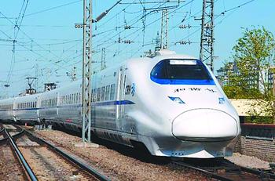
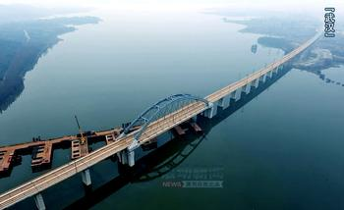
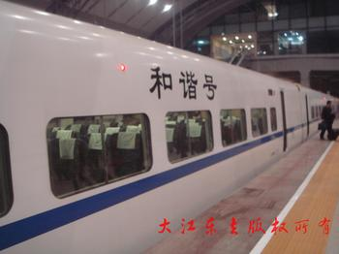
Government investment in infrastructure Burgeoning high-speed railway system
Between 2009-2012, annual investment on railway system was about RMB 700billion.

Slide 18
Outstanding Debts of Central Government (100 million yuan)
Year | Total | Domestic Debts | External Debts
2005 | 32614.21 | 31848.59 | 765.52
2006 | 35015.28 | 34380.24 | 635.02
2007 | 52074.65 | 51467.39 | 607.26
2008 | 53271.54 | 52799.32 | 472.22
2009 | 60237.68 | 59736.95 | 500.73
2010 | 67548.11 | 66987.97 | 560.14
In 2010, local debts were 107175 (100 million yuan).
Local governments can not issue bonds until recently. But they can indirectly borrow money through local financing vehicles such as SOEs.
It is believed that these debts are mostly used for economic infrastructure.

Slide 19
Categories of foreign-funded enterprises
1. Equity Joint Venture (EJV)
EJV are jointly funded by foreign and domestic organizations or individuals. The foreign capital accounts for no less that 25% of the total registered capital. The foreign partners can use cash, valuable materials, industrial property rights, or technology as the investment, while the Chinese partners may use land use fee as the investment.
Partners enjoy rights and take responsibilities according to its share in the investment.
2. Contractual Joint Venture (CJV)
CJV are jointly-run enterprises based on contracts between domestic and foreign partners. Rights and responsibilities are according to the contract rather than the share in the investment.
CJV also requires foreign partners to invest at least 25% of the total registered capital.
3. Wholly Foreign-owned Enterprise (WFE)
WFE is singly established by foreign investors.

Slide 20
Major forms of foreign investment
Unit: USD million | 1996 |  | 2006 |  | 2011
 | No. of project | Contracted value | No. of project | Contracted value | No. of project | Contracted value
Total | 24556| | 73,276 | 41,473 | 193,727 | 27,712 | 117,698
Joint Venture | 12628 | 31,876 | 10,223 | 32,937 | 5,005 | 21,415
Cooperative Venture | 2849 | 14,296 | 1036 | 8,074 | 284 | 1,757
Wholly Foreign-owned Enterprise | 9062 | 26,810 | 30,164 | 151,557 | 22,388 | 91,205
A foreign-funded enterprise shall be a limited liability company.

Slide 21
International trade based on foreign-funded enterprises
Unit: USD million | 2006
 | Total | Exports | Imports
China's total | 1,760,396 | 968,936 | 791,461
Foreign-funded Enterprises | 1,036,269 | 563,779 | 472,490
National percentage | 58.9% | 58.2% | 59.7%
In the early half of 2007, foreign-funded enterprises created 28% of the industrial value-added, 57% of the export，and 21% of the taxes. Direct employment was 28 million, about 10% of urban employment.

Slide 22
Foreign direct investment by Sector by yearend 2006
Unit: USD 100 million | No. of enterprises | Total investment | Registered Capital | Foreign capital
National Total | 274,863 | 17,075.65 | 9,465 | 7,406
Manufacturing | 187,458 | 10,412 | 5,924 | 4681 （63.2%）
Real Estate | 14,438 | 2,271 | 1,134 | 920
Leasing and Business Services | 12,070 | 396 | 265 | 225
Electricity, Gas and Water | 1,980 | 866 | 332 | 195
Information, Computer Services and Software | 7,045 | 349 | 207 | 191
Transport, Storage and Post | 4,743 | 572 | 306 | 184
Wholesale and Retail Trades | 15,786 | 378 | 223 | 181
Scientific Research, Technical Service | 6,954 | 322 | 188 | 158
Construction | 3,876 | 308 | 171 | 118
Hotels and Catering Services | 6,194 | 282 | 153 | 112
Agriculture, Forestry, Animal, Husbandry | 5,821 | 257.1 | 127 | 106
Culture, Sports and Entertainment | 2,308 | 138 | 78 | 63
Services to Households and Other Services | 3,311 | 100 | 65 | 49
Management of Water Conservancy, Environment and Public Facilities | 786 | 102 | 60 | 41
Mining | 970 | 81 | 52 | 35
Financial Intermediation | 182 | 59 | 50 | 30
Health, Social Security and Social Welfare | 210 | 22 | 12 | 8
Education | 196 | 5 | 3 | 2

Slide 23
Foreign Direct Investment by Sector in 2011
Sector | No. of projects | Investment (USD 1m)
Total | 27712 | 116011
Manufacturing | 11114 | 52100 （45%）
Real Estate | 466 | 26881
Wholesale and Retail Trades | 7259 | 8424
Leasing and Business Services | 3518 | 8382
Transport, Storage and Post | 413 | 3190
Information Transmission, Computer Services and Software | 993 | 2699
Scientific Research, Technical Service, etc | 1357 | 2457
Production and Supply of Electricity, Gas and Water | 214 | 2118
Agriculture, Forestry, Animal Husbandry and Fishery | 865 | 2008
Financial Intermediation | 156 | 1909
Services to Households and Other Services | 212 | 1883
Construction | 215 | 916
Management of Water Conservancy, etc | 151 | 864
Hotels and Catering Services | 513 | 842
Culture, Sports and Entertainment | 152 | 634
Mining | 87 | 612
Health, Social Security and Social Welfare | 11 | 77
Education | 15 | 3
Public Management and Social Organizations | 1 | 0.66

Slide 24
Performance of foreign-funded enterprises
In 2004, a survey by Fortune Chinese showed that 65.8% of the surveyed managers of foreign-funded enterprises thought that most of foreign-funded enterprises in China are making profits.
European Chamber of Commerce in China had a survey in 2007 and found that 83％ of the EU enterprises thought that they made profit by having FDI in China, and the profitability level was higher than other regions or countries.
Major international companies have built their manufacturing or R&D centers in China, like Boeing, Airbus, IBM, Siemens, GE, etc. Major international financial institutions are opening their branches in China. It is hard to be “international” without significant involvement in China.

Slide 25
3) International and domestic consumption
--High dependence on international trade and market
1. Favorable policies toward export
2. Foreign exchange earned as an indicator of economic performance
China’s foreign exchange reserve was more than the total of G8 in 2010.
3. Expanding domestic market and the strategic use of this strength
Anti-dumping against China’ photovoltaic products by EU in 2013
4. Complex international political economy and mutual dependence

Slide 26
A World Bank Evaluation of Ease of Doing Business in 2008 and 2012

Slide 27
China’s ranking in doing business, 2008 and 2012
Indicators | 2008 | 2012
Ease of doing business | 83 | 91
Starting a business | 135 | 151
Dealing with licenses | 175 | 181*
Employing workers | 86 | na
Registering property | 29 | 44
Getting credit | 84 | 70
Protecting investors | 83 | 100
Paying taxes | 168 | 122
Trading across borders | 42 | 68
Enforcing contracts | 20 | 19
Closing a business | 57 | na
* In 2012 this indicator was “Dealing with Construction Permits”

Slide 28
The balance of financial terror ---Larry Summers
Investment imbalance between China and the US (FDI)

Slide 29
Trade imbalance

Slide 30
China’s holding of US debts

Slide 31
Increasing dependence on domestic consumption
In 2005, China consumes roughly 30% energy and raw materials of the world, including 7.4% oil，31% coal，27% steel, and 40% cement.
China’s consumer markets increased by 18％ per year in recent years.
It is already the second largest market in the world.
Problems that prevent its further growth
The tradition to save for the future
Social security
Rural market
Market environment

Slide 32
4) Maintaining and creating comparative advantages
Cheap labor: with a total labor force of 800 million
Decades of demographic dividends account for a quarter of China’s economic growth. Gross dependence ratio dropped from 62.6% in 1982 to 34.2% in 2010.

Slide 33
Wage rates in 2004
In 2010
Country | Wage ($/hour)
China | 0.67
USA | 15.29
Japan | 16.54
Germany | 17.74
France | 12.3
Canada | 17.44
South Korea | 8.9
Country | Wage ($/year)
China | 4,185
USA | 37,610
Japan | 34,510
Germany | 25,250
France | 24,770
Canada | 23,930
South Korea | 12,020

Slide 34
Policies to avoid quick labor cost increase
Gradual urbanization policy
Government coordination of the flow of labor force
Continuous adjustment of minimum wage
In 2014, Shanghai’s minimum wage is RMB1820, the highest in the country
Continuous but small-step increase of labor protection
The 2007 Labor Contract Law

Slide 35
Growing capacity of education and research
---Higher education in 2010
 | New enrollment | Total enrollment | Graduates | % of females
Postgraduates | 538,177 | 1,538,416 | 383,600 | 47.86
Doctor's Degree | 63762 | 258950 | 48987 | 35.48
Master's Degree | 474415 | 1279466 | 334613 | 50.36
Regular Undergraduates and College Students | 6,617,551 | 22,317,929 | 5,754,245 | 50.86
Enrolled in Full Undergraduate Courses (4 year) | 3512563 | 12656132 | 2590535 | 49.68
Enrolled in Specialized Courses (2 year) | 3104988 | 9661797 | 3163710 | 52.41
Adult Undergraduates and College Students | 2,084,259 | 5,360,388 | 1,972,873 | 53.12
Enrolled in Full Undergraduate Courses | 853319 | 2250457 | 803915 | 54.90
Enrolled in Specialized Courses | 1230940 | 3109931 | 1168958 | 51.84

Slide 36
Program for International Student Assessment (PISA)
OECD started in 2000 to test 15-year old student their capacities in reading, math, and science.
Shanghai participated in 2009 and 2012, and scored no.1 continuously.
About 5000 students in SH participated.
How to explain and interpret this?

Slide 37
Low environmental costs (to the enterprises)
Environment is a production factor since economic activities consumes environmental resources and lead to environmental cost, this can be especially serious for resource intensive primary products.
Since environment is a public good, its consumption can only be internalized into the price of the products through government regulations and policies.
In comparison, China’s environmental regulation lags behind due to the governments’ less preference, people’s unawareness, and its technical backwardness.
the value of Index of Environmental Sensitivity Performance: Japan 83.9, S. Korea 78.6, Germany 73.2, USA 67.9, France 66.1, Canada 58.9 and China 41.9
the emission intensity of SO2 (kg/103$): China 16.5, Canada 2.6, USA 1.4, South Korea 1.3, Japan 0.3, France 0.3 and Germany 0.3
Domestic transfer of resource-intensive industries

Slide 38
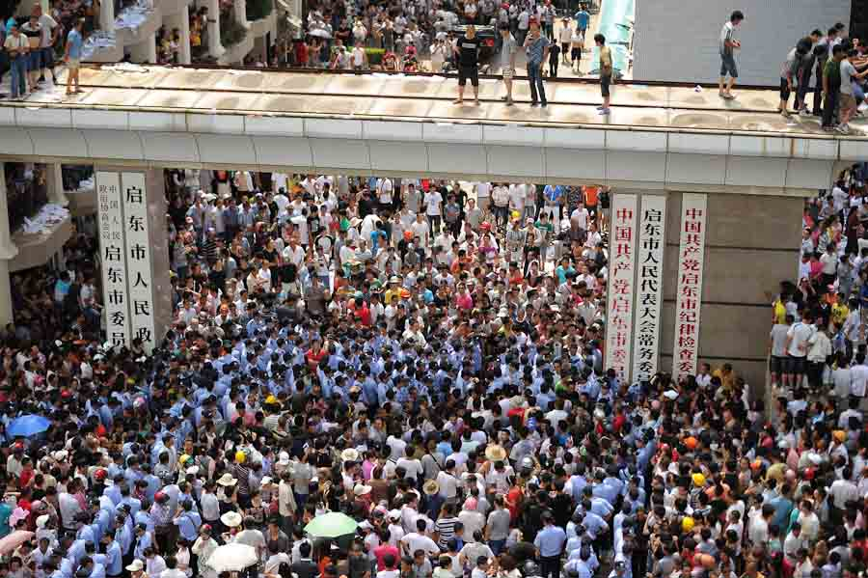
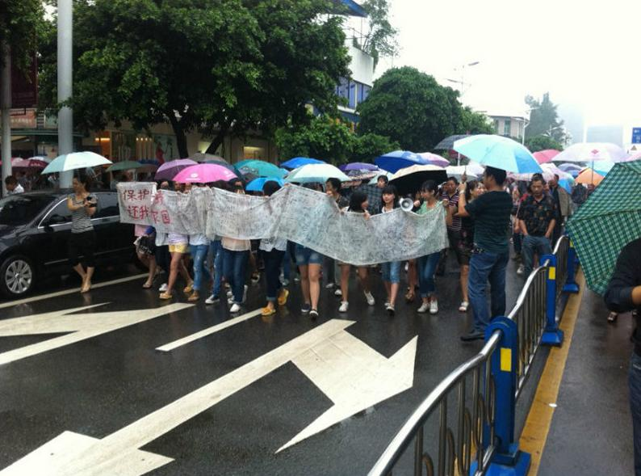
Citizen protests against environmentally harmful industrial projects have delayed or failed quite many projects

Slide 39
The established market infrastructure
Availability of all kinds of markets
Relatively mature production and distribution chains and networks
Relatively mature economic law system and law enforcement
Improved environment for foreign investment
Pro-growth governments
Improved physical infrastructure

Slide 40
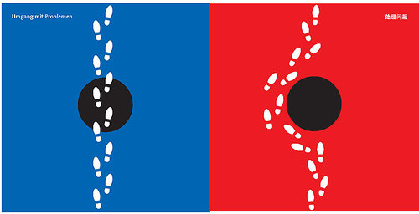
Reform: radical vs. incremental
5) Reform path and strategy

Slide 41
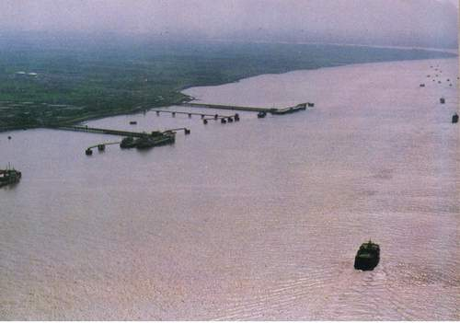
The power of incremental transition The east side of Bund (外滩) in 1980s

Slide 42
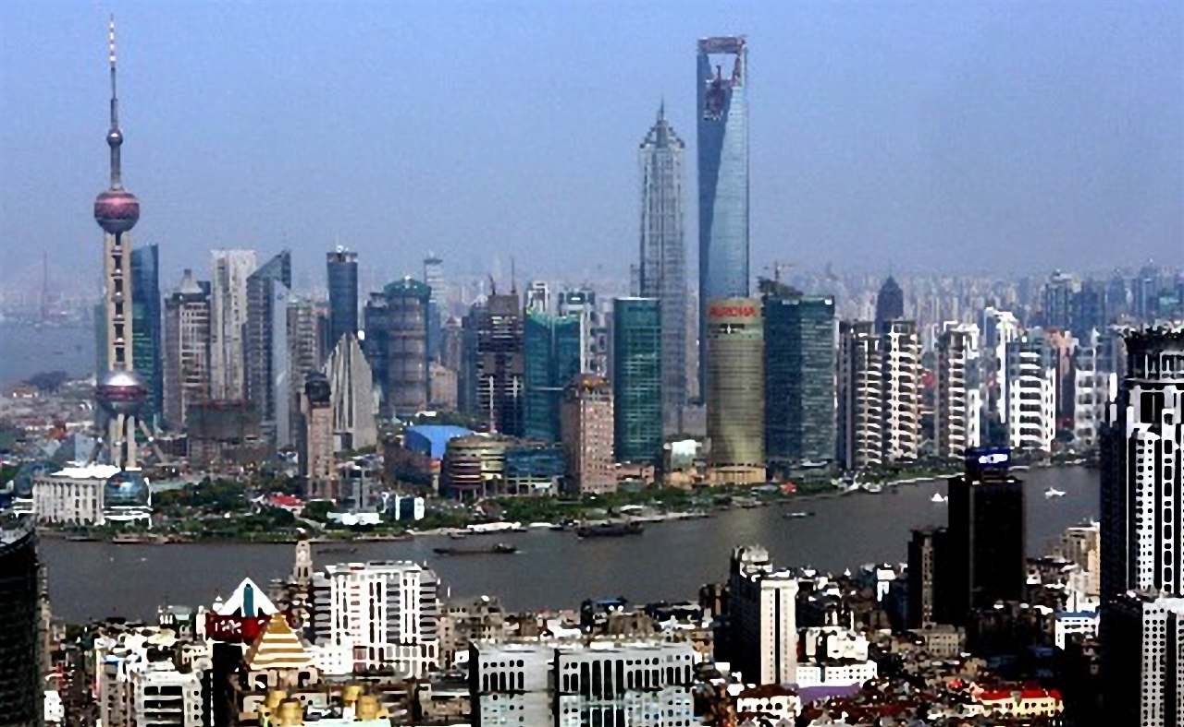
The east side of Bund in 2009

Slide 43
China’s reform path (Incremental reform, gradual reform, piecemeal reform)
Economic reform first, political reform second.
Reforms should be done under social stability.
Reforms should start from easy areas.
Reforms may benefit part of the population first, with a purpose to create development and growth that can benefit everyone.
Reforms should be pushed forward continuously.

Slide 44
Major steps of China’s economic reform
In 1982 the Twelfth Party Congress proposed “planned economy as the main pillar and market economy as a supplementary element”.
In 1987 the Thirteenth Party Congress proposed “combining planned and market economies”.
In 1992 the Fourteenth Party Congress made the economic reform goal as establishing “a socialist market economy”.
In 1999, the Second Plenary Session of the Ninth People’s Congress passed a third constitutional amendment, which legitimated private economic activities and other forms of non-state ownership.
Gradually, private entrepreneurs were allowed to join the CCP.
In 2007, Property Rights Law was enacted and equalizes the protection of private ownership to that of state and collective ownership.

Slide 45
Thank you!

