Slide 1
10301010241 陸泓
Myth and Fact
---Losing Weight

Slide 2
Myth1 : Skipping meals is a good way to lose weight.
Fact:
Skipping meal increases our desire for high calorie foods later in the day.
Eating many small meals throughout the day helps people control their appetites.

Slide 3
Myth2 : Eating after 8 p.m. causes weight gain.
Fact:
It's not when you eat, it's what (and how much) you eat.
No matter when you eat, your body will store extra calories as fat.

Slide 4
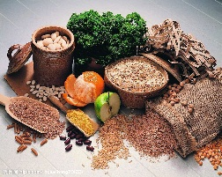
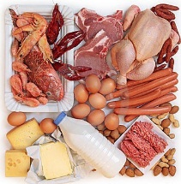
Myth3 : High-protein/low-carbohydrate diets are a healthy way to lose weight.
Fact:
Not enough fruits, vegetables, and whole grains
Too much fat and cholesterol
Buildup of ketones in your blood (ketosis)

Slide 5
Myth4 : Low-fat or non-fat means no calories.
Fact:
Just as many calories as the full-fat version of the same food or even more calories
Sugar, flour, or starch thickeners may be contained
Read the Nutrition Facts Label first

Slide 6
Myth5 : Exercise burns off calories. If I work up a sweat for a long enough time, I can burn off enough weight that I can eat more.
Fact:
Exercise doesn't burn off significantly more calories than sleeping does
Metabolism (digesting food, thinking, making your heart beat, and so on) burns off most of your calories

Slide 7
Myth6 : I don’t need to exercise if I eat less.
Fact:
It's very important
Hypothalamus will slow down your metabolism

Slide 8
Keyword
Myth and fact weight

Slide 9
Thanks !

