Slide 1
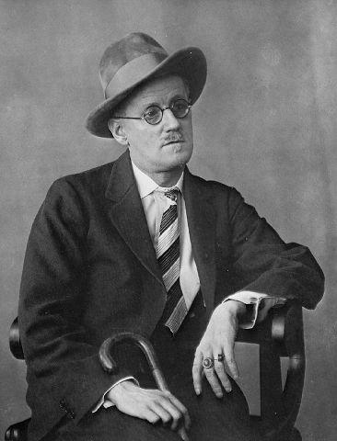
Araby
James Joyce

Slide 2
Meanings of title
1.a splendid bazaar with eastern enchantment
2. a symbol of idealized fantasy of love
The way to Araby is actually a starting to come into his sexual identity
A transformation from a boy to adolescence

Slide 3
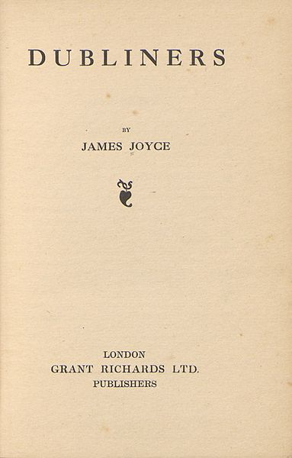
Plot 1
North Richmond
The former tenant of his house :
a charitable priest
Wild garden behind the house
Boys’ play

Slide 4
Street —— blind
House —— uninhabited
Priest —— died
Air —— musty
Bicycle-pump —— rusty
Lanterns —— feeble
Negative Tedious Drab
echoed shouts, career of play, ran the gauntlet, hid in the shadow, peer up

Slide 5
Plot 2
Her dress swung as she moved” and the soft rope of her hair tossed from side to side.
Her image accompanied me even in places the most hostile to romance.
I pressed the palms of my hands together until they trembled, murmuring: O love! O love! many times.
Admiration of the narrator’s who is on the brink of sexual awareness

Slide 6
light, morning, summons, chalice, harp ——positive, bright, romantic idealization
Turning :
When she addressed the first words to me I was so confused that I did not know what to answer. She asked me if I was going to Araby. I forget whether I answered yes or no.
——If I go, I said , I will bring you something.

Slide 7
Plot 3
I had hardly any patience with the serious work of life which, now that it stood between me and my desire .
Aunt’s doubt: “hoped it was not some freemason affair”
Master’s sternness: ”hoped I was not beginning to idle”
Uncle’s mindlessness: “answered me curtly”

Slide 8
Plot 4
Change of attitude:
“recalled to me the purpose of my journey”
—change to —”remembering with difficulty why I had come”
—change to —refuse to buy anything (give up the original purpose)

Slide 9
Plot 5
Realization:”creature driven and derided by vanity” and his “eyes burned with anguish and anger”.
Epiphany(顿悟):a moment of sudden and intense insight →his idealization crashes
One point should be highlightened:
Anomymous →possible anyone

Slide 10
Things to be noted
Unrequited love
Sweet, romantic, ideal, sorrowful
vivid description of the inner thought
The gloomy atmosphere that actually sets the scene at the start of the story is an anticipation of what lies ahead for the little boy in the bazaar of Araby.
(his doomed/inevitable failure)

Slide 11
Question 1: What themes does Araby concern?
Coming of age
The loss of innocence
The life of the mind versus poverty (both physical and intellectual)
The dangers of idealization
The Catholic Church's influence to make Dublin a place of asceticism where desire and sensuality are seen as immoral
The pain that often comes when one encounters love in reality instead of its elevated form
These themes build on one another entirely through the thoughts of the young boy, who is portrayed by the first-person narrator, who writes from memory.

Slide 12
Epiphany---sudden realization
maturing; growing-up (anguish and anger)
Gap between the ideal and the reality
Disillusion: love; passion of life
The sense of isolation
Spiritual paralysis

Slide 13
Question 2: What kind of romantic elements can you find in this story?
As with many of the stories in the collection, Araby involves a character going on a journey, the end result of which is fruitless, and ends with the character going back to where he came from. Eveline is just one other story in Dubliners to feature a circular journey in this manner. Also, the narrator lives with his aunt and uncle, although his uncle appears to be a portrait of Joyce's father, and may be seen as a prototype for Stephen Dedalus of A Portrait of the Artist as a Young Man and Ulysses. The scorn the narrator has for his uncle is certainly consistent with the scorn Joyce showed for his father, and the lack of "good" parents is pertinent.

