Slide 1
演示场景

Slide 2
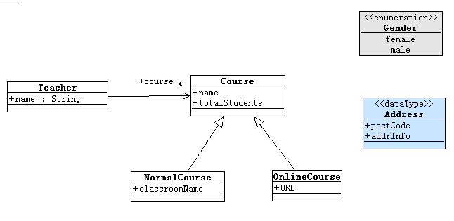
类图

Slide 3
配置
HibernateApplicationContext.xml
hibernate.cfg.xml
创建数据库
ooad/ooad
关于Library/Project模板

Slide 4
Class mapping
创建类Teacher及属性name/birthday
基类的用途
修改Hibernate.cfg.xml
第一次运行：
看DB Schema
修改Rollback属性，再次运行
看DB数据
SQL输出日志说明
@Test
public void createTeacherTest() {
Teacher teacher = new Teacher();
teacher.setName("student1");
teacher.setBirthday(new Date());
getPersistenceManager().save(teacher);
assertObjectPersisted(teacher);
}

Slide 5
Datatype/enum Mapping
自定义属性的映射：Address{postcode,addrinfo}，观察Schema自动更新
@Test
public void createTeacherWithAttribute() {
Teacher teacher = new Teacher();
teacher.setName("teacher1");
teacher.setBirthday(new Date());
teacher.getAddress().setPostCode("200433");
teacher.setGender(Gender.female);
getPersistenceManager().save(teacher);
assertObjectPersisted(teacher);
Teacher savedTeacher = getPersistenceManager().get(Teacher.class,
teacher.getId());
assertEquals(teacher, savedTeacher);
assertEquals(teacher.getGender(), savedTeacher.getGender());
}

Slide 6
@Enumerated
@Enumerated(EnumType.STRING)
Delete all tables：因为Schema有时无法自动更新
Check database schema

Slide 7
Simple HQL
@Test
public void findTeacherByHQL() {
Teacher teacher = new Teacher();
teacher.setName("teacher1");
teacher.setBirthday(new Date());
teacher.getAddress().setPostCode("200433");
teacher.setGender(Gender.female);
getPersistenceManager().save(teacher);
String findTeacherHQL = "from Teacher t where t.name like 't%'"
+ " and t.address.postCode = '200433'";
Query hql = getPersistenceManager().createQuery(findTeacherHQL);
assertEquals(1, hql.list().size());
}

Slide 8
Inheritance Mapping
继承的映射方式：单表映射
Create abstract course class, and it’s subclasses;
@Entity
@Inheritance(strategy = InheritanceType.SINGLE_TABLE)
@DiscriminatorColumn(name = "COURSETYPE")
public abstract class Course extends BaseModelObject {
@Basic
String name;
@Basic
Integer totalStudents;
@Entity
@DiscriminatorValue("NORMAL")
public class NormalCourse extends Course {

Slide 9
Inheritance Mapping
测试代码：创建两个不同类型的Course,查看DB Schema，Rollback(false)，运行后查看数据
NormalCourse normalCourse = new NormalCourse();
normalCourse.setName("normal course");
normalCourse.setTotalStudents(10);
normalCourse.setClassroomName("S209");
getPersistenceManager().save(normalCourse);
assertObjectPersisted(normalCourse);
OnlineCourse onlineCourse = new OnlineCourse();
onlineCourse.setName("online course");
onlineCourse.setTotalStudents(200);
onlineCourse.setURL("http://www.course.com/test");
getPersistenceManager().save(onlineCourse);
assertObjectPersisted(onlineCourse);

Slide 10
Inheritance Mapping
测试代码如下，在运行前分析是否能通过：测试代码的副作用的危害。
String hsql1 = "from Course";
List hsql1Result = getPersistenceManager().createQuery(hsql1).list();
assertEquals(2, hsql1Result.size());
String hsql2 = "from NormalCourse";
hsql1Result = getPersistenceManager().createQuery(hsql2).list();
assertEquals(1, hsql1Result.size());

Slide 11
Association Mapping
对于数据库设计来说，一对多/多对一的实现方法。
修改Course的构造函数，增加Teacher作为参数。
在Teacher中增加createXXXCourse方法。
对于没有级联的情况，实现如下
@OneToMany(mappedBy = “teacher”)
private Collection<Course> courses = new ArrayList<Course>();
@ManyToOne
Teacher teacher;

Slide 12
Association Mapping
没有级联的情况的测试代码：
@Test
public void associationCreateTest() {
Teacher teacher = new Teacher("ztg");
getPersistenceManager().save(teacher);
Course course1 = teacher.createNormalCourse("ooad");
getPersistenceManager().save(course2);
Course course2 = teacher.createOnlineCourse("software test");
getPersistenceManager().save(course3);
assertEquals(2, teacher.getCourses().size());
}

Slide 13
Association Mapping
期望：
设定级联
public void associationCascadeCreateTest() {
Teacher teacher = new Teacher("ztg");
teacher.createNormalCourse("ooad07");
teacher.createNormalCourse("ooad08");
teacher.createOnlineCourse("software test");
getPersistenceManager().save(teacher);
assertEquals(3, teacher.getCourses().size());
}
@OneToMany(mappedBy = "teacher", cascade = { CascadeType.ALL })
private Collection<Course> courses = new ArrayList<Course>();

Slide 14
Association Mapping
级联删除测试
@Test
@Rollback(false)
public void associationCascadeDeleteTest() {
for (Teacher teacher : getPersistenceManager().all(Teacher.class)) {
getPersistenceManager().delete(teacher);
}
}

