Slide 1
AOP
Aspect Oriented Programming

Slide 2
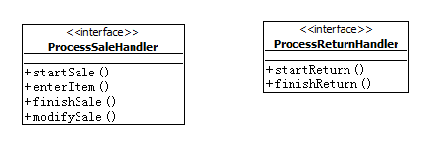
问题
考虑一个POS机的销售处理模块

Slide 3
如何处理权限问题
在处理一个销售的过程中，收银员可以执行启动销售等操作(startSale)，如果需要修改销售的内容(changeSale)则需要由管理员执行。
如何处理权限问题？
在每段方法的开头加上权限处理的代码？
或者应该将ProcessSaleHandler分解为两个类？

Slide 4
第一种方法
问题：
在所有的业务代码中都混杂了权限相关代码(Code tangling)
与权限相关的代码分散在各处(Code scattering )
public ISale startSale() {
if (securityManager.isFunctionValid4CurrentUser("startSale"))
return new SaleMemImpl();
else
throw new SecurityViolatedException("startSale");
}

Slide 5
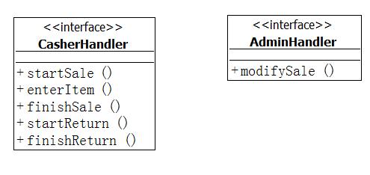
第二种方法
类提供了一种层次化的分类方法，但问题是，他只能提供一个维度的分类方法

Slide 6
Security Aspect的实现(Spring)
public class SecurityCheckAspect implements MethodInterceptor {
ISecurityManager securityManager;
public void setSecurityManager(ISecurityManager securityManager) {
this.securityManager = securityManager;
}
@Override
public Object invoke(MethodInvocation invocation) throws Throwable {
String funcName = invocation.getMethod().getName();
if (securityManager.isFunctionValid4CurrentUser(invocation.getMethod().getName()))
return invocation.proceed();
else
throw new SecurityViolatedException(funcName);
}
}

Slide 7
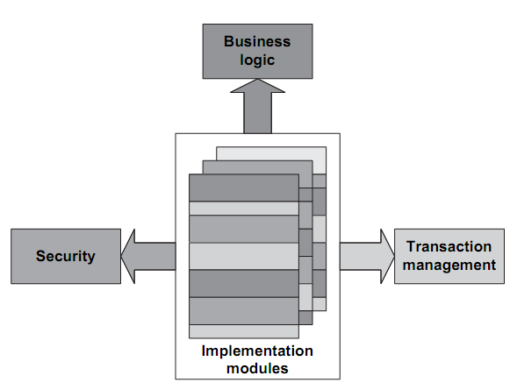
Code tangling

Slide 8
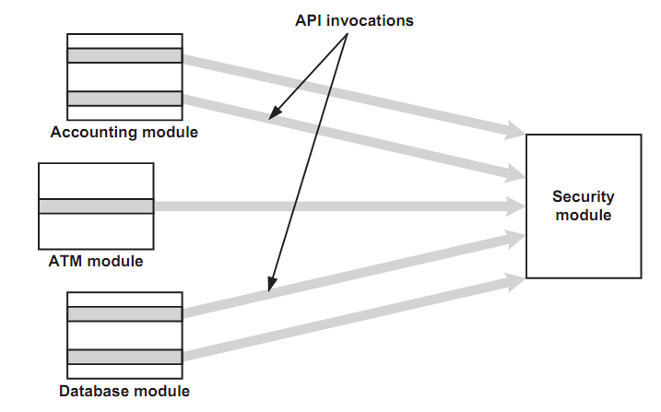
Code scattering

Slide 9
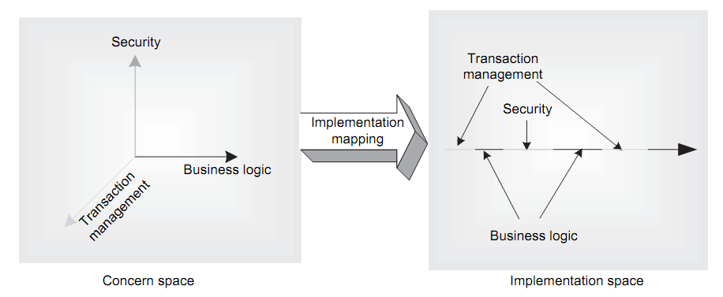
N-dimensional concern

Slide 10
Security Aspect的实现(AspectJ)
public aspect SecurityAspect {
private ISecurityManager securityManager = SecurityManager.getInstance();
pointcut securedAccess():
execution ( * IUsecaseHandler+.*(..) );
//Advice
before(): securedAccess(){
String functionName = thisJoinPoint.getSignature().getName();
if(!securityManager.isFunctionValid4CurrentUser(functionName))
throw new SecurityViolatedException(functionName);
}
}

Slide 11
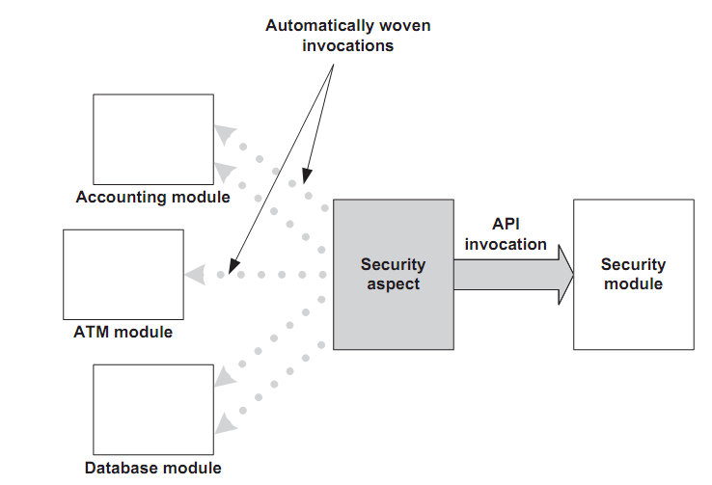
AOP Solution

Slide 12
结果
模块化
简洁

Slide 13
Terminology
Cross-cutting – Identify areas of code where common functionality exists
Joinpoint – Where one or more aspects can be applied
Pointcut – A collection of joinpoints
Advice – The code to be injected
Aspect – General term for where advice and point-cuts are combined

Slide 14
Terminology
Weaving – Integrating applications and aspects (e.g. AspectJ is an “aspect weaver”)
Compile-time – Can produce integrated source-code, but typically only produces woven byte-code.
Run-time – Aspects are applied “on the fly” (typically when classes are loaded)

Slide 15
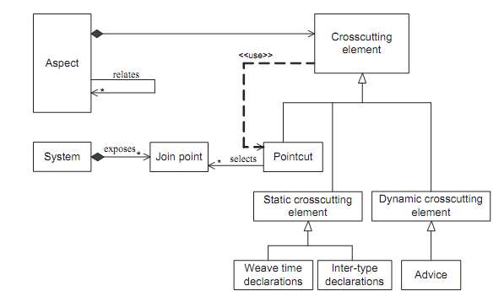

Slide 16
Static Cross-cutting Element Type
How to implement Comparable/Cloneable/Hashable without modify existing source

Slide 17
Coreplus sample
aspect acctstop1 {
pointcut acctstopinIHO1 () :
transition ( for * input M_IM_MSS_LOC_UPD_REQ nextstate Exiting );
after () : acctstopinIHO1() {
sendAccountingStop(
SSLC_AUTH_ACCT_STOP_StopAcctType_t::IdleModeToStop
);
}
}

