Slide 1
Complications of Diabetes
10301010058
刘心华

Slide 2
Diabetes definition
Metabolic disorder of multiple
etiology characterized by chronic
hyperglycemia with disturbances of
carbohydrate, fat and protein
metabolism resulting from defects
in insulin secretion, insulin action,
or both.

Slide 3
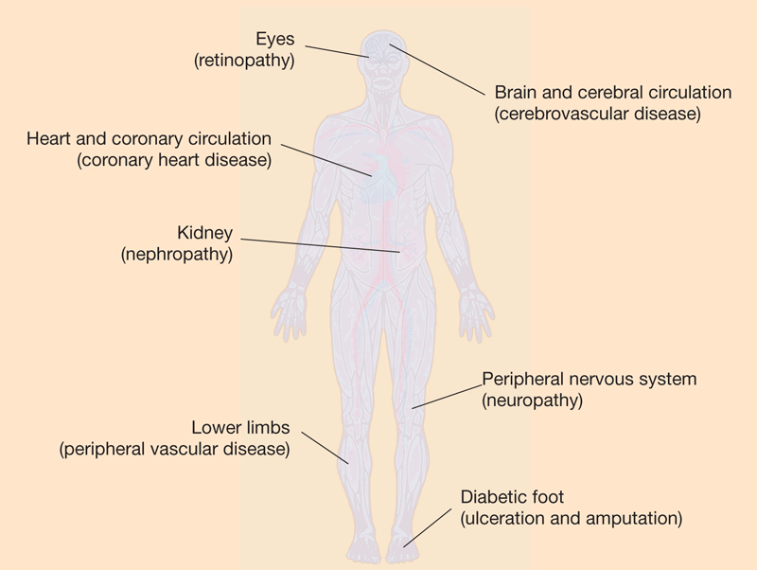
Diabetes complications
Cardiovascular problems
Eye damage
Kidney damage
High blood sugar
Nerve damage
Foot damage
Osteoporosis
Brain problems
Skin conditions

Slide 4
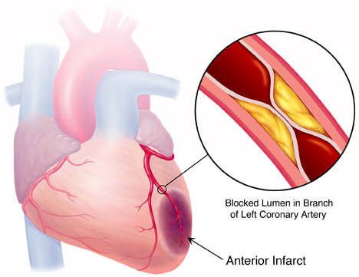
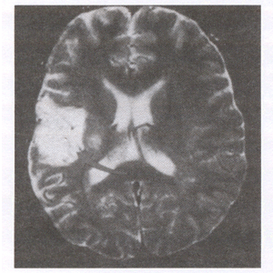
Cardiovascular problems
Angina
Myocardial infarction
Stroke
Atherosclerosis
High blood pressure

Slide 5
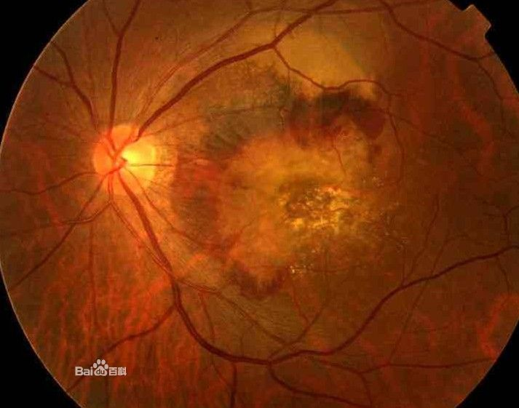
Eye damage
Glaucoma
Capillary
damage
Cataract
Diabetic
retinopathy

Slide 6
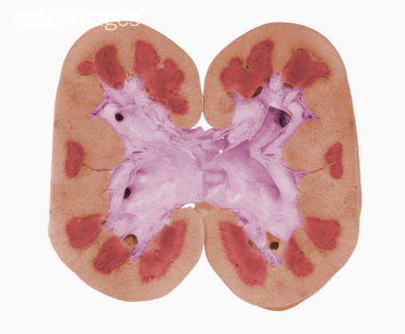
Nephropathy
Dialysis
Kidney transplant
Step 4
Kidney failure
Step 3
Loss of protein in the urine
Step 2
Scarring changes in the kidney tissue
Step 1
Tiny blood vessel clusters damaged

Slide 7
Neuropathy
Numbness and tingling
Insensitivity to pain

Slide 8
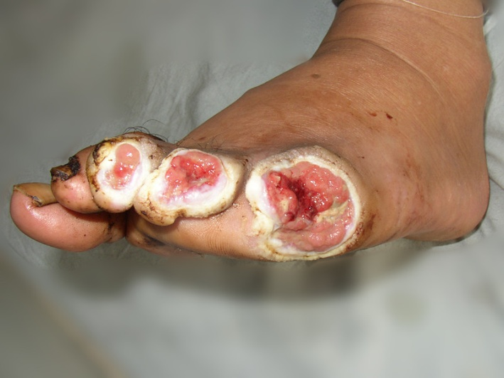
Foot damage
Nerve damage
Diabetes foot disease
Poor blood flow

Slide 9
Other complications
Skin conditions
Bacterial infections, fungal infections and itching
Osteoporosis
Lower than normal bone mineral density
Brain problems
An increased risk of dementia and Alzheimer's disease
Sex dysfunction
Damage to the nerves and blood vessels essential for normal function of the genital organs

Slide 10
Summary
Diabetes complications may be disabling or even life-threatening.
The risk of diabetes complications can be reduced.

Slide 11
References
1. Emerging Risk Factors Collaboration (2010). "Diabetes mellitus, fasting blood glucose concentration, and risk of vascular disease: A collaborative meta-analysis of 102 prospective studies". The Lancet 375 (9733): 2215–22
2. Boussageon R, Bejan-Angoulvant T, Saadatian-Elahi M, Lafont S, Bergeonneau C, Kassaï B, Erpeldinger S, Wright JM, Gueyffier F, Cornu C (2011). "Effect of intensive glucose lowering treatment on all cause mortality, cardiovascular death, and microvascular events in type 2 diabetes: meta-analysis of randomised controlled trials". BMJ 343: d4169.
3. Shoback, edited by David G. Gardner, Dolores (2011). Greenspan's basic & clinical endocrinology (9th ed.). New York: McGraw-Hill Medical. pp. Chapter 17. ISBN 0-07-162243-8.
4. World Health Organization Department of Noncommunicable Disease Surveillance(1999). Definition, Diagnosis and Classification of Diabetes Mellitus and its Complications. WHO/NCD/NCS/99.2

Slide 12
Thank You!
10301010058
刘心华

