Slide 1
A VERY BRIEF
INTRODUCTION TO
ZhangRui 10301010076

Slide 2
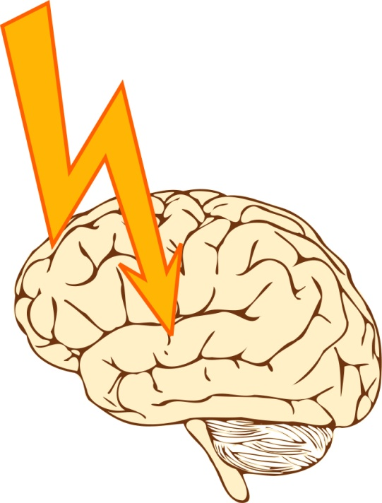
CONTENTS
defination
types
signs
rehabilitation

Slide 3
PHRASES & VOCABULARIES
crytogenic 原因不明的
tPA, tissue plasminogen activator组织纤维蛋白溶酶原激活剂
a six-month window 六个月的最佳恢复期

Slide 4
DEFINATION
a sudden interruption in the blood supply of the brain
WHO: “neurological deficit of cerebrovascular causes”,
“>24 hours”
transient ischemic attack

Slide 5
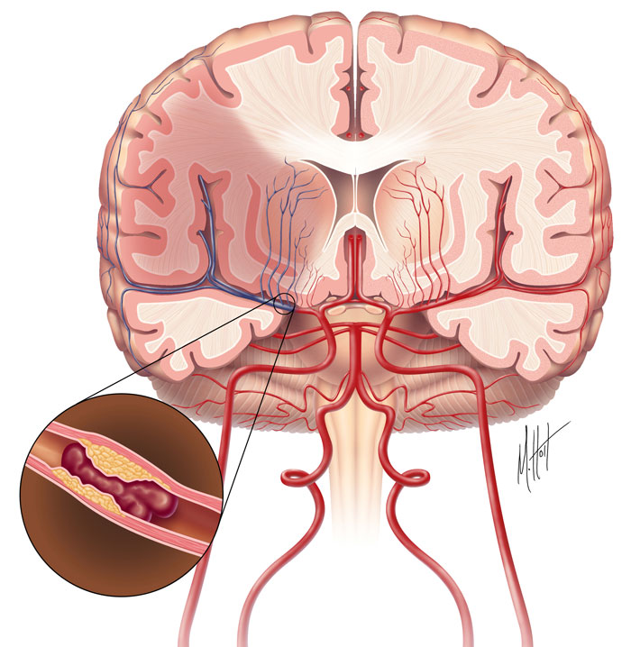
TYPES: ISCHEMIC
thrombosis
embolism
systemic hypoperfusion
crytogenic stroke

Slide 6
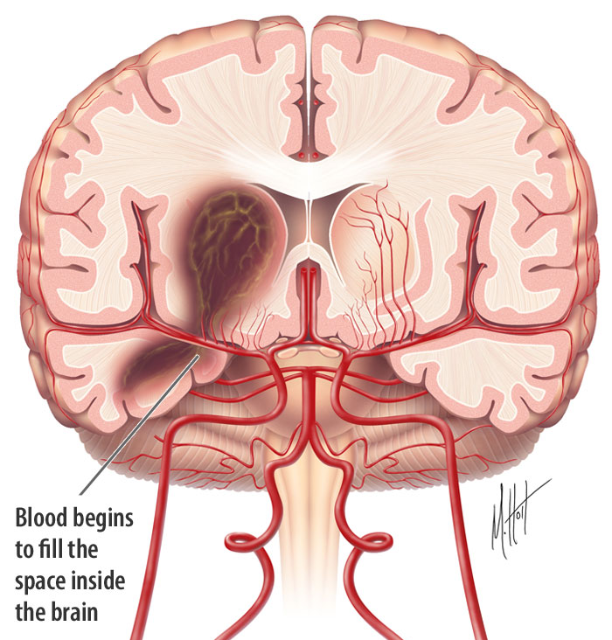
TYPES: HEMORRHAGIC
hypertension
aneurysm
anticoagulant
specific symptoms:
headache, vomiting,
numbness or weakness
intracerebral & subarachnoid

Slide 7
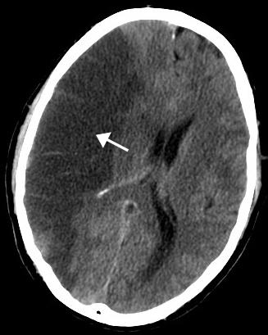
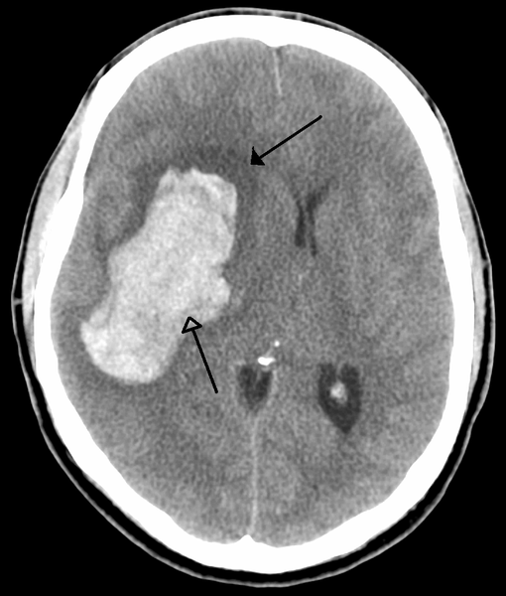
TYPES: COMPARISION

Slide 8
WARNING SIGNS
Clot-busting drug: tPA

Slide 9
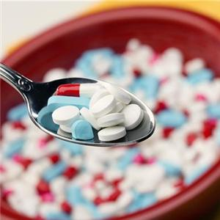
REHABILITATION
lifelong process
6 month window—>2 years
neuro-plasticity
LOVE & HOPE

Slide 10
REFERENCE
http://www.strokeassociation.org/
http://www.who.int
http://www.stroke.org/
http://www.worldlifeexpectancy.com/
"WHO Disease and injury country estimates". World Health Organization. 2009.
Donnan GA, Fisher M, Macleod M, Davis SM (May 2008). "Stroke". Lancet 371 (9624): 1612–23.
http://www.nlm.nih.gov/medlineplus/stroke.html

Slide 11
THANK YOU!
ZhangRui 10301010076

