Slide 1
Part V China’s tax reform

Slide 2
China’s Tax Reform
Tax reform from late 1970’s to the beginning of 1990’s
Tax reform in 1994
New round of tax reform

Slide 3
Tax reform from late 1970’s to the beginning of 1990’s

Slide 4
Tax Reform from Late 1970’s to Early 1990’s
The background: Before 1979, under the traditional economic system, Chinese tax system was extremely simplified.
Namely, as the result of the 1973 tax reform, the tax system was nearly a single tax system.
Profits from the state-owned enterprise are major source of fiscal revenue.

Slide 5
Tax Reform from Late 1970’s to Early 1990’s
In 1980’s, China took various measures to set up a new tax system which would better fit the market-oriented economic reform.
As a result of the economic reform, foreign (investment) enterprises and private enterprises played more and more important role in the economy. New income taxes were introduced to collect revenue from these enterprises.
Sino-foreign joint investment enterprise income tax 1980
Foreign enterprise income tax 1981
Collective enterprise income tax 1985
Private enterprise income tax 1988

Slide 6
Tax Reform from Late 1970’s to Early 1990’s
In addition, China changed the way to collect revenue from the SOEs.
The introduction of state-owned enterprise income tax .
In 1983, China began to levy 55% enterprise income tax on state-owned enterprises. Previously the state-owned enterprise need not pay income tax. They just had to transfer nearly all the profits to the government.

Slide 7
Tax Reform from Late 1970’s to Early 1990’s
In addition to enterprise income tax, during this stage, China also introduced :
Individual income tax (introduced in 1980,levied on foreign nationals deriving taxable income in China) , Individual income adjustment tax (introduced in 1988 levied on Chinese nationals) , income tax for individual business households (introduced in 1986).

Slide 8
Tax Reform from Late 1970’s to Early 1990’s
In 1984,China introduced new turnover tax: product tax, business tax, Value-added tax .

Slide 9
Tax Reform from Late 1970’s to Early 1990’s
About the foreign-related tax system:
Introduction of individual income tax in 1980
Introduction of Sino-foreign joint investment enterprise income tax in 1980, foreign enterprises income tax in 1981，which was replaced by the foreign invested enterprises and foreign enterprises Income tax in 1992.
Turnover tax applied to enterprises with foreign investment:
Industrial and commercial consolidated tax(5%)

Slide 10
Tax Reform from Late 1970’s to Early 1990’s
In summary, during this time period, the single tax system adopted in the traditional planning economy had been replaced by a new tax system based mainly on turnover tax and income tax.
But the new tax system got more and more complicated and brought more and more distortions to the economy. In addition, the ratio of tax revenue to GDP and central government’ share in the total tax revenue kept declining. A fundamental tax reform was inevitable.

Slide 11
Tax Reform in 1994

Slide 12
Tax Reform in 1994
Major measures
Turnover tax reform
New VAT ,consumption tax and business tax was introduced, which would be levied on both domestic and foreign (investment) enterprises. The product tax on domestic enterprises and the industrial and commercial consolidated tax on foreign invested enterprises and foreign enterprises were repealed.

Slide 13
Tax Reform in 1994
Major measures
Income tax reform
Enterprises income tax was no longer divided on the basis of enterprises’ ownership. State-owned enterprise income tax, collective enterprise income tax and private enterprise income tax was merged into “enterprise income tax”，so that unified domestic enterprise income tax system was established.
Meanwhile, the individual income adjustment tax (for national taxpayers), individual income tax (for foreign taxpayers), income tax for individual business households were merged into the unified “individual income tax”.

Slide 14
Tax Reform in 1994
It is commonly thought that the tax system after 1994 is more reasonable and better fits the “socialist market economy.” The reform gained breakthrough and was regarded as a historic success.
Since 1994，tax revenues has rapidly jumped in China, from 507.08 billion RMB yuan in 1994 to 3763.63 billion RMB yuan in 2010. The ratio of tax revenues to GDP increased from about 10% in 1994 to about 18% at present.

Slide 15
New round of tax reform (Since 2004)

Slide 16
New Round of Tax Reform (Since 2004)
VAT;
Consumption tax;
Enterprise income tax;
Individual income tax;
Property tax;
Resource tax；
Environmental tax

Slide 17
New Round of Tax Reform (Since 2004)
VAT reform: “Transition” and “Enlargement”
Transition of VAT
Switch from production-type VAT to consumption-type VAT: 2004-2009 (Allow input tax credit for purchased fixed assets)
Enlargement of VAT
Subject more services to VAT instead of Business Tax

Slide 18
VAT Transition
A simplified input-output model of the economy
Value-added=C+I=GDP
=
Output Input |  | Intermediate use |  |  | Final use |  | Total output
 |  | s1 | s2 | … | C | I
Middle Inputs | Sector 1
 | Sector 2
 | …
Value-added | Indirect tax
 | Depreciation of FA
 | Labor compensation
 | Business earnings
Total input
Production-type VAT
Input tax credit only allowed for middle inputs
Overall tax base is the total values-added(GDP) of the economy
Consumption-type VAT
Input tax credit allowed for middle inputs and fixed assets
Overall tax base is aggregate consumption of the economy
Notes:
For each sector, total input= middle output+ value-added, total output= intermediate use+ final use.
Final use= consumption +investment+exports-imports, value-added=indirect tax+depreciation+labor compensation+ business earnings
For the whole economy, if there is no exports and imports, value-added=C+I=GDP

Slide 19
VAT Transition
Why China adopted production-type VAT in the 1994 tax reform?
To collect more tax revenue
To fight the record-high inflation by curbing over-investment (China’s CPI in 1994 was 24.1%)

Slide 20
VAT Transition
Why China switches to consumption-type VAT in 2009?
To fight the financial crisis by boosting domestic demand
To encourage technological upgrading and industrial restructuring.
To improve the efficiency of the tax system Production-type VAT cause great distortions to the economy，especially since China had began the implementation on trial of consumption-type VAT in some provinces in 2004.

Slide 21
VAT Enlargement
To enlarge the scope of VAT by levying VAT on the items currently subject to business tax. So virtually the enlargement of VAT means replacement of business tax by VAT.
Why is the VAT scope enlargement necessary? The current system incurs multiple taxation for the items subject to business tax.

Slide 22
Reexamine the Previous Example: What if Enterprise D is a Restaurant?
Enterprise | Commodity | Tax inclusive price | Tax exclusive price | Tax rate | Output tax | Input tax | Tax payable
A | Wheat | 100 | 100 |  | 0 | 0 | 0
B | Flour | 226 | 200 | 13 | 26 | 13 | 13
C | Cake | 936 | 800 | 17 | 136 | 26 | 110
D1 | Cake | 1170 | 1000 | 17 | 170 | 136 | 34
D2 | restaurant | 1170 |  | 5% (BT) | 58.5 (BT) | 0 | 58.5
C might be a food factory and D1 might be a supermarket.

Slide 23
Reexamine the Previous Example: What if Enterprise D is a Restaurant?
As a restaurant, D2 is not a VAT taxpayer and is denied VAT input tax credit so that its tax burden is eventually higher even though the business tax rate is lower.

Slide 24
VAT Enlargement
To mitigate the multiple taxation issue associated with goods and services and to support the development of “modern service industries”
State Council has resolved in early 2011 that a Pilot Program will be formally introduced in selected locations and for selected industries to gradually expand the scope of Value Added Tax (“VAT”) to cover industries that are currently subject to Business Tax (“BT”)

Slide 25
VAT Enlargement: Pilot Program in Shanghai (2012)
Pilot Industries | Applicable VAT rate | Former BT rate
Transportation service industry | 11% | 3%
Certain Modern Service Industries
1. Research, development and technical services | 6% | 5%
2.Information technology services | 6% | 5%
3.Cultural creative services | 6% | 5%
4.Logistic Auxiliary services | 6% | 3%
5.Certification and consulting services | 6% | 5%
6. Tangible movable property leasing services | 17% | 5%

Slide 26
Estimation of the Tax-cut Effect
No. | item | Transportation | Modern service | Note
1 | Revenue(billion yuan) | 5328 | 5232
2 | Costs( billion yuan) | 3330 | 3482
3 | Credit rate of costs | 80% | 30%
4 | BT rate | 3% | 5%
5 | VAT(output rate) | 11% | 6%
6 | VAT(input rate) | 17% | 17%
7 | BT payable | 159.8 | 261.6 | (1)×(4)
8 | VAT output tax | 528.0 | 296.2 | (1)÷[1+(5)]×(5)
9 | VAT input tax | 387.1 | 151.8 | (2)÷[1+(6)]×(6)×(3)
10 | VAT payable | 140.9 | 144.4 | (8)-(9)
11 | Tax-cut(billion yuan) | 18.9 | 117.2 | (7)-(10)

Slide 27
Further Expansion of the VAT Enlargement
Beijing
2012,9
Jiangsu,Anhui
2012,10
Fujian(Xiamen),Guangdong(Shenzhen)
2012,11
Tianjin, Zhejiang(Ningbo),Hubei
2012,12
Nationwide
2013,8
Add railway transportation and post industry
Add telecommunications industry

Slide 28
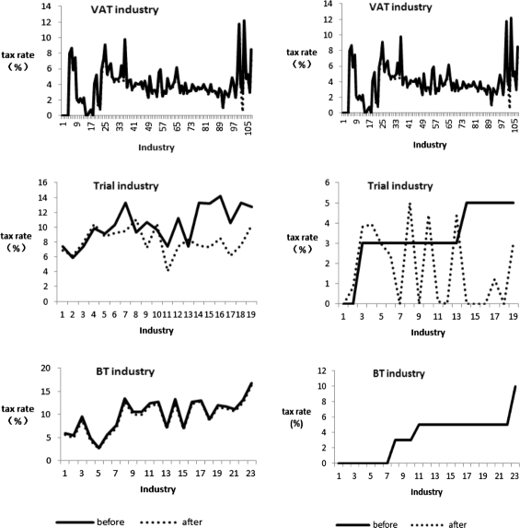
Estimation of the Tax-cut Effect

Slide 29
VAT Reform
Further measures during the 13th 5-year plan period:
Continue the VAT enlargement :
Banking and insurance industry
Construction industry
Real estate industry
Household service industry
……
Reduce the standard rate?
Streamline the rate structure?

Slide 30
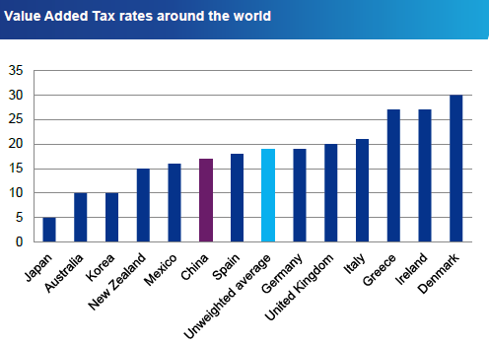

Slide 31
New Round of Tax Reform (Since 2004)
Consumption Tax
Adjust the taxable items and tax rates
Add such taxable items as refined oil products, yachts, disposable wood chopsticks, golf and tools, wood floor, and high-class watches in 2006
Adjust the rates for oil products, motorcycles, etc. in 2014
……
Further measures during the 13th 5-year plan period:
Change the taxable stage from the production or importation stage to retail stage?

Slide 32
New Round of Tax Reform (Since 2004)
Enterprise income tax Unify domestic and foreign (investment )enterprise income tax Streamline the tax incentives Introduce new anti-avoidance measures Further measures during the 13th 5-year plan period:
Strengthen the anti-avoidance system esp. for cross-border transactions under BEPS framework

Slide 33
New Round of Tax Reform (Since 2004)
Individual income tax Increase the standard deduction from 1600 to 2000(2007) and 3500(2011) and adjust the rate schedule Require taxpayers in the high income bracket to do self-assessment and file their income tax returns(2007)
Further measures during the 13th 5-year plan period:
Implement the individual income tax system combining the global and schedular features?

Slide 34
New Round of Tax Reform (Since 2004)
House property tax
Unify the house property tax levied on domestic and foreign taxpayers in 2009
In 2011,pilot program in Shanghai and Chongqing to levy house property tax on residential properties
In Shanghai, buyers will pay between 0.4% and 0.6% tax on their new second homes.
In Chongqing, the tax is levied on villas and newly purchased high-end homes at three rates: 0.5%, 1%, and 1.2%, depending on market transaction prices.
Further measures during the 13th 5-year plan period::
Speed up the lawmaking procedure

Slide 35
New Round of Tax Reform (Since 2004)
Resource tax China is campaigning for energy and resource conservation
Switch from unit tax to ad valorem tax
Oil and natural gas
2010.6 Xinjiang trial, 2010.12,expanded to 12 western provinces
2011.11 nationwide
Coal
Dec. 1, 2014
Further measures during the 13th 5-year plan period:
Switch from unit tax to ad valorem tax for other taxable items

Slide 36
New Round of Tax Reform (Since 2004)
Environmental tax China is to strengthen the environmental protection system, tax measures are under discussion
Further measures during the 13th 5-year plan period:
Emission tax for emission fee reform

