Slide 1
Hypertension ＆ Salt
Name: 吴俊龙
Student ID： 10301010020

Slide 2
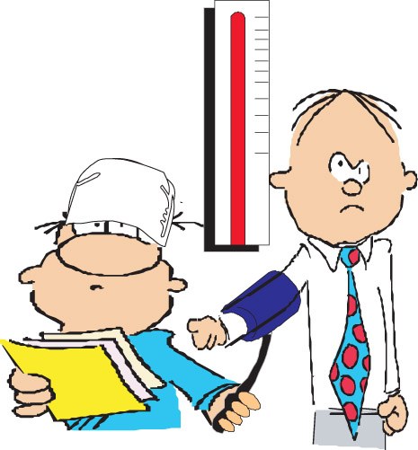
What is hypertension？
Definition：Hypertension is a chronic medical condition in which the blood pressure in the arteries is elevated.
Standards for judging：systolic/diastolic pressure is persistently at or above 140/90 mmHg.

Slide 3
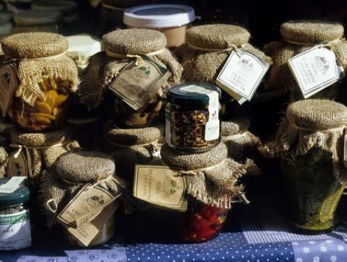
History of salt usage
Ate natural foods；Less than 0.5g per day^{[1]}
Ancestors
Chinese people used salt to preserve foods； high salt intake^{[1]}
5000years
ago
The current salt intake in many countries
is between 9 and 12 g/day.^{[2]}
20th century
Invention of refrigerator； reduction in salt usage^{[1]}

Slide 4
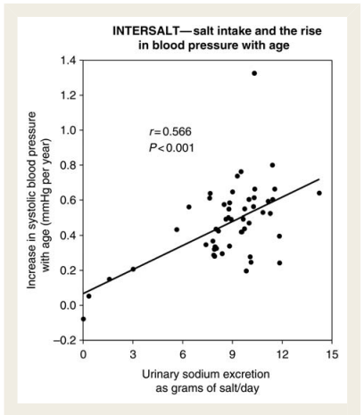
Relationship between Salt ＆ BP
INTERSALT studies：
A significant positive
relationship between
salt intake and BP.
A highly significant
positive relationship
between salt intake and
the increase in BP with
Age^{[3]}
Gene studies：
Many individual
genes influence the
body’s handling of
sodium to varying
degrees^{[4]}.

Slide 5
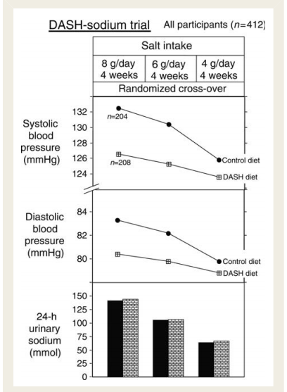
Dose—Response Relationship
Method： To look at the BP responses to several levels of salt intake.
Cases: 2 well-controlled trials
Conclusion: To reduce salt from 9 – 12 to 5 – 6 g/day will have a major effect on BP and a further reduction to 3 g/day will have a much greater effect^{[5]}.

Slide 6
Further Studies:
People of African origin
Several studies showed that a given reduction in salt intake, the fall in BP was larger in certain people.^{[6]}
People with raised BP
Older people

Slide 7
Further Studies:
1
Less salt + balanced diet
Enhance BP control
Reduce the need for drug therapy.^{[7]}
2
Less salt + healthy lifestyle
3
Less salt + drug treatment

Slide 8
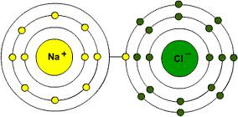
Molecular Mechanism^{[8][9]}
Skip
NaCl： can increase BP
Hypertension
Cl⁻ ：important role
Na₃ PO₄
NaHCO₃
……
Hypertension
Increase intracellular Na and drive Ca into cells
Na⁺ ：Inhibit Na pump
Increase peripheral vascular resistance
Hypertension

Slide 9
Summary：
Key words：Hypertension；Salt；Blood Pressure（BP）
Core information：
1、Lowering salt intake can reduce BP and prevent hypertension
2、“Lowering salt intake + healthy life” has a more positive effect on reducing BP

Slide 10
References：
[1]. MacGregor GA, de Wardener HE.Salt, Diet and Health. Cambridge: Cambridge University Press, 1998.
[2]. Brown IJ, Tzoulaki I, Candeias V, Elliott P. Salt intakes around the world: implications for public health.Int J Epidemiol 2009;38:791 – 813.
[3]. Intersalt Cooperative Research Group. Intersalt: an international study of electro-lyte excretion and blood pressure. Results for 24 hour urinary sodium and potassium excretion.BMJ1988;297:319 – 328.
[4]. O’Shaughnessy KM, Karet FE. Salt handling and hypertension.Annu Rev Nutr. 2006;26:343-365.
[5]. Sacks FM, Svetkey LP, Vollmer WM, Appel LJ, Bray GA, Harsha D, Obarzanek E,Conlin PR, Miller ER III, Simons-Morton DG, Karanja N, Lin PH. Effects on blood pressure of reduced dietary sodium and the Dietary Approaches to Stop Hyper-tension (DASH) diet. DASH-Sodium Collaborative Research Group.N Engl J Med 2001;344:3 – 10.
[6]. Vollmer WM, Sacks FM, Ard J, Appel LJ, Bray GA, Simons-Morton DG, Conlin PR,
Svetkey LP, Erlinger TP, Moore TJ, Karanja N. Effects of diet and sodium intake on blood pressure: subgroup analysis of the DASH-sodium trial.Ann Intern Med2001; 135:1019 – 1028.
[7]. Whelton PK, Appel LJ, Espeland MA, Applegate WB, Ettinger WH Jr, Kostis JB,
Kumanyika S, Lacy CR, Johnson KC, Folmar S, Cutler JA. Sodium reduction and weight loss in the treatment of hypertension in older persons: a randomized con-trolled trial of nonpharmacologic interventions in the elderly (TONE). TONE Collaborative Research Group.JAMA 1998;279:839 – 846.
[8]. Kurtz TW, Al-Bander HA, Morris RC. “Salt-sensitive” essential hypertension in men. Is the sodium ion alone important?N Engl J Med. 1987;317:1043.
[9]. Adrogue HJ, Madias NE. Sodium and potassium in the pathogenesis of hypertension.N Engl J Med. 2007;356:1966.

