Slide 1
The Philosopher By Sherwood Anderson
Jiang Cheng
09300120193

Slide 2
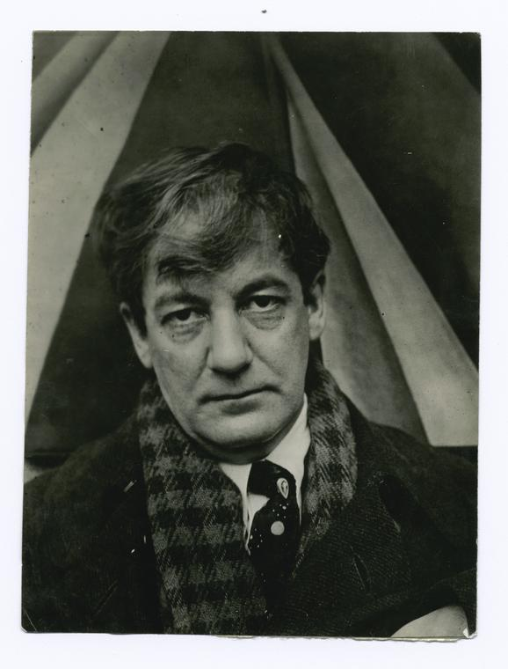
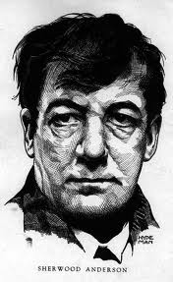

Slide 3
Sherwood Anderson
short story writer
Winesburg, Ohio: A Group of Tales of Ohio Small Town Life (1919)
Psychological
“selective, indefinite, and provocative, instead of inclusive, precise, and explanatory.” (Burton Rascoe)

Slide 4
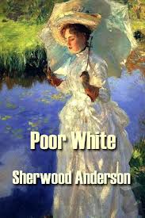
Many Marriages (1923) and Dark Laughter (1925)
crippling effects of sexual repression
Poor White (1920)
dehumanizing effects of mass production

Slide 5
The Philosopher
The title
"I want to fill you with hatred and contempt so that you will be a superior being,"
a deep insecurity covered in cynicism
alienated and paranoid

Slide 6
paradoxical contradictions
"I studied to be a minister and prayed. I was a regular ass about saying prayers.“
detailed description
“The lid of the left eye twitched; it fell down and snapped up; it was exactly as though the lid of the eye were a window shade and someone stood inside the doctor’s head playing with the cord.”

Slide 7
disillusioned modern sensibility
sense of solitude
rule of money and power
degeneration of religion
“everyone in the world is Christ and they are all crucified. ”

Slide 8
Psychological novel
Stream of consciousness (narrative mode)

Slide 9
Psychological novel
a novel of the "inner man"
interior characterization, motives, circumstances, and internal action
Three hallmarks
stream of consciousness
interior monologues
Flashback

Slide 10
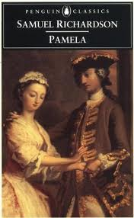
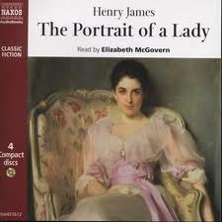

Slide 11
Discussion
“[…] The superintendent of the asylum and some of his helpers came in and stood about looking sheepish. It was very amusing. I spread out my hands and said, 'Let peace brood over this carcass.' That's what I said.“

Slide 12
“As he stood by the bar talking to Will Henderson he rubbed the hands together. As he grew more and more excited the red of his fingers deepened. It was as though the hands had been dipped in blood that had dried and faded.”

Slide 13
Thank you

