Slide 1
Mayhew
10300120194 陈天怡

Slide 2
Author
Techniques
Theme

Slide 3
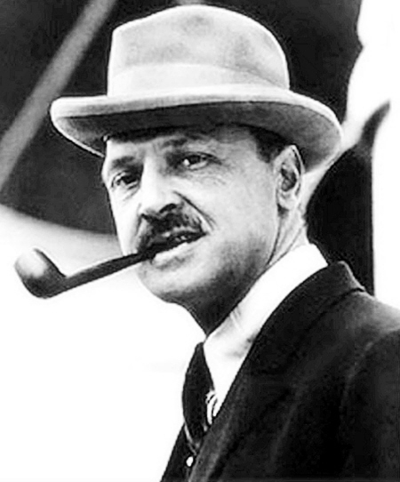
William Somerset Maugham
1874.1.25~ 1965.12.15
British novelist, playewright and short-story writer
Studied medicine and qualified as a doctor
Worked as a secret agent in World War One
A keen traveller

Slide 4
Significant Works
Of Human Bondage (1915)
The Moon and Sixpence (1919)
Cakes and Ale (1930)
The Razor’s Edge (1944)
Famous for his sober obversation and incisive analysis of society and human nature

Slide 5
Perspective:
First person—— “I”
“I never met a more interesting man than Mayhew.”
“I suppose his friends thought him crazy; some must have done all they could to dissuade him.”
“I find it strange that Mayhew should have settled on this lovely island, for I never knew a man more insensible to beauty.”

Slide 6
“I”——observer who doesn’t take part in
the story
Advantages:
Brings readers closer to the hero
Leaves more room for readers

Slide 7
Writing Style:
Plain yet Expressive:
e.g. Vivid description of character:
He sent for a cable form, wrote it out, and dispatched it.
He arranged his affairs, packed up his furniture, and started.
Adventurous and Resolute

Slide 8
He worked harder than he had ever worked in Detroit. He would start at noon and work all through the night till the whistle of the steamer that goes every morning from Capri to Naples told him that it was five o'clock and time to go to bed.
As the years went by he was to be found seldom in the ways of men. He could be tempted to come out of his house only by a game of chess or the chance of an argument.
Hard-working and Ambitious

Slide 9
The story of Mayhew:
He is a competent lawyer with a lucrative practice and a bright future.
He gives up his career and moves to a remote island in Italy.
Inspired by the natural beauty, he decides to write a history and works for it unremittingly for fourteen years.
His long neglected body takes revenge on him and he dies with his aim unachieved.

Slide 10
Different Paths of Life:
Streetcar：
strictly abiding by the rules of society
Flivver：
freely following the heart’s desire
Mayhew

Slide 11
“He thought he could do more with life than spend it on composing the trivial quarrels of unimportant people. He had no definite plan. He merely wanted to get away from a life that had given him all it had to offer.”
Dissatisfaction with secular, material gains

Slide 12
“In this place which appeals so extravagantly to the senses he lived a life entirely of the spirit.”
“He loved to set his brain against another's. He was widely read now, not only in history, but in philosophy and science; and he was a skilful controversialist, quick, logical, and incisive. ”
Spiritual gains

Slide 13
Futility of Life——Untimely Death
“For fourteen years he toiled unremittingly…… He had his subject at his finger ends, and at last was ready to begin. He sat down to write. He died.”
“That vast accumulation of knowledge is lost for ever. Vain was that ambition, surely not an ignoble one, to set his name beside those of Gibbon and Mommsen. As the years pass on and to the world he is unknown in death as he was in life.”

Slide 14
The True Meaning of life:
“And yet to me his life was a success. The pattern is good and complete. He did what he wanted, and he died when his goal was in sight and never knew the bitterness of an end achieved.”
Doing what one really wants to do
Undisturbed by secular fame and wealth

Slide 15
For Further Discussion:
“The lives of most men are determined by their environment. ”
From the passage, I rather think Mayhew’s life largely depends on his character. Does the environment also play a part? What do you think?

Slide 16
The end
Thanks for attention

