Slide 1
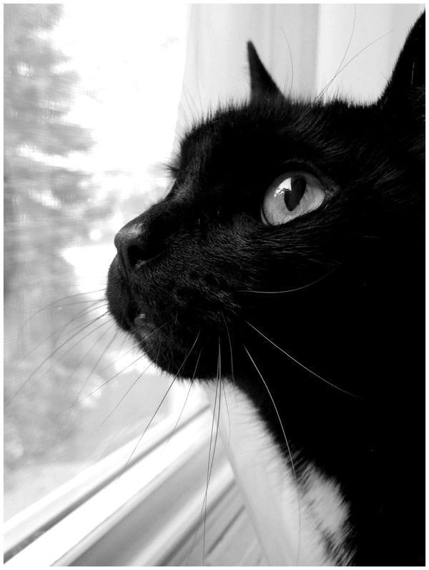
The Black Cat
Edgar Allan Poe
10300120201
杨 晶
翻译系

Slide 2
Point of view——first-person narrative
a condemned man
an unreliable narrator
Limited knowledge of all the events
Better experience the psychological change of the narrator
A good artistic effect

Slide 3
The Black Cat
Superstitions
My wife, made frequent allusion to the ancient popular notion, which regarded all black cats as witches in disguise.
Pluto—the Roman god of the Underworld
The first cat—evil
The second cat—revenge/guilt

Slide 4
Symbols
cuts Pluto’s eye from its socket
fire
the impression of Pluto upon the wall
a large splotch of white
wife
self-inflicted partial blindness to his own vision of moral goodness
almost complete moral disintegration
unforgivable and incorrigible sin
the punishment of evil
goodness

Slide 5
Denouncement of Alcohol
Our friendship lasted, in this manner, for several years, during which my general temperament and character - through the instrumentality of the Fiend Intemperance - had (I blush to confess it) experienced a radical alteration for the worse.
But my disease grew upon me - for what disease is like Alcohol!
I again plunged into excess, and soon drowned in wine all memory of the deed.

Slide 6
Art for Art’s Sake
The intrinsic value of art, and the only "true" art, is divorced from any didactic, moral or utilitarian function.

Slide 7
Other interpretation
I—— White southerners (reason)
The black cat—— black slaves (instinct)

Slide 8
Thank You

