Slide 1
Pre-hypertension
11307120134
Shuaiqi Huang

Slide 2
上医治未病。 ——《黄帝内经》
The upper grade doctors focus on prevention of disease.
=
The students from SHMC

Slide 3
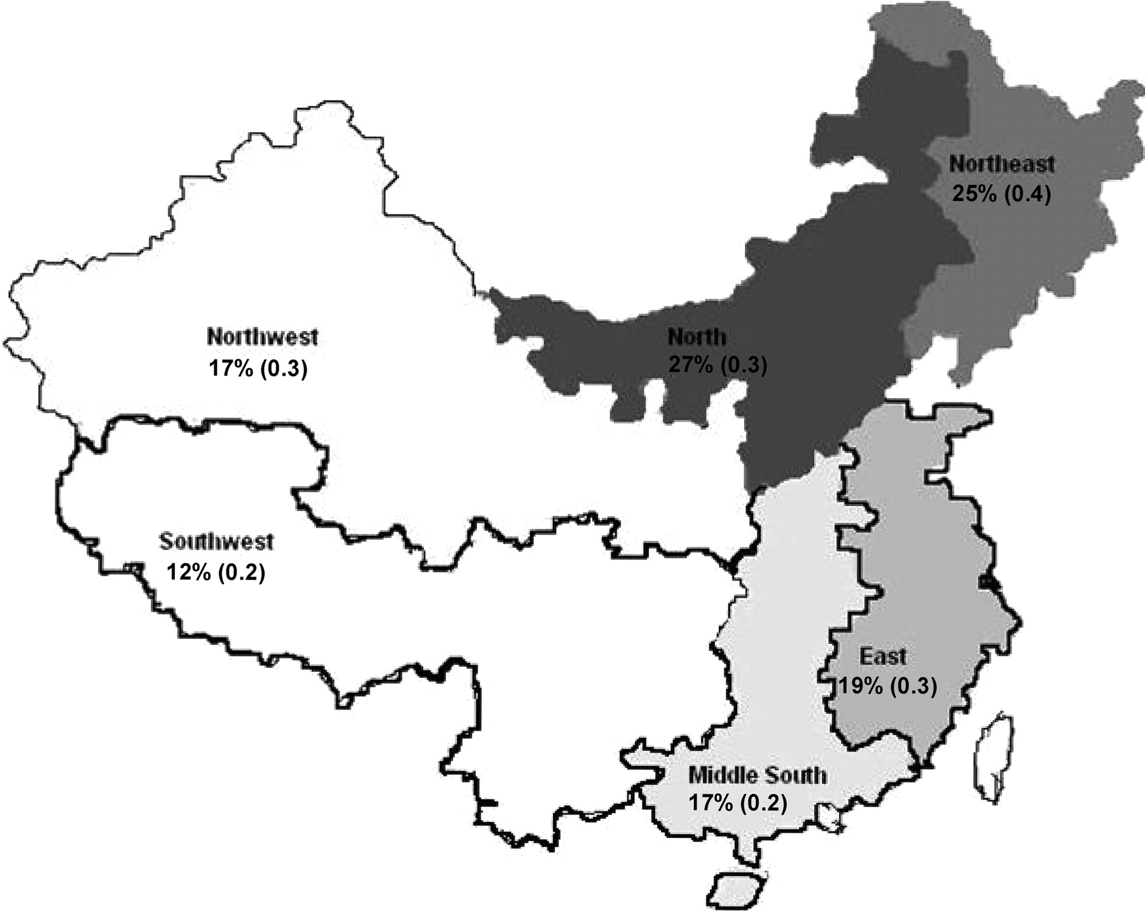
Epidemiological investigation
.
Total:
330 million
(Adults only)*
Image source:Wu Y et al. Circulation. 2008;118:2679-2686
*Data source: 中华预防医学杂志. 2012，46409
Notes:
Figure 3. Map showing the estimated age- and sex-standardized prevalence of hypertension in each region of China.

Slide 4
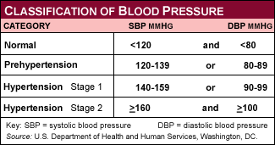
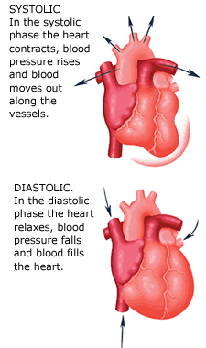
Diagnosis
A person's blood pressure is elevated above normal, but not to the level considered hypertension.
Image source:left-http://gwpublichealth.files.wordpress.com/2012/07/bp_chart.gif
Right- http://www.i-am-pregnant.com/images/blood-pressure.gif

Slide 5
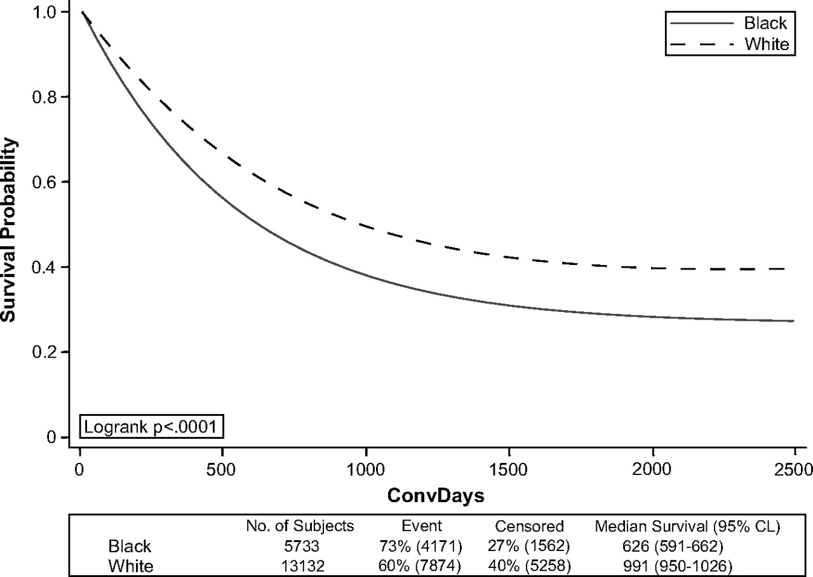
Progression from preHT to HT
Selassie A et al. Hypertension. 2011;58:579-587
Notes:
The age-adjusted probability of remaining nonhypertensive is depicted separately for black and white adults 18 to 85 years of age who were not hypertensive at time 0.

Slide 6
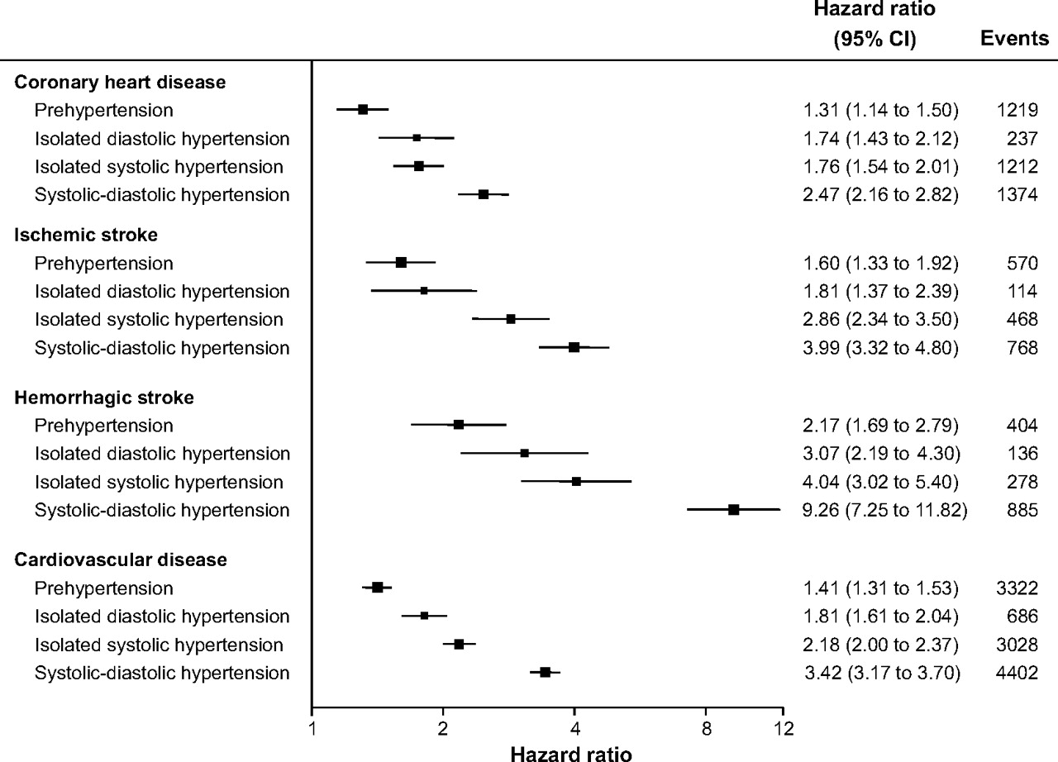
Effects of preHT and HT subtype on the risk of CV disease
Arima H et al. Hypertension. 2012;59:1118-1123
Notes:
Effects of prehypertension and hypertension subtype on the risk of cardiovascular disease and its major subtypes. Hazard ratios were adjusted for age, total cholesterol, and smoking and stratified by sex and study. Normal blood pressure was used as the reference group. The center of each solid box is plotted against the point estimate, and the horizontal lines are drawn to the 95% confidence limits. Areas of the boxes are proportional to the reciprocal of the variance of the estimates.

Slide 7
Risk factors
Age over 55
Family history
Obesity
Smoking
High salt intake
sedentary lifestyle
Binge drink
Irreversible
Reversible(Lifestyle modification)

Slide 8
Treatment
Advice from JNC-7:
Taking
drugs
Lifestyle modification
The Seventh Report of the Joint National Committee on Prevention, Detection, Evaluation, and Treatment of High Blood Pressure (JNC 7),2003

Slide 9
Q&A

