Slide 1
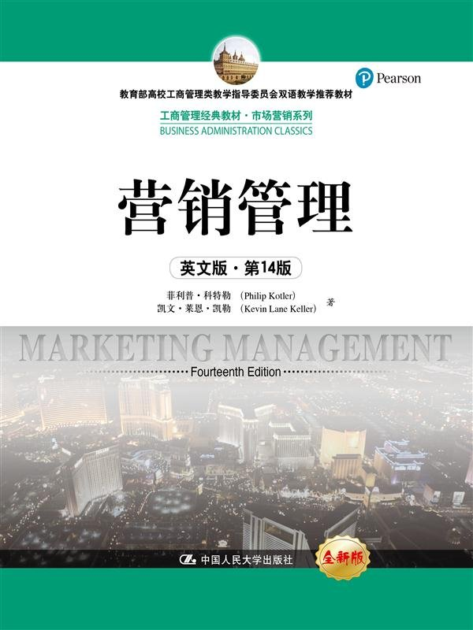
Session 9
Channel Strategy
Chapter 15

Slide 2
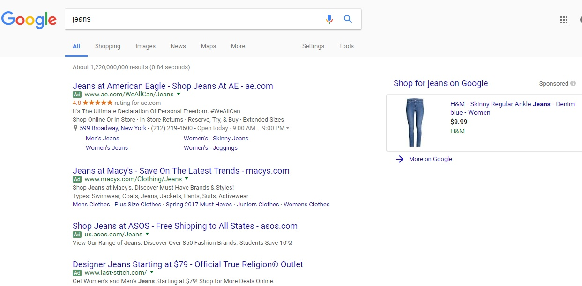
Internet makes the exposure much easier
Notes:
Good use of search engine advertising

Slide 3
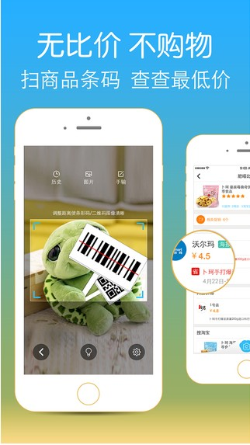
Embed Seamlessly into Target Customers’ Life: Make Shopping As Easy As It Can Be

Slide 4
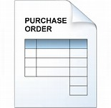
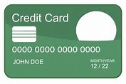
Scope of Distribution System
Products
Information
Finances
Notes:
Transmission of three things: logistics of real products from seller to buyer; transmission of order information between buyer and seller, what product, how much quantity, deliver to whom and where; and transmission of money from buyer to seller.

Slide 5
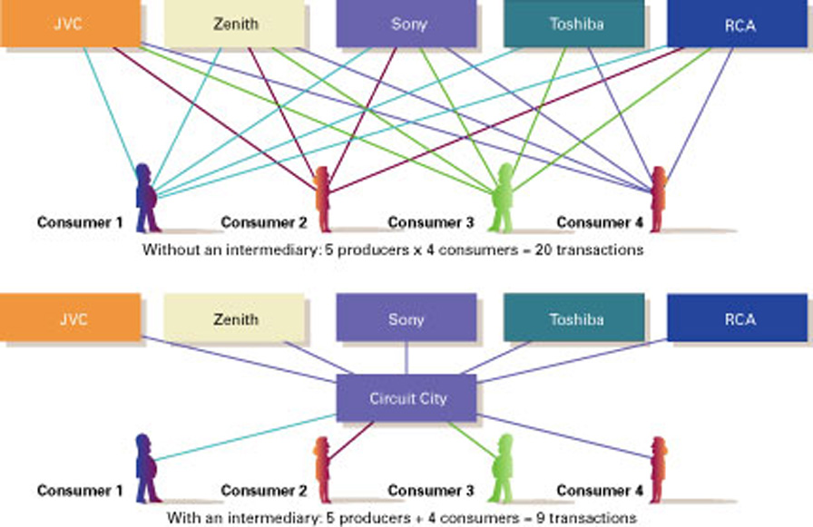
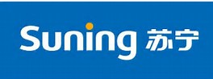
Why is Distribution Important?
Notes:
Efficiency in Exchanges Provided by an Intermediary

Slide 6
Why is Distribution Important?
Channels are intermediaries between the manufacturer/producer and the customer/consumer/end user
They take some profit (but also some cost)
They may be partners or competitors and may preferentially sell your product or a competitors’ product
What functions do intermediaries perform?
Physical distribution, Sales activities, Inventory, Service, Information/market feedback, Negotiation…

Slide 7
Channels for Consumer Products
Direct
Channel
Retailer
Channel
Wholesaler
Channel
Agent/Broker
Channel
Manufacturer
Manufacturer
Manufacturer
Manufacturer
Agents or Brokers
Wholesalers
Wholesalers
Retailers
Retailers
Retailers
Consumers
Consumers
Consumers
Consumers
Notes:
Notes:
Exhibit illustrates the four ways manufacturers can route products to consumers.
Direct channel is used to sell products directly to consumers. No intermediaries are used. Examples are telemarketing, catalog shopping, on-line shopping, and television shopping networks.
At the other end of the spectrum, an agent/broker channel may be used in markets with small manufacturers/retailers that lack the resources to find each other. The agents or brokers bring the manufacturers and wholesalers together for negotiations, but they do not take title to merchandise.
Most consumer products are sold through distribution channels similar to the retailer channel and the wholesaler channel.
Direct Channel: Boutique stores,

Slide 8
Channel Intermediaries
Retailer
A channel intermediary that
sells mainly to customers.
Merchant
Wholesaler
An institution that buys goods from manufacturers, takes title to goods, stores them, and resells and ships them.
Agents and
Brokers
Wholesaling intermediaries who facilitate the sale of a product by representing channel member.
Notes:
Notes:
Intermediaries in a channel negotiate with one another, facilitate the change of ownership between buyers and sellers, and physically move products from the manufacturer to the final end user.
Notes:
The most prominent difference separating intermediaries is whether or not they take title to the product. Taking title means they own the merchandise and control the terms of the sale.

Slide 9
Why is Distribution Important?
Channels are intermediaries between the manufacturer/producer and the customer/consumer/end user
They take some profit (but also some cost)
They may be partners or competitors and may preferentially sell your product or a competitors’ product
What functions do intermediaries perform?
Physical distribution, Sales activities, Inventory, Service, Information/market feedback, Negotiation…

Slide 10
Channel Functions Performed by Intermediaries
Contacting/Promotion
Transactional Functions
Negotiating
Risk Taking
Physically distributing
Logistical
Functions
Storing
Sorting
Facilitating Function
Researching
Financing
Notes:
Notes:
The three basic functions performed by intermediaries are shown in Exhibit 12.3.

Slide 11
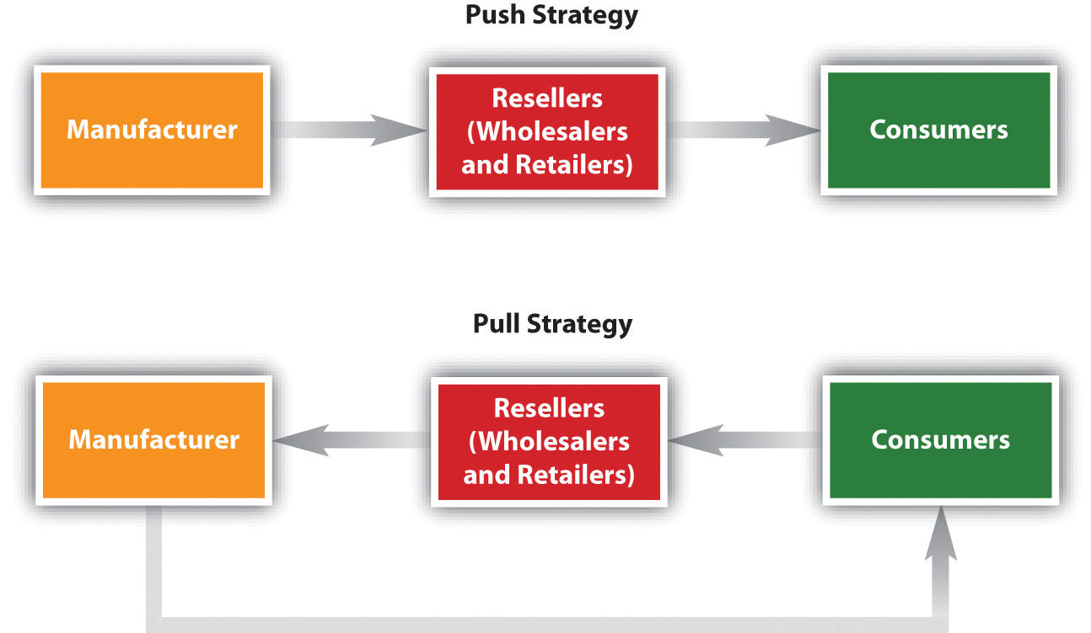
Push vs. Pull Strategy
Notes:
A push strategy uses the manufacturer’s sales force, trade promotion money, or other means to induce intermediaries to carry, promote, and sell the product to end user. (appropriate when brand loyalty is low, brand choice made in the store, the product is impulsive item, etc.)
In a pull strategy, a manufacturer uses advertising, promotion, and other forms of communication to persuade consumers to demand the product from the intermediaries, thus inducing the intermediaries to order it. (appropriate when brand loyalty is high, high involvement, consumers are able to perceive the differences between brands, consumers choose brand before they go to the store.)
Many companies use a combination of two. A push strategy is more effective when accompanied by a well-designed and well-executed pull strategy that activates consumer demand.

Slide 12
Channel Strategy Decisions
Factors
Affecting
Channel
Choice
Level of Distribution Intensity
Market Factors
Intensive Distribution
Product Factors
Selective Distribution
Manufacturer Factors
Exclusive Distribution
Notes:
Notes:
Before choosing a marketing channel, supply chain managers must analyze several factors, which often interact. These factors can be grouped as market factors, product factors, and producer factors. An explanation follows.
Organizations have three options for intensity of distribution: intensive, selective, or exclusive distribution. An explanation follows.

Slide 13
Market Factors
Market Factors That Affect
Channel Choices
Customer Profiles
Consumer or Industrial
Customer
Size of Market
Geographic Location
Notes:
Notes:
Market factors include the target customer considerations, such as these questions: Who are the potential customers? What/where/when/how do they buy?
Also important to channel selection is the distinction between consumer or industrial customers. Consumer buy in small quantities and don’t require much service, whereas industrial customers purchase in larger quantities and require more customer service.
A large market requires more intermediaries.
If the target market is concentrated in specific areas, direct selling is appropriate. If widely dispersed, intermediaries would be less expensive.

Slide 14
Product Factors
Product Factors That Affect
Channel Choices
Product Complexity
Product Price
Product Life Cycle
Product Delicacy
Notes:
Notes:
Products that are more complex, customized, and expensive benefit from shorter and more direct marketing channels and through a direct sales force. Standardized products can be sold through longer distribution channels with greater numbers of intermediaries.
The choice of channel may change over the life of the product. As products become more common, producers turn from a direct channel to more alternative channels.
Perishable items and fragile products require fairly short marketing channels.

Slide 15
Manufacturer Factors
Manufacturer Factors That Affect
Channel Choices
Manufacturer Resources
Number of Product Lines
Desire for Channel Control
Notes:
Notes:
Producers with larger financial, managerial, and marketing resources are able to use more direct channels.
Producers with several products in a related area choose channels that are more direct, and sales expenses can be spread over more products.
A producer’s desire to control pricing, positioning, brand image, and customer support may avoid channels in which discount retailers are present. Furthermore, manufacturers of upscale products may sell only in expensive stores to maintain an image of exclusivity.

Slide 16
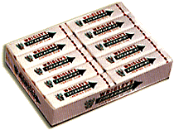
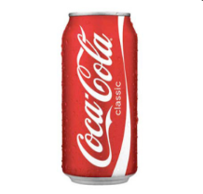
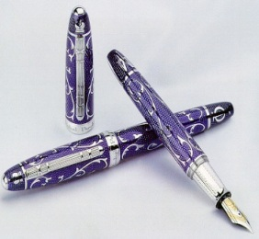
Channel Design Decisions - Intensity of Distribution
Intensive
Using all available outlets to distribute product
Selective
Using only some available outlets to distribute a product
Exclusive
Using a single outlet in a fairly large geographic area to distribute a product
Why not always maximize distribution intensity?

Slide 17
Think About It…
What level of intensity of market coverage would you select for this product?
Courtesy Burt’s Bees

Slide 18
Changing Channel Organization
A major trend is toward disintermediation which means that product or service producers are bypassing intermediaries and going directly to final buyers.
Examples
Manufacturer power is high when
Few suppliers
Products or services are highly differentiated
Buyers are low volume accounts
Potential for forward integration
…
15
Notes:
Computers: Dell
Airline Tickets: Southwest
Music: iTunes, MusicMatch

