Slide 1
Session 8
Pricing Strategy
Chapter 14

Slide 2
The Importance of Price
Consumer
Value = Benefits - Costs
To the consumer... Price is the cost of something
Consumer seeks to maximize value.
Firm
Profit = Sales - Costs
To the seller... Price is revenue
For-profit Firm seeks to maximize profit.
Price plays an important role for both consumers and firms.
Notes:
In order to answer this question, let’s look at two basic business formulas.
Three levels: economic, psychological, social
How do consumer choose among options? How do consumers maximize value? Maximize benefits and/or minimize costs.
Other cost includes space rental costs, Research and development costs,
How do firms maximize profit? Maximize sales and/or minimize costs. They can try to sell more quantities, sell at higher price, save manufacturing cost, like save labor cost, save raw materials cost, save service cost (outsource service center), etc.
In my previous class, some students proposed a strategy with premium quality, premium service, but lowest market price. Would this be possible in real world? Why?
Let me check with questions here. Any question about the two formulas?
Since you are business students, these are two basic business formulas you have to grasp. When you understand these two formulas, you understand the business world.

Slide 3
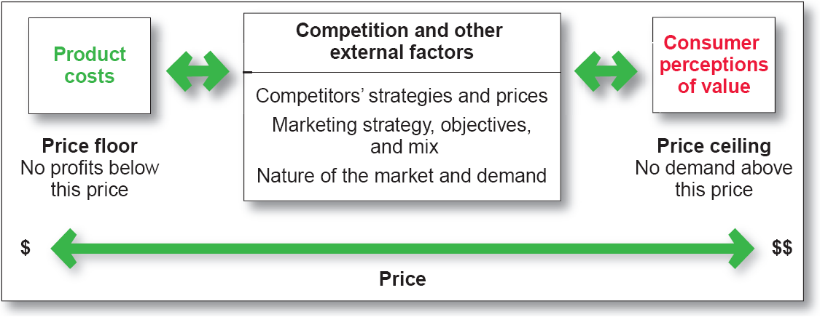
Considerations in Setting Price

Slide 4
Categorizations of Buyers
Price Conscious
Striving to pay low prices.
Value Conscious
Concerned about price and quality of a product.
Prestige Sensitive
Drawn to products that signify prominence and status.

Slide 5
Think About It…
To what category of buyer do you think this ad is appealing?
www.vancleef-arpels.com

Slide 6
Price and Nonprice Competition
Price Competition
Emphasizing price as an issue and matching or beating competitors’ prices.
To compete effectively, firm must be the low-cost seller
Relies on standardized products
Frequent price changes
Provides flexibility
Nonprice Competition
Emphasizing factors other than price to distinguish a product from competing brands.

Slide 7
Nonprice Competition
Emphasizes distinctive product:
Features
Quality
Promotion
Packaging
Other
Distinction must be effective

Slide 8
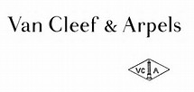
Compare Below Ads
vs.

Slide 9
Analysis of Demand
The Demand Curve
A graph of the quantity of products expected to be sold at various prices if other factors remain constant.
Price
Quantity
A Classical Example of Demand Curve

Slide 10
Other Examples of Demand Curve: What products would have demand curves as below?
Price
Price
Quantity
Quantity
10
Notes:
Not all types of demand conform to the classic demand curve

Slide 11
Price Equilibrium
S
D
Price
S
Price Equilibrium
D
Quantity
Price equilibrium - The price at which demand and supply are equal.
Price is an invisible hand, which allocates
resources in a free-market economy.
Notes:
Notes:
An equilibrium price is reached when supply and demand are equal.
A price below equilibrium results in a shortage because the demand is greater than the available supply. A shortage puts upward pressure on price.
At a price above equilibrium, the demand is less than the available supply, and a surplus is created. A surplus lowers the price.
Establishing an equilibrium price may not be reached all at once. Prices may fluctuate as the market for a good moves toward equilibrium; however, demand and supply will settle into the proper balance.

Slide 12
Analysis of Demand: Demand Fluctuations
Changes in
Buyers’ Needs
Seasonality
Variations in
Effectiveness of
Marketing MIX
Demand
Fluctuations
Dynamic
Environmental
Factors
Presence of
Substitutes

Slide 13
Analysis of Demand
Price Elasticity of Demand
A measure of the sensitivity of demand to changes in price
Assessing the Price Elasticity of Demand
Elastic Demand
A change in price causes an opposite change in total revenue
An increase in price will decrease total revenue
Inelastic Demand
A change in price results in a change in the same direction as total revenue
An increase in price will increase total revenue.

Slide 14
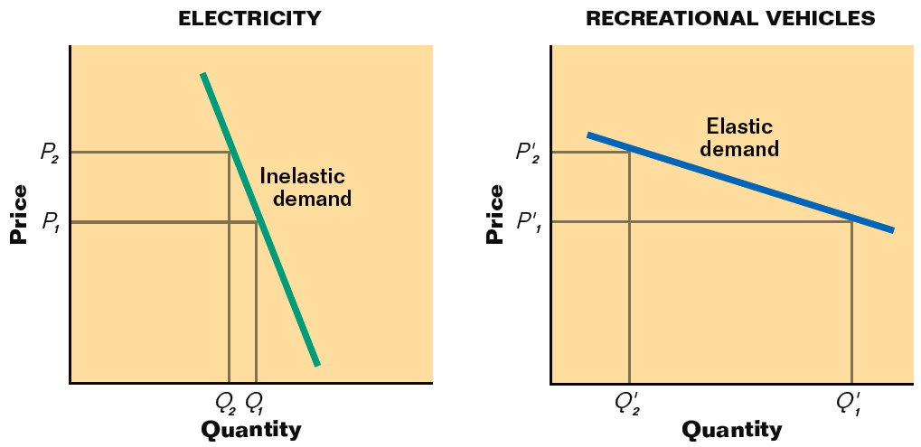
Elasticity of Demand
Notes:
Here we depict the demand curve as a straight line only for illustration. The demand curve rarely behaves as a straight line. For example, for decent brands, a small increase on price would not affect the demand much, i.e. customers would still buy the products even the price increases a little bit; however, a small decrease on price would increase the demand a lot, i.e. when the price drops a little bit, customers would purchase much more, either for stocking purpose or switching from other brands.

Slide 15
Factors Affecting Elasticity Of Demand
Availability of substitutes
Can consumers replace coffee with tea for caffeine?
Amount of income available to spend on a good
With an increase in price, will the consumer on a fixed income be forced to buy less?
Time
Over time will a consumer cutback/quit smoking if price of cigarettes goes up?

Slide 16
Customer’s Interpretation and Response
Interpretation
What price means or communicates to customer’s
Response
Moves customer closer to purchase and enhances satisfaction with purchase experience and product

Slide 17
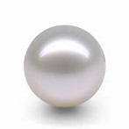
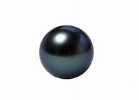
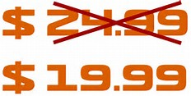
Reference Prices
Internal Reference Price
Develops in buyer’s mind through experience with product
External Reference Price
A comparison price provided by others
17

Slide 18
Approaches to Pricing of Products
Cost-Based Pricing / Standard Mark-up Pricing
Competition-based Pricing
Value/Customer-based Pricing
New Products: Skimming vs Penetration Strategies

Slide 19
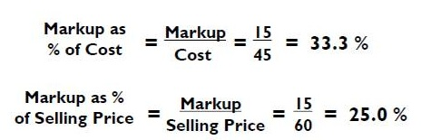
Cost-based Pricing
“Company managers would calculate how much it would cost to make and deliver each product, and add a flat percentage on top%.”
- WSJ March 27, 2007
Cost-plus Pricing
Adding a specified dollar amount to the seller’s costs
Markup
Adding to the cost of the product a predetermined percentage of that cost

Slide 20
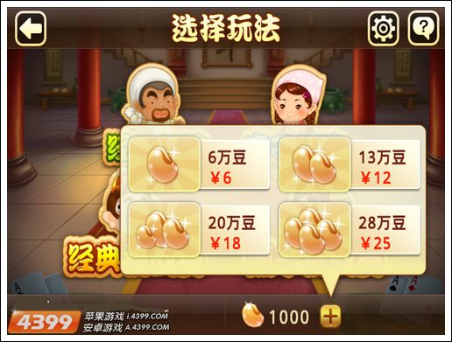
Problems
Fail to take into account the customer’s perspective
Do customers know your cost?
Do customers care about your cost?
Unrealized revenue and profit can be substantial!

Slide 21
Competition-based Pricing
Setting prices based on the prices that competitors charge for similar products
When?
Competing products are homogeneous
Organization is serving markets in which price is a key consideration
In a market with a small number of competitors, usually the smaller firms follow the leader. They change their prices when the market leader’s price changes, rather than when their own demand or costs change.

Slide 22
Potential Problems
Passive player in the market, failing to focus on creating something customers will love
Tendency to lower prices to protect market share and end up with price wars!
Notes:
In 1990’s, airbus kept seizing market share from Boeing, and accounted for nearly 30% of commercial airplanes. To fight against Airbus, Boeing decided to lower price to secure its dominant market share. Boeing lowered the price by 5%, then Airbus lowered even more to struggle for the same order; and then Boeing lowered its price further. It ended up that no airplane could be sold without at least 20% discount off. The margin for commercial airplane is around 10%, so both Boeing and Airbus were losing money by every airplane they sold.

Slide 23
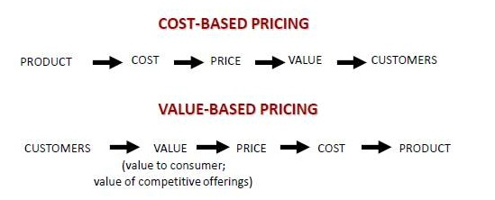
Value/Customer-based Pricing
Determining prices by what a customer is willing to pay, rather than what a product costs to make
Price is based on buyer’s perceptions of value
Quantify consumer benefits relative to existing products.

Slide 24
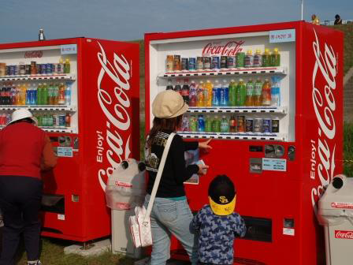
Value-based Pricing - Price as a Function of Temperature

Slide 25
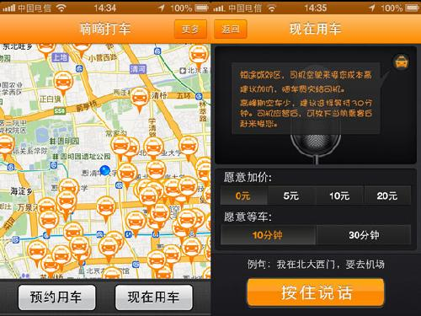
Value-based Pricing – Didi Taxi App

Slide 26
Pricing New Products
"Skimming" refers to setting initially high prices, and slowly lowering them over time to maximize profits at every price-sensitive layer in the market.
Market
Skimming
Market
Penetration
"Penetration" involves setting a low initial price to enter the market quickly and deeply --to attract a large number of buyers and win a large market share.

Slide 27
Skimming vs. Penetration Pricing
Skimming when
Enough early-adopters willing to buy at high price
High price will not attract competition
High Price is a heuristic for high quality
Lowering the price has only a minor effect on increasing the sales volume (inelastic) and reducing the unit cost
Penetration when
Customers are price sensitive
Low price means lower competition
Products costs decrease when more volume

