Slide 1
DIABETES MELLITUS TYPE Ⅱ & OBESITY
10301010046
宋子贤

Slide 2
Diabetes mellitus type 2
Noninsulin-dependent diabetes mellitus (NIDDM) or adult-onset diabetes
90% of cases of diabetes
Obesity as the cause
Year | 1985 | 2010
Case | 30，000，000 | 285，000，000

Slide 3
Diagnosis
Diabetes diagnostic criteria
Condition | 2 hour glucose | Fasting glucose | HbA_{1c}
 | mmol/l(mg/dl) | mmol/l(mg/dl) | %
Normal | <7.8 (<140) | <6.1 (<110) | <6.0
Impaired fasting glycaemia | <7.8 (<140) | ≥ 6.1(≥110) & <7.0(<126) | 6.0–6.4
Impaired glucose tolerance | ≥7.8 (≥140) | <7.0 (<126) | 6.0–6.4
Diabetes mellitus | ≥11.1 (≥200) | ≥7.0 (≥126) | ≥6.5

Slide 4
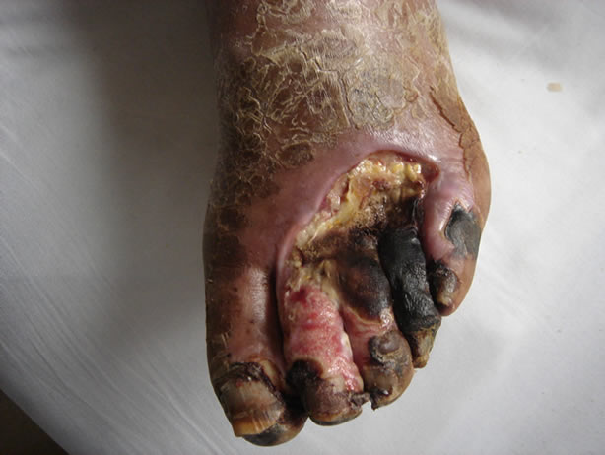
Complications

Slide 5
Obesity
Main cause of NIDDM

Slide 6
Mechanism
Common soil hypothesis
Leptin resistance
Hypernecrosin
Hypoadiponectin
Thrifty gene

Slide 7
Therapy & Prevention
Diet
Exercise
Medication
Surgery

Slide 8
References
[1] Definition and diagnosis of diabetes mellitus and intermediate hyperglycemia: report of a WHO/IDF consultation. Geneva: World Health Organization. 2006. p. 21. ISBN 978-92-4-159493-6.
[2] Vijan, S (March 2010). "Type 2 diabetes". Annals of Internal Medicine 152 (5): ITC31-15. doi:10.1059/0003-4819-152-5-201003020-01003. PMID 20194231.
[3] Williams textbook of endocrinology. (12th ed.). Philadelphia: Elsevier/Saunders. pp. 1371–1435. ISBN 978-1-4377-0324-5.
[4] Ripsin CM, Kang H, Urban RJ (January 2009). "Management of blood glucose in type 2 diabetes mellitus". Am Fam Physician 79 (1): 29–36. PMID 19145963.
[5] Smyth, S; Heron, A (2006 Jan). "Diabetes and obesity: the twin epidemics". Nature Medicine 12 (1): 75–80. doi:10.1038/nm0106-75. PMID 16397575.

